Slide 1
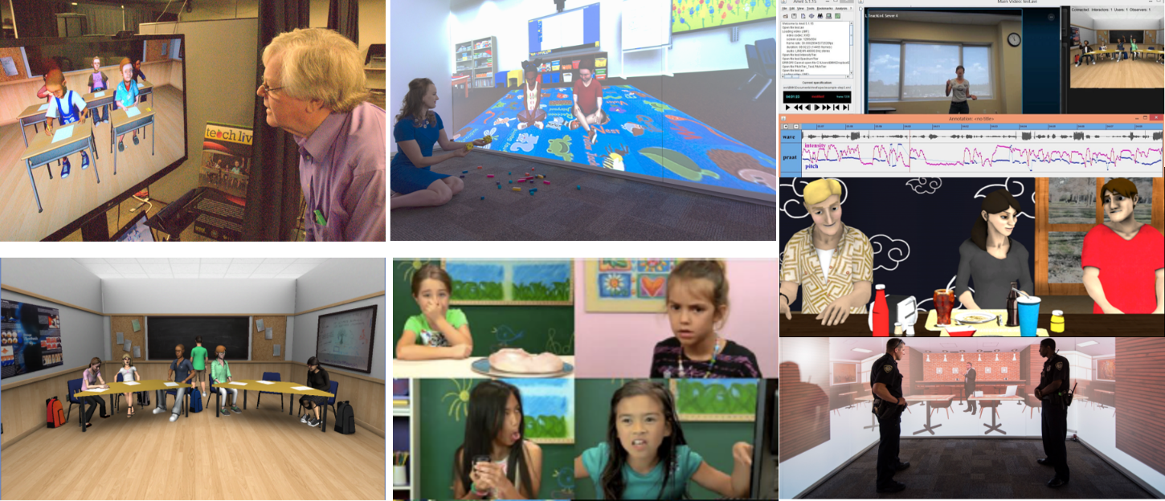
Charlie Hughes
Synthetic Reality Laboratory (SREAL)

Slide 2
Virtual Humans and Avatars
Virtual Human:
Synthetic character that has a human form and human-like behaviors.
Avatar:
A person’s alter ego often with an idealized appearance. For our purposes, our avatars are virtual humans and each has a very distinct personality and personal history (backstory)

Slide 3
TeachLivE Paradigm
Realistic virtual classroom experiences
classroom management
pedagogy
content delivery
parent-teacher meetings
teacher-principal interviews, evaluations
Integrated reflection tools

Slide 4
Teacher Rehearsal (four 10-minute sessions change targeted behaviors)
Personalities: | Dependent | Independent
Aggressive | Attention-Grabber | Leader
Passive | Follower | Withdrawn

Slide 5
TeachLivE’s Usage
>85 Universities and 10 school districts use it
50,000+ teachers/administrators used in 2014-16
Changes targeted classroom behaviors, e.g., high order questions and wait time, in four 10-minute sessions and changes transferred to classroom
Used in Abu Dhabi, Australia, Italy, Malaysia, …
Helps people hone social skills
Selected one of most innovative in teacher preparation by Children’s Television Workshop
Applied to desk staff training at North America Best-Western hotels (2400 hotels, 12000 desk staff)
Applied by ETS to teacher/administrator licensure

Slide 6
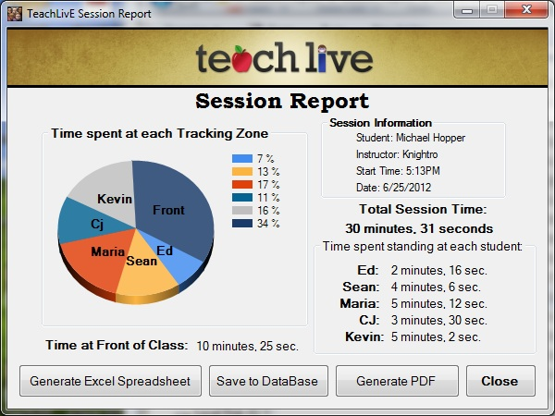
Reflection

Slide 7
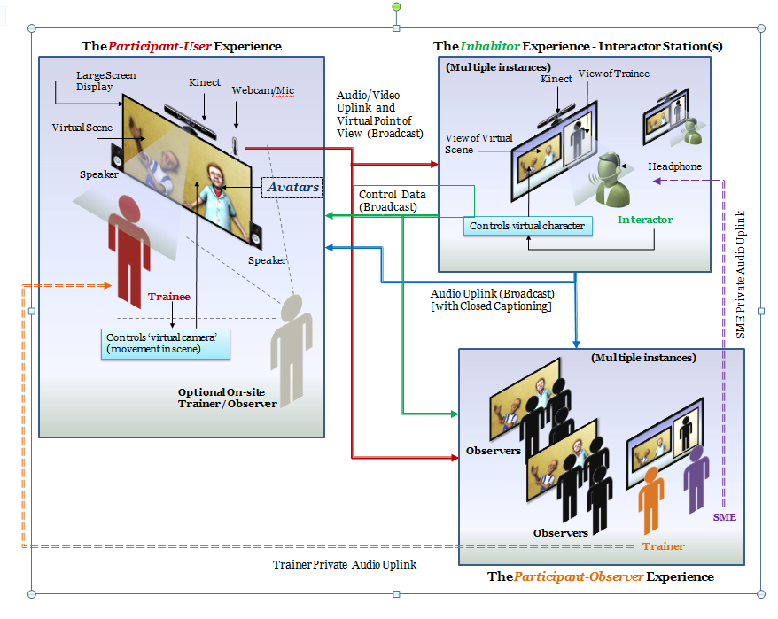

Slide 8
Project: Coaching and Reflection
Develop open source plug-in for Unity that supports video and textual coaching (embedded window that can be moved and can be active or inactive).
Extend this to include video capture (similar to Camtasia but embedded into our reflection system in the TeachLivE environment). This should automatically select simulation and Skype windows.
Replace Skype with an open source secure alternative, such as Tox, embedding in TeachLivE.

Slide 9
Nonverbal Messaging

Slide 10
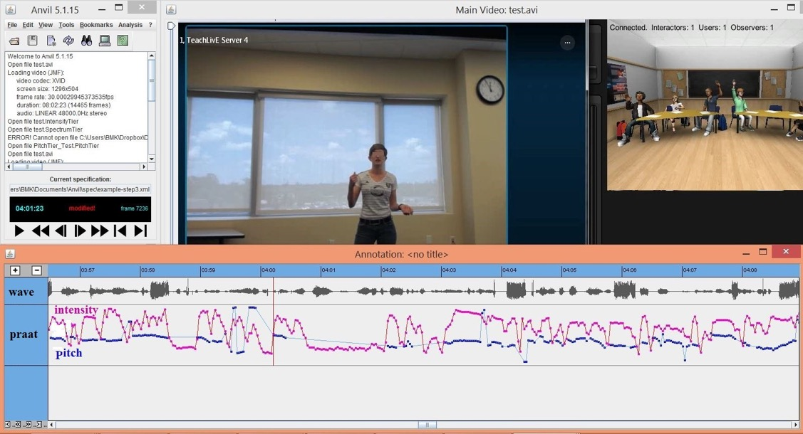
Non-Verbal Messaging (posture/vocalization) Leila Barmaki

Slide 11
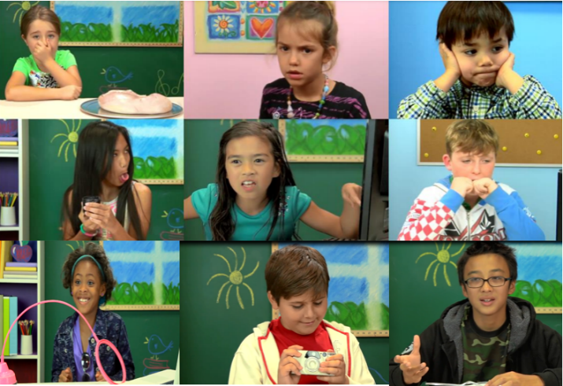
Emotions (Facial/Vocalization) Behnaz Nojavanasghari

Slide 12
Current UCF Collaborators
Arts & Humanities (English, History, Visual Arts & Des.)
Business
Education & Human Performance
Engineering & Computer Science
Hospitality Management
Law Enforcement
Medicine
Modeling & Simulation
Nursing
Public Health and Affairs
Sciences (Biol, Chem, Math, Phil, Physics, Psych, Stat)
Student Development and Enrollment Services

Slide 13
Research Funding
National Science Foundation
Office of Naval Research
Bill&Melinda Gates Foundation
NewSchools Venture Fund
National Endowment for the Humanities

Slide 14
Contact Information
Charlie Hughes Pegasus Professor, Computer Science Co-Director, IST/Synthetic Reality Lab Professor, School of Visual Arts & Design University of Central Florida Orlando, FL 32816-2362
E-mail: ceh@cs.ucf.edu Web: http://www.cs.ucf.edu/~ceh/ http://teachlive.org http://sreal.ucf.edu

