Slide 1
Discrete II Theory of Computation
Charles E. Hughes
Supplemental

Slide 2
Equivalence of Models
Equivalency of computation by Turing machines,
register machines, factor replacement systems, recursive functions

Slide 3
Proving Equivalence
Constructions do not, by themselves, prove equivalence.
To do so, we need to develop a notion of an “instantaneous description” (id) of each model of computation (well, almost as recursive functions are a bit different).
We then show a mapping of id’s between the models.

Slide 4
Instantaneous Descriptions
An instantaneous description (id) is a finite description of a state achievable by a computational machine, M.
Each machine starts in some initial id, id₀.
The semantics of the instructions of M define a relation ⇒_{M} such that, id_{i} ⇒_{M} id_{i+1}, i≥0, if the execution of a single instruction of M would alter M’s state from id_{i} to id_{i+1} or if M halts in state id_{i} and id_{i+1}=id_{i}.
⇒⁺_{M} is the transitive closure of ⇒_{M}
⇒*_{M} is the reflexive transitive closure of ⇒_{M}

Slide 5
id Definitions
For a register machine, M, an id is an s+1 tuple of the form (i, r₁,…,r_{s})_{M} specifying the number of the next instruction to be executed and the values of all registers prior to its execution.
For a factor replacement system, an id is just a natural number.
For a Turing machine, M, an id is some finite representation of the tape, the position of the read/write head and the current state. This is usually represented as a string αqxβ, where α (β) is the shortest string representing all non-blank squares to the left (right) of the scanned square, x is the symbol at the scanned square and q is the current state.
Recursive functions do not have id’s, so we will handle their simulation by an inductive argument, using the primitive functions are the basis and composition, induction and minimization in the inductive step.

Slide 6
Equivalence Steps
Assume we have a machine M in one model of computation and a mapping of M into a machine M’ in a second model.
Assume the initial configuration of M is id₀ and that of M’ is id’₀
Define a mapping, h, from id’s of M into those of M’, such that, R_{M} = { h(d) | d is an instance of an id of M }, and
id’₀⇒*_{M’} h(id₀), and h(id₀) is the only member of R_{M} in the configurations encountered in this derivation.
h(id_{i})⇒⁺_{M’} h(id_{i+1}), i≥0, and h(id_{i+1}) is the only member of R_{M} in this derivation.
The above, in effect, provides an inductive proof that
id₀⇒*_{M} id implies id’₀⇒*_{M’} h(id), and
If id’₀⇒*_{M’} id’ then either id₀⇒*_{M} id, where id’ = h(id), or id’ ∉ R_{M}

Slide 7
All Models are Equivalent
Equivalency of computation by Turing machines, register machines, factor replacement systems, recursive functions

Slide 8
Our Plan of Attack
We will now show TURING ≤ REGISTER ≤ FACTOR ≤ RECURSIVE ≤ TURING where by A ≤ B, we mean that every instance of A can be replaced by an equivalent instance of B.
The transitive closure will then get us the desired result.

Slide 9
TURING ≤ REGISTER

Slide 10
Encoding a TM’s State
Assume that we have an n state Turing machine. Let the states be numbered 0,…, n-1.
Assume our machine is in state 7, with its tape containing … 0 0 1 0 1 0 0 1 1 q7 0 0 0 …
The underscore indicates the square being read. We denote this by the finite id 1 0 1 0 0 1 1 q7 0
In this notation, we always write down the scanned square, even if it and all symbols to its right are blank.

Slide 11
More on Encoding of TM
An id can be represented by a triple of natural numbers, (R,L,i), where R is the number denoted by the reversal of the binary sequence to the right of the qi, L is the number denoted by the binary sequence to the left, and i is the state index.
So, … 0 0 1 0 1 0 0 1 1 q7 0 0 0 … is just (0, 83, 7). … 0 0 1 0 q5 1 0 1 1 0 0 … is represented as (13, 2, 5).
We can store the R part in register 1, the L part in register 2, and the state index in register 3.

Slide 12
Simulation by RM
1. DEC3[2,q0] : Go to simulate actions in state 0
2. DEC3[3,q1] : Go to simulate actions in state 1
…
n. DEC3[ERR,qn-1] : Go to simulate actions in state n-1
…
qj. IF_r1_ODD[qj+2] : Jump if scanning a 1
qj+1. JUMP[set_k] : If (qj 0 0 qk) is rule in TM
qj+1. INC1[set_k] : If (qj 0 1 qk) is rule in TM
qj+1. DIV_r1_BY_2 : If (qj 0 R qk) is rule in TM
MUL_r2__BY_2
JUMP[set_k]
qj+1. MUL_r1_BY_2 : If (qj 0 L qk) is rule in TM
IF_r2_ODD then INC1
DIV_r2__BY_2[set_k]
…
set_n-1. INC3[set_n-2] : Set r3 to index n-1 for simulating state n-1
set_n-2. INC3[set_n-3] : Set r3 to index n-2 for simulating state n-2
…
set_0. JUMP[1] : Set r3 to index 0 for simulating state 0

Slide 13
Fixups
Need epilog so action for missing quad (halting) jumps beyond end of simulation to clean things up, placing result in r1.
Can also have a prolog that starts with arguments in first n registers and stores values in r1, r2 and r3 to represent Turing machines starting configuration.

Slide 14
Prolog
Example assuming n arguments (fix as needed)
1. MUL_rn+1_BY_2[2] : Set rn+1 = 11…10₂, where, #1's = r1
2. DEC1[3,4] : r1 will be set to 0
3. INCn+1[1] :
4. MUL_rn+1_BY_2[5] : Set rn+1 = 11…1011…10₂, where, #1's = r1, then r2
5. DEC2[6,7] : r2 will be set to 0
6. INCn+1[4] :
…
3n-2. DECn[3n-1,3n+1] : Set rn+1 = 11…1011…1011…1₂, where, #1's = r1, r2,…
3n-1. MUL_rn+1_BY_2[3n] : rn will be set to 0
3n. INCn+1[3n-2] :
3n+1 DECn+1[3n+2,3n+3] : Copy rn+1 to r1, rn+1 is set to 0
3n+2. INC2[3n+1] :
3n+3. : r2 = left tape, r1 = 0 (right), r3 = 0 (initial state)

Slide 15
Epilog
1. DEC3[1,2] : Set r3 to 0 (just cleaning up)
2. IF_r1_ODD[3,5] : Are we done with answer?
3. INC2[4] : putting answer in r2
4. DIV_r1_BY_2[2] : strip a 1 from r1
DEC1[5,6] : Set r1 to 0 (prepare for answer)
DEC2[6,7] : Copy r2 to r1
INC1[6] :
: Answer is now in r1

Slide 16
REGISTER ≤ FACTOR

Slide 17
Encoding a RM’s State
This is a really easy one based on the fact that every member of Z⁺ (the positive integers) has a unique prime factorization. Thus all such numbers can be uniquely written in the form where the p_{i}'s are distinct primes and the k_{i}'s are non-zero values, except that the number 1 would be represented by 2⁰.
Let R be an arbitrary n-register machine, having m instructions.
Encode the contents of registers r1,…,rn by the powers of p₁,…p_{n} . Encode rule number's 1,…,m by primes p_{n+1} ,…, p_{n+m} Use pn+m+1 as prime factor that indicates simulation is done.
This is in essence the Gödel number of the RM’s state.

Slide 18
Simulation by FRS
Now, the j-th instruction (1≤j≤m) of R has associated factor replacement rules as follows:
j. INCr[i] p_{n+j}x → p_{n+i}p_{r}x
j. DECr[s, f] p_{n+j}p_{r}x → p_{n+s}x
p_{n+j}x → p_{n+f}x
We also add the halting rule associated with m+1 of
p_{n+m+1}x → x

Slide 19
Importance of Order
The relative order of the two rules to simulate a DEC are critical.
To test if register r has a zero in it, we, in effect, make sure that we cannot execute the rule that is enabled when the r-th prime is a factor.
If the rules were placed in the wrong order, or if they weren't prioritized, we would be non-deterministic.

Slide 20
Example of Order
Consider the simple machine to compute r1:=r2 – r3 (limited)
1. DEC3[2,3]
2. DEC2[1,1]
3. DEC2[4,5]
4. INC1[3]
5.

Slide 21
Subtraction Encoding
Start with 3^{x}5^{y}7
7 • 5 x → 11 x
7 x → 13 x
11 • 3 x → 7 x
11 x → 7 x
13 • 3 x → 17 x
13 x → 19 x
17 x → 13 • 2 x
19 x → x

Slide 22
Analysis of Problem
If we don't obey the ordering here, we could take an input like 3⁵5²7 and immediately apply the second rule (the one that mimics a failed decrement).
We then have 3⁵5²13, signifying that we will mimic instruction number 3, never having subtracted the 2 from 5.
Now, we mimic copying r2 to r1 and get 2⁵5²19 .
We then remove the 19 and have the wrong answer.

Slide 23
FACTOR ≤ RECURSIVE

Slide 24
Universal Machine
In the process of doing this reduction, we will build a Universal Machine.
This is a single recursive function with two arguments. The first specifies the factor system (encoded) and the second the argument to this factor system.
The Universal Machine will then simulate the given machine on the selected input.

Slide 25
Encoding FRS
Let (n, ((a₁,b₁), (a₂,b₂), … ,(a_{n},b_{n})) be some factor replacement system, where (a_{i},b_{i}) means that the i-th rule is a_{i}x → b_{i}x
Encode this machine by the number F,

Slide 26
Simulation by Recursive # 1
We can determine the rule of F that applies to x by RULE(F, x) = μ z (1 ≤ z ≤ exp(F, 0)+1) [ exp(F, 2*z-1) | x ]
Note: if x is divisible by a_{i}, and i is the least integer for which this is true, then exp(F,2*i-1) = a_{i} where a_{i} is the number of prime factors of F involving p_{2i-1}. Thus, RULE(F,x) = i. If x is not divisible by any a_{i}, 1≤i≤n, then x is divisible by 1, and RULE(F,x) returns n+1. That’s why we added p_{2n+1} p_{2n+2}.
Given the function RULE(F,x), we can determine NEXT(F,x), the number that follows x, when using F, by NEXT(F, x) = (x // exp(F, 2*RULE(F, x)-1)) * exp(F, 2*RULE(F, x))

Slide 27
Simulation by Recursive # 2
The configurations listed by F, when started on x, are
CONFIG(F, x, 0) = x
CONFIG(F, x, y+1) = NEXT(F, CONFIG(F, x, y))
The number of the configuration on which F halts is
HALT(F, x) = μ y [CONFIG(F, x, y) == CONFIG(F, x, y+1)]
This assumes we converge to a fixed point only if we stop

Slide 28
Simulation by Recursive # 3
A Universal Machine that simulates an arbitrary Factor System, Turing Machine, Register Machine, Recursive Function can then be defined by Univ(F, x) = exp ( CONFIG ( F, x, HALT ( F, x ) ), 0)
This assumes that the answer will be returned as the exponent of the only even prime, 2. We can fix F for any given Factor System that we wish to simulate.

Slide 29
FRS Subtraction
2⁰3ª5^{b} ⇒ 2^{a-b} 3*5x → x or 1/15 5x → x or 1/5 3x → 2x or 2/3
Encode F = 2³ 3¹⁵ 5¹ 7⁵ 11¹ 13³ 17² 19¹ 23¹
Consider a=4, b=2
RULE(F, x) = μ z (1 ≤ z ≤ 4) [ exp(F, 2*z-1) | x ] RULE (F,3⁴ 5²) = 1, as 15 divides 3⁴ 5²
NEXT(F, x) = (x // exp(F, 2*RULE(F, x)-1)) * exp(F, 2*RULE(F, x)) NEXT(F,3⁴ 5²) = (3⁴ 5² // 15 * 1) = 3³5¹ NEXT(F,3³ 5¹) = (3³ 5¹ // 15 * 1) = 3² NEXT(F,3²) = (3² // 3 * 2) = 2¹3¹ NEXT(F, 2¹3¹) = (2¹3¹ // 3 * 2) = 2² NEXT(F, 2²) = (2² // 1 * 1) = 2²

Slide 30
Rest of simulation
CONFIG(F, x, 0) = x CONFIG(F, x, y+1) = NEXT(F, CONFIG(F, x, y))
CONFIG(F,3⁴ 5²,0) = 3⁴ 5² CONFIG(F,3⁴ 5²,1) = 3³5¹ CONFIG(F,3⁴ 5²,2) = 3² CONFIG(F,3⁴ 5²,3) = 2¹3¹ CONFIG(F,3⁴ 5²,4) = 2² CONFIG(F,3⁴ 5²,5) = 2²
HALT(F, x)=μy[CONFIG(F,x,y)==CONFIG(F,x,y+1)] = 4
Univ(F, x) = exp ( CONFIG ( F, x, HALT ( F, x ) ), 0) = exp(2²,0) = 2

Slide 31
Simplicity of Universal
A side result is that every computable (recursive) function can be expressed in the form F(x) = G(μ y H(x, y)) where G and H are primitive recursive.

Slide 32
RECURSIVE ≤ TURING

Slide 33
Standard Turing Computation
Our notion of standard Turing computability of some n-ary function F assumes that the machine starts with a tape containing the n inputs, x1, … , xn in the form …01^{x1}01^{x2}0…01^{xn}0… and ends with …01^{x1}01^{x2}0…01^{xn}01^{y}0… where y = F(x1, … , xn).

Slide 34
More Helpers
To build our simulation we need to construct some useful submachines, in addition to the R, L, R, L, and C_{k} machines already defined.
T -- translate moves a value left one tape square …?01^{x}0… ⇒ …?1^{x}00…
Shift -- shift a rightmost value left, destroying value to its left …01^{x1}01^{x2}0… ⇒ …01^{x2}0…
Rot_{k} -- Rotate a k value sequence one slot to the left …01^{x1}01^{x2}0…01^{xk}0… ⇒ …01^{x2}0…01^{xk}01^{x1}0…

Slide 35
Basic Functions
All Basis Recursive Functions are Turing computable:
C_{a}^{n}(x₁,…,x_{n}) = a (R1)ªR
(x₁,…,x_{n}) = x_{i} C_{n-i+1}
S(x) = x+1 C₁1R

Slide 36
Closure Under Composition
If G, H₁, … , H_{k} are already known to be Turing computable, then so is F, where F(x₁,…,x_{n}) = G(H1(x₁,…,x_{n}), … , Hk(x₁,…,x_{n})) To see this, we must first show that if E(x₁,…,x_{n}) is Turing computable then so is E<m>(x₁,…,x_{n}, y₁,…,y_{m}) = E(x₁,…,x_{n}) This can be computed by the machine L^{n+m} (Rot_{n+m})^{n} R^{n+m} E L^{n+m+1} (Rot_{n+m})^{m} R^{n+m+1} Can now define F by H₁ H₂<1> H₃<2> … H_{k}<k-1> G Shift^{k}

Slide 37
Closure Under Induction
To prove the that Turing Machines are closed under induction (primitive recursion), we must simulate some arbitrary primitive recursive function F(y,x₁,x₂, …, x_{n}) on a Turing Machine, where F(0, x₁,x₂, …, x_{n}) = G(x₁,x₂, …, x_{n})
F(y+1, x₁,x₂, …, x_{n}) = H(y, x₁,x₂, …, x_{n}, F(y,x₁,x₂, …, x_{n}))
Where, G and H are Standard Turing Computable. We define the function F for the Turing Machine as follows:
Since our Turing Machine simulator can produce the same value for any arbitrary PRF, F, we show that Turing Machines are closed under induction (primitive recursion).
0
R^{n+2}
GL^{n+1} L
1
0R^{n+2} H Shift L^{n+2} 1

Slide 38
Closure Under Minimization
If G is already known to be Turing computable, then so is F, where F(x₁,…,x_{n}) = μy (G(x₁,…,x_{n}, y) == 1) This can be done by

Slide 39
Consequences of Equivalence
Theorem: The computational power of Recursive Functions, Turing Machines, Register Machine, and Factor Replacement Systems are all equivalent.
Theorem: Every Recursive Function (Turing Computable Function, etc.) can be performed with just one unbounded type of iteration.
Theorem: Universal machines can be constructed for each of our formal models of computation.

Slide 40
Hamiltonian Circuit (HC) Decision Problem is NP-Hard

Slide 41
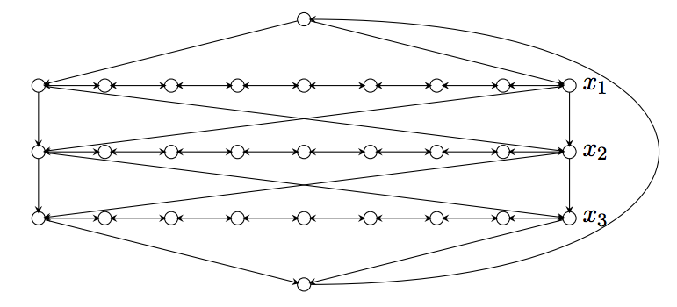
HC Variable Gadget

Slide 42
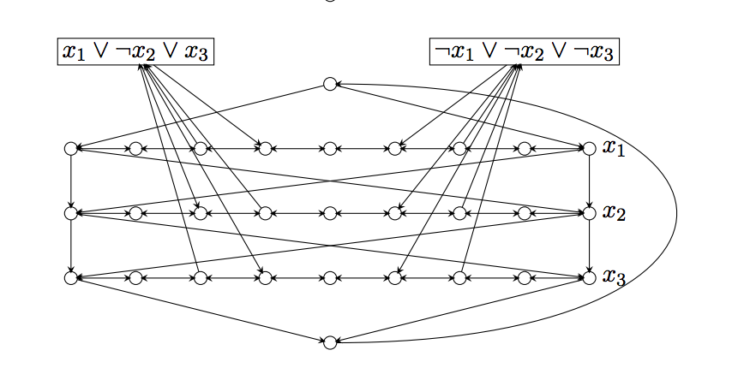
HC Gadgets Combined

Slide 43
Hamiltonian Path
Note we can split an arbitrary node, v, into two (v’,v’’ – one, v’, has in-edges of v, other, v’’, has out-edges. Path (not cycle) must start at v’’ and end at v’ and goal is still K.

Slide 44
Travelling Salesman
Start with HC = (V,E), K=|V|
Set edges from HC instance to 1
Add edges between pairs that lack such edges and make those weights 2 (often people make these K+1); this means that the reverse of unidirectional links also get weight 2
Goal weight is K for cycle

Slide 45
Tiling
Undecidable and NP-Complete Variants

Slide 46
Basic Idea of Tiling
A single tile has colors on all four sides. Tiles are often called dominoes as assembling them follows the rules of placing dominoes. That is, the color (or number) of a side must match that of its adjacent tile, e.g., tile, t2, to right of a tile, t1, must have same color on
Its left as is on the right side of t1.
This constraint applies to top and as well as sides. Boundary tiles do not have constraints on their sides that touch the boundaries.

Slide 47
Instance of Tiling Problem
A finite set of tile types (a type is determined by the colors of its edges)
Some 2d area (finite or infinite) on which the tiles are to be laid out
An optional starting set of tiles in fixed positions
The goal of tiling the plane following the adjacency constraints and whatever constraints are indicated by the starting configuration.

Slide 48
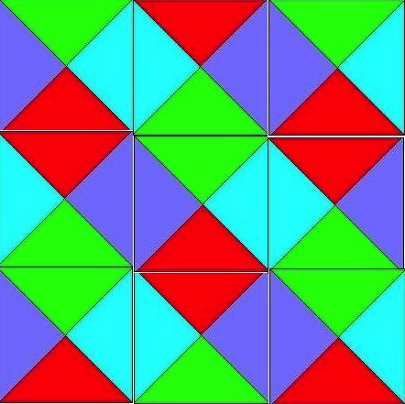
A Valid 3 by 3 Tiling of Tile Types from Previous Slide

Slide 49
Some Variations
Infinite 2d plane (impossible in general)
Our two tile types can easily tile the 2d plane
Finite 2d plane (hard in general)
Our two tile types can easily tile any finite 2d plane
This is called the Bounded Tiling Problem.
One dimensional space (hmm?)
Infinite 3d space (not even semi-decidable in general)

Slide 50
Tiling the Plane
We will start with a Post Machine, M = (Q, Σ, δ, q₀), with tape alphabet Σ = {B,1} where B is blank and δ maps pairs from Q×Σ to Q×(Σ ∪ {R,L}). M starts in state q₀
(Turing Machine with each action being L, R or Print)
We will consider the case of M starting with a blank tape
We will constrain our machine to never go to the left of its starting position (semi unbounded tape)
We will mimic the computation steps of M
Termination occurs if in state q reading b and δ(q,b) is not defined
We will use the fact that halting when starting at the left end of a semi unbounded tape in its initial state with a blank tape is undecidable

Slide 51
The Tiling Decision Problem
Given a finite set of tile types and a starting tile in lower left corner of 2d plane, can we tile all places in the plane?
A place is defined by its coordinates (x,y), x≥0, y≥0
The fixed starting tile is at (0,0)

Slide 52
Colors
Given M, define our tile colors as
{X, Y, *, B, 1, YB, Y1} ∪ Q×{B,1} ∪ Q×{YB,Y1} ∪ Q×{R,L}
Simplest tile (represents Blank on X axis)
B
B
B
X

Slide 53
Tiles for Copying Tape Cell
Copy cells not on
left boundary and not scanned
B
1
*
*
*
*
B
1
YB
Y1
Copy cells on
left boundary
but not scanned
Y
*
Y
*
YB
Y1

Slide 54
Right Move δ(q,a) = (p,R)
a
*
p,R
q,a
p,b
where b∈Σ
p,R
*
b
Ya
Y
p,R
q,Ya

Slide 55
Left Move δ(q,a) = (p,L)
p,b
*
p,L
b
a
where b∈Σ
p,L
*
q,a
p,Yb
Y
p,L
Yb

Slide 56
Print δ(q,a) = (p,c)
p,c
*
*
q,a
p,Yc
Y
*
Yc

Slide 57
Corner Tile and Bottom Row
q₀,YB
Y
B
X
Zero-ed Row is forced to be
q₀,YB
B
B
Y
B
B
B
B
B
………...
X
X
X

Slide 58
First Action Print
As we cannot move left of leftmost character first action is either right or print. Assume for now that δ(q₀,B) = (p,a)
p,Ya
B
B
Y
*
*
*
*
*
………...
q₀,YB
B
B
q₀,YB
B
B
Y
B
B
B
B
B
………...
X
X
X

Slide 59
First Action Right Move
As we cannot move left of leftmost character first action is either right or print. Assume for now that δ(q₀,B) = (p,R)
YB
p,B
B
Y
p,R
p,R
*
*
*
………...
q₀,YB
B
B
q₀,YB
B
B
Y
B
B
B
B
B
………...
X
X
X

Slide 60
The Rest of the Story Part 1
Inductively we can show that, if the i-th row represents an infinite transcription of the Turing configuration after step i then the (i+1)-st represents such a transcription after step i+1. Since we have shown the base case, we have a successful simulation.

Slide 61
The Rest of the Story Part 2
Consider the case where M eventually halts when started on a blank tape in state q₀. In this case we will reach a point where no actions fill the slots above the one representing the current state. That means that we cannot tile the plane.
If M never halts, then we can tile the plane (in the limit).

Slide 62
The Rest of the Story Part 3
The consequences of Parts 1 and 2 are that Tiling the plane is as hard as the complement of the Halting problem which is co-RE Complete.
This is not surprising as this problem involves a universal quantification over all coordinates (x,y) in the plane.

Slide 63
Constraints on M
The starting blank tape is not a real constraint as we can create M so its first actions are to write arguments on its tape.
The semi unbounded tape is not new. If you look back at Standard Turing Computing (STC), we assumed there that we never moved left of the blank preceding our first argument.
If you prefer to consider all computation based on the STC model then we add to M the simple prologue (R1)^{x1}R(R1)^{x2}R…(R1)^{xk}R so the actual computation starts with a vector of x1 … xk on the tape and with the scanned square to the blank to right of this vector. The rest of the tape is blank.
Think about how, in the preceding pages, you could actually start the tiling in this configuration.

Slide 64
Bounded Tiling Problem #1
Consider a slight change to our machine M. First, it is non-deterministic, so our transition function maps to sets.
Second, we add two auxiliary states {q_{a}, q_{r}}, where q_{a} is our only accept state and q_{r} is our only reject state.
We make it so the reject state has no successor states, but the accept state always transitions back to itself rewriting the scanned square unchanged.
We also assume our machine accepts or rejects in at most n^{k} steps, where n is the length of its starting input which is written immediately to the right of the initial scanned square.

Slide 65
Bounded Tiling Problem #2
We limit our rows and column to be of size n^{k}+1. We change our initial condition of the tape to start with the input to M. Thus, it looks like
Note that there are n^{k} – n of these blank representations at the end. But we really only need the first.
q₀,YB
x₁
x_{n}
B
Y
B
B
B
B
B
B
B
…
…
X
X
X
X

Slide 66
Bounded Tiling Problem #3
The finitely bounded Tiling Problem we just described mimics the operation of any given polynomially-bounded non-deterministic Turing machine.
This machine can tile the finite plane of size (n^{k}+1) * (n^{k}+1) just in case the initial string is accepted in n^{k} or fewer steps on some path.
If the string is not accepted then we will hit a reject state on all paths and never complete tiling.
This shows that the bounded tiling problem is NP-Hard
Is it in NP? Yes. How? Well, we can be shown a tiling (posed solution takes space polynomial in n) and check it for completeness and consistency (this takes linear time in terms of proposed solution). Thus, we can verify the solution in time polynomial in n.

Slide 67
A Final Comment on Tiling
If you look back at the unbounded version, you can see that we could have simulated a non-deterministic Turing machine there, but it would have had the problem that the plane would be tiled if any of the non-deterministic choices diverged and that is not what we desired.
However, we need to use a non-deterministic machine for the finite case as we made this so it tiled iff some path led to acceptance. If all lead to rejection, we get stalled out on all paths as the reject state can go nowhere.

Slide 68
Comments on Variations
One dimensional space (think about it)
Infinite 3d space (really impossible in general)
This become a ∀∃ problem
In fact, one can mimic acceptance on all inputs here, meaning M is an algorithm iff we can tile the 3d space

