Slide 1
Avatar-Mediated Interaction
Charlie Hughes
Synthetic Reality Laboratory (SREAL.UCF.EDU)
© UCF 2016

Slide 2
Shameless Plug for CS/IT
Both are fully accredited with IT one of only 30 such programs in US
UCF is one of nation’s top teams in the International Programming Competition making finals in 27 of last 35 years – 28th in world, 3rd in US last year (primarily CS students)
UCF is National Center of Academic Excellence in Cyber Defense Education and is national cyber defense champion three years in a row (primarily IT students)

Slide 3
Virtual Environments
Virtual Reality:
Setting and all objects are synthetic
Augmented Reality:
Real setting with synthetic object overlays
Augmented Virtuality:
Synthetic setting behind real objects
Mixed Reality:
Seamless blending of real and synthetic

Slide 4
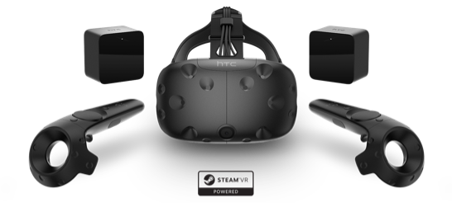
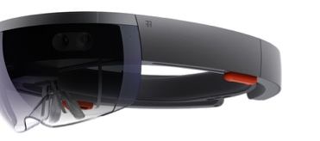
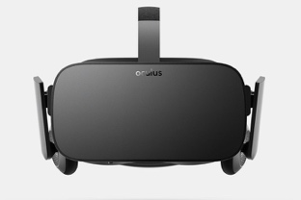
An Incomplete History of VR
Virtual Reality has been with us for a long time
Concept was discussed by Leonardo DaVinci in 1400s
First HMD was created by Ivan Sutherland in 1965
Army used networked VR in 1980s
Cost and Consumers
HMDs cost $25K to $125K just sixyears ago
Now they cost $600 and have wider FOV
Good tracking cost $6K to $100K just 10 years ago
Now Vive tracking is bundled with $800 HMD
Cost was driven down by cell phones
Displays and even cardboard VR

Slide 5
Virtual Humans and Avatars
Virtual Human:
Synthetic character that has a human form and human-like behaviors.
Avatar:
A person’s alter ego often with an idealized appearance. For our purposes, our avatars are virtual humans and each has a very distinct personality and personal history (backstory)

Slide 6
TeachLivE
teachlive.org

Slide 7
TeachLivE Paradigm
Realistic virtual classroom experiences
classroom management
pedagogy
content delivery
parent-teacher meetings
teacher-principal interviews, evaluations
Integrated reflection tools

Slide 8
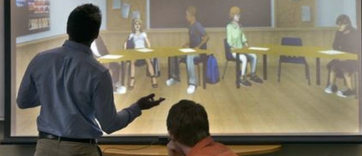
TeachLivE Model

Slide 9
The TeachLivE Paradigm

Slide 10
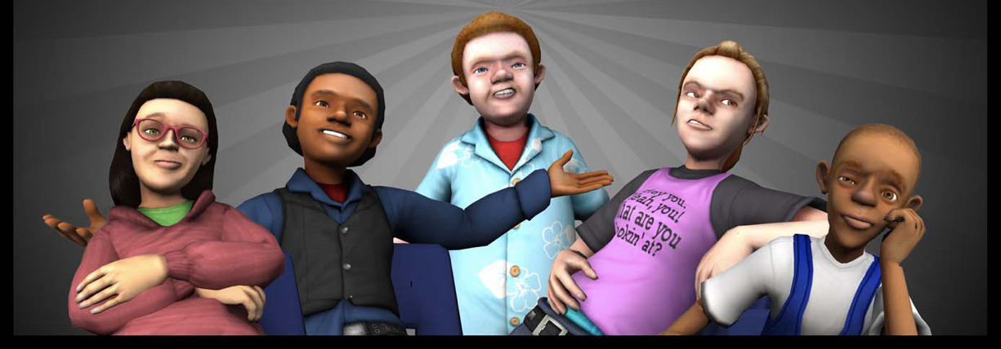
Character Profiles
Personality Types
Personalities: | Dependent | Independent
Aggressive | Attention-getter | Leader
Passive | Follower | Withdrawn
Notes:
These avatars are based upon Long’s personalities types a research based framework.

Slide 11
TeachLivE’s Usage
>85 Universities and 10 school districts use it
50,000+ teachers/administrators rehearsed skills in 2014-16
Changes targeted classroom behaviors, e.g., high order questions and wait time, in four 10-minute sessions and changes transferred to classroom
Used outside US in Abu Dhabi, Italy, Malaysia, …
Helps people hone social skills
Selected one of most innovative approaches to teacher preparation by Children’s Television Workshop
Applied to desk staff training at Best-Western hotels
Applied by ETS to teacher/administrator licensure

Slide 12
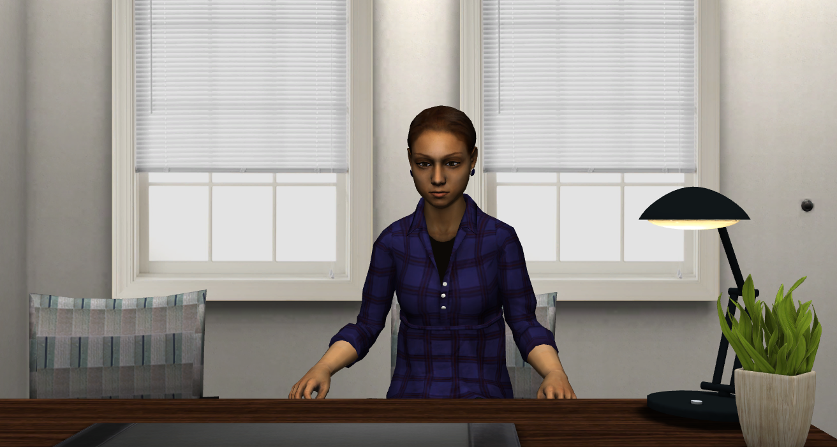
Interviewer/Interviewee

Slide 13
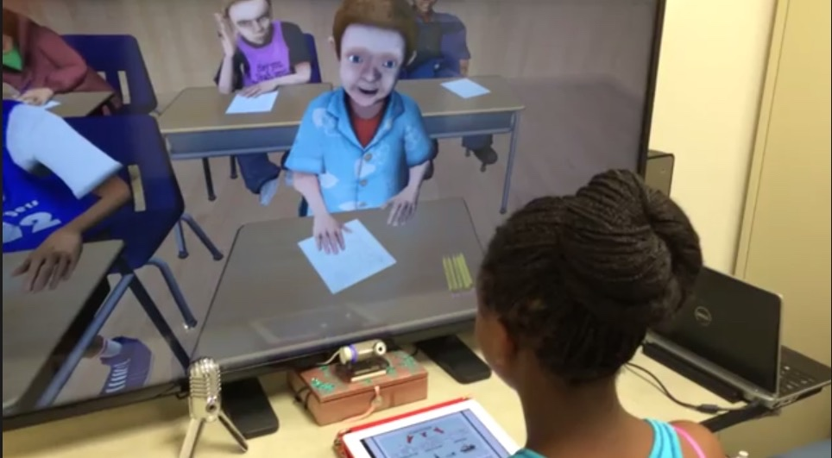
Peer Tutors

Slide 14
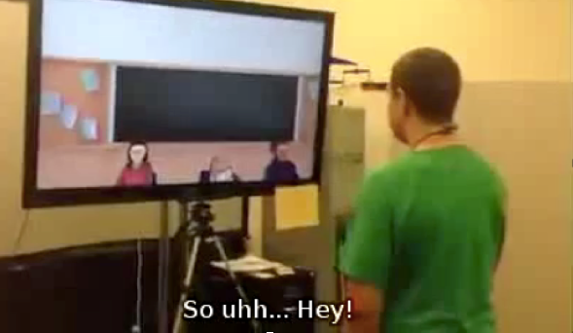
Social Skills Practice

Slide 15
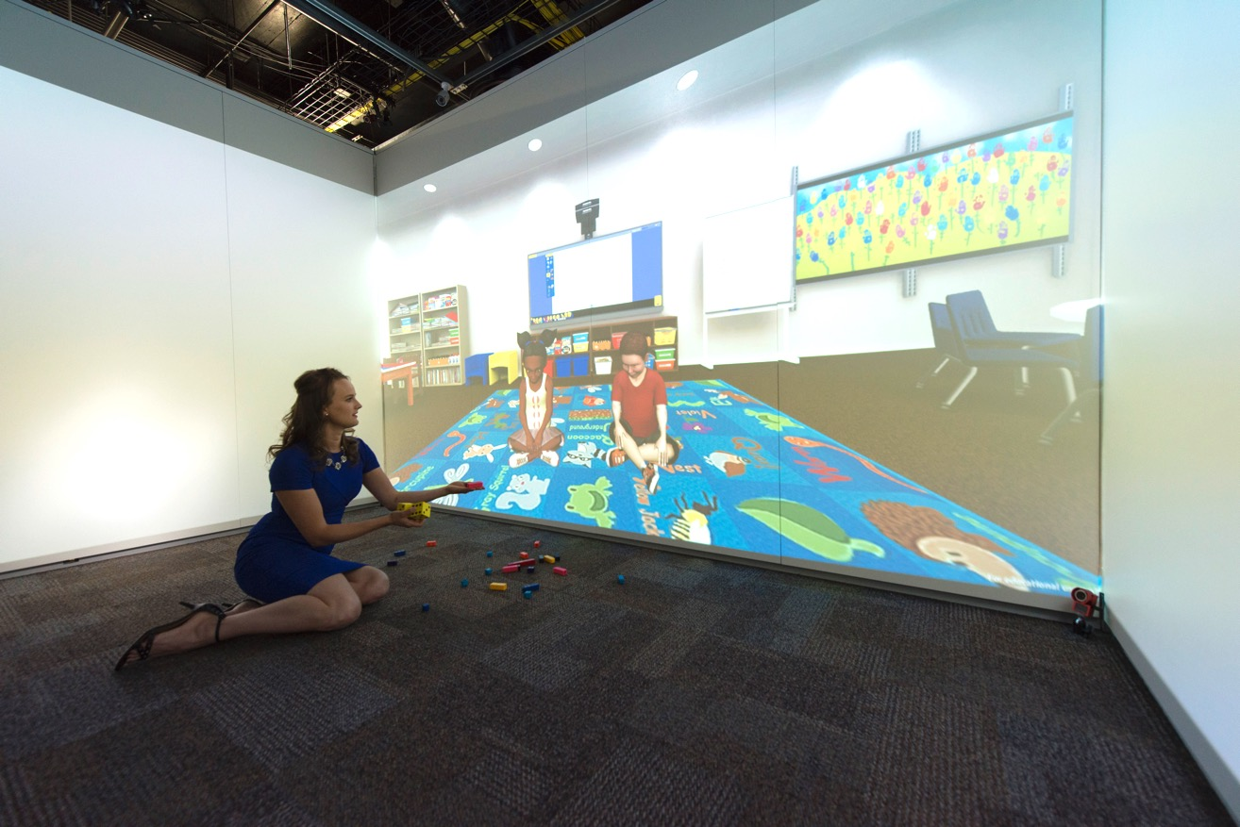
Elementary School Kids

Slide 16
Some Other Applications

Slide 17
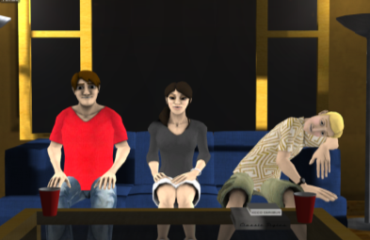
CollegeLiVE

Slide 18
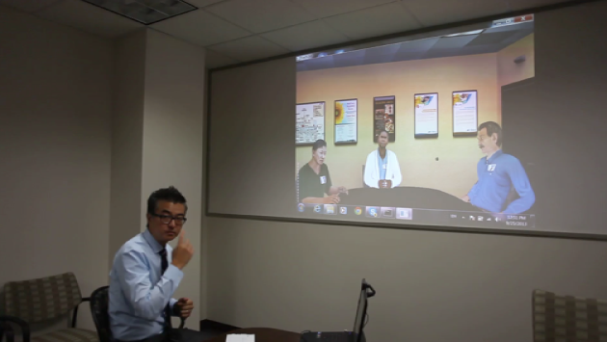
Debriefing with Good Judgement

Slide 19
De-escalation Skills

Slide 20
Physical-Virtual Avatars

Slide 21
Robothespian

Slide 22
Multiple Manifestations

Slide 23
Virtual Patient (with UCF Nursing)

Slide 24
Nonverbal Messaging

Slide 25
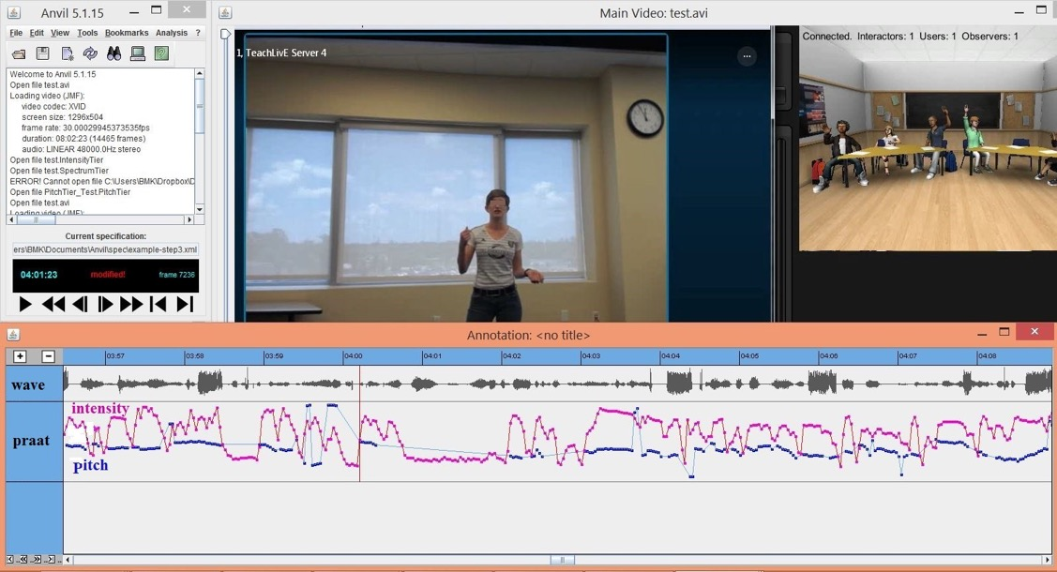
Non-Verbal Messaging (posture/vocalization) Leila Barmaki

Slide 26
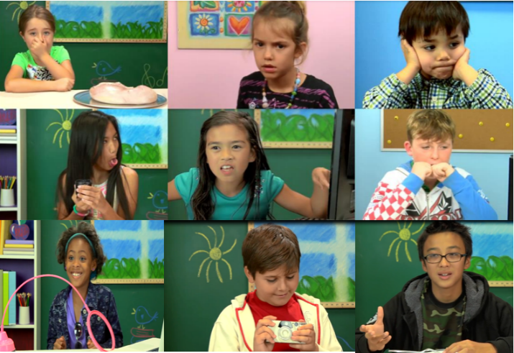
Emotions (Facial/Vocalization) Behnaz Nojavanasghari

Slide 27
Body Ownership & Presence

Slide 28
Kinds of Presence
Physical Presence
Co-Presence
Social Presence

Slide 29
Sense of Remote Presence
Visual perception of “being there”
See what virtual or physical counterpart sees except for own body
Auditory perception of “being there”
Tactile perception of “being there”
Sense of responsibility for safety of remote self

Slide 30
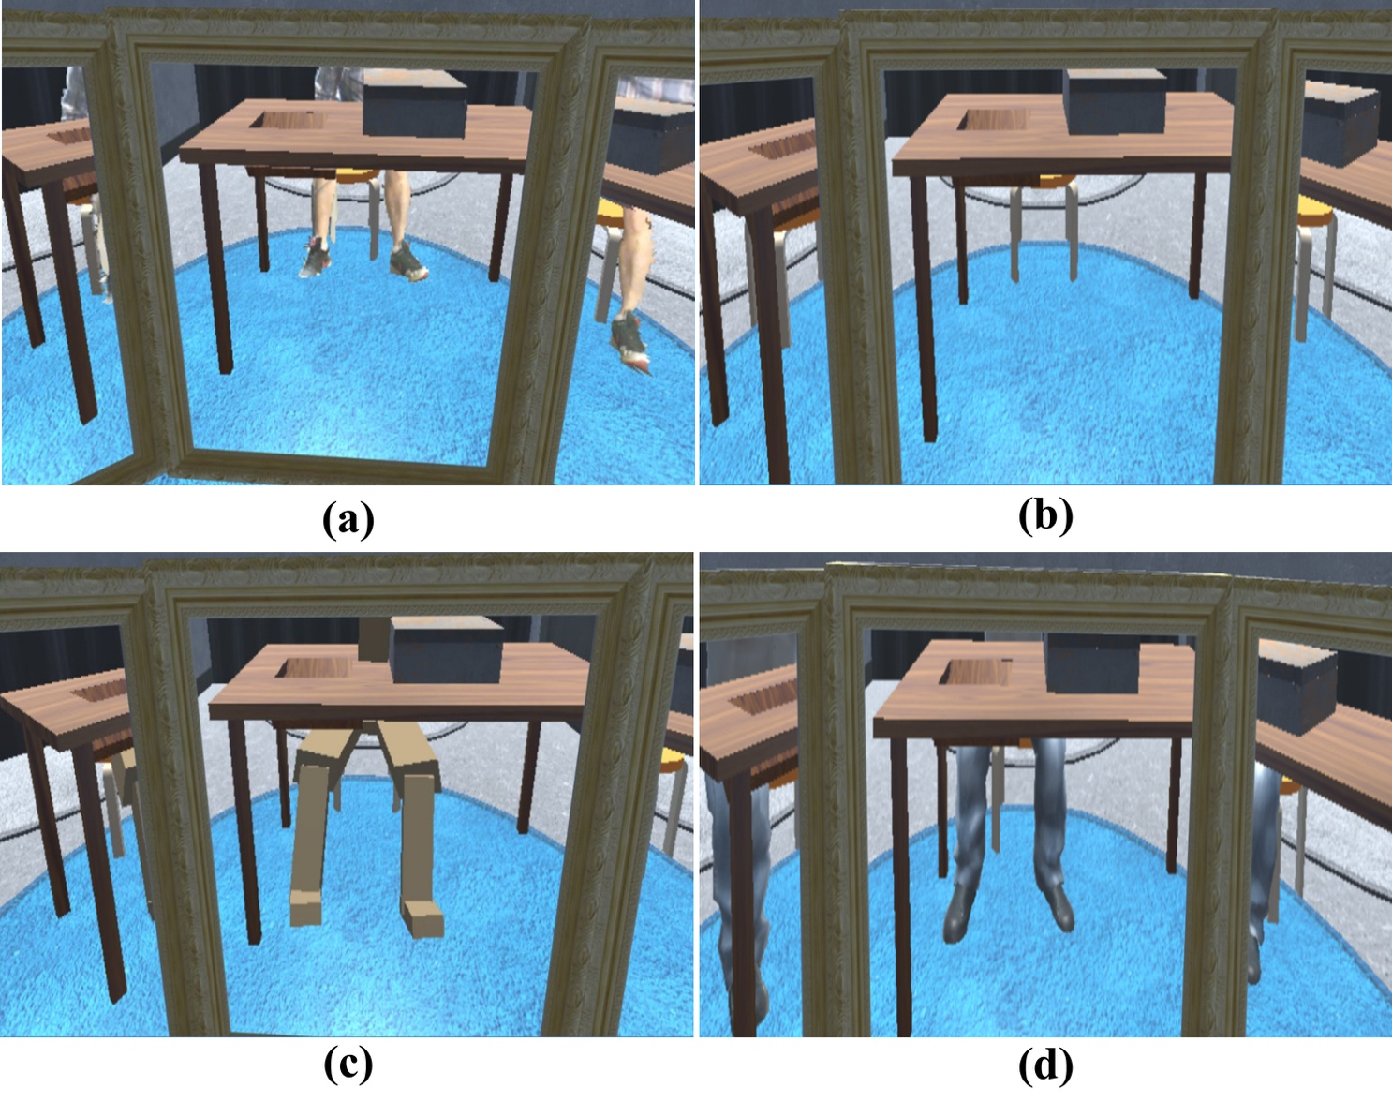
Indirect Cues (legs unrelated to task)

Slide 31
Cultural Heritage

Slide 32
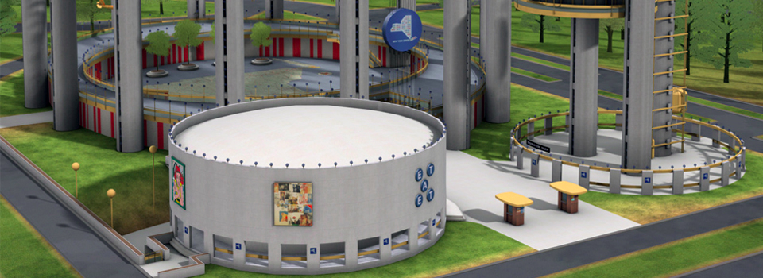
1964/65 NY World’s Fair (connecting STEM, Arts & Humanities)
CHRONOLEAP.ORG
Lori Walters

Slide 33
It’s a Wrap

Slide 34
Current UCF Collaborators
Arts & Humanities
Business
Education & Human Performance
Engineering & Computer Science
Hospitality Management
Law Enforcement
Medicine
Modeling & Simulation
Nursing
Public Health and Affairs
Sciences
Student Development and Enrollment Services

Slide 35
Research Funding
National Science Foundation
Office of Naval Research
Bill&Melinda Gates Foundation
NewSchools Venture Fund
National Endowment for the Humanities

Slide 36
Contact Information
Charlie Hughes Pegasus Professor, Computer Science Co-Director, IST/Synthetic Reality Lab Professor, School of Visual Arts & Design University of Central Florida Orlando, FL 32816-2362
E-mail: ceh@cs.ucf.edu Web: http://www.cs.ucf.edu/~ceh/ http://teachlive.org http://sreal.ucf.edu

