Slide 1
Final Exam Topics 1
Regular languages
  Decision Problems
    Membership
    Emptiness
    Finiteness
    Σ*
    Equality
    Containment
  Closure
    Union/Concatenation/Star
    Complement
    Substitution/Quotient, Prefix, Infix, Suffix
    Max/Min

Slide 2
Final Exam Topics 2
Context free languages
  Writing a simple CFG
  Decision Problems
    Membership
    Emptiness
    Finiteness
    Σ* (undecidable)
    Equality (undecidable)
    Containment (undecidable)
  Closure
    Union/Concatenation/Star
    Intersection with Regular
    Substitution/Quotient with Regular, Prefix, Infix, Suffix
  Non-closure
    intersection, complement, quotient, Max/Min
  Pumping Lemma for CFLs

Slide 3
Final Exam Topics 3
Chomsky Hierarchy
(Red involve no constructive questions)
  Regular, CFG, CSG, PSG (type 3 to type 0)
  FSAs, PDAs, LBAs, Turing machines
  Length preservation or increase makes membership in associated languages decidable for all but PSGs
  CFLs can be inherently ambiguous but that does not mean a language that has an ambiguous grammar is automatically inherently ambiguous

Slide 4
Final Exam Topics 4
Computability Theory
  Decision problems: solvable (decidable, recursive), semi-decidable (recognizable, recursively enumerable/re, generable), non-re
  A set is re iff it is semi-decidable
  If set is re and complement is also re, set is recursive (decidable)
  Halting problem (K₀): diagonalization proof of undecidability
    Set K₀ is re but complement is not
  Set K = { f | f(f) converges }
  Algorithms (Total): diagonalization proof of non-re
  Reducibility to show certain problems are not decidable or even non-re
  K and K₀ are re-complete – reducibility to show these results
  Rice’s Theorem: All non-trivial I/O properties of functions are undecidable (weak and strong versions)
  Use of quantification to discover upper bound on complexity

Slide 5
Final Exam Topics 5
Computability Applied to Formal Grammars
(Red only results not constructions that lead to these)
  Post Correspondence problem (PCP)
    Definition
    Undecidability (proof was only sketched and is not part of this course)
    Application to ambiguity and non-emptiness of intersections of CFLs and to non-emptiness of CSLs
  Traces of Turing computations
    Not CFLs
    Single steps are CFLs (use reversal of second configuration)
    Intersections of pairwise correct traces are traces
    Complement of traces (including terminating traces) are CFL
    Use to show cannot decide if CFL, L, is Σ*
    L= Σ* and L = L² are undecidable for CFLs
  PSG can mimic TM, so generate any re language; thus, membership in PSL is undecidable, as is emptiness of PSL.
  All re sets are homomorphic images of CSLs (erase fill character)

Slide 6
Final Exam Topics 6
Complexity Theory
  Verifiers versus solvers: P versus NP
  Definitions of NP: verify in deterministic poly time vs solve in non-deterministic polynomial time
  Co-P and co-NP; NP-Hard versus NP-Complete
  Basic idea behind SAT as NP-Complete
  Reduction of SAT to 3-SAT to Subset-Sum
  Equivalence of Subset-Sum to Partition
  Relation of Subset-Sum and Partition to multiprocessor scheduling
  Vertex cover, 3-coloring, register allocation, Independent set
  Gadgets for above

Slide 7
1. Let set A be recursive, B be re non-recursive and C be non-re. Choosing from among (REC) recursive, (RE) re non-recursive, (NR) non-re, categorize the set D in each of a) through d) by listing all possible categories. No justification is required.
a.) D = ~C RE, NR
b.) D ⊆ (A∪C) REC, RE, NR
c.) D = ~B NR
d.) D = B − A REC, RE

Slide 8
2. Prove that the Halting Problem (the set K₀ ) is not recursive (decidable) within any formal model of computation. (Hint: A diagonalization proof is required here.)
Assume we can decide the halting problem. Then there exists some total function Halt such that
1 if [x] (y) is defined
Halt(x,y) =
0 if [x] (y) is not defined
Here, we have numbered all programs and [x] refers to the x-th program in this ordering. We can view Halt as a mapping from ℵ into ℵ by treating its input as a single number representing the pairing of two numbers via the one-one onto function
pair(x,y) = <x,y> = 2^{x} (2y + 1) – 1
with inverses <z>₁ = exp(z+1,1) and <z>₂ = ((( z + 1 ) // 2 ^{<z>1} ) – 1 ) // 2
Now if Halt exist, then so does Disagree, where
0 if Halt(x,x) = 0, i.e, if Φ_{x} (x) is not defined
Disagree(x) =
μy (y == y+1) if Halt(x,x) = 1, i.e, if Φ_{x} (x) is defined
Since Disagree is a program from ℵ into ℵ , Disagree can be reasoned about by Halt. Let d be such that Disagree = Φ_{d}, then
Disagree(d) is defined ⇔ Halt(d,d) = 0 ⇔ Φ_{d} (d) is undefined ⇔ Disagree(d) is undefined
But this means that Disagree contradicts its own existence. Since every step we took was constructive, except for the original assumption, we must presume that the original assumption was in error. Thus, the Halting Problem is not solvable.

Slide 9
3.Using reduction from the known undecidable HasZero,
HZ = { f | ∃x f(x) = 0 }, show the non-recursiveness (undecidability) of the problem to decide if an arbitrary recursive function g has the property IsZero, Z = { f | ∀x f(x) = 0 }.
HZ = { f | ∃x ∃t [ STP(f, x, t) & VALUE(f, x, t) == 0] }
Let f be the index of an arbitrary effective procedure.
Define g_{f}(y) = 1 - ∃x ∃t [ STP(f, x, t) & VALUE(f, x, t) == 0]
If ∃x f(x) = 0, we will find the x and the run-time t, and so we will return 0 (1 – 1)
If ∀x f(x) ≠ 0, then we will diverge in the search process and never return a value.
Thus, f ∈ HZ iff g_{f} ∈ Z = { f | ∀x f(x) = 0 }.

Slide 10
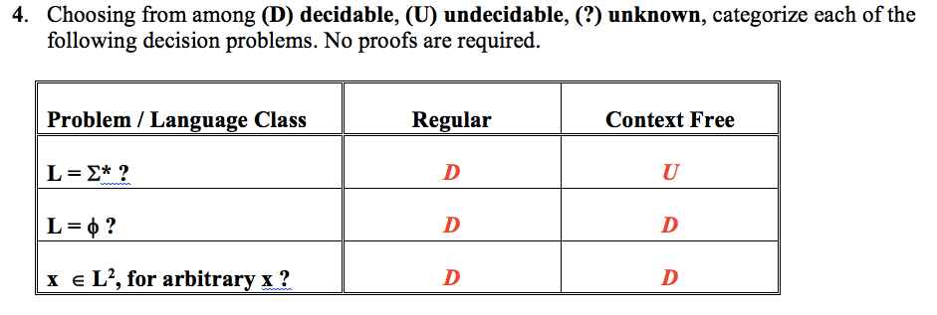

Slide 11
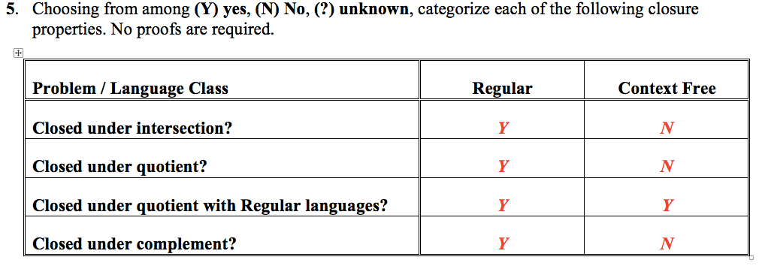

Slide 12
6. Prove that any class of languages, C, closed under union, concatenation, intersection with regular languages, homomorphism and substitution (e.g., the Context-Free Languages) is closed under MissingMiddle, where, assuming L is over the alphabet Σ,
MissingMiddle(L) = { xz | ∃y ∈ Σ* such that xyz ∈ L }
You must be very explicit, describing what is produced by each transformation you apply.
Define the alphabet Σ’ = { a’ | a∈Σ }, where, of course, a’ is a “new” symbol, i.e., one not in Σ.
Define homomorphisms g and h, and substitution f as follows:
g(a) = a’ ∀a∈Σ h(a) = a ; h(a’) = λ ∀a∈Σ f(a) = {a, a’ } ∀a∈Σ
Consider R = Σ* • g(Σ*) • Σ* = { x y’ z | x, y, z ∈Σ* and y’=g(y) ∈Σ’* }
Σ* is regular since it is the Kleene star closure of a finite set.
g(Σ*) is regular since it is the homomorphic image of a regular language.
R is regular as it is the concatenation of regular languages.
Now, f(L) = { f(w) | w ∈ L } is in C since C is closed under substitution. This language is the set of strings in L with randomly selected letters primed. Any string w∈L gives rise to 2^{|w|} strings in f(L).
f(L) ∩ R = { x y’ z | x y z ∈ L and y’=g(y) } is in C since C is closed under intersection with regular languages.
MissingMiddle(L) = h( f(L) ∩ R ) = { x z | ∃y ∈ Σ* such that xyz ∈ L } which is in C, since C is closed under homomorphism. Q.E.D.

Slide 13
7. Use PCP to show the undecidability of the problem to determine if the intersection of two context free languages is non-empty. That is, show how to create two grammars G_{A} and G_{B} based on some instance P = <<x₁,x₂,…,x_{n}>, <y₁,y₂,…,y_{n}>> of PCP, such that L(G_{A}) ∩ L(G_{B}) ≠ φ iff P has a solution. Assume that P is over the alphabet Σ.You should discuss what languages your grammars produce and why this is relevant, but no formal proof is required.
G_{A} = ( { A } , Σ ∪ { [ i ] | 1≤i≤n } , A , P_{A} } G_{B} = ( { B } , Σ ∪ { [ i ] | 1≤i≤n } , B , P_{B} }
P_{A} : A → x_{i} A [ i ] | x_{i} [ i ] P_{B} : A → y_{i} B [ i ] | y_{i} [ i ]
L(G_{A}) = { x_{i1} x_{i2} … x_{ip} [i_{p}] … [i₂] [i₁] | p ≥ 1, 1 ≤ i_{t} ≤ n, 1 ≤ t ≤ p }
L(G_{B}) = { y_{j1} y_{j2} … y_{jq} [j_{q}] … [j₂] [j₁] | q ≥ 1, 1 ≤ j_{u} ≤ n, 1 ≤ u ≤ q }
L(G_{A}) ∩ L(G_{B}) = { w [k_{r}] … [k₂] [k₁] | r ≥ 1, 1 ≤ k_{v} ≤ n, 1 ≤ v ≤ r }, where
w = x_{k1} x_{k2} … x_{kr} = y_{k1} y_{k2} … y_{kr}
If L(G_{A}) ∩ L(G_{B}) ≠ φ then such a w exists and thus k₁ , k₂ , … , k_{r} is a solution to this instance of PCP. This shows that a decision procedure for the non-emptiness of the intersection of CFLs implies a decision procedure for PCP, which we have already shown is undecidable. Hence, the non-emptiness of the intersection of CFLs is undecidable. Q.E.D.

Slide 14
8. Consider the set of indices CONSTANT = { f | ∃K ∀y [ ϕ_{f}(y) = K ] }. Use Rice’s Theorem to show that CONSTANT is not recursive. Hint: There are two properties that must be demonstrated.
First, show CONSTANT is non-trivial.
Z(x) = 0 is in CONSTANT
S(x) = x+1 is not in CONSTANT
Thus, CONSTANT is non-trivial
Second, let f, g be two arbitrary computable functions with the same I/O behavior.
That is, ∀x, if f(x) is defined, then f(x) = g(x); otherwise both diverge, i.e., f(x)↑ and g(x)↑
Now, f ∈ CONSTANT
⇔ ∃K ∀x [ f(x) = K ] by the definition of CONSTANT
⇔ ∀x [ g(x) = C ] where C is the instance of K above, since ∀x [ f(x) = g(x) ]
⇔ ∃K ∀x [ g(x) = K ] from above
⇔ g ∈ CONSTANT by the definition of CONSTANT
Since CONSTANT meets both conditions of Rice’s Theorem, it is undecidable. Q.E.D.

Slide 15
9. Show that CONSTANT ≡_{m} TOT, where TOT = { f | ∀y ϕ_{f}(y)↓ }.
CONSTANT ≤_{m} TOT
Let f be an arbitrary effective procedure.
Define g_{f} by
g_{f} (0) = f(0)
g_{f} (y+1) = f(y+1) + μ z [f(y+1) = f(y) ]
Now, if f ∈ CONSTANT then ∀y [ f(y)↓ and [ f(y+1) = f(y) ] ].
Under this circumstance, μ z [f(y+1) = f(y) ] is 0 for all y and g_{f} (y) = f(y) for all y.
Clearly, then g_{f} ∈ TOT
If, however, f ∉ CONSTANT then ∃y [f(y+1) ≠ f(y) ] or ∃y f(y)↑.
Choose the least y meeting this condition.
If f(y)↑ then g_{f} (y)↑ since f(y) is in g_{f} (y)’s definition (the 1st term).
If f(y)↓ but [f(y+1) ≠ f(y)] then g_{f} (y)↑ since μ z [ f(y+1) = f(y) ]↑ (the 2nd term).
Clearly, then g_{f} ∉ TOT
Combining these, f ∈ CONSTANT ⇔ g_{f} ∈ TOT and thus CONSTANT ≤_{m} TOT

Slide 16
TOT ≤_{m} CONSTANT
Let f be an arbitrary effective procedure.
Define g_{f} by g_{f} (y) = f(y) – f(y)
Now, if f ∈ TOT then ∀y [ f(y)↓ ] and thus ∀y g_{f} (y) = 0 .
Clearly, then g_{f} ∈ CONSTANT
If, however, f ∉ TOT then ∃y [f(y)↑ ] and thus, ∃y [g_{f} (y)↑]. Clearly, then g_{f} ∉ CONSTANT
Combining these, f ∈ TOT ⇔ g_{f} ∈ CONSTANT and thus
TOT ≤_{m} CONSTANT
Hence, CONSTANT ≡_{m} TOT. Q.E.D.

Slide 17
10. Why does Rice’s Theorem have nothing to say about each of the following? Explain by showing some condition of Rice’s Theorem that is not met by the stated property.
a.) AT-LEAST-LINEAR = { f | ∀y ϕ_{f}(y) converges in no fewer than y steps }.
We can deny the 2nd condition of Rice’s Theorem since
Z, where Z(x) = 0, implemented by the TM R converges in one step no matter what x is and hence is not in AT-LEAST-LINEAR
Z’, defined by TM L R R, is in AT-LEAST-LINEAR since it takes over 2*|input| steps.
However, ∀x [ Z(x) = Z’(x) ], so they have the same I/O behavior and yet one is in and the other is out of AT-LEAST-LINEAR, denying the 2nd condition of Rice’s Theorem
b.) HAS-IMPOSTER = { f | ∃ g [ g≠f and ∀y [ ϕ_{g}(y) = ϕ_{f}(y) ] ] }.
We can deny the 1st condition of Rice’s Theorem since all functions have an imposter. To see this, consider, for any function f, the equivalent but distinct function g(x) = f(x) + 0. Thus, HAS-IMPOSTER is trivial since it is equal to ℵ, the set of all indices.

Slide 18
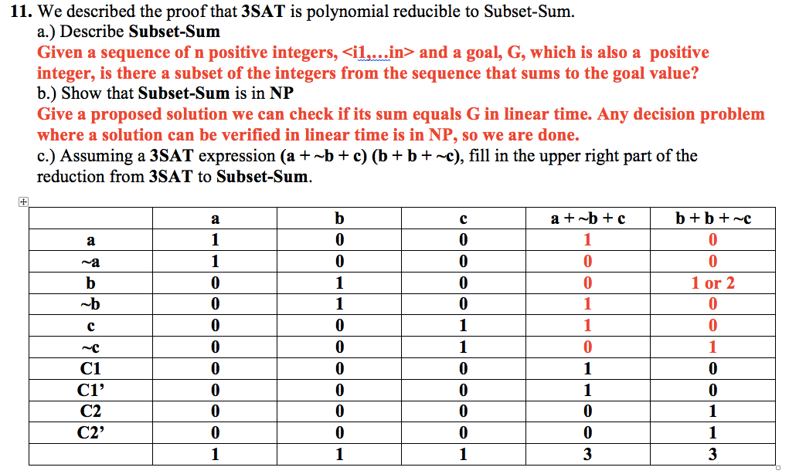

Slide 19
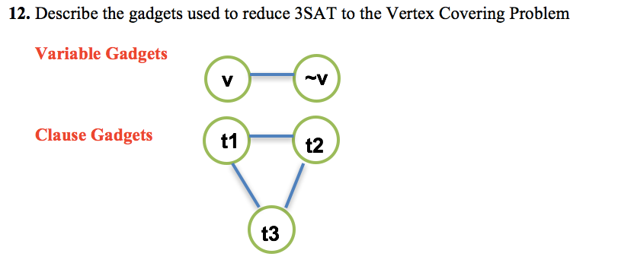

Slide 20
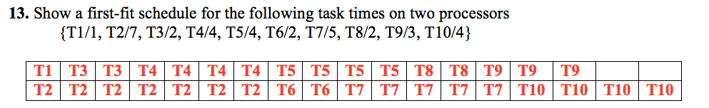

Slide 21
14. Use the Pumping Lemma for CFLs to show:
{ ww | w is over {a,b} } is not Context Free
Assume the language L = { ww | w is over {a,b} } is Context Free. Let N>0 be the value associated with L by the Pumping Lemma for Context Free languages.
a^{N}b^{N}a^{N}b^{N} ∈ L.
By Pumping Lemma, a^{N}b^{N}a^{N}b^{N} = uvwxy, for some strings u,v,w,x,y over {a,b},
where |vx| > 0, |vwx| ≤ N and ∀i≥0 uv^{i}wx^{i}y ∈ L.
All cases collapse into the following analysis. vwx must include at most one of the ‘a’ sequences and at most one of the ‘b’ sequences; moreover it must have at least one of these cases (first ‘a’ sequence but not second; first ‘b’ sequence but not second; second ‘a’ sequence but not first; or second ‘b’ sequence but not first). Set i=0 and we have removed letters from one of the ‘a’ sequences and/or one of the ‘b’ sequences, but not the other. This denies that uwy is in L, thereby contradicting the Pumping Lemma.

Slide 22
15. Write a context-free grammar for the complement of
{ ww | w is over {a,b} }
S → L<Odd> | AB | BA
<Odd> → L<Even> | λ
<Even> → L<Odd>
A → L A L | a
B → L B L | b
L → a | b

Slide 23
Sample Question#5
5. Let S be an re (recursively enumerable), non-recursive set, and T be an re, possibly recursive set. Let
E = { z | z = x + y, where x ∈ S and y ∈ T }.
Answer with proofs, algorithms or counterexamples, as appropriate, each of the following questions:
(a) Can E be non re? No. If T = ∅ then E is recursive.
Assume S is non-empty and S and T are enumerated by f_{S}, f_{T}, resp.
Then f_{E}(<x,y>) = f_{S}(x) + f_{S}(y) enumerates E.
(b) Can E be re non-recursive? Yes. T = {0}, E = S
(c) Can E be recursive? Yes, T=ℵ, E = { x | x ≥ min value in S }

Slide 24
Assignment # 8.1 Key
Use reduction from Halt to show that one cannot decide REPEATS, where
REPEATS = { f | for some x and y, x ≠ y, ϕ_{f}(x)↓, ϕ_{f}(y)↓ and ϕ_{f}(x) == ϕ_{f}(y) }
Let f,x be an arbitrary pair of natural numbers. <f,x> is in Halt iff ϕ_{f}(x)↓
Define g by ϕ_{g}(y) = ϕ_{f}(x) - ϕ_{f}(x), for all y.
Clearly, ϕ_{g}(y) = 0, for all y, iff ϕ_{f}(x)↓, and ϕ_{g}(y)↑, for all y, otherwise.
Summarizing, <f,x> is in Halt implies g is in REPEATS and <f,x> is not in Halt implies g is not in REPEATS
Halt ≤_{m} REPEATS as we were to show.
Note: I have not overloaded the index of a function with the function in my proof, but I do not mind if you do such overloading.

Slide 25
Assignment # 8.2 Key
Show that REPEATS reduces to Halt. (1 plus 2 show they are equally hard)
Let f be an arbitrary natural number. f is in REPEATS iff for some x and y, x ≠ y, ϕ_{f}(x)↓, ϕ_{f}(y)↓ and ϕ_{f} (x) == ϕ_{f}(y)
Define g by ϕ_{g}(z) = ∃<x,y,t> [STP(f,x,t) & STP(f,y,t) & (x≠y) & (VALUE(f,x,t) = (VALUE(f,y,t) )], for all z.
Clearly, ϕ_{g}(z) = 1, for all z, iff there is some pair, x,y, such that ϕ_{f}(x)↓ and ϕ_{f}(y)↓ and ϕ_{f}(x) = ϕ_{f}(y), and ϕ_{g}(z)↑, for all z, otherwise.
Summarizing, f is in REPEATS iff g is in Halt and so
REPEATS ≤_{m} Halt as we were to show.

Slide 26
Assignment # 8.3 Key
Use Reduction from Total to show that DOUBLES is not even re, where
DOUBLES = { f | for all x, ϕ_{f}(x)↓, ϕ_{f}(x+1)↓ and ϕ_{f}(x+1)=2*ϕ_{f}(x) }
Let f be an arbitrary natural number. f is in Total iff ∀x ϕ_{f}(x) ↓
Define g by ϕ_{g}(x) = ϕ_{f}(x) - ϕ_{f}(x), for all x.
Clearly, ϕ_{g}(x) = 0, and so ϕ_{g}(x+1) = 2*ϕ_{g}(x) = 0 for all x, iff ∀x ϕ_{f}(x)↓; otherwise ϕ_{g}(x)↑ for some x.
Summarizing, f is in Total iff g is in DOUBLES and so
TOTAL ≤_{m} DOUBLES as we were to show.

Slide 27
Assignment # 8.3 Alternate Key
Use Reduction from Total to show that DOUBLES is not even re, where
DOUBLES = { f | for all x, ϕ_{f}(x)↓, ϕ_{f}(x+1)↓ and ϕ_{f}(x+1)=2*ϕ_{f}(x) }
Let f be an arbitrary natural number. f is in Total iff ∀x ϕ_{f}(x) ↓
Define g by ϕ_{g}(x) = ϕ_{f}(x) - ϕ_{f}(x)+2^x for all x.
Clearly, ϕ_{g}(x) = 2^x, and so ϕ_{g}(x+1) = 2*ϕ_{g}(x) = 2^(x+1) for all x, iff ∀x ϕ_{f}(x)↓; otherwise ϕ_{g}(x)↑ for some x.
Summarizing, f is in Total iff g is in DOUBLES and so
TOTAL ≤_{m} DOUBLES as we were to show.

Slide 28
Assignment # 8.4 Key
Show DOUBLES reduces to Total. (4 plus 5 show they are equally hard)
Let f be an arbitrary natural number. f is in DOUBLES iff ∀x ϕ_{f} (x)↓, ϕ_{f}(x+1)↓ and ϕ_{f} (x+1)=2*ϕ_{f} (x).
Define g by ϕ_{g}(x) = μy[ϕ_{f}(x+1) = 2*ϕ_{f}(x)], for all x.
Clearly, ϕ_{g}(x)↓, for all x, iff ∀x ϕ_{f}(x)↓, ϕ_{f}(x+1)↓ and ϕ_{f}(x+1)=2*ϕ_{f}(x); otherwise ϕ_{g}(x)↑ for some x.
Summarizing, f is in DOUBLES iff g is in Total and so
DOUBLES ≤_{m} TOTAL as we were to show.

Slide 29
Assignment # 8.5 Key
Use Rice’s Theorem to show that REPEATS is undecidable
First, REPEATS is non-trivial as C0(x) = 0 is in REPEATS and S(x) = x+1 is not.
Second, REPEATS is an I/O property.
To see this, let f and g are two arbitrary indices such that
∀x [ϕ_{f}(x) = ϕ_{g}(x)]
f ∈ REPEATS iff ∃ y,z, y ≠ z, such that ϕ_{f}(y)↓, ϕ_{f}(z)↓ and ϕ_{f}(y) = ϕ_{f}(z)
iff, since∀x [ϕ_{f}(x) = ∀x ϕ_{g}(x)], ∃ y,z, y ≠ z, y ≠ z, (same y,z as above) such that ϕ_{g}(y)↓, ϕ_{g}(z)↓ and ϕ_{g}(y) = ϕ_{g}(z) iff g ∈ REPEATS.
Thus, f ∈ REPEATS iff g ∈ REPEATS.

Slide 30
Assignment # 8.6 Key
Use Rice’s Theorem to show that DOUBLES is undecidable
First, DOUBLES is non-trivial as C0(x) = 0 (2*0 = 0) is in DOUBLES and S(x) = x+1 is not.
Second, DOUBLES is an I/O property.
To see this, let f and g are two arbitrary indices such that
∀x [ϕ_{f}(x) = ϕ_{g}(x)].
f ∈ DOUBLES iff for all x, ϕ_{f}(x)↓, ϕ_{f}(x+1)↓ and ϕ_{f}(x+1)=2*ϕ_{f} (x) iff, since ∀x [ϕ_{f}(x) = ϕ_{g}(x)], for all x, ϕ_{g}(x)↓, ϕ_{g}(x+1)↓ and ϕ_{g}(x+1)=2*ϕ_{g}(x) iff g ∈ DOUBLES.
Thus, f ∈ DOUBLES iff g ∈ DOUBLES.

Slide 31
Assignment # 9.1a Key
Use quantification of an algorithmic predicate to estimate the complexity (decidable, re, co-re, non-re) of each of the following, (a)-(d):
  REPEATS = { f | for some x and y, x ≠ y, f(x)↓, f(y)↓ and f(x) == f(y) }
  ∃<x,y,t>[STP(f,x,t) & STP(f,y,t) & (x≠y) & (VALUE(f,x,t) = (VALUE(f,y,t) )]
  RE

Slide 32
Assignment # 9.1b Key
  DOUBLES = { f | for all x, f(x)↓, f(x+1)↓ and f(x+1)=2*f(x) }
∀x∃t [STP(f,x,t) & STP(f,x+1,t) & (2*VALUE(f,x,t) = (VALUE(f,x+1,t))]
Non-RE, Non-Co-RE

Slide 33
Assignment # 9.1c Key
  DIVEVEN = { f | for all x, f(2*x)↑ }
  ∀<x,t> [~STP(f,2*x,t)]
  Co-RE

Slide 34
Assignment # 9.1d Key
  QUICK10={ f | f(x), for all 0≤x≤9, converges in at most x+10 steps }
STP(f,0,10) & STP(f,1,11) & … & STP(f,9,19)
or
∀x_{0≤x≤9} [ STP(f,x,x+10) ]
REC

Slide 35
Assignment # 9.21 Key
Let sets A be recursive (decidable) and B be re non-recursive (undecidable).
Consider C = { z | min(x,y), where x ∈ A and y ∈ B }. For (a)-(c), either show sets A and B with the specified property or demonstrate that this property cannot hold.
  Can C be recursive?
  YES. Consider A = {0}. B = Halt. C = {0}

Slide 36
Assignment # 9.2b Key
  Can C be non-recursive?
  YES. Consider A = { 2x | x ∈ N }. B = { 2x+1 | x ∈ Halt}. C = A ∪ B. This is semi-decidable but non re as Halt is reducible to C.

Slide 37
Assignment # 9.2c Key
  Can C be non-re?
  No. Can enumerate C as follows.
  First if A is empty then C is empty and so RE by definition.
  If A is non-empty then A is enumerated by some algorithm f_{A} as recursive sets are RE.
  As B is non-recursive RE, then it is non-empty and enumerated by some algorithm f_{B}.
  Define f_{C} by f_{C}(<x,y>) = min(f_{A}(x),f_{B}(y)). f_{C} is clearly an algorithm as it is the composition of algorithms. The range of f_{C} is then { z | min(x,y), where x ∈ A and y ∈ B } = C and so C must be RE.

