Slide 1
Assignment # 7.1a Key
a.) Use the Pumping Lemma for CFLs to prove that the following is NOT a CFL
L = { a^{i} b^{j} | j > 2*I }
This language is a CFL, so you cannot show it to be a non-CFL. A grammar that works is
S → aSbb | Sb | b

Slide 2
Assignment # 7.1b Key
b.) Use the Pumping Lemma for CFLs to prove that the following is NOT a CFL.
  L = { a^{n} b^{Fib(n)} | n>0 }, where Fib(i) is the i^{th} Fibonacci number
PL: Provides N>0
We: Choose a^{N}b^{N!} ∈ L
PL: Splits a^{N}b^{N!} into uvwxy, |vwx| ≤ N, |vx| > 0, such that ∀i≥0 uv^{i}wx^{i}y ∈ L
We: Choose i=2
Case 1: vwx contains only b’s, then we are increasing the number of b’s while leaving the number of a’s unchanged. In this case uv²wx²y is of form a^{N}b^{N!+c}, c>0 and this is not in L.
Case 2: vwx contains some a’s and maybe some b’s. Under this circumstances uv²wx²y has at least N+1 a’s and at most N!+N-1 b’s. But (N+1)! = N!(N+1) = N!*N+N ≥ N! + N > N!+N-1 and so is not in L.
Cases 1 and 2 cover all possible situations, so L is not a CFL

Slide 3
Assignment # 7.2
 | b | a | b | b | a
1 | B,D | A,C | B,D | B,D | A,C
2 | S | S,A |  | S
3 | S,B | S | B
4 | B | S
5 | B,S
Present the CKY recognition matrix for the string babba assuming the Chomsky Normal Form grammar,
G = ({S,A,B,C,D }, {a,b}, R, S), specified by the rules R:
  S → AB | BA | SC
  A → CS | CD | a
  B → DS | b
  C → a
  D → b

Slide 4
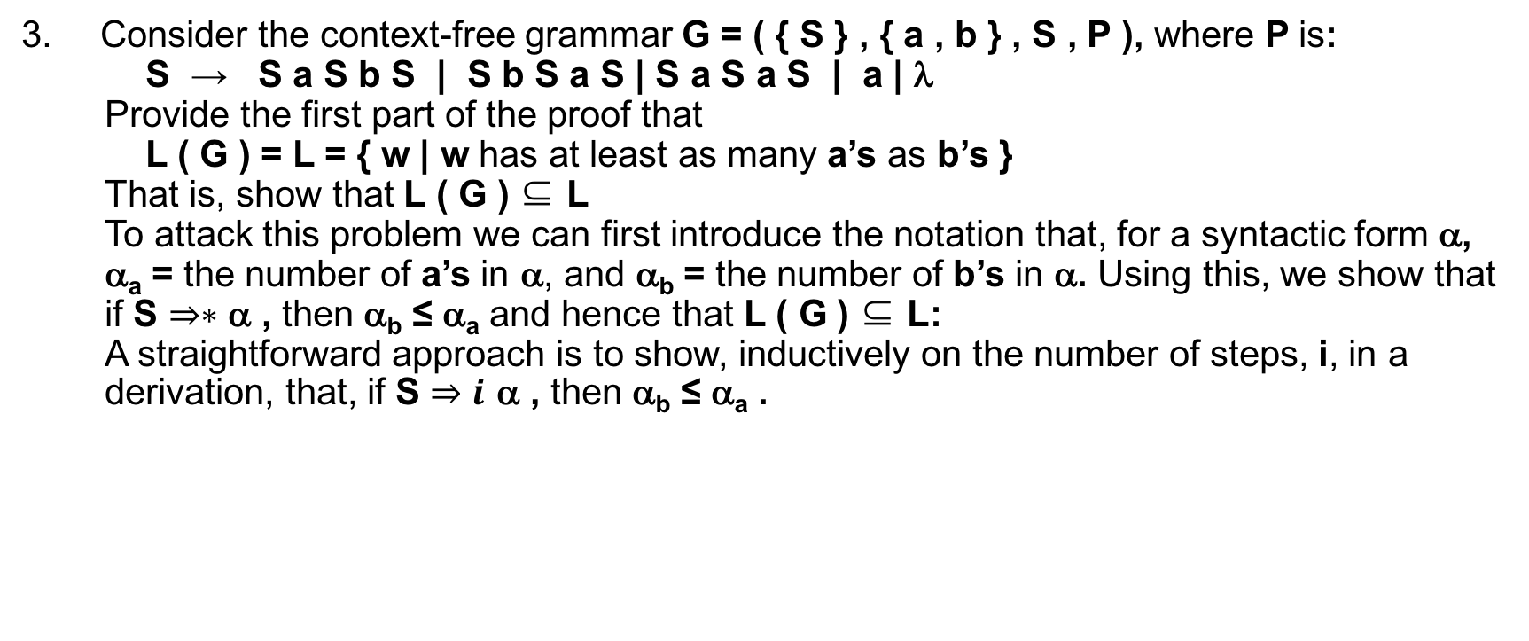
Assignment # 7.3a
Consider the context-free grammar G = ( { S } , { a , b } , S , P ), where P is:
  S → S a S b S | S b S a S | S a S a S | a | λ
  Provide the first part of the proof that
  L ( G ) = L = { w | w has at least as many a’s as b’s }
  That is, show that L ( G ) ⊆ L
  To attack this problem we can first introduce the notation that, for a syntactic form α, α_{a} = the number of a’s in α, and α_{b} = the number of b’s in α. Using this, we show that if S $⇒∗$ α , then α_{b} ≤ α_{a} and hence that L ( G ) ⊆ L:
  A straightforward approach is to show, inductively on the number of steps, i, in a derivation, that, if S $⇒i$ α , then α_{b} ≤ α_{a} .

Slide 5
Assignment # 7.3b
Basis (i=1): Since S ⇒α iff S → α and all rhs of S have α_{b} ≤ α_{a} then the base case holds
IH: Assume if S ⇒_{m}α , then α_{b} ≤ α_{a} , whenever m ≤ n
IS: Show that if S ⇒_{n+1}α , then α_{b} ≤ α_{a}
If S α then S ⇒_{n} β and β⇒α
Since G has only one non-terminal S, the rewriting of β to α involves a single application of one of the S-rules. By the I.H., β has the property that β_{b} ≤ β_{a}. Since a single application of an S rule either adds no b’s or a’s, one a, one a and one b, or two b’s, we have the three following cases:

Slide 6
Assignment # 7.3c
Case 0: α_{a} = β_{a}, and α_{b}= β_{b}
In which case, using the IH, we have:
β_{b} ≤ β_{a} → α_{b} ≤ α_{a}
Case 1: α_{b} = β_{b}, and α_{a}= β_{a} +1
In which case, using the IH, we have:
β_{b} ≤ β_{a} → α_{b} ≤ α_{a}
Case 2: α_{b} = β_{b}+1, and α_{a}= β_{a} +1
In which case, using the IH, we have:
β_{b} ≤ β_{a} → α_{b} ≤ α_{a}
Case 3: α_{b} = β_{b}, and α_{a}= β_{a} +2
In which case, using the IH, we have:
β_{b} ≤ β_{a} → α_{b} ≤ α_{a}

