Slide 1
Assignment # 2.1 Key
Prove or disprove, if p and q are distinct prime numbers (p≠q), then √(pq) is irrational.
Proof:
  Assume √pq is a rational number. Let a/b be the reduced fraction (no common prime factors) that equals √(pq).
  √(pq) = a/b : assumption (note a≠b, as then pq=1)
  pq = a²/b² : square both sides
  pqb² = a² : multiply both sides by b²
  pqb² = (kpq)² : for some k, as p and q must be prime
  factors of a since a and b have no common prime factors
  b² = k²pq : divide both sides by pq
  But then p and q must be prime factors of both a and b. But then a/b is not reduced as both have common prime factors p and q. This contradicts our original assumption that √(pq) is rational, so it is irrational.

Slide 2
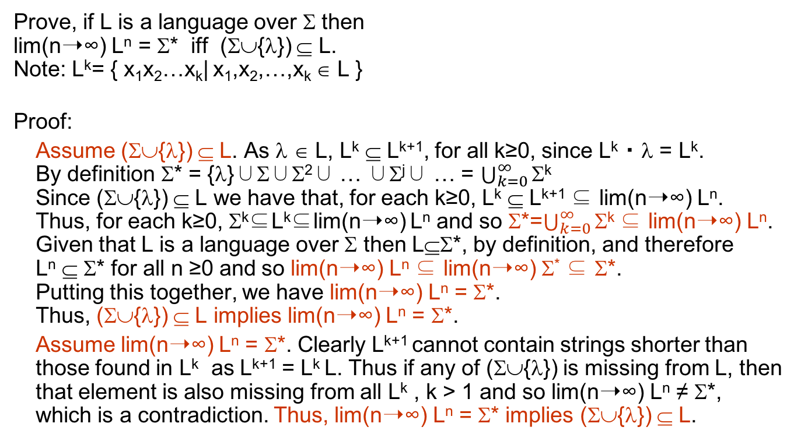
Assignment # 2.2 Key
Prove, if L is a language over Σ then
lim(n➝∞) L^{n} = Σ* iff (Σ∪{λ}) ⊆ L.
Note: L^{k}= { x₁x₂…x_{k}| x₁,x₂,…,x_{k} ∈ L }
Proof:
Assume (Σ∪{λ}) ⊆ L. As λ ∈ L, L^{k} ⊆ L^{k+1}, for all k≥0, since L^{k} ・ λ = L^{k}.
By definition Σ* = {λ}∪Σ∪Σ²∪ … ∪Σ^{j}∪ … = $\bigcup_{k=0}^{∞}{\text{Σ}\text{k}}$
Since (Σ∪{λ}) ⊆ L we have that, for each k≥0, L^{k} ⊆ L^{k+1} ⊆ lim(n➝∞) L^{n}.
Thus, for each k≥0, Σ^{k}⊆L^{k}⊆lim(n➝∞) L^{n} and so Σ*=$\bigcup_{k=0}^{∞}{\text{Σ}\text{k}}$ ⊆ lim(n➝∞) L^{n}.
Given that L is a language over Σ then L⊆Σ*, by definition, and therefore
L^{n} ⊆ Σ* for all n ≥0 and so lim(n➝∞) L^{n} ⊆ lim(n➝∞) Σ* ⊆ Σ*.
Putting this together, we have lim(n➝∞) L^{n} = Σ*.
Thus, (Σ∪{λ}) ⊆ L implies lim(n➝∞) L^{n} = Σ*.
Assume lim(n➝∞) L^{n} = Σ*. Clearly L^{k+1} cannot contain strings shorter than those found in L^{k} as L^{k+1} = L^{k} L. Thus if any of (Σ∪{λ}) is missing from L, then that element is also missing from all L^{k} , k > 1 and so lim(n➝∞) L^{n} ≠ Σ*, which is a contradiction. Thus, lim(n➝∞) L^{n} = Σ* implies (Σ∪{λ}) ⊆ L.

Slide 3
Second Solution for 2.2
Proof by Induction :
Assume (Σ∪{λ}) ⊆ L.
We want to prove that, ∀i≥0, Σ⁰∪Σ¹∪Σ²∪ … ∪Σ^{i} ⊆ L^{i} :
Base: I = 0: as Σ⁰={λ} ⊆ L⁰ by definition of 0-th power (even {}⁰ contains λ)
Induction Hypothesis: Assume for some i ≥0, Σ⁰∪Σ∪Σ²∪ … ∪Σ^{i} ⊆ L^{i}
Induction Step: Show for i+1
  Σ^{i} ⊆ L^{i} by IH
  Σ ⊆ L assumed Σ^{i+1} ⊆ L^{i +1}
  Because λ ∈ L, ∀k≥0, L^{k} ⊆ L^{k+1}
  Hence, Σ⁰ ∪Σ∪Σ²∪ … ∪Σ^{i} ∪Σ^{i+1} ⊆ L^{i} ∪Σ^{i+1} ⊆ L^{i+1}
  As i goes to infinity The left side becomes Σ* and right side becomes lim(n➝∞) L^{n} . Therefore Σ* ⊆ lim(n➝∞) L^{n} .
  lim(n➝∞) L^{n} ⊆ Σ* is trivial. Now we can conclude that Σ* = lim(n➝∞) L^{n}.

