Slide 1
Synthetic Reality Lab University of Central Florida

Slide 2
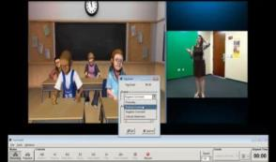
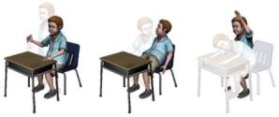
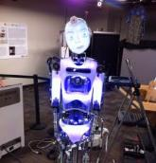
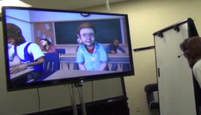
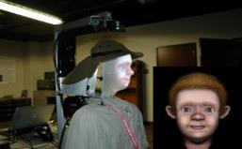
Co-Directors: Charlie Hughes, Greg Welch
Avatar mediated interaction
Microposes
Manifestations of surrogates
Applications to teacher practice, train the trainer, serious social issues, …

Slide 3
Avatar-Mediated Interaction & Teacher Practice with Lisa Dieker, Mike Hynes, Arjun Nagendran, Carrie Straub and a host of others

Slide 4
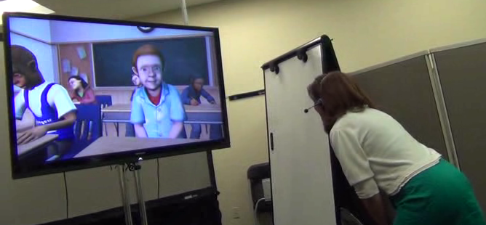
Teacher Rehearsal
Personalities: | Dependent | Independent
Aggressive | Attention-Grabber | Leader
Passive | Follower | Withdrawn

Slide 5
A Math Lesson

Slide 6
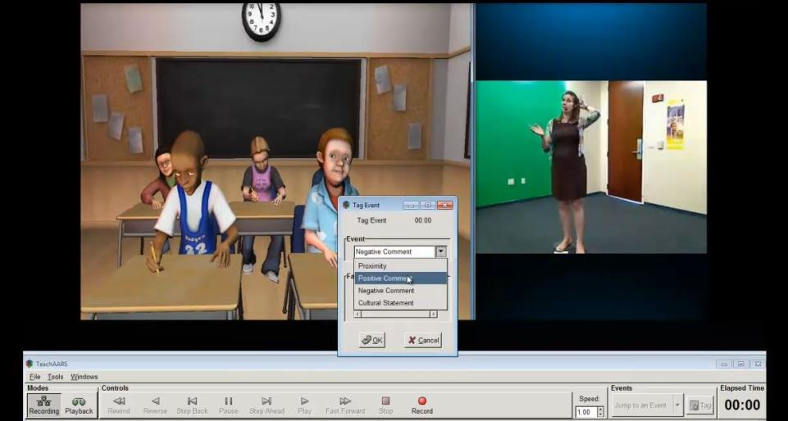
Reflection – tag, browse, export

Slide 7
Avatar-Mediated Interaction & Protective Strategies

Slide 8
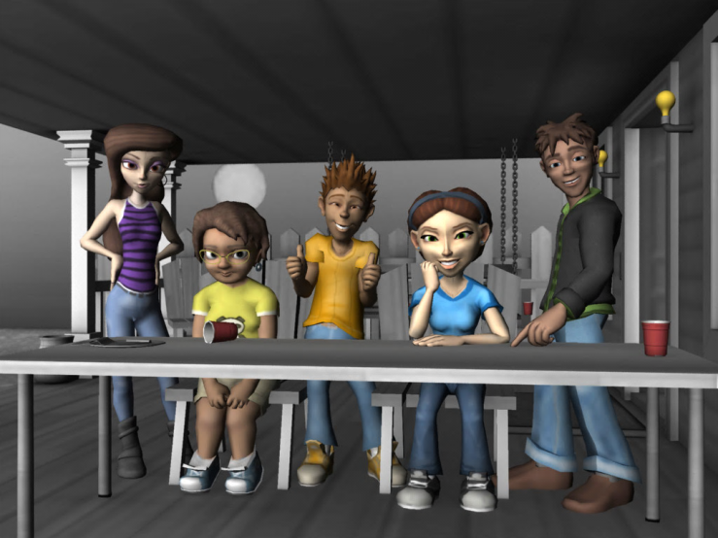
Peer Pressure on Middle Schoolers

Slide 9
Avatar-Mediated Interaction & Debriefing Trainers

Slide 10
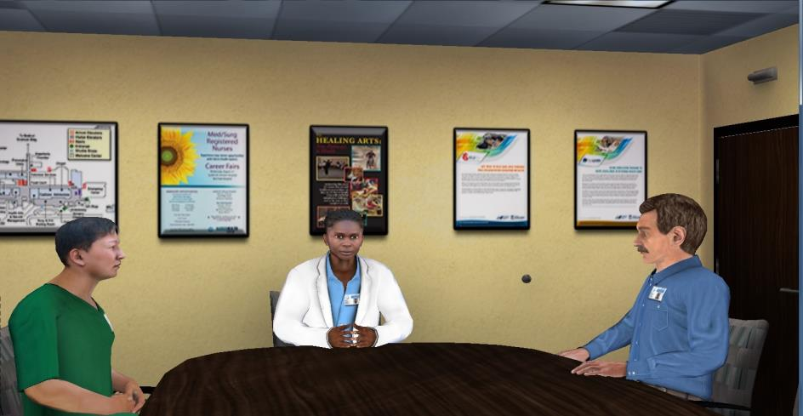
Debriefing Rehearsal

Slide 11
Physical-Virtual Avatars Led by Greg Welch with Arjun Nagendran, Remo Pillat

Slide 12
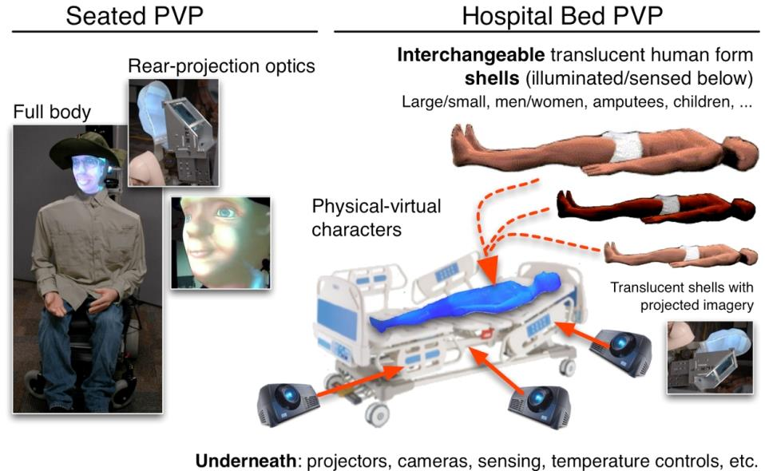
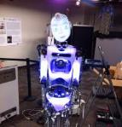
Physical Virtual Patient
Robothespian

Slide 13
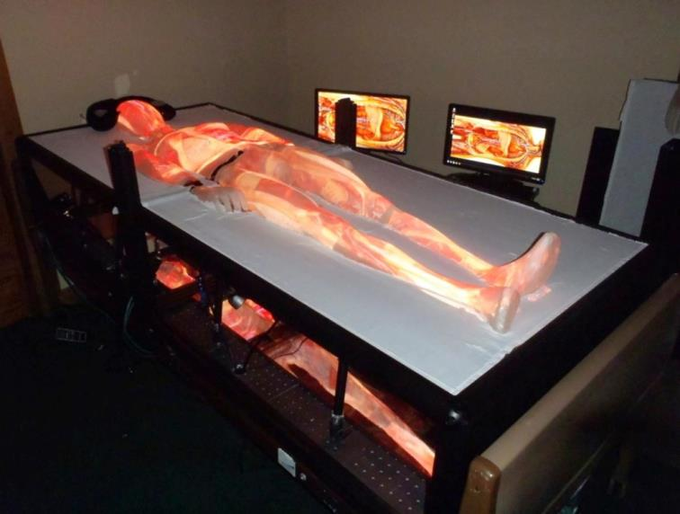
Patient Bed (Prototype)
13

Slide 14
Virtual Patient

Slide 15
PVA and 2D Avatars

Slide 16
DigitalHeritage & STEM Education

Slide 17
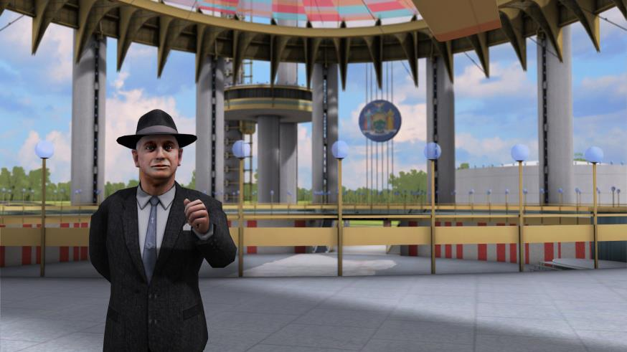
1964/65 NY World’s Fair

Slide 18
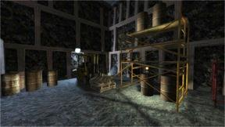
Connecting STEM
WV Coal Mine Entered from WV Pavilion

