Slide 1
Human Surrogates Charlie Hughes with Greg Welch & Arjun Nagendran (SREAL) Lisa Dieker & Mike Hynes (TeachLivE) CECS/CS and Synthetic Reality Lab University of Central Florida

Slide 2
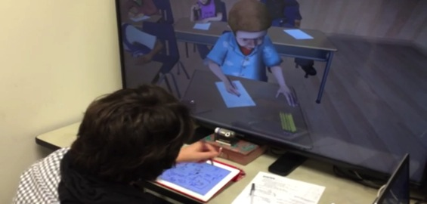
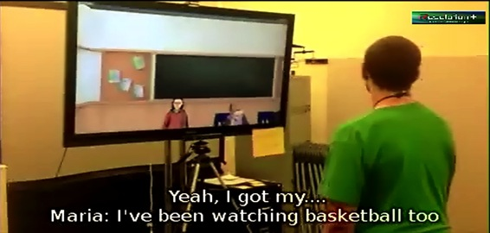
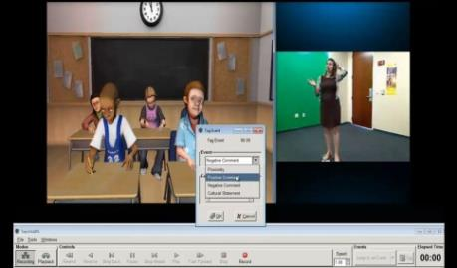
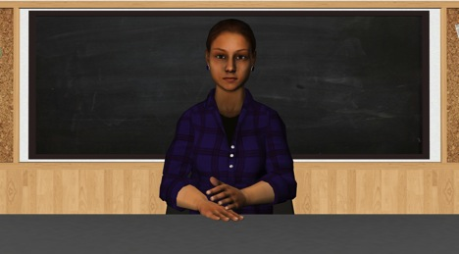
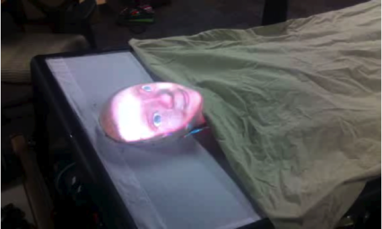
Avatar Research
Avatar mediated interaction
Manifestations of surrogates
Applications to teacher practice, social skills, healthcare, train the trainer, interview practice, …
For more on SREAL, go to http://sreal.org

Slide 3
Teacher Rehearsal
Personalities: | Dependent | Independent
Aggressive | Attention-Grabber | Leader
Passive | Follower | Withdrawn
For more on TeachLivE, go to http://teachlive.org

Slide 4
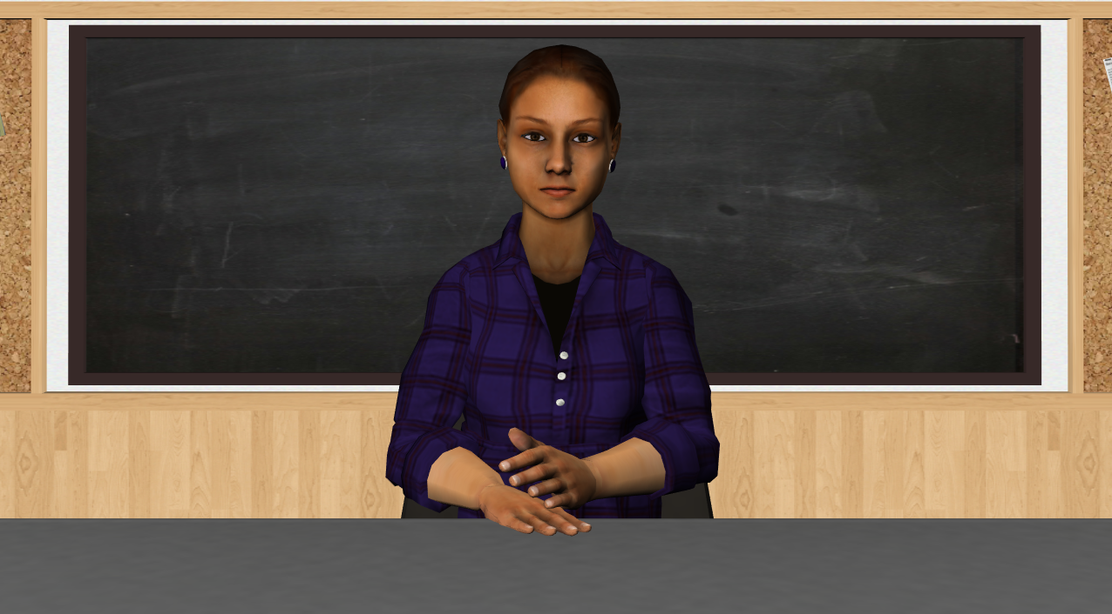
Interview Skills

Slide 5
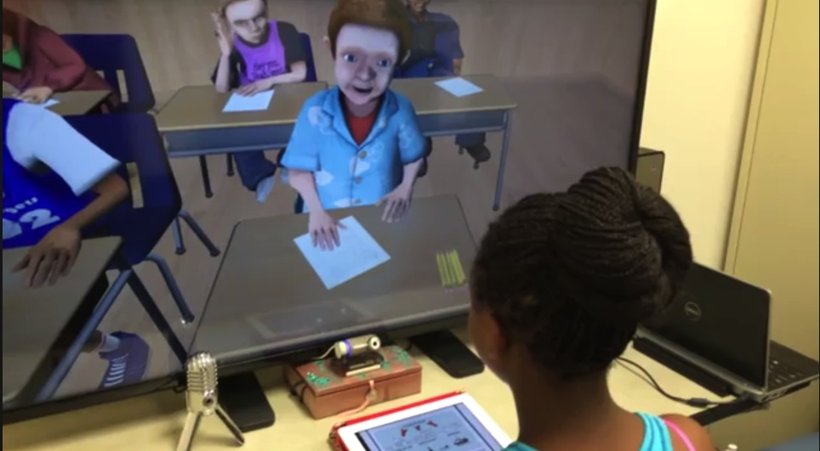
Peer Tutoring

Slide 6
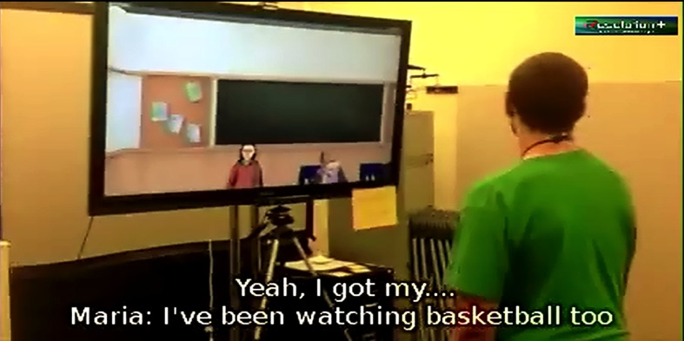
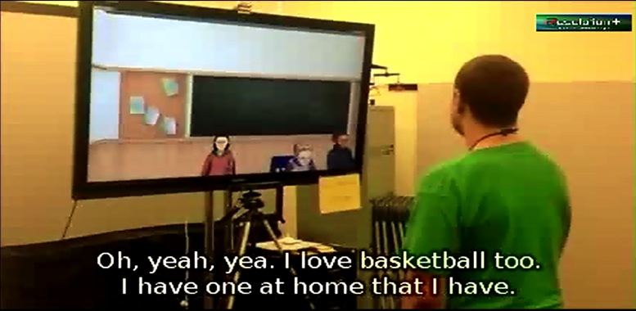
Social Skills Practice
For more on CJ, go to
http://autismmovesout.org

Slide 7
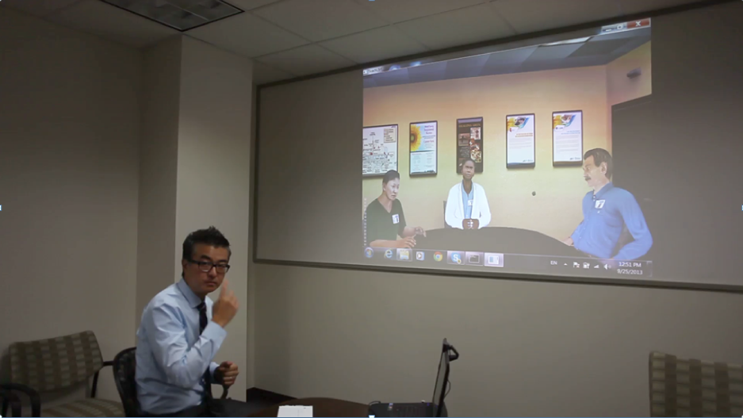
Debriefing Rehearsal

Slide 8
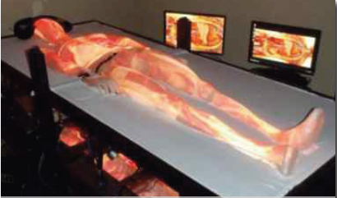
Healthcare
C1
C2
C3
h₂
θ₁
P1
h₁
θ₂
P7
θ₂
P6
θ₂
P5
H

Slide 9
Robotic Manifestation

Slide 10
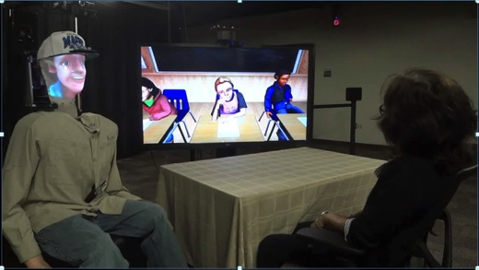
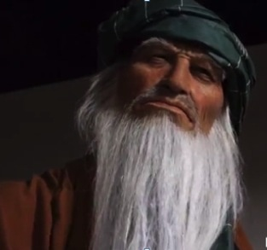
Other Manifestations
Mixed manifestation
Multiple avatar forms interacting in single context
Animatronic manifestation
Interaction with Lockheed supported by ONR Code 30

Slide 11
Funding

