Slide 1
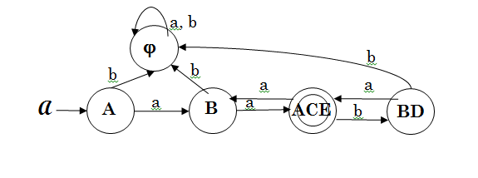
Assignment # 4.1 Key
Convert the following NFA to an equivalent DFA.
State | A | B | C | D | E
λ-closure | { A } | { B } | { C } | { B, D } | { A, E }

Slide 2
Assignment # 4.2 Key
State Ripping
Remove C
Simplify
S
aa (aa+ba)*
F
A
a
B
a
C
b
D
Final RegEx: 0⁺1(0 + 10⁺1)*
a
a
Add S,F
A = λ
B = Aa + Ca
C = Ba + Da
D = Cb
B = a + Ca
C = (a + Ca)a + Cba
C = aa + C(aa + ba)
C = aa (aa + ba)*
S
λ
A
a
B
a
C
b
D
0
a
a
λ
F
Remove A
S
a
B
a
C
b
D
a
a
λ
F
Remove B
aa
S
aa
C
b
D
a
λ
F
Remove B
aa+ba
S
aa
C
λ
F

Slide 3
Convert the DFA you developed in #1 to a regular expression, first by using either the GNFA (or state ripping) or Rij(k) approach, and then by using regular equations. You must show all steps in each part of this assignment.

Slide 4
Assignment # 4.2
Convert the following NFA to an equivalent DFA.
0
1
0
A:
A
1
B
λ
C
λ
D
0
E
1
0,1
1
1
1
A
BCD
0
BCDE
ABCD
1
0
0
0
0
0
Φ
ABCDE
0,1

Slide 5
Assignment # 4.2 Answer
0,1
q0
1
q1
0
qD
0,1

