Slide 1
Autonomous vehicles: Technical issues
Alan Reichner, Steven Jenzen

Slide 2
Table Of Contents
Overview of Technical Issues
Vehicle Network Communication
IEEE standards
Security Issues
Weather
Road Issues
Malfunctions
Conclusion
Sources

Slide 3
Overview of Technical Issues
Driverless cars are quickly improving over the years, but there are still a few more areas that need to be revised:
Security of communication and vehicles
Being addressed in the IEEE standards
Reliability of driving in weather
Improvement in awareness of surroundings
Decrease the probability and potential result of software malfunctions, glitches, or bugs

Slide 4
Security Risks
Attacks on the User – Risk to safety and user acceptance
Disable important features such as breaking
Cause bad driving decisions which could result with a collision, or traffic congestion
Rerouting car
Attacks on the communications system – Risk to privacy
Attacker steals the route or location tracking information

Slide 5
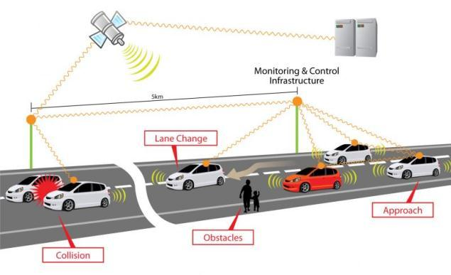
Vehicle Network Communication
Vehicle-to-vehicle (V2V) – wireless communication between vehicles
Vehicle-to-Infrastructure (V2I) - wireless exchange of operational and safety data between vehicles and road infrastructure
Alerts vehicles or users to potential traffic issues in advance

Slide 6
IEEE Standards
IEEE 802.11p – Wireless Access in Vehicular Environments (WAVE)
Provides support for Intelligent Transportation Systems (V2V and V2I)
Uses the 5.9GHz band
IEEE 1609
1609.0 – Architecture
1609.1 – Resource Manager
1609.2 – Security Services
1609.3 – Networking Services
1609.4 – Multi-Channel Operations
P1609.11 – Over-the-Air Data Exchange Protocol for ITS
Up to 27Mb/s
Range of up to 1000m

Slide 7
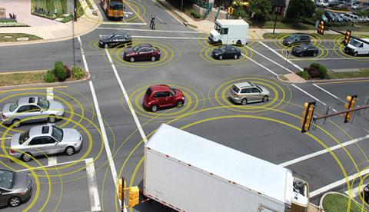
Frequent data transmission
In order to maximize vehicle efficiency and safety, vehicle data and variables need to be exchanged V2V and V2I
Vehicles must send updates about its acceleration and velocity at least every 20 milliseconds
When traveling in heavy traffic or large packs, it becomes extremely important that all the information is transmitted successfully to the other vehicles

Slide 8
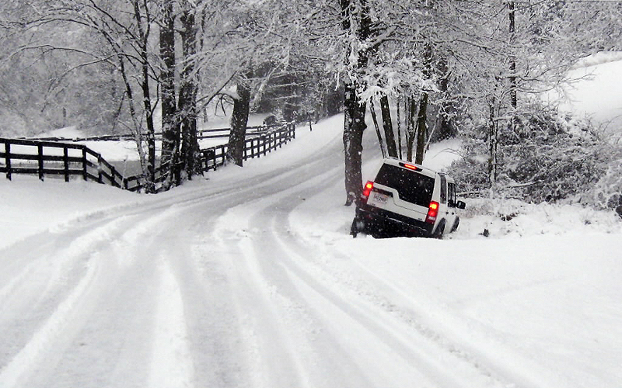
Weather
Obstructed or Poor visibility
Heavy rain
Fog or Smoke
Snow
Radar can still be used to map objects and obstacles, but the system lacks vision of lane indicators that keep it on the road

Slide 9
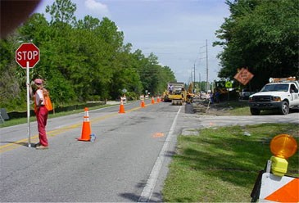
Road issues
New or unmapped roads
Roads currently undergoing construction
Third party instructions
or directions
Altered roads

Slide 10
Malfunctions
In the event of a malfunction or bug in the software what occurs?
Alert user and give them control over the vehicle
-Or-
If possible, exit from the road and wait until it is safe to resume operation, or seek repairs

Slide 11
Conclusion
For the most part, autonomous vehicles have proven to be very successful in recent testing
For driverless cars to be successful, consumers will need to feel safe when putting their lives in the hands of these autonomous systems
Before being ready for mass production and consumer release, these issues will have to be solved:
Secure from hackers and malicious intent
Precise driving in bad weather conditions
Need to be able to work around road construction easily
Need the capability of taking directions from a third party

Slide 12
Sources
RITA U.S. Department of Transportation. (2011). RITA white paper on the communications security for V2V systems [White paper]. Retrieved from http://ntl.bts.gov/lib/43000/43500/43513/FHWA-JPO-11-130_FINAL_Comm_Security_Approach_11_07_11.pdf
3 challenges faced by google's autonomous vehicles. (2013, March 4). Retrieved from http://www.govtech.com/transportation/3-Challenges-Face-by-Googles-Autonomous-Vehicles.html
Pau, G. (2013). Quickly home please: How connected vehicles are revolutionizing road transportation.IEEE Internet Computing, 17(1), 80-83. doi: 10.1109/MIC.2013.13
Frey, T. (2012). Driverless highways: Creating cars that talk to the roads. Journal of Environmental Health, 75(5), 37-40.
Cunningham, R., & Cahill, V. (2000). In Marc Shapiro (Chair). System support for smart cars: Requirements and research directions. Presented at the Acm sigops european workshop, New York. 159-164

Slide 13
Autonomous vehicles: Technical issues
Alan Reichner, Steven Jenzen

