Slide 1
Mobile First Person Shooter
By
Jonathan Coole Alexander Mena Michael Chisolm
Raymond Cload Zachary Duckett Seiji Uchiyama

Slide 2
Software being produced
A first-person shooter style game for the iPad and iPad mini platforms.
Game will allow a user to host or join a game session, and each game session can have different modes.
Game will be based on the Unreal Engine.

Slide 3
Different Users
Hosting user: A hosting user can pick the rules of the game he is hosting. These rules are as follows: (Round time, Number of rounds, Round score limit, Game mode).
Joining player: This user joins a game hosted by a hosting player and plays with the rules set by the hosting player.

Slide 4
Game Modes
Team play: In this mode of operation players are put into teams play against the opposite team.
Free for all: In this mode all users fight against one another.

Slide 5
Assumptions we made
The software will be operating on an iPad and/or iPad mini
The processor will be a 1GHz Apple A4 on the iPad and iPad Mini
The amount of memory assumed is anywhere from 256 MB to 1024 MB depending on the model version
The software may interface with a router using one of the 802.1x standards.

Slide 6
Stakeholders
The customer is a stakeholder because they will be the one purchasing and using the software.
The developers are a stakeholder because they are directly concerned with the development of the software.
The TA is also a stakeholder because he is the client.

Slide 7
Use Case Diagram

Slide 8
Use Case Descriptions
User host game: User host a game and has the ability to set game rules such as round time, point limit, number of rounds, and which map to play on.
Select Round Time: Select the amount of time in a round
Select Point limit: Select the amount of points necessary for a win before time runs out
Select number of rounds: select the number of rounds per game

Slide 9
Use Case Descriptions continued
Select Map: Select which map the user wants to play on
User joins game: User can join a game hosted by another user.
User plays game: User can open ingame menu during play and exit game.
Open ingame menu: Opens up a menu while in game with different options
Exit Game: Takes the user out of the game

Slide 10
Physical Environment Requirements
The application should be able to run on an iPad and iPad mini device
The development environment should have a minimum specification of:
Windows XP SP3
2GHz or better CPU
2+ GB of RAM
A graphics card with Shader Model 3.0 support

Slide 11
Physical Environment Requirements continued
The software will support larger text sizes for the visually impaired
The software will prevent unauthorized access to game servers and sessions
The software will ensure that the users are using the same data as the host
The software will have a tutorial mode to explain the rules for each game type

Slide 12
Data Requirements &Security Requirements
The software shall track the score and other various statistics of each of the players
The software shall ensure a fair and competitive gameplay experience

Slide 13
Resource Requirements & Quality Assurance Requirements
There are little to no physical resource requirements for the software after development, all hosting will be done on the device running the game.
Unreal Development Kit
The software shall strive for a high level of uptime

Slide 14
Design Issues
Reusability
Maintainability
Prototypes
Testability
Performance
Difficulties

Slide 15
Reusability & Maintainability
This software can be renewed through expansions or addition of content like new weapons, and maps to make the system more reusable.
Patches and updates can be implemented thought the app store in iOS devices.

Slide 16
Prototypes
We will go through various prototype stages. The initial prototype will run on windows and will implement the basic functionality of the game. Second a prototype to test the multiplayer functionality running on windows. Third and final prototype will run on iOS to test the controls and multiplayer functionality on iOS. This will let us find strategies on to how to implement the controls on iOS devices

Slide 17
Testability, Performance, & Difficulties
The game will be tested through different stages from the prototype stage all the way to the beta stage of the game then testing will be done in platform (iOS) for final testing.
The game is expected to perform at 30FPS.
We expect difficulties with the design of the control scheme on iOS devices.

Slide 18
Tests to run on our game
Connectivity Testing
Collision Detection testing
Stage limit testing

Slide 19
Connectivity Testing
Test Description: Testing the amount of users that can play in one session at a time.
Test Conditions: Testing will be done in an IOS environment.
Expected Results: Smooth play with minimum delay.

Slide 20
Collision Detection testing
Test Description: Check character and object collision detection to check for character/object, character/character overlapping when in close proximity of one another.
Test Conditions: Initial testing will be done In engine, Secondary in a windows environment, and final testing will be done in an iOS environment.
Expected Results: Smooth navigation of the stages between users and users and users and objects.

Slide 21
Stage limit testing
Test Description: Check that areas of the stage that are off limits are not accessible by users during play.
Test Conditions: Initial testing will be done In engine, Secondary in a windows environment, and final testing will be done in an iOS environment.
Expected Results: Clear defined boundaries in the stages.

Slide 22
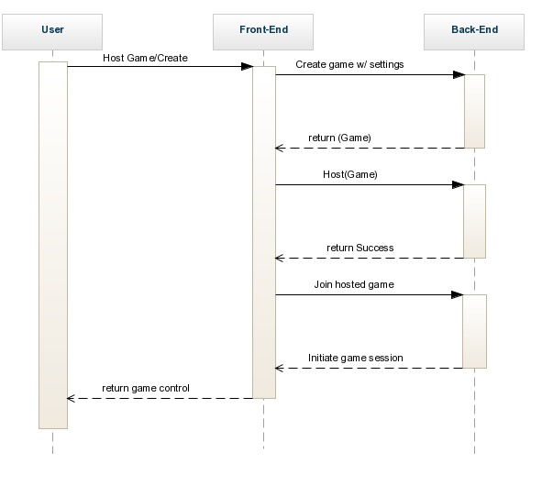
Sequence Diagram
Game creation/hosting:

Slide 23
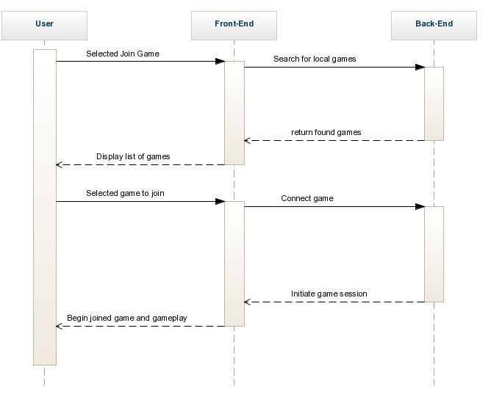
Sequence Diagram
Joining game:

Slide 24
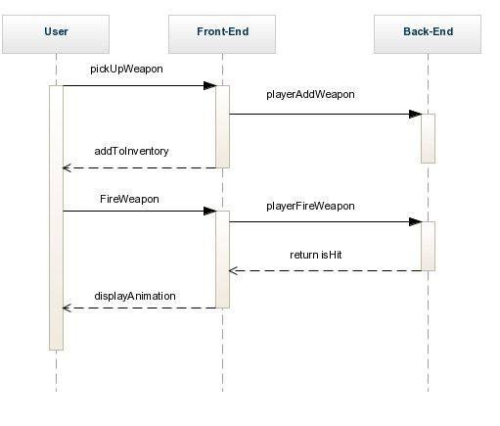
Sequence Diagram
Playing the game

Slide 25
Class Diagram

