Slide 1
Fast Pass Parking
Team Members: Alex Gordon, Kyle Mera, Pedro Poveda, Darin Doria, Ivan Lugo, Jason Braswell

Slide 2
Project Description
Goals:
Make parking easy and hassle free.
Search for nearby parking lots/garages.
Let you buy a parking pass from your phone.
Let you easily add time to your parking pass.

Slide 3
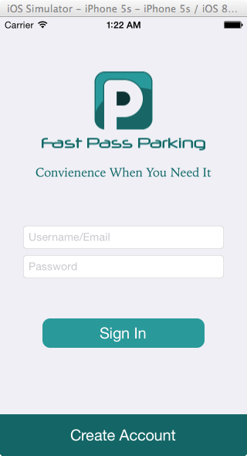
Operational Description(Use Case)
User opens app and hits create account:

Slide 4
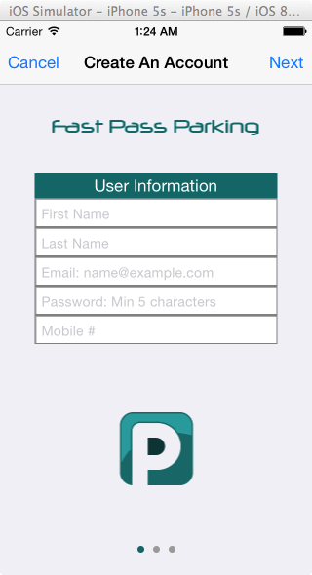
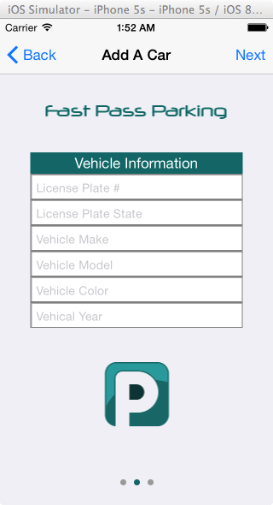
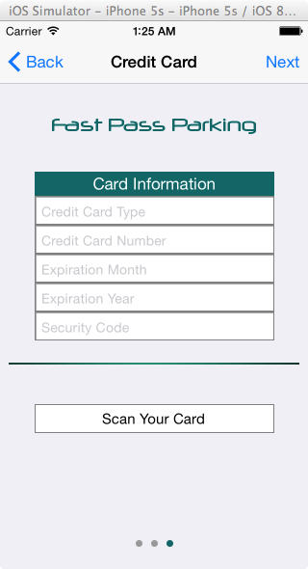
Operational Description(Use Case)
Fills in their personal and vehicle information:

Slide 5
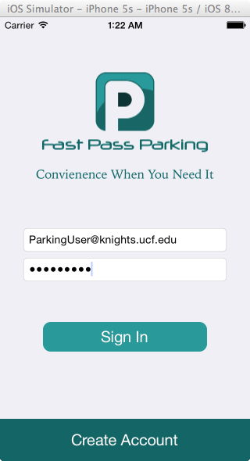
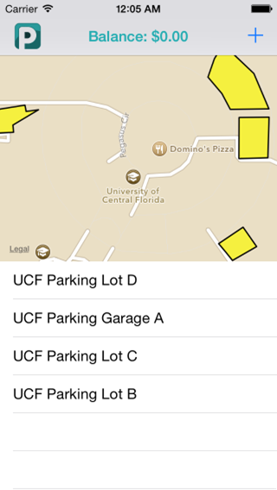
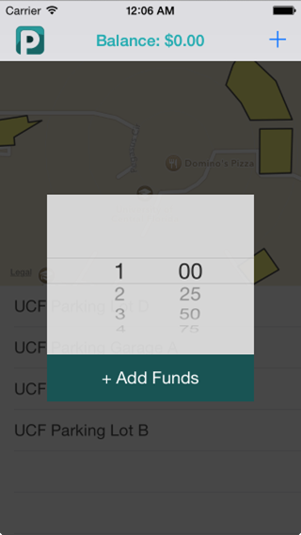
Operational Description(Use Case)
User logs in & adds to balance by hitting +

Slide 6
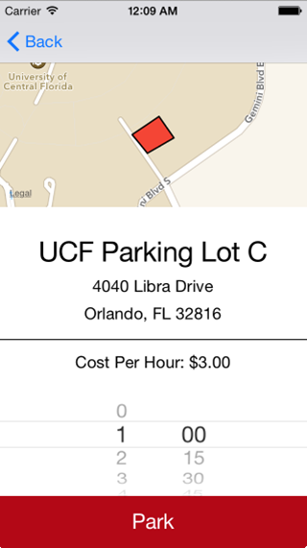
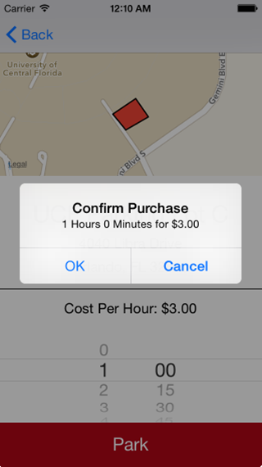
Operational Description(Use Case)
User selects lot & purchases a parking pass

Slide 7
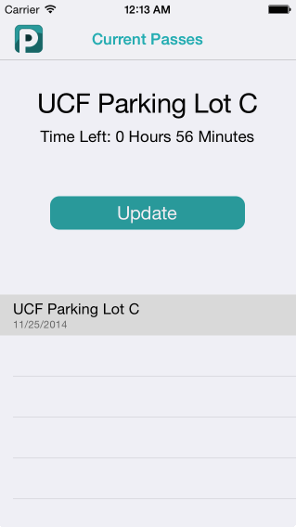
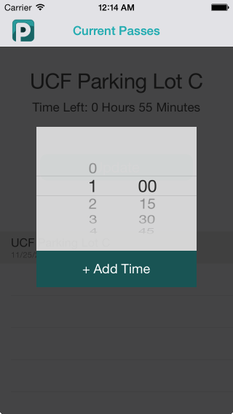
Operational Description(Use Case)
User adds time to their parking pass

Slide 8
Technical Description
When a user creates an account through the app, it adds a user object to the noSQL database as a mongoDB document.
When a user tries to log in, the server validates the password and returns an error or confirmation to the app which is reflected on screen.

Slide 9
Technical Description
Parking lots’ geo-locations are also pulled from the database and utilize the Apple Maps api to represent them on screen.
When a user purchases a parking pass, the lot, time, and user object is linked to it.
When adding time to a parking pass, the new “end time” of the parking pass is updated in the database.

Slide 10
Issues during Development
All members did not have iOS devices.
Members had no experience with noSQL databases.
Members had no experience with server management.
Requirements changed during development during meetings with team members.

Slide 11
Deliverable Progress
Completed:
User can create and login to account.
Map shows nearby parking lots/garages.
Functional parking pass system.
Enterprise app allows attendant to see if a license plate is valid.
Stretch Goals:
Notification system.
Integration with a payment system such as paypal.

