Slide 1
Knight’s Guard
Group #1
Megan Postava, Katie Jurek, David Moore
Jon Bennett, Miguel Corona, Will Adkins

Slide 2
Basic description
Knight’s Guard is a tower defense game for PC and mobile (Android) platforms. It features:
Fast, fun gameplay
A UCF theme
An online scoreboard

Slide 3
Concept of Operations
System Needs
UCF Map
Varied Tower Types
Portability
Operational features
Musts
Run on Windows
Have towers, a base, and enemies
Multiple waves of enemies
Wants
Online scoreboard
Run on Android platform
Technologies using to develop the game
GameMaker, Google Docs, Github, Trello, and more...

Slide 4
Software Requirements Specification
Assumptions
That the game will be able to run on a normally configured Windows PC or Android Device
The users will have a basic understanding of how Tower Defense games are played
Stakeholders
Client - Professor/TA
Software Engineers - Group Members
Users - People playing the game. All the above.

Slide 5
Software Requirements Specification
Event Table
Event Name | External Stimuli | External Responses | Internal data and state
Start Game | User clicks “Start Game” | Game Starts | Initiate game
Place Tower | User places tower on the map by clicking. | Place a tower on the user specified location | Create specified tower
Upgrade tower | User clicks on a tower placed on the map | Display possible upgrades and cost(s) | Wait for user to choose an upgrade, determine if user can upgrade
Spawn Enemy | Start of new level/more enemies left to spawn | New enemy created | New enemy created and stored with current enemies
Sync Score(s) | User clicks “Syn score with leaderboard.” | Display score synced successfully/unsuccessfully | Score either saved to web server or no change.

Slide 6
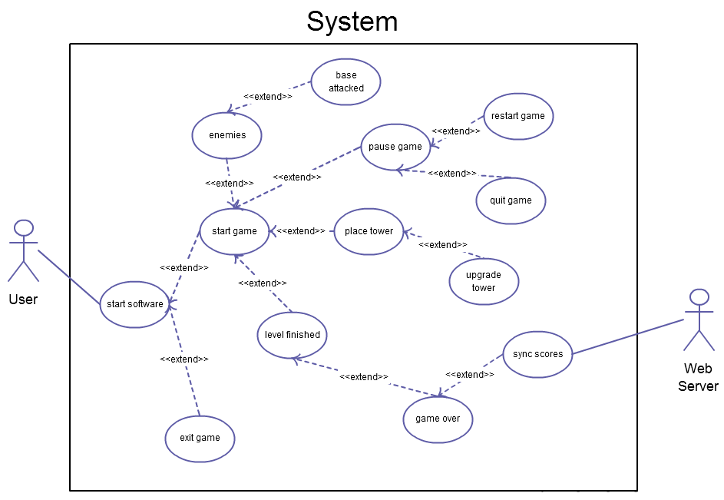
Software Requirements Specification
Use Case Diagram

Slide 7
Software Requirements Specification
Specific Requirements
Functional
Must allow the spawning of units
Must allow the placing of towers
Must allow the users base to take damage
Interface
Must allow the user to interact with the user interface
Must allow the user to start, pause, restart, and quit game
User and Human Factors
Must provide the casual player an enjoyable experience
Must be easy to learn to use/play

Slide 8
Software Requirements Specification
Specific Requirements (continued)
Documentation
Must provide a user manual for installation and how-to play instructions
Data
Must keep track of the number of enemy units spawned
Must keep track of the number of levels completed successfully
Resource
Must have experienced coders
Must have basic knowledge of GameMaker at a minimum

Slide 9
Software Requirements Specification
Specific Requirements (continued)
Security
Must prevent unauthorized change of scores
Quality Assurance
Must be easy to navigate (according to play-testers)
Must play smoothly (avg. 60 frames per second), no hiccups
Must meet the client’s expectations

Slide 10
Test Plan
Overall objective of testing
Verify game’s stability and ability to run on Windows 7
Test Environment
The test environment is GameMaker: Studio on the developers’ side and Windows 7 on the player’s side, and the testers include the developers as well as volunteers
Stopping Criteria
If we run into a problem, we immediately try to fix it, as opposed to leaving it in and trying to fix it later when we are trying to program other features

Slide 11
Test Plan
Example Test Cases:
Adding Towers to Map
Starting Next Wave
Spawning Enemies
Enemies Move Toward Player’s Buildings
Spawning Tower Projectiles
Destroy projectiles if off screen
Damage enemies upon contact
Winning/Losing
Syncing Leaderboard

Slide 12
Test Case: Starting Next Wave
Test Objective:
When the player presses Enter and the amount of enemies currently on the map is 0, then the next wave (or round) of enemies begins. Each round is divided into a number of waves.
Test Description:
There will be a variable that counts the number of enemies still on the map.
The tester shall verify that this number is accurate, given the number of enemies on the screen.
If this number is not 0, then pressing Enter will do nothing.
Test Conditions:
See Test Environment; Windows 7 and a keyboard.
Expected Results:
The game correctly moves to the next round.

Slide 13
Test Case: Spawning Tower Projectiles
Test Objective:
The player’s towers shoot projectiles when enemies come within 300 pixels.
Test Description:
Each tower the player has placed will shoot projectiles at the enemies. These projectiles will increase in strength based on the type of tower that was built.
There will be a set interval between the tower shooting projectiles where it does not shoot another projectile.
The tester shall verify that this interval is correct for every tower type, as detailed in the design documents.
Test Conditions:
See Test Environment; Windows 7 and a keyboard.
Expected Results:
Each tower, when an enemy comes within its attack range, will shoot projectiles as defense.

Slide 14
Test Case: Winning
Test Objective:
The player wins the game.
Test Description:
If the round is above 8 (school semesters in uni) and the player has not yet lost, then there are no more rounds or waves left and the player has won; a winning message will be displayed.
The tester shall verify that the correct winning message is displayed after they finish the level.
Test Conditions:
See Test Environment; Windows 7 and a keyboard.
Expected Results:
The player wins the game and can exit after syncing leaderboard.

Slide 15
Project Management Plan
Team Organization:
No set roles, but we utilize our expertise
Configuration Management:
Code version control -> Github
Bug & task tracking -> Trello
Tools & Computing:
The entire team is using Windows PCs
GameMaker Studio
The GameMaker language is like a mix of C and Python
Github for Windows
Google Docs

Slide 16
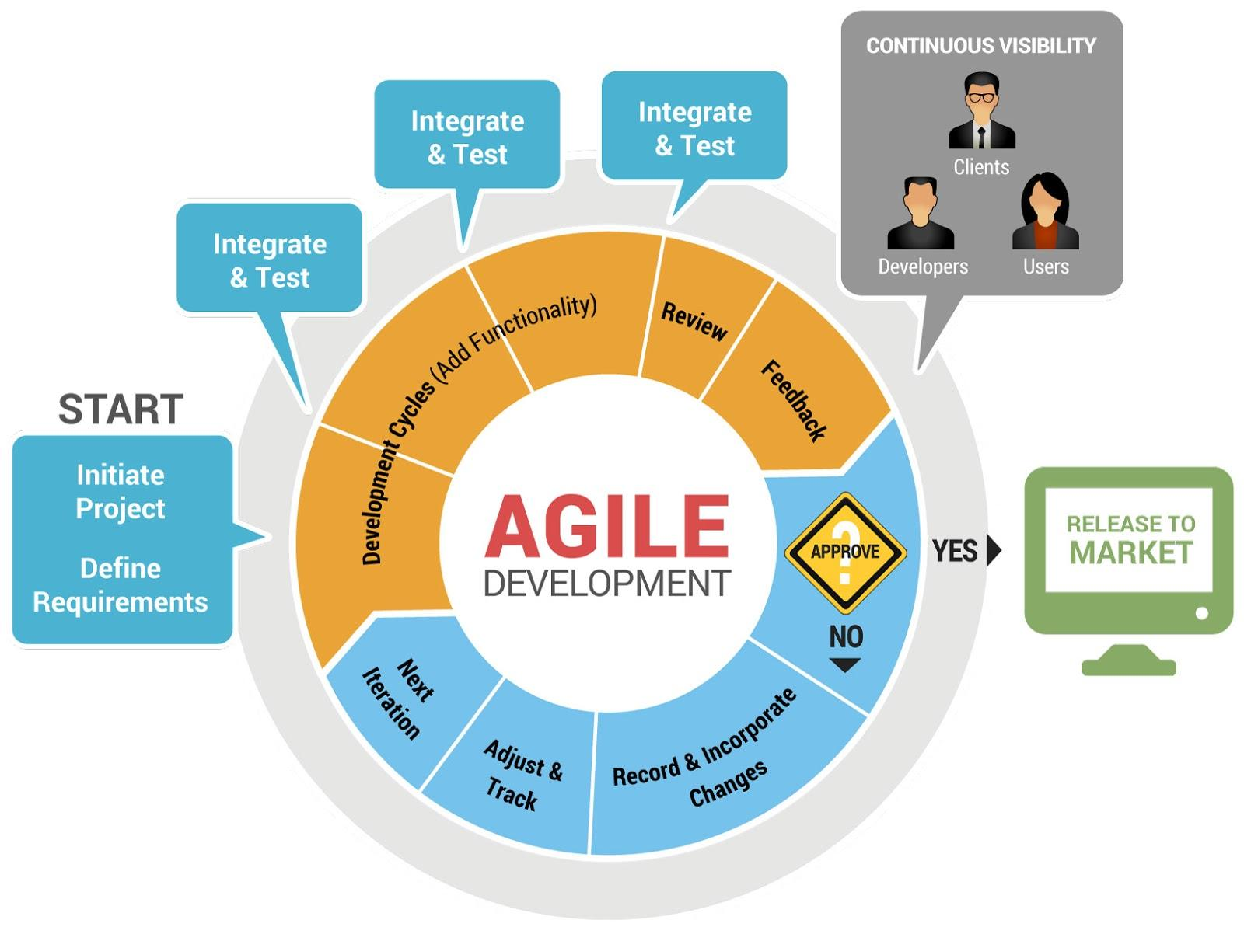
Software Life Cycle Process

Slide 17
Project Management Plan
Quality Assurance:
Frequent prototypes, frequent testing
Prioritizing fixing bugs over adding new features
Risk Management:
Communicate about our personal schedules to avoid delays
Play-test our game mechanics to make sure it’s fun
Use Internet services to help prevent data loss (Github, Google Docs)
Technical Progress Metrics:
Progress is determined by new prototypes and features
Tracking & Reporting:
Weekly face-to-face meeting
Trello for bug & task tracking
Individual activity logs

Slide 18
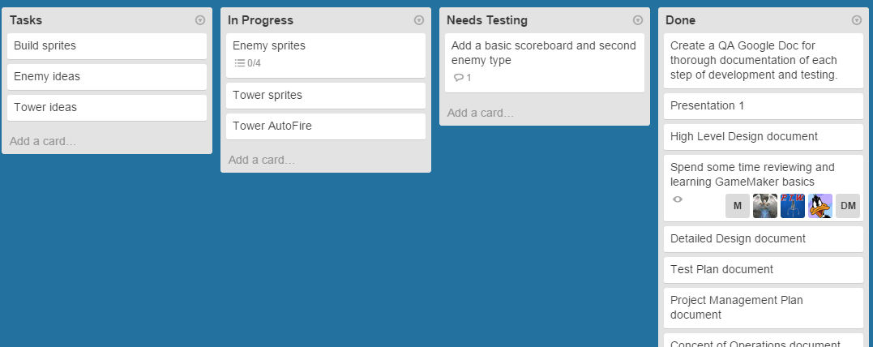
Project Management Plan

Slide 19
High Level Design
High Level Architecture
Major Components
Desktop/mobile client
Web server
Sync scores
Interfaces
The title screen
The game screen (this is the primary interface)
The game stats screen (between levels)
The scoreboard screen

Slide 20
High Level & Detailed Design
Design Issues
Reusability
Towers creation function used to create all tower types
Maintainability
Objects allow for changes to be made to specific components quickly
Testability
Since the components are separated into objects, each object can be tested thoroughly independent of other objects
Play-testing is used for interaction between objects and mechanics

Slide 21
High Level & Detailed Design
Design Issues (continued)
Performance
Target to get 60 frames per second
Sync scores under 5 seconds
Portability
GameMaker is designed to work on multiple operating systems
Technical Risks
General
Group member availability could change
Specific
Scoreboard API could change or have downtime

Slide 22
High Level & Detailed Design
Design Issues (continued)
Technical Difficulties
Time for artwork
Most of team unfamiliar with GameMaker
Learning how to implement the scoreboard
Consistent level difficulty
Enemy pathing
Safety
Syncing of scores, preventing fakes

Slide 23
Detailed Design
Prototypes
#1
Get the basic mechanics working.
Basic 1-color map
One location where enemies spawn
One enemy type
One base enemies move to (using A* path-finding)
Place towers anywhere on map
Towers automatically shoot at the nearest enemy
#2
Specific tower points
Multiple enemy types
Multiple enemy spawn locations
UI elements added

Slide 24
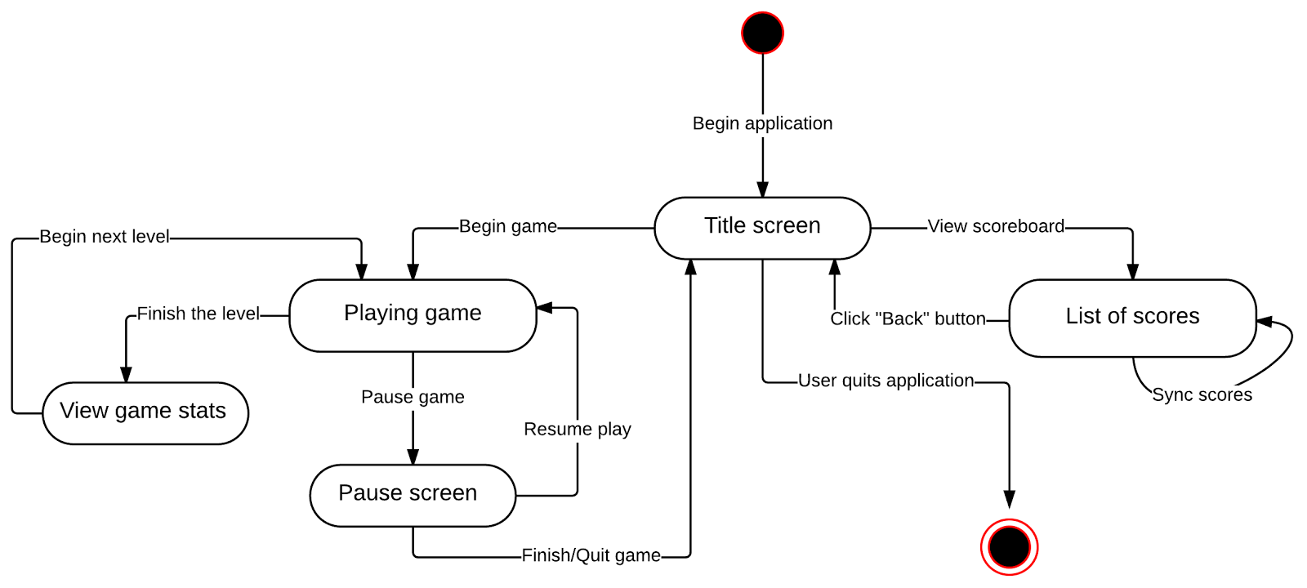
State Diagram

Slide 25
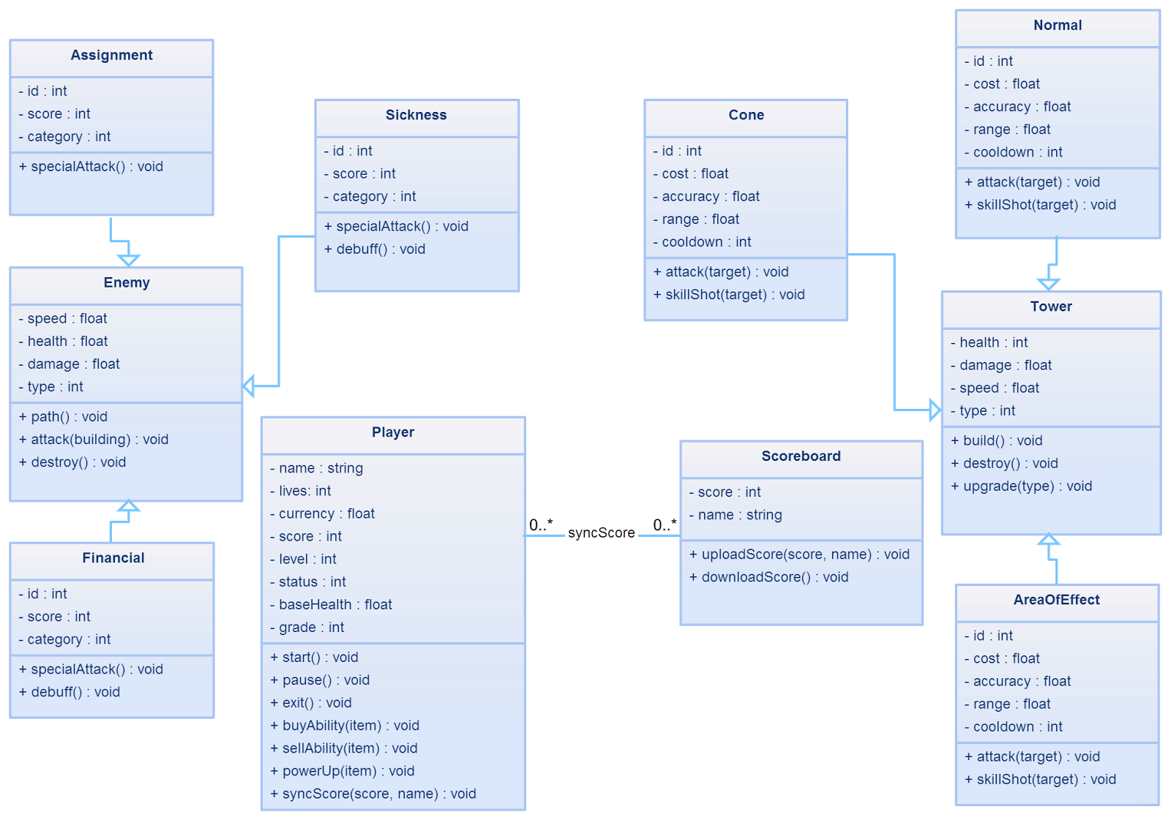
Class Diagram

Slide 26
Detailed Design
Trace of Requirements
Requirement From SRS | Implementation location
The system shall allow the user to place towers. | If the user has an available tower to place, they may place it by clicking on “mount points”, or points where they are allowed to have towers.
The system shall allow the user the option to quit the current game. | If the user presses the Escape key, they will back out to a menu. If they press it again, the game will be exited
Development of the system shall take place in an environment capable of coordinating with a git repository. | GameMaker: Studio is compatible with using a git repository. The “GitHub for Windows” software is primarily used.
The system shall keep track of the number of units spawned. | There will be a numEnemies variable that keeps track of how many enemies have been spawned and are currently alive on the screen.

Slide 27
Demonstration
Demo of prototype #2

Slide 28
Questions & Comments?
☺

