Slide 1

Luke Thomas

Slide 2
Outline
Introduction
History
Philosophy
Features
Syntax
Interactive
Everything’s an object
Flexibility
Methods
Classes
String Arithmetic
Flow Control
Who Uses Ruby?
Installation
Conclusion

Slide 3
Introduction to Ruby
Ruby is a dynamic, open source programming language with a focus on simplicity and productivity. It has an elegant syntax that is natural to read and easy to write.
Totally Free: free to use, copy, modify, and distribute.
Developed mostly for GNU/Linux, but works on many operating systems including UNIX, Mac OS X, Windows, DOS, etc.

Slide 4
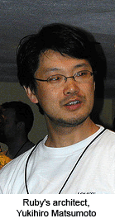
History I
Created in Japan by Yukihiro “Matz” Matsumoto.
He was looking for a scripting language more powerful than Perl, and more object oriented than Python.
Blended parts from his favorite languages (Perl, Smalltalk, Eiffel, Ada, and Lisp)
Timeline
  February 1993: Work started on Ruby
  December 21, 1995: Ruby .95
  December 25, 1995: Ruby 1.o
  January 30, 2009: Ruby 1.9.1 (Latest stable release)

Slide 5
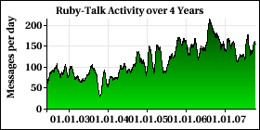
History II
Ruby was written (and can be extended) in C.
“Matz” worked on Ruby alone until 1996. A user community now contributes fixes and patches. However, much of the work is still done by “Matz”.
Name: Birthstone for June = Pearl, July = Ruby.
The user base in Japan is much larger than in the U.S., but popularity has been growing steadily.
Ruby-Talk Mailing List
Messages Per Day
2003 - 2007

Slide 6
Philosophy
Principle of Least Surprise
  The language should behave in such a way as to minimize confusion for experienced users.
  Matsumoto tried to distance Ruby from the term because he designed it so it would be least surprising to him.
  He said after two years of exclusive C++ programming, it still surprised him.
  Really, he designed a language that he wanted to use, other people just happened to like it too.

Slide 7
Features
Dynamic Typing
Garbage Collection
OS Independent Threading
Highly Portable
Operator Overloading
Exception Handling
Mix-ins
Multiple programming paradigms
  Procedural, Object Oriented, Functional
Iterators and Closures
Large Standard Library
Continuation and Generators

Slide 8
Syntax
Class and Method declarations are signaled by keywords.
Line breaks signify the end of a statement. Semicolons can also be used.
Sigils can be used to change the scope of a variable.
  Local Variable - var
  Global Variable - $var
  Instance Variable - @var
Blocks typically ended with keyword “end”. Braces can also be used.

Slide 9
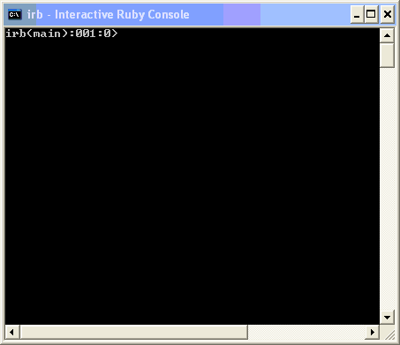
Interactive
Ruby includes an interactive console called irb.
You can immediately see the results of any Ruby statements you feed it.
Playing around with irb is a good way to learn the language.

Slide 10
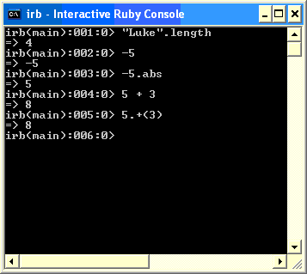
Everything’s an object
In Ruby, everything is an object, even primitives.

Slide 11
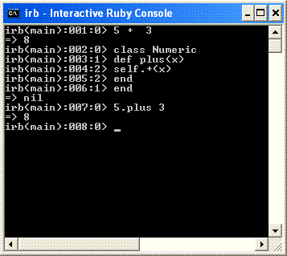
Flexibility
Ruby allows you to alter its parts.

Slide 12
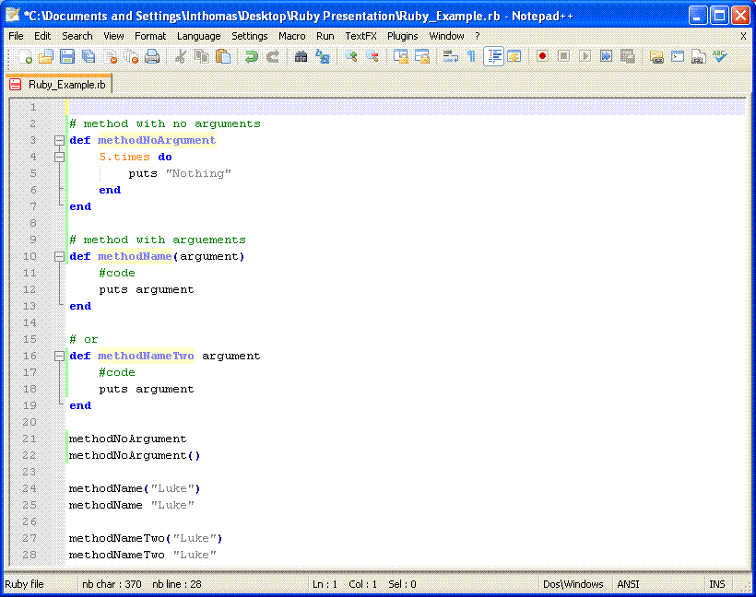
Methods
Start with “def” keyword, end with “end” or semicolon.
Methods can be called with or without parenthesis.

Slide 13
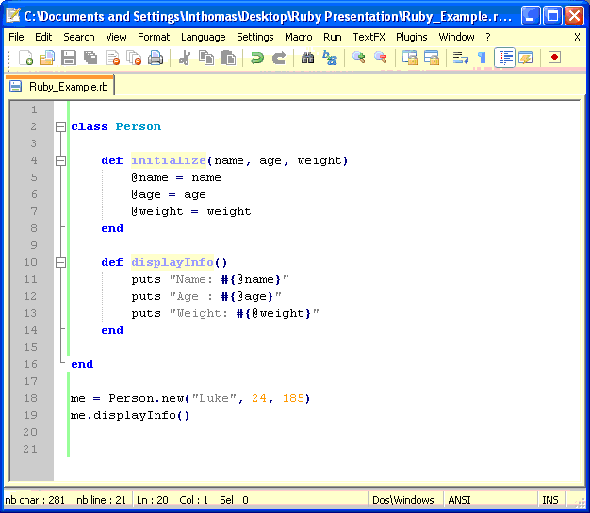
Classes
Notice the ‘@’ symbol signifying instance membership.

Slide 14
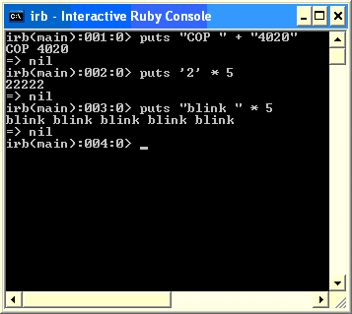
String Arithmetic
Strings can be added and multiplied.

Slide 15
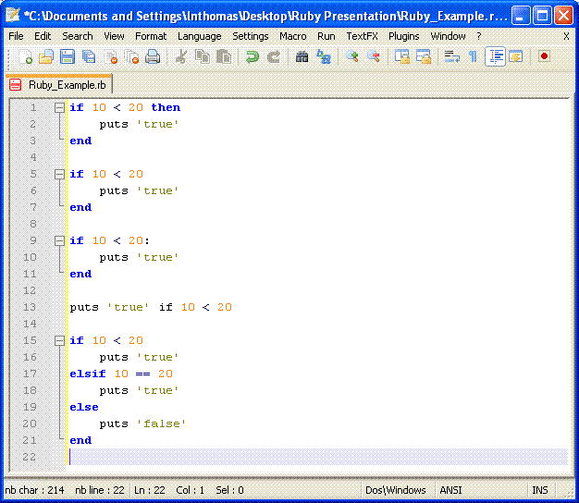
Flow Control
IF – THEN
IF – ELSE
IF – ELSIF

Slide 16



Who uses Ruby?
Simulation
  NASA
  Motorola
3D Modeling
  Google SketchUp
Web Development (Ruby on Rails)
  Twitter
  Yellow Pages
  + more

Slide 17
Installation
www.ruby-lang.org/en/downloads
You can:
Use installer for Windows
Compile source yourself
Use package manager for Linux
Ruby in Twenty Minutes
www.ruby-lang.org/en/documentation/quickstart/

Slide 18
Conclusion
Ruby is another good choice for scripting languages.
It has value as a “job skill”, so it is worth learning.
There are many other features and much more depth to Ruby that this presentation was not able to cover.
Thank you for listening.

Slide 19
Luke Thomas

