Slide 1
Compile Driver
COP 3402 System Software
Summer 2014

Slide 2
What is a compile driver?
Is a program that coordinates the execution of different compiler tools (parser, code generator, linker) in order to go from source code to machine code in one step.
A compile driver receives directives and gives them to the corresponding program.
gcc is a compile driver.

Slide 3
How to implement a compile driver?
You can program your own compile driver, that takes and passes directives to another programs.
You can take other tools (like make) and use them to work as compile drivers (not covered here).
In any case, you need to implement programs that understand console directives.

Slide 4
How to read directives in C?
The function main() can be defined in two ways:
int main(), or
int main(int argc, char **argv)
The second way allow us to read directives (also called command line arguments).
main() can also be defined as:
int main(int argc, char *argv[])

Slide 5
argc and argv
argc – (argument counter) is the number of directives.
argv – (argument values) is an array of directives. To use the first directive, you simple write argv[0].
There is always at least one directive. Usually this is the program name.

Slide 6
Simple Example
#include <stdio.h>
int main(int argc, char **argv) {
int i;
for(i = 0; i < argc; i++){
printf(“Directive %d: %s\n”, i, argv[i]);
}
}

Slide 7
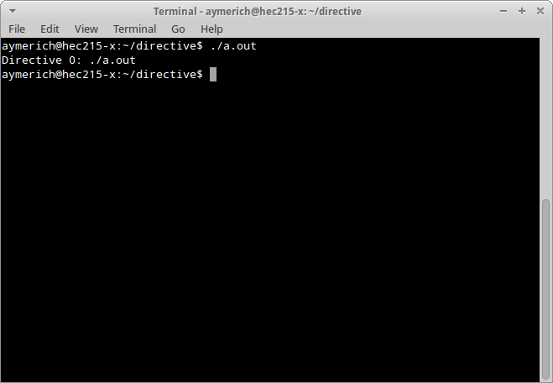
Simple Example

Slide 8
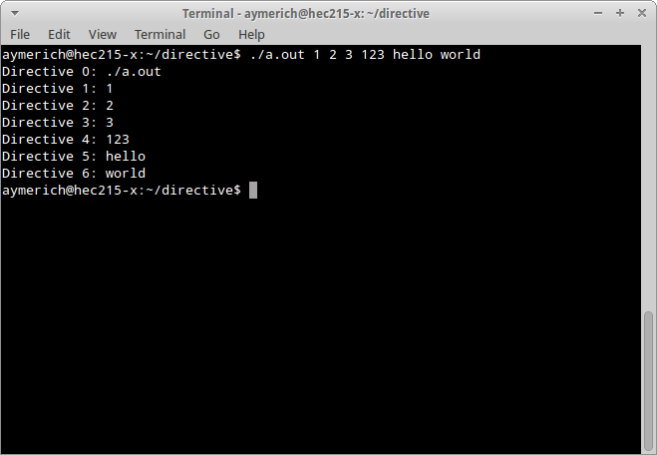
Simple Example

Slide 9
How to parse the directives?
The best way to handle directives inside a program is to parse them at the beginning.
By parse, we mean two things:
Check if the directives are valid to my program.
Set some global variables according to such directives.
It is better if we handle this in a function outside of main.

Slide 10
Example 2
We want a “Hello World” program than accepts one directive ‘-v’.
If it gets –v, then it prints Hello Word.
If not, then it does nothing.

Slide 11
Wrong way
#include <stdio.h>
#include <string.h>
int main(int argc, char **argv) {
if( strcmp( argv[1], “-v” ) == 0){
printf(“Hello World!\n”);
}
}

Slide 12
Wrong way

Slide 13
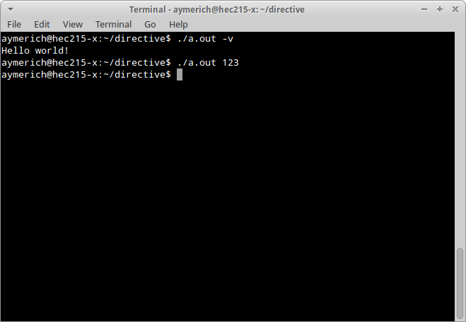
Wrong way

Slide 14
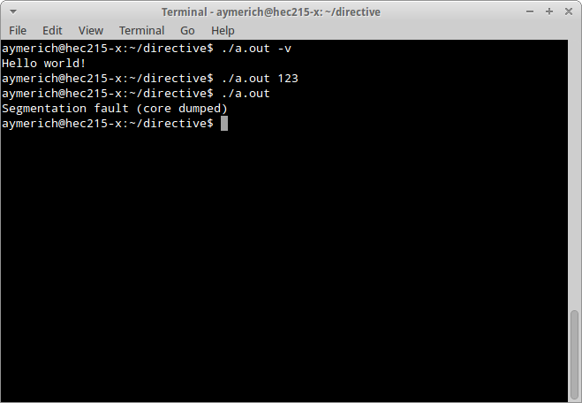
Wrong way

Slide 15
Problems in Wrong way
Fails if no directives are given.
Don’t check all directives.
Directives must be in a specific order to work.

Slide 16
Example 2
#include <stdio.h>
#include <string.h>
#define NO_PRINT 0
#define PRINT 1
int VERBOSE = NO_PRINT; // Set to default behavior.
void parseDirectives(int argc, char** argv){
for(int i = 1; i < argc; i++){
if (strcmp( argv[i], “-v” ) == 0){
VERBOSE = PRINT;
}else{
printf(“Bad directive: %s\n”, argv[i]);
exit(-1); // Optional, depends on desired behavior.
}
}
}
int main(int argc, char **argv) {
parseDirectives(argc, argv);
if( VERBOSE == PRINT ){printf(“Hello World!\n”);}
}

Slide 17
Execute programs from within C
We use the function “system()”:
int system(const char *command);
It receives a string with the command (or program) we want to execute.
It return -1 on error, or the exit status of the command.
It is system dependant: system(“pause”) works on Windows, but it doesn’t on Linux.

Slide 18
Another simple example
We want to call two programs (‘a’ and ‘b’) from program ‘z’.
Ok, too simple. What if we want to stop if ‘a’ gives an error?
#include <stdlib.h>
int main(int argc, char **argv) {
system(“a”);
system(“b”);
}

Slide 19
Simple Example
#include <stdlib.h>
int main(int argc, char **argv) {
int ret = system(“a”);
if (ret < 0 || WEXITSTATUS(ret) != EXIT_SUCCESS){
// Opps, something failed. Better stop.
exit(EXIT_FAILURE);
}
// Everything is OK. Keep going
ret = system(“b”);
...
exit(EXIT_SUCCESS);
}
This is the standard way for a program to say “I didn’t finish my work correctly.”

Slide 20
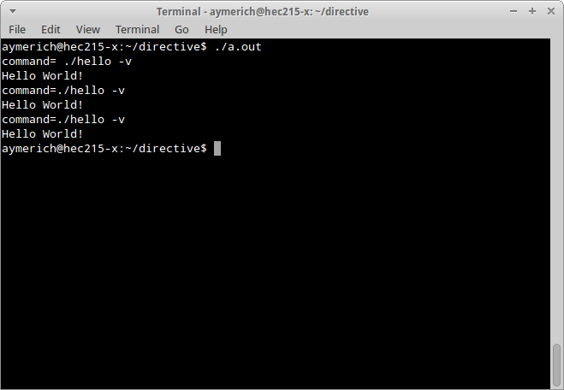
Simple Example

Slide 21
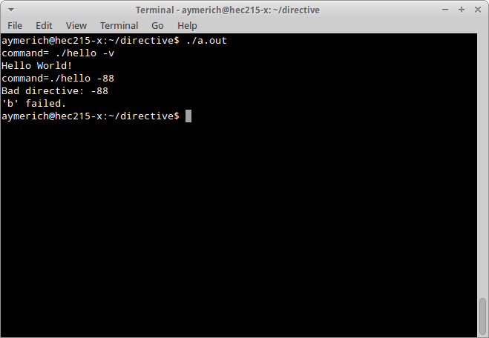
Simple Example

Slide 22
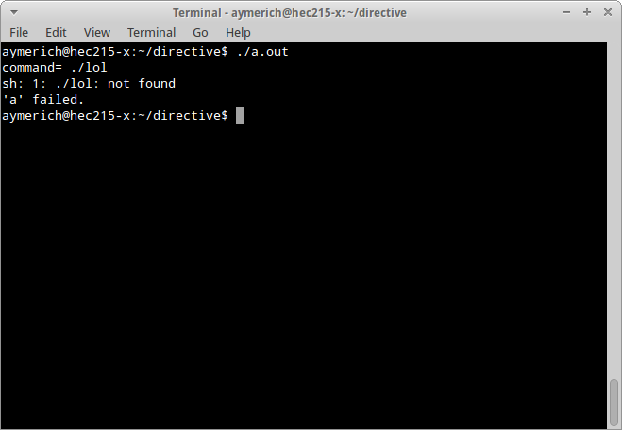
Simple Example

Slide 23
Add directives to commands
Let’s say that our compile driver gets some directive, and we want to “pass on” that directive to another program.
We should have a string with the program we want to execute (“hello”), and then add the directive to such string. This is called a command (program name + directives).

Slide 24
Add directives
#include <stdlib.h>
#include <stdio.h>
#include <string.h>
char cmd[100];
char tmp[100];
void initCommands(){
sprintf(cmd,"./hello");
}
void parseDirectives(int argc, char** argv){
for(i = 1; i < argc; i++){
if (strcmp( argv[i], "-v" ) == 0){
sprintf(tmp,"%s %s",cmd,"-v");
strcpy(cmd,tmp);
}else{
printf("Bad directive: %s\n", argv[i]);
exit(EXIT_FAILURE);
}
}
}
int main(int argc, char **argv) {
initCommands();
parseDirectives(argc,argv);
int ret = system(cmd);
if (ret < 0 || WEXITSTATUS(ret) != EXIT_SUCCESS){
printf("'a' failed.\n");
exit(EXIT_FAILURE);
}
}

Slide 25
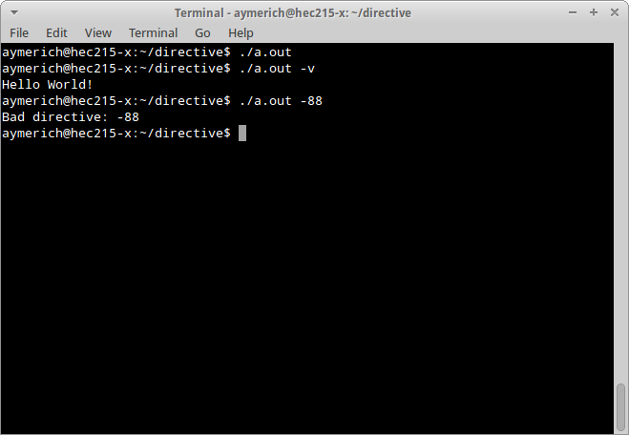
Add directives

