Slide 1
Compilation Process
COP 3402
(Summer 2014)

Slide 2
Compilation process
Break the command "gcc -o hello hello.c ..."
into preprocessing, compilation, assembly, and linking.
Input → Program → Output
Source code → Preprocessor → Expanded source
Expanded code → Compiler → Assembly source
Assembly source → Assembler → Object code
Object code → Linker → Executable code
Executable code → Loader → Execution

Slide 3
Compilation process
Two programs: A simple program that adds two number (no including any library), and “Hello world” with i/o library included.
Example1: Source program
int test_fun(int x){
return x + 17;
}
int main(void){
int x = 1;
int y;
y = test_fun(x);
return 0;
}
Example2: Source program
#include <stdio.h>
int main (void){
printf ("Hello, world!\n");
return 0;
}

Slide 4
Compilation process
Step 1 (Preprocessing): cpp hello.c hello.i
Step 2 (Compilation): gcc -S hello.i -o hello.s
Step 3 (Assembly): as hello.s -o hello.o
The file contains the machine code for program hello
Step 4 (Linking): gcc hello.o (for linking) and produces a.out
Step 5 (Execution): ./a.out (to load and execute)
Hello, world!

Slide 5
Compilation process
Step 1 - Preprocessor: cpp simple.c simple.i
simple.c simple.i
int test_func(int x){
return x + 17;
}
int main(void){
int x = 1;
int y;
y = test_func(x);
return 0;
}
# 1 "simple.c"
# 1 "<built-in>"
# 1 "<command-line>"
# 1 "simple.c"
int test_func(int x){
return x + 17;
}
int main(void){
int x = 1;
int y;
y = test_func(x);
return 0;
}

Slide 6
Compilation process
Step 2 - Compiler: gcc -S simple.i –o simple.s
simple.s
.file "simple.c"
.text
.globl test_func
.type test_func, @function
test_func:
.LFB0:
.cfi_startproc
pushl %ebp
.cfi_def_cfa_offset 8
.cfi_offset 5, -8
movl %esp, %ebp
.cfi_def_cfa_register 5
movl 8(%ebp), %eax
addl $17, %eax
popl %ebp
.cfi_restore 5
.cfi_def_cfa 4, 4
ret
.cfi_endproc
.LFE0:
.size test_func, .-test_func
.globl main
.type main, @function
main:
.LFB1:
.cfi_startproc
pushl %ebp
.cfi_def_cfa_offset 8
.cfi_offset 5, -8
movl %esp, %ebp
.cfi_def_cfa_register 5
subl $20, %esp
movl $1, -8(%ebp)
movl -8(%ebp), %eax
movl %eax, (%esp)
call test_func
movl %eax, -4(%ebp)
movl $0, %eax
leave
.cfi_restore 5
.cfi_def_cfa 4, 4
ret
.cfi_endproc
.LFE1:
.size main, .-main
.ident "GCC: (Ubuntu/Linaro 4.7.3-2ubuntu1~12.04) 4.7.3"
.section .note.GNU-stack,"",@progbits

Slide 7
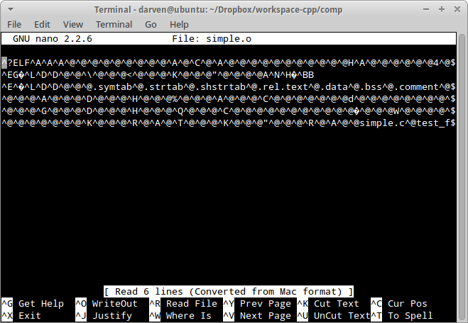
Compilation process
Step 3 - Assembler: as simple.s –o simple.o
simple.o

Slide 8
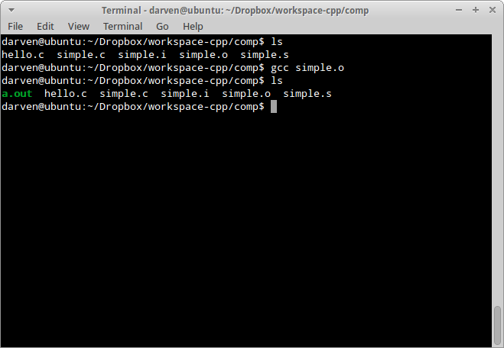
Compilation process
Step 4 - Linker: gcc simple.o
Note: gcc simple.o –o simple specifies the name of executable file.
a.out

Slide 9
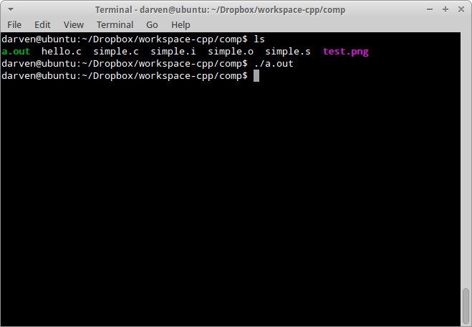
Compilation process
Step 5 – Load and execute: ./a.out
a.out

Slide 10
Compilation process
Step 1 - Preprocessor: cpp hello.c hello.i
hello.c hello.i
#include <stdio.h>
int main(void){
printf("Hello world!\n");
return 0;
}
# 1 "hello.c"
# 1 "<built-in>"
# 1 "<command-line>"
# 1 "hello.c"
# 1 "/usr/include/stdio.h" 1 3 4
. . .
typedef unsigned char __u_char;
typedef unsigned short int __u_short;
typedef unsigned int __u_int;
typedef unsigned long int __u_long;
. . .
typedef unsigned int _G_uint16_t __attribute__ ((__mode__ (__HI__)));
typedef unsigned int _G_uint32_t __attribute__ ((__mode__ (__SI__)));
. . .
# 940 "/usr/include/stdio.h" 3 4
# 2 "hello.c" 2
int main(void){
printf("Hello world!\n");
return 0;
}
This is trimmed to fit in the slide. The actual file is really long…

Slide 11
Compilation process
Step 2 - Compiler: gcc -S hello.i –o hello.s
hello.s
.file "hello.c"
.section .rodata
.LC0:
.string "Hello world!"
.text
.globl main
.type main, @function
main:
.LFB0:
.cfi_startproc
pushl %ebp
.cfi_def_cfa_offset 8
.cfi_offset 5, -8
movl %esp, %ebp
.cfi_def_cfa_register 5
andl $-16, %esp
subl $16, %esp
movl $.LC0, (%esp)
call puts
movl $0, %eax
leave
.cfi_restore 5
.cfi_def_cfa 4, 4
ret
.cfi_endproc
.LFE0:
.size main, .-main
.ident "GCC: (Ubuntu/Linaro 4.7.3-2ubuntu1~12.04) 4.7.3"
.section .note.GNU-stack,"",@progbits

Slide 12
Compilation process
Step 3 - Assembler: as hello.s –o hello.o
hello.o

Slide 13
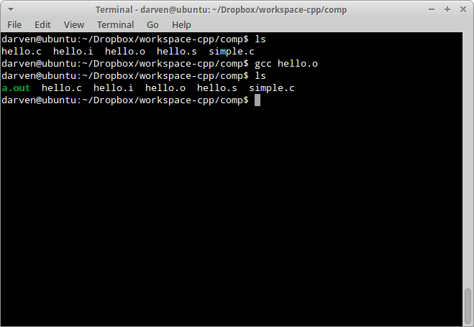
Compilation process
Step 4 - Linker: gcc hello.o
Note: gcc hello.o –o myname specifies the name of executable file.
a.out

Slide 14
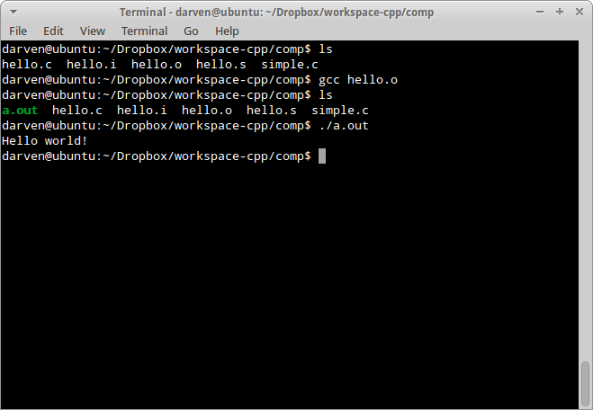
Compilation process
Step 5 – Load and execute: ./a.out
a.out

