Slide 1
Parser & Code Generation II
COP 3402 System Software
Summer 2013

Slide 2
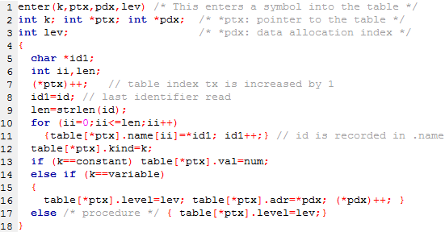
Enter Symbol
Notes:
You’ll know the kind, k, based on where you are in the parser when you call enter.
When procedures are called in your parser you’ll increment lev.
Num is a global variable like id, this variable contains the last number read.

Slide 3
Parsing Procedures

Slide 4
Block declaration
do {
if (sym==constsym) {
getsym();
do {
constdeclaration(lev,&tx,&dx);
while(sym==comma) {
getsym(); constdeclaration(lev,&tx,&dx);
}
if(sym==semicolon)getsym(); else error(5);
} while (sym==ident);
}
if (sym==varsym) {
getsym();
do { vardeclaration(lev,&tx,&dx);
while (sym==comma) {
getsym(); vardeclaration(lev,&tx,&dx);
}
if(sym==semicolon) getsym(); else error(5);
} while(sym==ident);
}
proc-declaration::= {"procedure" ident ";
"block ";" } statement .

Slide 5
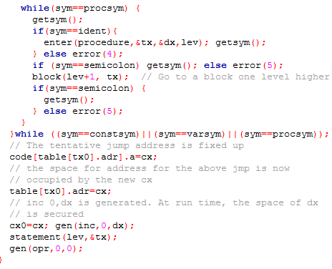

Slide 6
procedure STATEMENT;
begin
if TOKEN = "identsym" then begin
GET(TOKEN);
if TOKEN != "becomessym" then ERROR;
GET(TOKEN);
EXPRESSION
end
else if TOKEN = "callsym" then begin
GET(TOKEN);
if TOKEN != "identsym" then ERROR;
GET(TOKEN)
end
else if TOKEN = "beginsym" then begin
GET TOKEN;
STATEMENT;
while TOKEN = "semicolomsym" do begin
GET(TOKEN);
STATEMENT
end;
if TOKEN != "endsym" then ERROR;
GET(TOKEN)
end
else if TOKEN = "ifsym" then begin
GET(TOKEN);
CONDITION;
if TOKEN != "thensym" then ERROR;
GET(TOKEN);
STATEMENT
end
else if TOKEN = "whilesym" then begin
GET(TOKEN);
CONDITION;
if TOKEN != "dosym" then ERROR;
GET(TOKEN);
STATEMENT
end
end;

Slide 7
Statement
if (sym==callsym) {
getsym();
if (sym!=ident) error(14); else
{ i=position(id, ptx);
if(i==0) error(11); else
if (table[i].kind==procedure)
gen(cal,lev-table[i].level, table[i].adr);
else error(15);
getsym();
}
}
// statement ::= [ "call" ident | … ]

Slide 8
Generating Code for lod and sto

Slide 9
Statement
if (sym==ident){
i=position(id,ptx);
if(i==0) error(11); else
if (table[i].kind!=variable) {
error(12); i=0;
};
getsym();
if (sym==becomes) getsym(); else error(13);
expression(lev,ptx);
if (i!=0)
gen(sto, lev-table[i].level, table[i].adr);
}

Slide 10
Factor Emit example
Factor(lev, ptx)
int lev, *ptx;
{
int i, level, adr, val;
while ((sym==ident)||(sym==number)||(sym==lparen)){
if (sym==ident){
i=position(id,ptx);
if (i==0) error(11); // undeclared identifier
else{
kind=table[i].kind;
level=table[i].level;
adr=table[i].adr;
val=table[i].val;
if (kind==constant) gen(lit,0,val);
else if (kind==variable) gen(lod,lev-level,adr);
else error(21); // Expression must not contain a procedure identifier
}
getsym();
} else if(sym==number) {
if (num>amax) {error(31); num=0;}
gen(lit,0,num); getsym();
} else if(sym==lparen) {
getsym(); expression(lev,ptx);
if (sym==rparen)getsym(); else error(22); // Right parenthesis missing.
} } }

