Slide 1
Parser & Code Generation
COP 3402 System Software
Summer 2013

Slide 2
Symbol Table
typedef struct
{
int kind; // const = 1, var = 2, proc = 3
char name[11]; // name up to 11 chars
int val; // number (ASCII value)
int level; // L level
int addr; // M address
} symbol;
symbol_table[MAX_SYMBOL_TABLE_SIZE];
For constants, you must store kind, name and value.
For variables, you must store kind, name, L and M.
For procedures, you must store kind, name, L and M.
Notes:
Changed from char name[10].

Slide 3
Functions
getsym()
  returns the next token (gets the next symbol)
enter()
  kind, level, address, index
error
  returns the error code corresponding to the error index

Slide 4
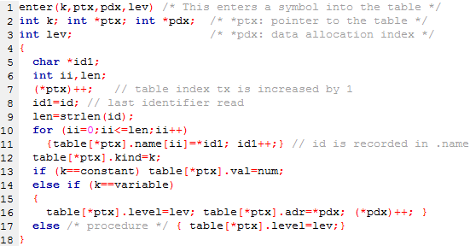
Enter Symbol
Notes:
You’ll know the kind, k, based on where you are in the parser when you call enter.
When procedures are called in your parser you’ll increment lev.
Num is a global variable like id, this variable contains the last number read.

Slide 5
Constant declaration
constdeclaration(lev,ptx,pdx)
{
if (sym==ident) {
getsym();
if ((sym==eql) || (sym==becomes)) {
if (sym==becomes) error(1); getsym();
if (sym==number) {
enter(constant,ptx,pdx,lev); getsym();}
}
}
}

Slide 6
Variable declaration
vardeclaration(lev,ptx,pdx)
{
if (sym==ident) {
enter(variable, ptx,pdx,lev);
getsym();
}
else error(4);
}

Slide 7
Block declaration
do {
if (sym==constsym) {
getsym();
do {
constdeclaration(lev,&tx,&dx);
while(sym==comma) {
getsym(); constdeclaration(lev,&tx,&dx);
}
if(sym==semicolon)getsym(); else error(5);
} while (sym==ident);
}
if (sym==varsym) {
getsym();
do { vardeclaration(lev,&tx,&dx);
while (sym==comma) {
getsym(); vardeclaration(lev,&tx,&dx);
}
if(sym==semicolon) getsym(); else error(5);
} while(sym==ident);
}
while(sym==procsym) {
getsym();
if(sym==ident){
enter(procedure,&tx,&dx,lev); getsym();
} else error(4);
if (sym==semicolon) getsym(); else if
(sym==lparen); else error(5);
block(lev+1, tx);
if(sym==semicolon) {
getsym();
} else error(5);
}
}while ((sym==constsym)||(sym==varsym)||(sym==procsym));

Slide 8
procedure STATEMENT;
begin
if TOKEN = "identsym" then begin
GET(TOKEN);
if TOKEN != "becomessym" then ERROR;
GET(TOKEN);
EXPRESSION
end
else if TOKEN = "callsym" then begin
GET(TOKEN);
if TOKEN != "identsym" then ERROR;
GET(TOKEN)
end
else if TOKEN = "beginsym" then begin
GET TOKEN;
STATEMENT;
while TOKEN = "semicolomsym" do begin
GET(TOKEN);
STATEMENT
end;
if TOKEN != "endsym" then ERROR;
GET(TOKEN)
end
else if TOKEN = "ifsym" then begin
GET(TOKEN);
CONDITION;
if TOKEN != "thensym" then ERROR;
GET(TOKEN);
STATEMENT
end
else if TOKEN = "whilesym" then begin
GET(TOKEN);
CONDITION;
if TOKEN != "dosym" then ERROR;
GET(TOKEN);
STATEMENT
end
end;

Slide 9
Errors
Use = instead of :=.
= must be followed by a number.
Identifier must be followed by =.
const, var, procedure must be followed by identifier.
Semicolon or comma missing.
Incorrect symbol after procedure declaration.
Statement expected.
Incorrect symbol after statement part in block.
Period expected.
Semicolon between statements missing.
Undeclared identifier.
Assignment to constant or procedure is not allowed.
Assignment operator expected.
call must be followed by an identifier.
Call of a constant or variable is meaningless.
then expected.
Semicolon or } expected.
do expected.
Incorrect symbol following statement.
Relational operator expected.
Expression must not contain a procedure identifier.
Right parenthesis missing.
The preceding factor cannot begin with this symbol.
An expression cannot begin with this symbol.
This number is too large.

Slide 10
Emit Calls Used in PL0
System Software
Summer 2013

Slide 11
Project Overview
Compiler Front End
  Scanner (assignment 2): Reads the source code written by users and creates tokens. The scanner should find syntax errors in the code.
Compiler Mid Section
  Parser and code generator(assignment 3): Parses the tokens, creates a symbol table and emits intermediate code.
Compiler Back End:
  Virtual Machine (assignment 1): Reads the intermediate code and runs the program to completion.

Slide 12
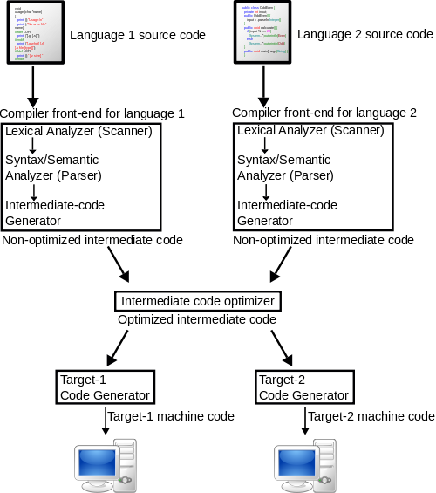
Project Overview cont.
Notes:
http://upload.wikimedia.org/wikipedia/commons/thumb/6/6b/Compiler.svg/500px-Compiler.svg.png

Slide 13
Emit/Gen
gen(x,y,z)
int x,y,z;
{
if (cx>cxmax) printf("program too long\n"); else
{
code[cx].f=x;
code[cx].l=y;
code[cx].a=z;
}
cx++;
}

Slide 14
Source code example of constant in block
Block{
…
do {
if (sym==constsym) {
getsym();
do {
constdeclaration(lev,&tx,&dx);
while(sym==comma) {
getsym(); constdeclaration(lev,&tx,&dx);
}
if(sym==semicolon)getsym(); else error(5);
} while (sym==ident);
}
…

Slide 15
Constant cont.
constdeclaration(lev,ptx,pdx)
int lev,*ptx,*pdx;
{
if (sym==ident) {
getsym();
if ((sym==eql) || (sym==becomes)) {
if (sym==becomes) error(1);
getsym();
if (sym==number) {enter(constant,ptx,pdx,lev); getsym();}
}
}
}

Slide 16
Constant
Constants are declared in the block of a program.
Constants can be used in an expression or any other place where a number could be used

Slide 17
Source code example of variable in block
Block{
…
do {
… //const code
if (sym==varsym) {
getsym();
do { vardeclaration(lev,&ptx,&pdx); /* *ptx: pointer to the table */
while (sym==comma) {
getsym(); vardeclaration(lev,&ptx,&pdx); /* *pdx: data allocation index */
}
if(sym==semicolon) getsym(); else error(5);
} while(sym==ident);
}

Slide 18
Variable cont
vardeclaration(lev,ptx,pdx)
int *ptx,*pdx,lev;
{
if (sym==ident) {enter(variable, ptx,pdx,lev); getsym();}
else error(4);
}

Slide 19
Term Emit Example
term(lev,ptx)
int lev, *ptx;
{
int mulop;
factor(lev,ptx);
while((sym==mult)||(sym==slash)) {
mulop=sym; getsym(); factor(lev,ptx);
if (mulop==mult) gen(opr,0,4); else gen(opr,0,5);
}
}

Slide 20
Factor Emit example
Factor(lev, ptx)
int lev, *ptx;
{
int i, level, adr, val;
while ((sym==ident)||(sym==number)||(sym==lparen)){
if (sym==ident){
i=position(id,ptx);
if (i==0) error(11); // undeclared identifier
else{
kind=table[i].kind;
level=table[i].level;
adr=table[i].adr;
val=table[i].val;
if (kind==constant) gen(lit,0,val);
else if (kind==variable) gen(lod,lev-level,adr);
else error(21); // Expression must not contain a procedure identifier
}
getsym();
} else if(sym==number) {
if (num>amax) {error(31); num=0;}
gen(lit,0,num); getsym();
} else if(sym==lparen) {
getsym(); expression(lev,ptx);
if (sym==rparen)getsym(); else error(22); // Right parenthesis missing.
} } }

Slide 21
Sample Output for Code Generator
var x, y;
begin
x := 1;
y := 8;
x := y + 56;
write (x);
end.
0 jmp 0 1
1 inc 0 5 // reserve space for SL, DL, RA, and two local variables
2 lit 0 1 // push 1
3 sto 0 3 // pop and store in x
4 lit 0 8 // push 8
5 sto 0 4 // pop and store in y
6 lod 0 4 // push y
7 lit 0 56 // push 56
8 opr 0 2 // add top two elements on stack
9 sto 0 3 // store result in x
10 lod 0 3 // push x
11 wrt 0 0 // output top of stack
12 opr 0 0 // return

