Slide 1
Linkers & Compiling Multiple Files
Summer 2010

Slide 2
Loading brings the object program into the memory for execution.
Relocation modifies the object program so that it can be loaded at an address different from 0.
Linking combines two or more separate object programs and supplies the information needed to allow references between them.
Subroutines Libraries
Linkage editors
Dynamic Linking
In most cases all the program translators on a particular system produce object programs in the same format.

Slide 3
Absolute Loader
No linking or relocation
All functions are performed in one pass
E.g. a Bootstrap Loader
H COPY 001000 00107A
T 001000 1E1 41033 482039 001036 281030 301015 482061 3C1003 00102A 0C1039 00102D
T 00101E 15 0C1036 482061 081033 4C0000 454F46 000003 000000
T 002039 1E 041030 001030 E0205D 30203F D8205D 281030 302057 549039 2C205E 38203F
T 002057 1C 101036 4C0000 F1 001000 041030 E02079 302064 509039 DC2079 2C1036
T 002073 07 382064 4C000 05
E 001000

Slide 4
Absolute Loader
Check Header file
Check if correct program is being loaded, and if it will fit into memory
Read Text Records
For each record move object code to indicated memory address.
Reach End Record
Loader jumps to specified address to begin execution

Slide 6
Linking
Calling one function from another is based on knowing the address of each other function.
Linking is simply the process of placing the address of a called function into the calling function’s code.
Static linking is used to combine multiple functions into a single executable module. This linking process takes place once – when the executable module is created
Linkage editors.
Dynamic linking – statically linked modules can contain references to functions that should be resolved during the execution.
Linking loaders for implicit dynamic linking.
Dynamic linker/loader for explicit dynamic linking

Slide 7
Loader design options
Linking loaders - linking and relocation at load
time.
Linkage editors - linking prior to load time.
Dynamic linking - linking is performed at
execution time.

Slide 8
Automatic Library Search
The library subroutines called by the program being loaded are:
Automatically fetched from the library
Linked with the main program
Loaded
The linking loader must:
Keep track of the unresolved external references
Searches the specified libraries that contain the definitions of these symbols
Processes the subroutines found by this search by the regular way.
The last step can provide additional unresolved external references,
so this whole process must be iterative!
This process allows the programmer to override the standard subroutines in the library by supplying his/her own routines.

Slide 9
Subroutines Library Structure
Libraries ordinarily contain compiled versions of the subroutines, organized in a special file structure.
Library
f1
Linking
Internal directory
f2
f1
f2
f3
f3
Function
name
Address within
the file

Slide 10
Linking loader vs. Linkage Editor
Object
program(s)
Object
program(s)
Library
Library
Linking loader
Linkage editor
Memory
Linked
program
A linkage editor produces a linked version of the program (load module), which is written to a file or library for later execution.
Simple Loader
Memory

Slide 11
Linkage editors
Advantages:
One linking and the most of relocation for many executions.
Possibility to create subroutines libraries.
Actual loading is very simple.
Disadvantages:
In recompiling for nearly every execution (program development).
In infrequently used programs (storage waste).

Slide 12
Dynamic Linking
Dynamic linking (dynamic loading, load on call) postpones the linking function until execution time; a subroutine is loaded and linked to the rest of the program when it first called.

Slide 13
Dynamic Linking (Cont)
Advantages:
Several executing programs can share one copy of a subroutine or library (Xwindows, C support routines).
The implementation of the method can be determined or even changed at the time the program is run.
The subroutine name might simply be treated as an input item (!)
Additional advantages:
Applications with rarely used subroutines (f.e. errors handling)
Application with a lot of possible services (f.e. mathematic packages)

Slide 14
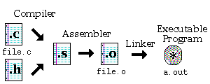
Simple Compilation

Slide 15
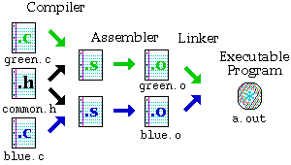
Compiling ‘n’ files

Slide 16
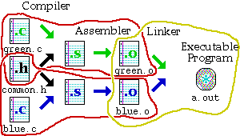
Compiling ‘n’ files

Slide 17
Commands
cc green.c blue.c
cc –c <filename>.c
output file : <filename>.o
Compile green.o: cc -c green.c
Compile blue.o: cc -c blue.c
Link the parts together: cc green.o blue.o

Slide 18
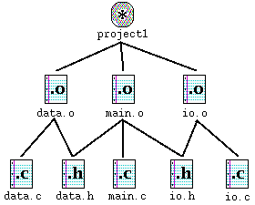
Executable

Slide 19
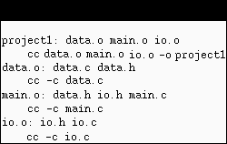
Executable

