Slide 1
Introduction to Flex

Slide 2
What Is Flex?
Generates a program (C source file) that performs lexical analysis on text
Often used to provide input for a syntactic analyzer

Slide 3
How Flex Works
Flex file (filename.l) contains all info needed for a file to be scanned and lexically analyzed, such as
Characters & character patterns that make up tokens
Actions (written in C) to take when patterns are matched
Additional functions (in C) to enhance modularity (if necessary) and/or to specify exactly how the scanner should operate
Flex.exe is run with filename.l passed as an argument
This generates a lengthy C source file, lex.yy.c
To scan a text file:
Compile lex.yy.c and then run it against the desired file

Slide 4
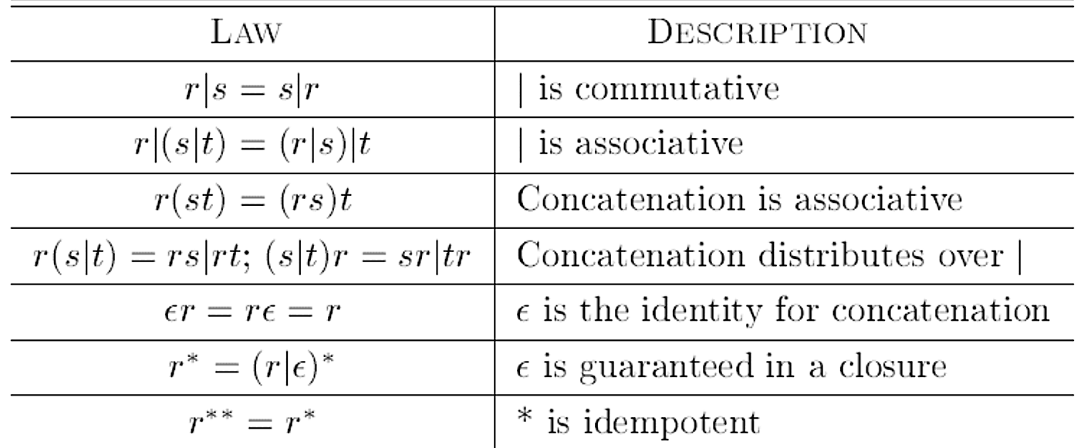
Algebraic Laws for Regular Expressions

Slide 5
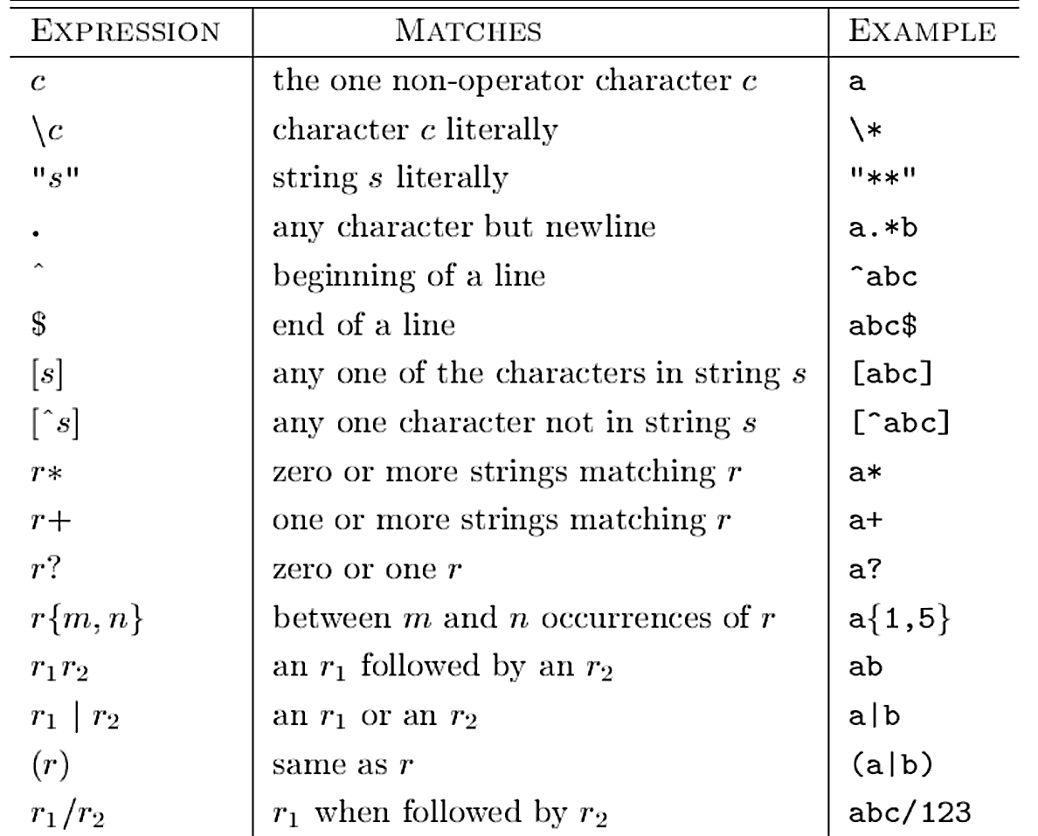
Flex Regular Expressions

Slide 6
Flex File Format
Format of Flex (.l) file: <Definitions> %% <Rules> %% <User code>
Note: When compiling in Windows, main() and yywrap() must be explicitly defined in user code section to avoid linker errors
In Linux/UNIX, linking with “-lfl” supplies the default definitions for these functions automatically

Slide 7
calc.l - Flex File Format: <Definitions>
/* Properly formatted code/comments in <Definitions>
section will be prepended to lex.yy.c */
%{
#include <stdlib.h>
%}
/* Macros */
I [iI]
N [nN]
T [tT]
digit [0-9]
integer {digit}+

Slide 8
calc.l - Flex File Format: <Definitions>
/* Properly formatted code/comments in <Definitions>
section will be prepended to lex.yy.c */
%{
#include <stdlib.h>
%}
/* Macros */
I [iI]
N [nN]
T [tT]
digit [0-9]
integer {digit}+

Slide 9
calc.l - Flex File Format: <Definitions>
/* Properly formatted code/comments in <Definitions>
section will be prepended to lex.yy.c */
%{
#include <stdlib.h>
%}
/* Macros */
I [iI]
N [nN]
T [tT]
digit [0-9]
integer {digit}+
Optional sub-section
Used for #include items, function declarations, global variable initializations, etc.

Slide 10
calc.l - Flex File Format: <Definitions>
/* Properly formatted code/comments in <Definitions>
section will be prepended to lex.yy.c */
%{
#include <stdlib.h>
%}
/* Macros */
I [iI]
N [nN]
T [tT]
digit [0-9]
integer {digit}+
Macros
Analogous to #define in C; i.e.
integer {digit}+
could be thought of as
#define INTEGER {digit}+

Slide 11
calc.l - Flex File Format: <Rules>
%%
/* Reserved Word (not case sensitive) */
{I}{N}{T} { printf("intsym "); }
/* Whitespace (currently, spaces and tabs only) */
[ \t]+ { }
/* Number */
{integer} { printf("number %s ", yytext); }
/* Special Symbols */
"+" { printf("plus "); }
"-" { printf("minus "); }
"*" { printf("times "); }
"/" { printf("divide "); }
"(" { printf("lparen "); }
")" { printf("rparen "); }
\n { printf("\n\n"); }
. { printf("INVALID(%s) ", yytext); }

Slide 12
calc.l - Flex File Format: <User Code>
%%
/* Properly formatted code/comments in <User Code> section are appended to lex.yy.c */
/* If called, allows for scanning of another file */
int yywrap()
{
return 1;
}
/* Main function for Flex file */
int main(int argc, char* argv[])
{
/* Insert message/prompt here, if necessary */
if (argc > 1) yyin = fopen(argv[1], "r");
else yyin = stdin;
yylex();
return 1;
}

Slide 13
Values Available to the User
There are a number of values that Flex makes available to the user, but for this project, these are likely to be the most useful to you:
yytext: Always a pointer to the scanned lexeme
i.e. Holds text of current token
Can be modified but lengthened (appended to)
yyleng: Length of the current token

Slide 14
Running From Command Line
Here, assume that:
"Sample.l" scans for tokens according to a grammar named Sample
"input.txt" is the file to be scanned; exclude this to scan from stdin
For lexical analysis only (no parsing):
flex.exe Sample.l
gcc –oSample lex.yy.c
Sample input.txt
If it doesn't work:
If issue is with Flex.exe, try inserting its full filepath instead.
If issue is due problems with token types, change all "return(tokenType)" statements to "printf" as shown in slides

Slide 15
Links/Installation
Flex Manual:
http://flex.sourceforge.net/manual/
To Install Flex on Windows:
http://flex.sourceforge.net/ for source, or
http://gnuwin32.sourceforge.net/packages/flex.htm for Windows executable
To Install Flex on Eustis:
Flex version 2.5.35 already installed
To Install Flex on Linux:
Flex package likely must be installed, but package name varies per distribution. Please search Google for package name and instructions.

