Slide 1
Digital Forensics
Curtis Laketek

Slide 2
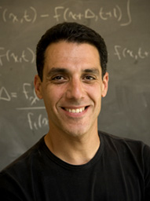
Hany Farid
http://www.cs.dartmouth.edu/farid/research/
http://www.cs.dartmouth.edu/~farid/dfd/index.php/topics

Slide 3
What is Digital Forensics?
The Act and science of determining if a photograph or piece of artwork is authentic

Slide 4
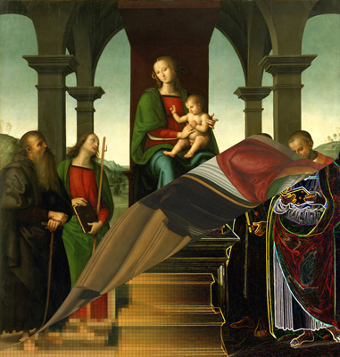
Art Forensics
Shown to the right is a painting by Perugino. Like many Renaissance paintings it is likely that Perugino only painted a portion of this work - apprentices did the rest. It is often very difficult to determine how many hands contributed to a painting. We have developed a mathematical technique that can classify various parts of a painting as belonging to one or more artists. Beginning with a high-resolution digital scan, our technique works by looking for statistical differences across the canvas.

Slide 5
Why is this important?
Media
Politics
Science
Law
National Security
Trust

Slide 6
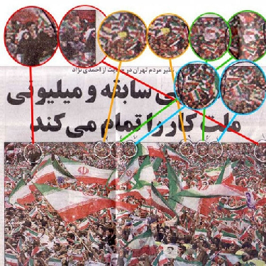
Media
The pro-Ahmadinejad rally photo shown above is definitely Photoshopped. The circled areas, which magnify crowd details, indicate Photoshop "cloning" aka, copying and pasting areas to expand the audience. Our recent report about a Scientology crowd photo (Dec 1999) discussed the use of same cloning technique to fake a larger audience.

Slide 7
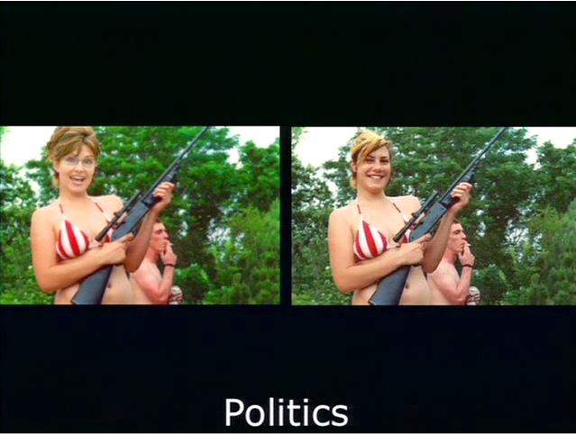

Slide 8
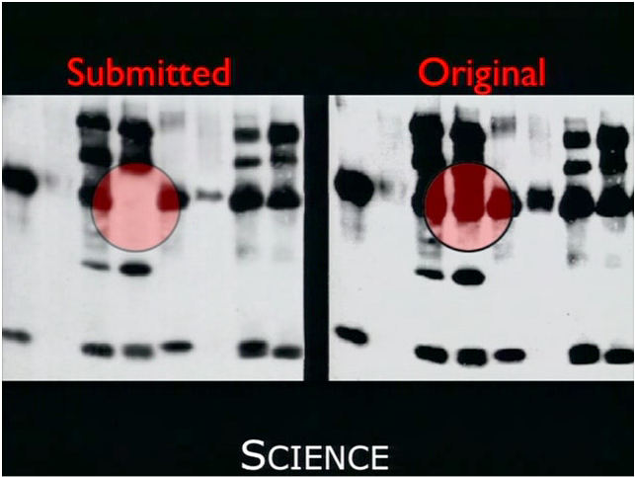

Slide 9
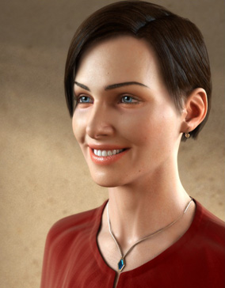
Computer Generated or Photographic?
Computer graphics rendering software is capable of generating highly photorealistic images that are often very difficult to differentiate from photographic images. We have, however, developed a method for differentiating between photographic and computer generated (photorealistic) images. Specifically, we have shown that a statistical model based on first- and higher-order wavelet statistics reveals subtle but significant differences between photographic and photorealistic images. This work has begun to have interesting legal applications in light of the 2002 United States Supreme Court ruling that effectively legalized "virtual child pornography".

Slide 10
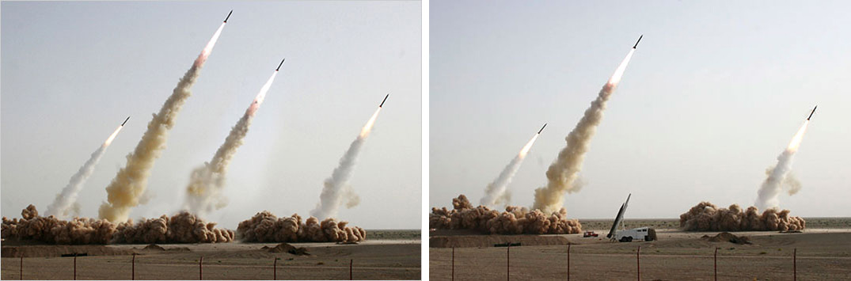
July 2008: This image of an Iranian missile test appeared on the front page of many major newspapers. The image is from the web site of Sepah News, the media arm of Iran's Revolutionary Guards. After the publication of this photo, it was revealed that the second missile from the right was digitally added to the image in order to conceal a missile on the ground that did not fire.

Slide 11
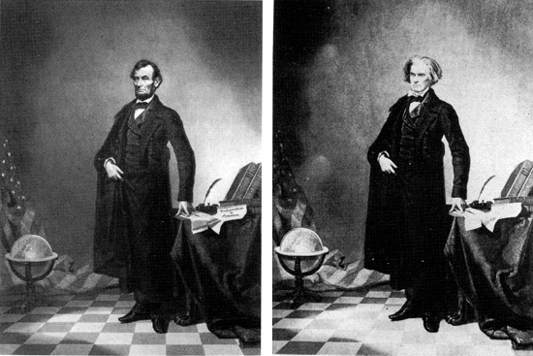
circa 1860:
This nearly iconic portrait of U.S. President Abraham Lincoln is a composite of Lincoln's head and the Southern politician John Calhoun's body. Putting the date of this image into context, note that the first permanent photographic image was created in 1826 and the Eastman Dry Plate Company (later to become Eastman Kodak) was created in 1881.

Slide 12
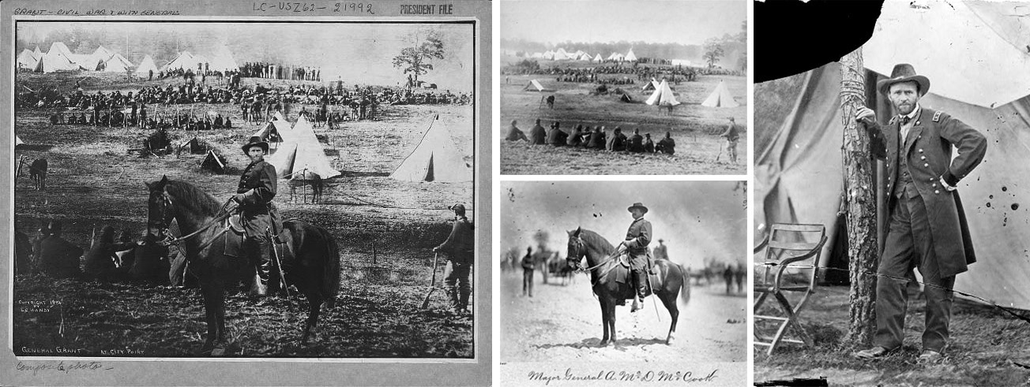
circa 1864:
This print purports to be of General Ulysses S. Grant in front of his troops at City Point, Virginia, during the American Civil War. Some very nice detective work by researchers at the Library of Congress revealed that this print is a composite of three separate prints: (1) the head in this photo is taken from a portrait of Grant; (2) the horse and body are those of Major General Alexander M. McCook; and (3) the background is of Confederate prisoners captured at the battle of Fisher's Hill, VA.

Slide 13
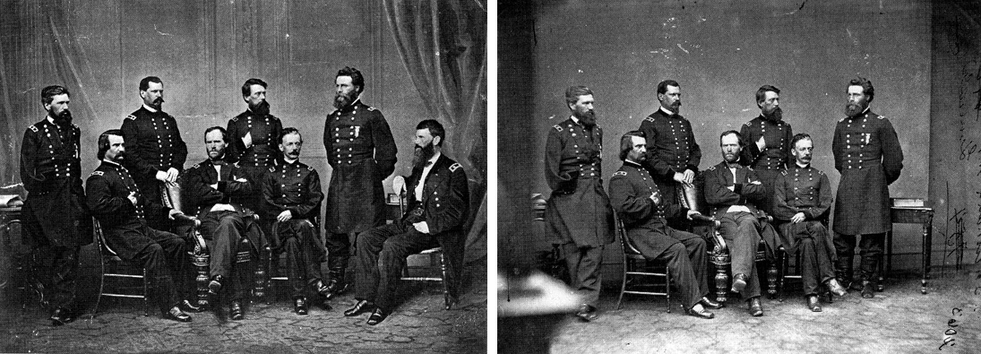
circa 1865: In this photo by famed photographer Mathew Brady, General Sherman is seen posing with his Generals. General Francis P. Blair (far right) was added to the original photograph.

Slide 14
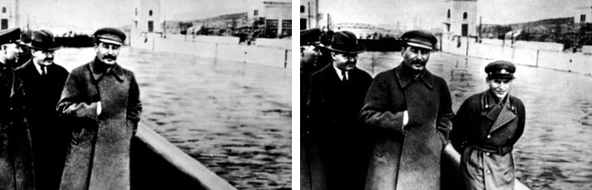
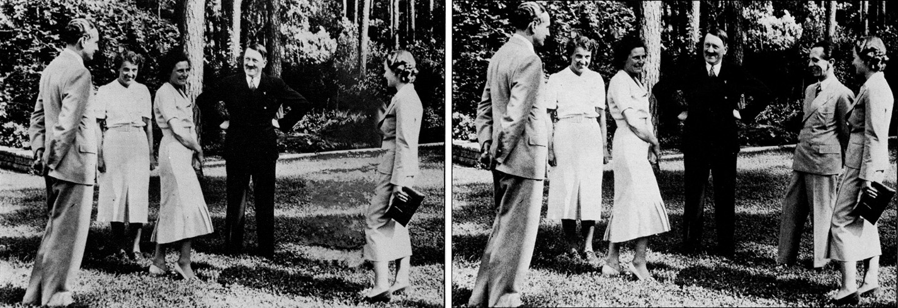

Slide 15
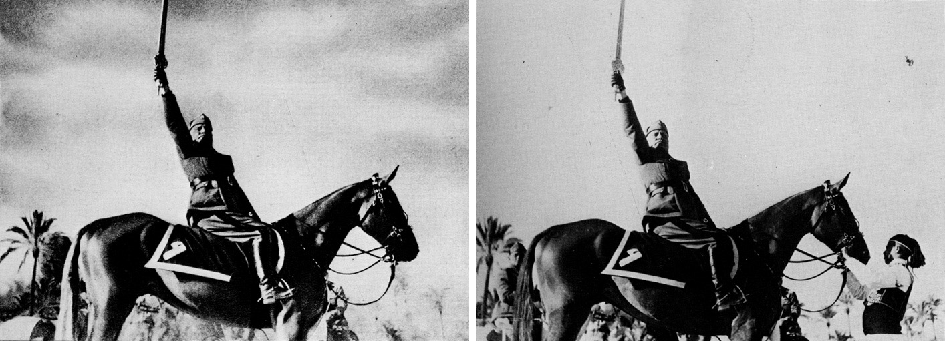
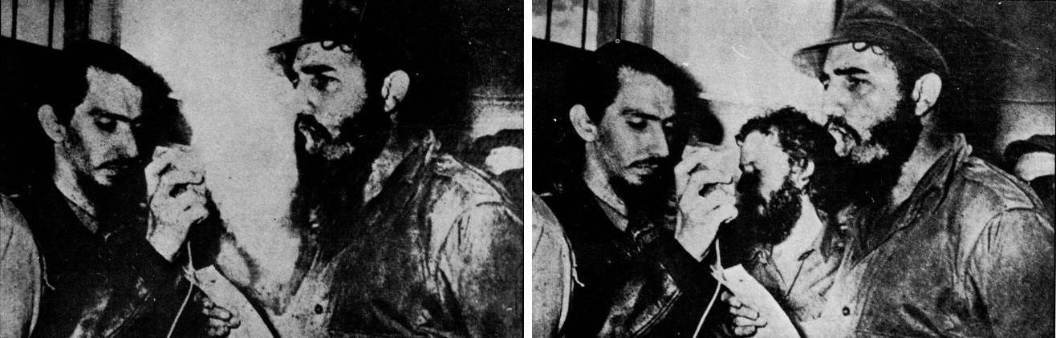
1942: In order to create a more heroic portrait of himself, Benito Mussolini had the horse handler removed from the original photograph.

Slide 16
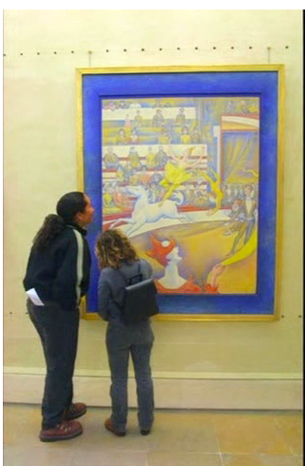
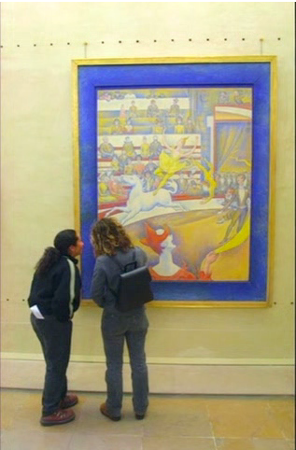
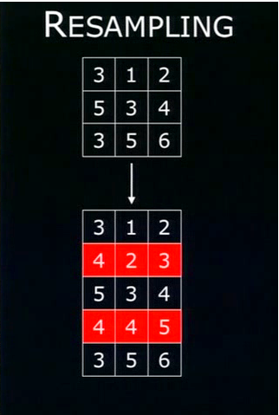
How is this done?
Interpolate

Slide 17
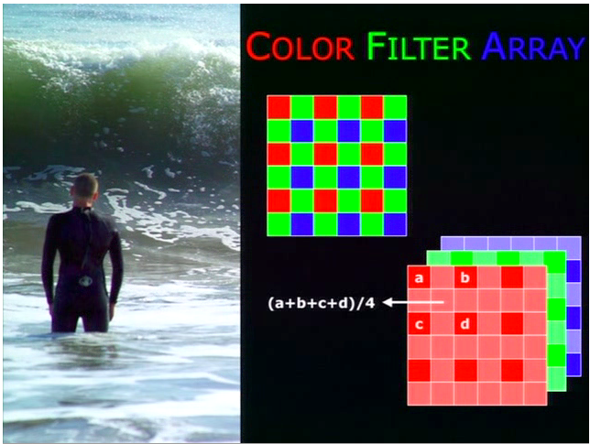
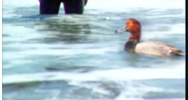

Slide 18
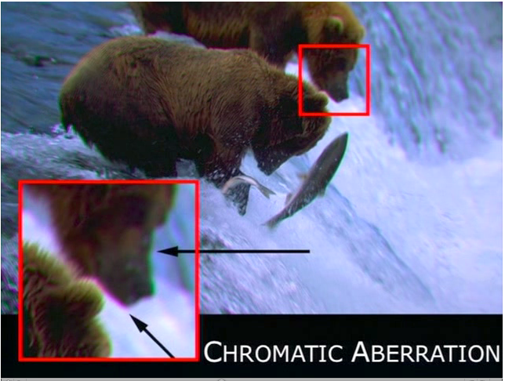

Slide 19
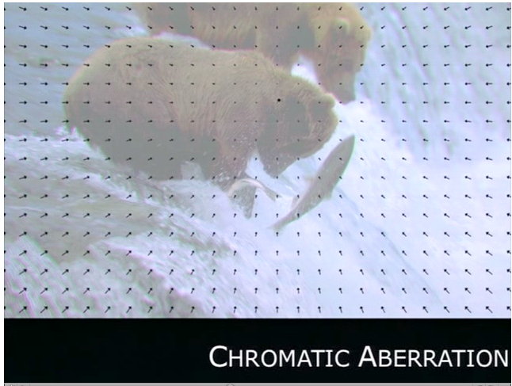
Take A first order approximation of Snell’s law and we see a expansion pattern

Slide 20
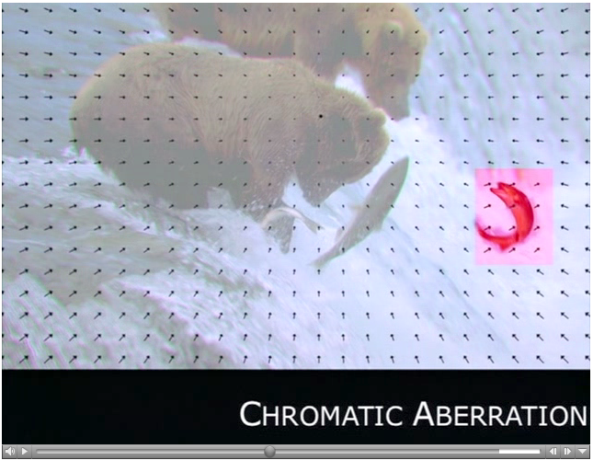
Only works on HD images

Slide 21
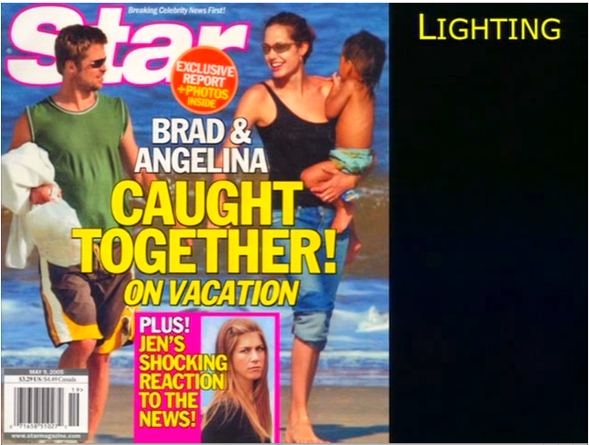

Slide 22
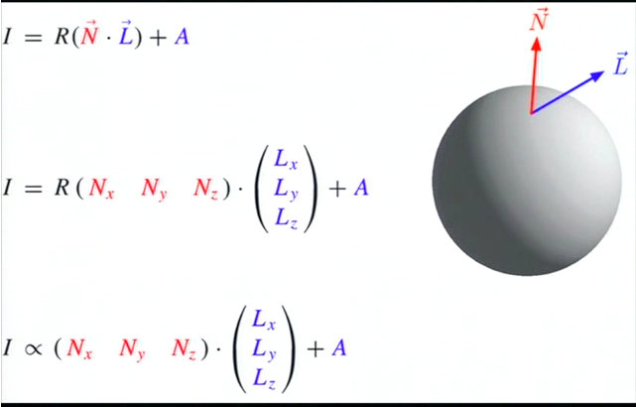
I = Intensity
R= Reflectiveness
N=Surface normal
L =Light direction
A= Ambient light

Slide 23
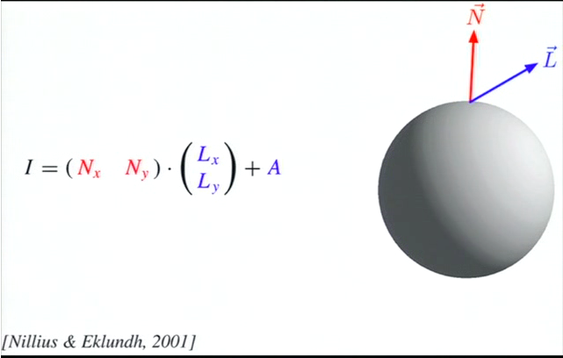
How do we get 3D surface normal's?

Slide 24
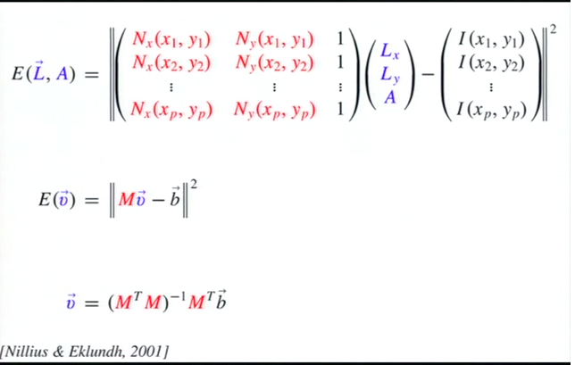
Matrix Form

Slide 25
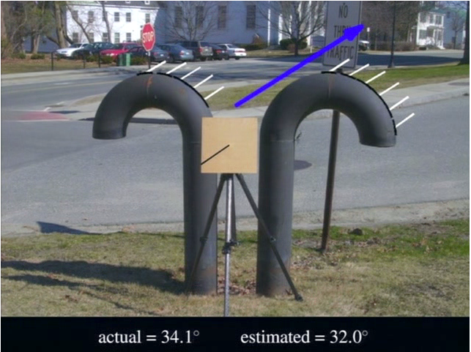

Slide 26
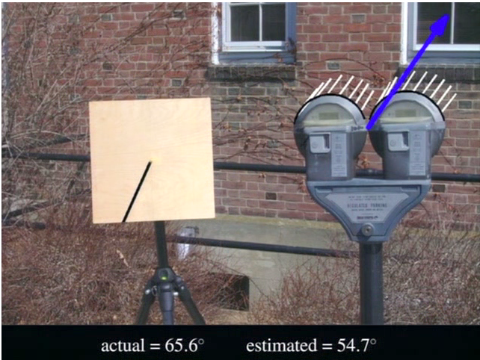
Average error of about 8 degrees

Slide 27
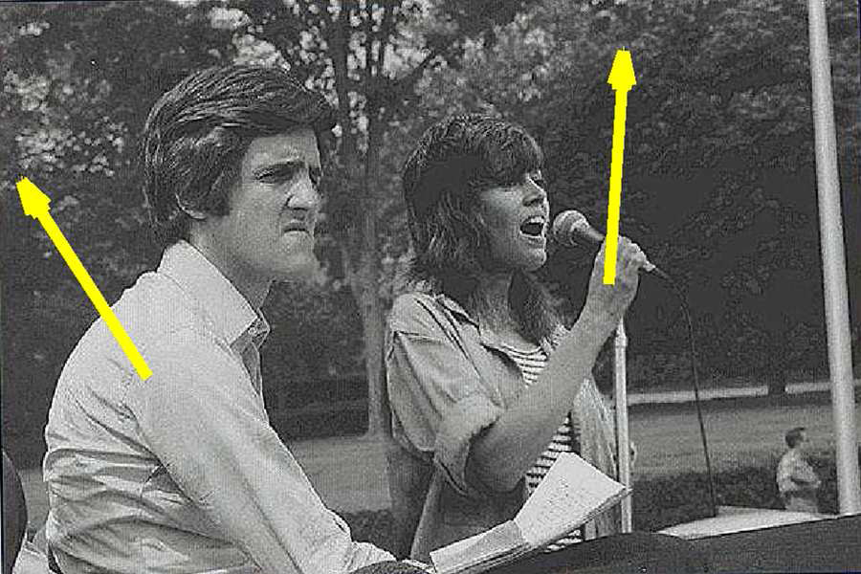
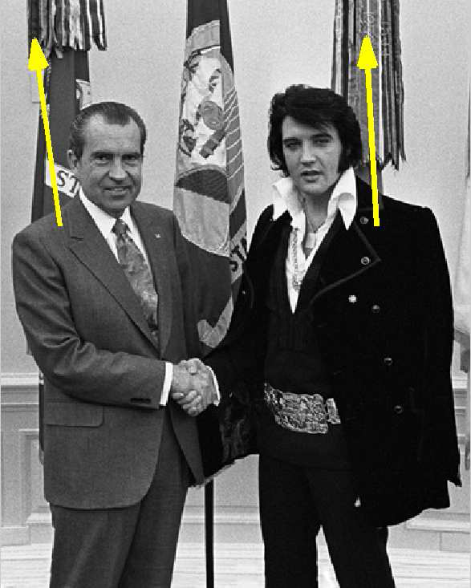
Shown above is a known forgery of John
Kerry and Jane Fonda sharing a stage at an antiwar
rally. The estimated light direction for Kerry
is 123, while the direction for Fonda is 86. Shown
below is an authentic image of Richard Nixon and
Elvis Presley. The estimated directions for Nixon
and Presley are 98 and 93.

Slide 28
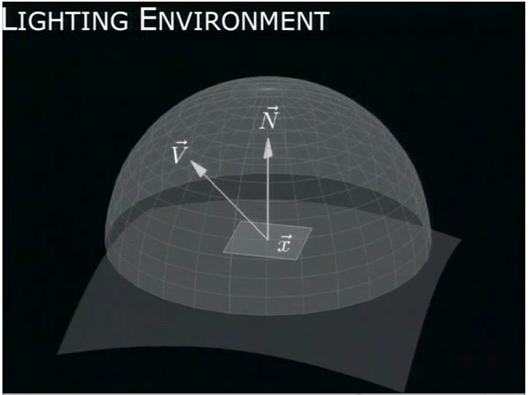

Slide 29
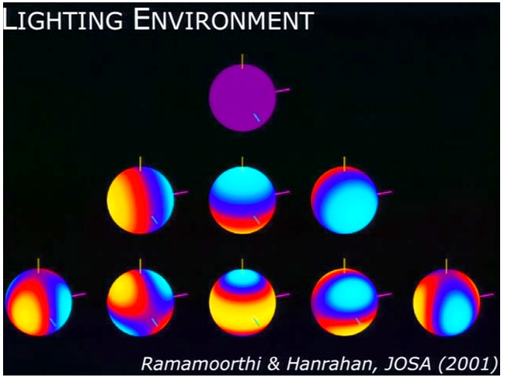
Spherical Harmonics

Slide 30
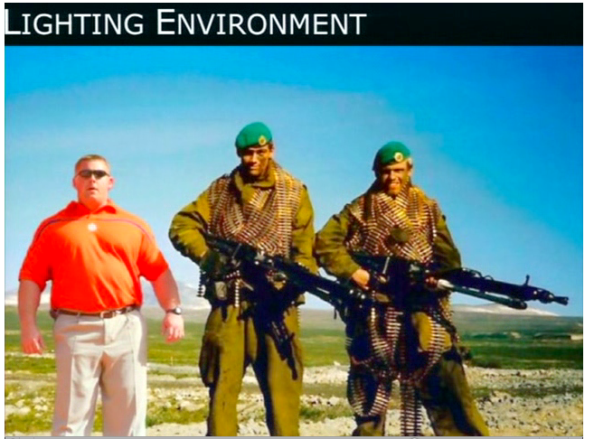
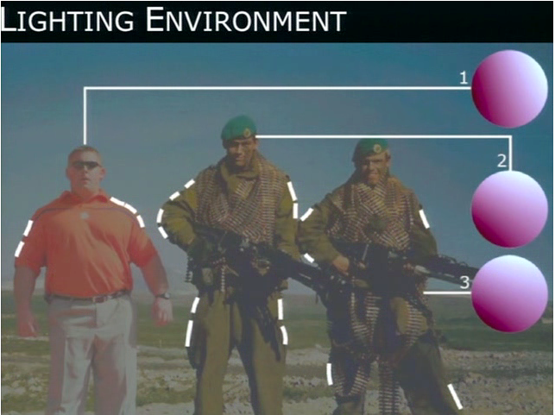

Slide 31
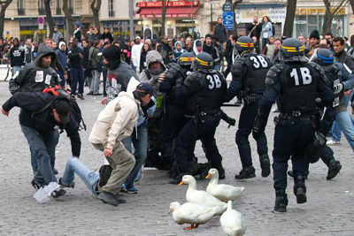
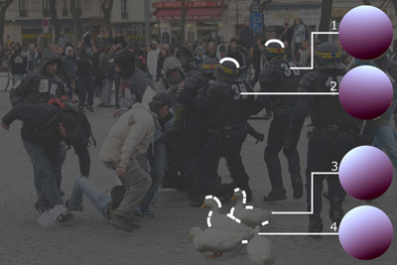

Slide 32
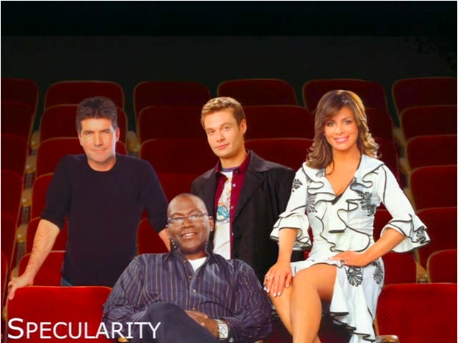

Slide 33
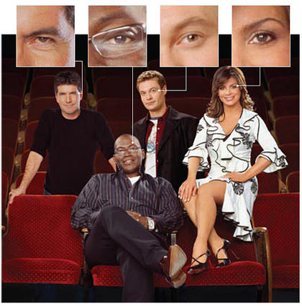

Slide 34
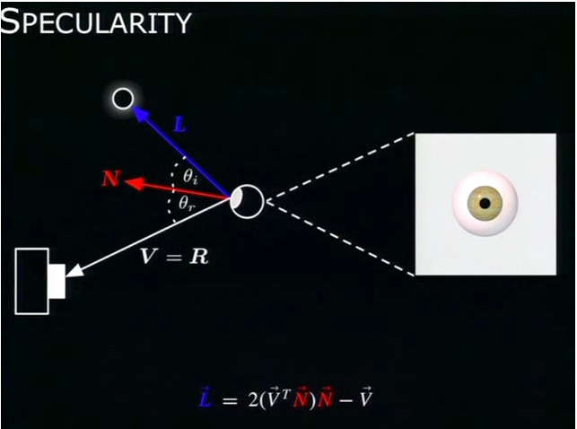
Light Detection in 3D
Farid modified his light-detection software, which analyzed lighting differences in two dimensions, to pinpoint a lighting source three-dimensionally by analyzing the light reflecting off a subject's eyeballs.

Slide 35
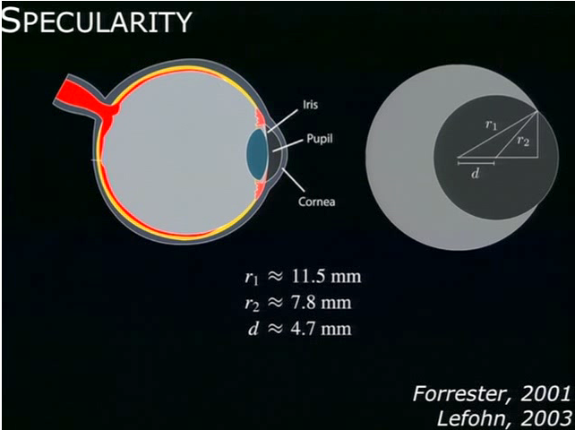

Slide 36
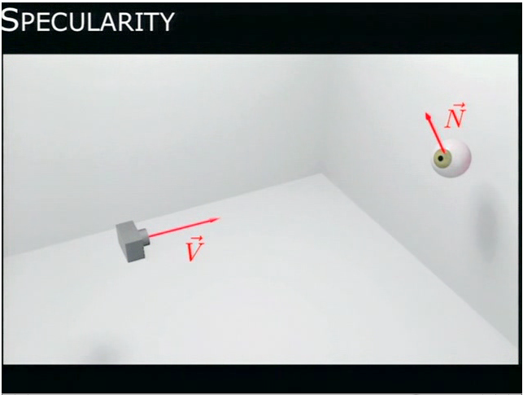
Wrong coordinate systems

Slide 37
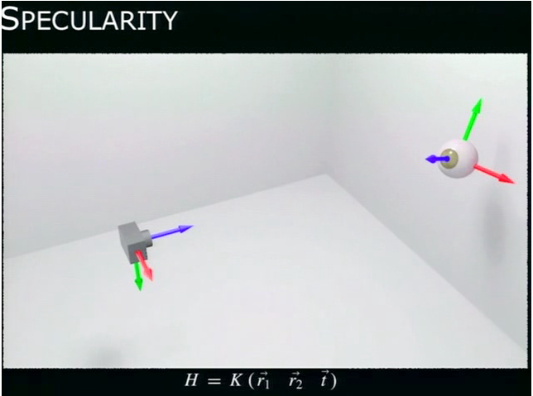

Slide 38
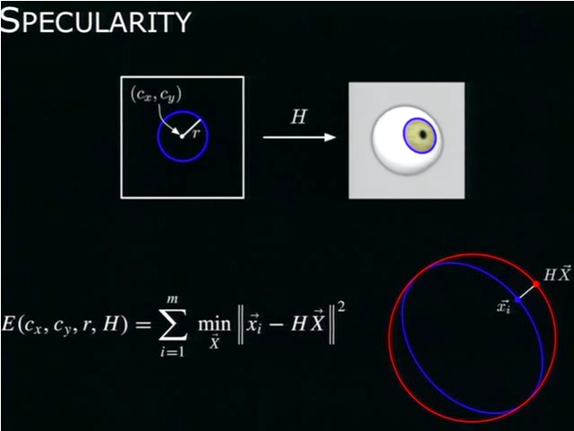

Slide 39
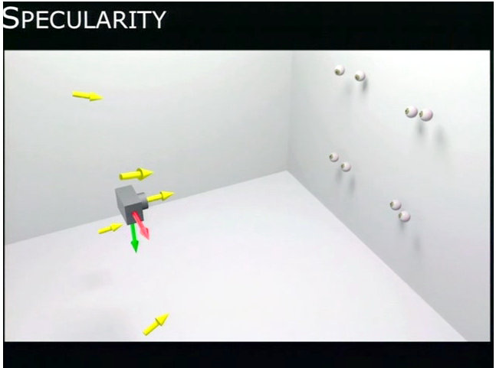

Slide 40
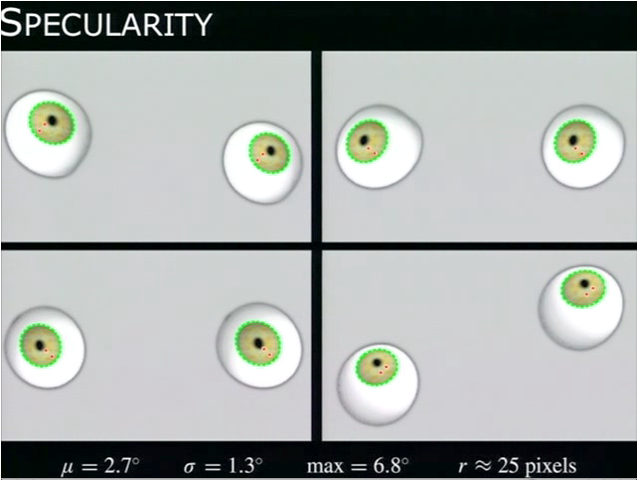

Slide 41
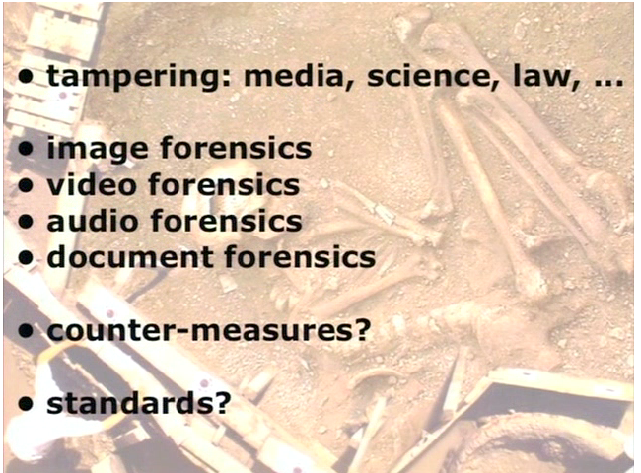
Close to 2 dozen different forensic techniques

Slide 42
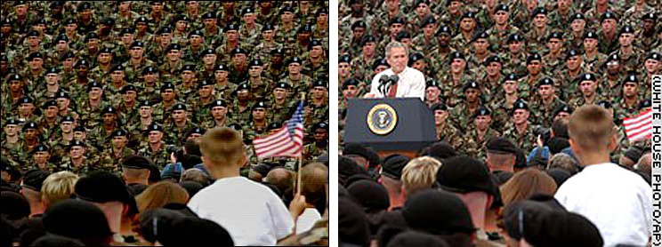
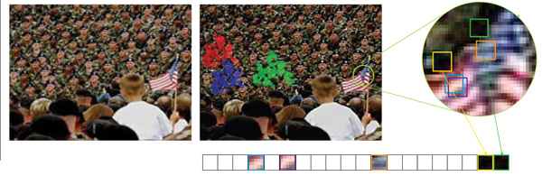
Cloning

Slide 43
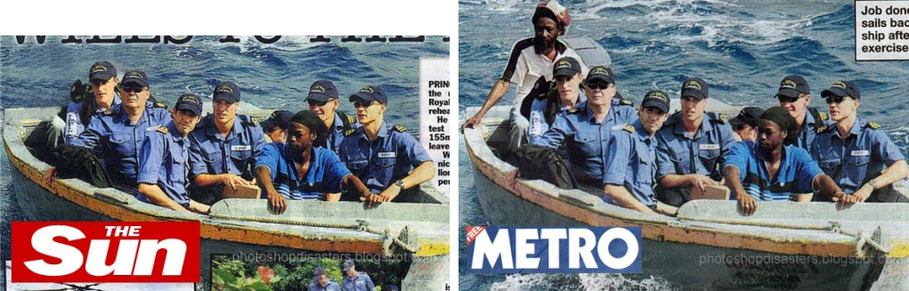
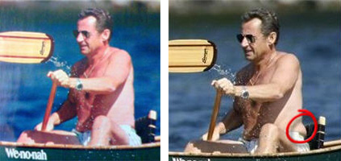
July 2008: This photo of Britian's Prince William appeared on the pages of The Sun. A person in the back of the boat was digitally removed from this photo (except for their knee). The Metro ran the unaltered photo, as did the on-line version of The Sun.
August 2007: The French Magazine Paris Match altered this photograph of French President Nicolas Sarkozy by removing some body fat. The magazine said it had tried adjusting the lighting on the picture. "The correction was exaggerated during the printing process," the magazine said.

Slide 44

July 2007: This cover of Redbook magazine shows a heavily re-touched (and thinner) image of singer and actress Faith Hill. Redbook was accused of contributing to the unattainable body image created by digital re-touching. In response, Redbook's editor in chief Stacy Morrison said, "The retouching we did on Faith Hill's photo for the July cover of Redbook is completely in line with industry standards.
http://www.stinkyjournalism.org/

