Slide 1
University of Central Florida COP 2500 Concepts in Computer Science

Slide 2
Agenda
Administrative information
JavaScript lecture
Dialog boxes / Alerts
Comments

Slide 3
Administrative Information

Slide 4
Instructor
Instructor
Josh Lazar
Office location: By Appointment
Office hours
Tuesday and Thursday 6:00 – 7:00 PM by appointment
Email: jlazar@labs.cs.ucf.edu

Slide 5
Teaching Assistants
Teaching Assistants
Name: Kumar Poojari
Email: kumar.raghav@knights.ucf.edu
Name: James Choi
Email: jchoi2012@knights.ucf.edu

Slide 6
Lab Schedule
Lab location: ENG1 O187
Section 11 – Tuesday 2:30 P.M – 3:45 P.M.
Section 12 – Tuesday 6:00 P.M – 7:15 P.M.
Section 13 – Thursday 1:00 P.M. – 2:15 P.M.
Section 14 – Thursday 2:30 P.M – 3:45 P.M.
Section 15 – Thursday 6:00 P.M – 7:15 P.M.

Slide 7
JavaScript

Slide 8
User Interaction With JavaScript
Interaction with the user is accomplished using dialog boxes which are created via the methods
alert()
prompt()
confirm()

Slide 9
alert()
Used to send a warning to the user or alert them to some action
Examples of usage
Data not entered correctly
Browser doesn’t support a specific plug-in
Debugging
Creates an independent windows called dialog box
Format
alert(“String of text”);
alert(expression);

Slide 10
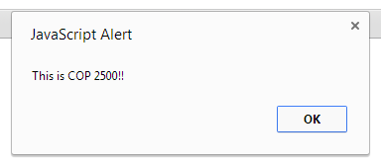
alert()
Example output

Slide 11
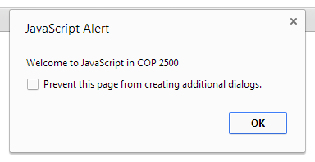
alert()
HTML is NOT rendered in a message string
Can include escape sequences
Format
alert(“String of text\n More text”);
alert(expression);

Slide 12
prompt()
Used to ask the user for information such as name, password, etc…
Prompt dialog box provides a single textfield box for input
When user enters data, the value is returned
prompt() method takes two arguments
String of text displayed to the user
String of text that is the initial default value for the dialog box

Slide 13
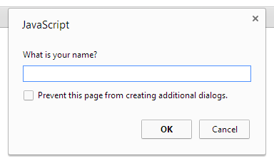
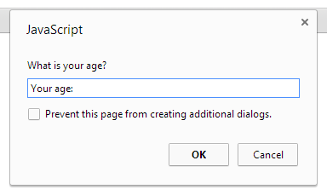
prompt()
Format
The value(s) in the parenthesis is an argument
prompt(message);
prompt(message, defaultText);

Slide 14
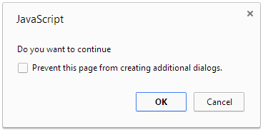
confirm()
Used to confirm a user’s answer to a question
User must agree before the action is complete
Examples include
Online orders
Bill payments
Two options
OK
Cancel

Slide 15
confirm()
Format
Encapsulated in an if() statement
if ( confirm(“Do you want to continue?”) == true) {
alert(“You want to continue”);
}
else {
alert(“You don’t want to continue”);
}

Slide 16
Comments

Slide 17
JavaScript Comments
/*
This is a BLOCK COMMENT
because you can have enter lines
and as many lines as you want
*/
// This is an INLINE COMMENT because it is only for one line
<!-- This is another format of the INLINE COMMENT -->

Slide 18
HTML Comments
<!-- This is another format of the INLINE/BLOCK COMMENT works in HTML too
-->

Slide 19
Questions
Any questions?

