Slide 1
Spam and Cybercrime

Slide 2
SMTP
Simple Mail Transfer Protocol
  Client connects to server on TCP port 25
  Client sends commands to server
  Server acks or notifies of error
Security issues
  Sender not authenticated
  Message and headers transmitted in plain text
  Message and header integrity not protected
  Spoofing trivial to accomplish
Example SMTP session
HELO mail.university.edu
MAIL FROM: president@whitehouse.gov
RCPT TO: chancellor@university.edu
DATA
From: president@whitehouse.gov
To: chancellor@university.edu
Date: April 1, 2010
Subject: Executive order
You are hereby ordered to increase the stipend of all TAs by $10,000 per year.
Sincerely,
The President of the United States
.

Slide 3
What is Email Spam?
Email spam is often defined as unsolicited bulk email
  Forbidden by all major ISPs
  Considered “acceptable business practice” by US Direct Marketing Association (DMA)
Unsolicited email and bulk email are individually acceptable practices for people, business, and organizations
Spam arises from the combination of unsolicited and bulk
In classifying email as spam, content does not matter
The US CAN-SPAM act (2004) regrettably protects commercial spam provided some requirements are satisfied, including:
  Opt-out mechanism
  Sender clearly identified and subject line not deceptive
  Adult material labeled in subject line

Slide 4
Who Responds to Spam anyhow?
A princess in Nigeria wants to send me money!

Slide 5
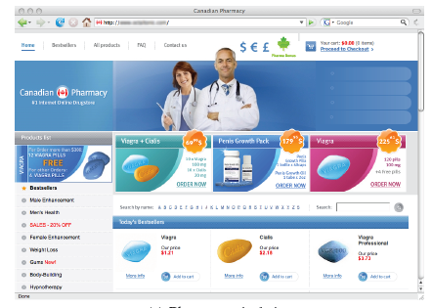
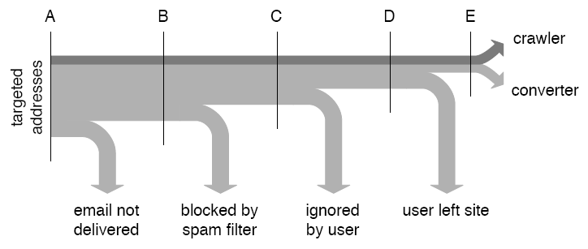
Spam Conversion
Empirical study [Kanich+ 2008]
  Parasitic infiltration into botnet launching spam campaign for “Canadian drugs”
  28 conversions, yielding $3K, from 300M spam messages over 26 days
Yes, Honey, you could
benefit from that drug.

Slide 6
Blacklisting
Spamhaus Black List (SBL)
  Real-time database of IP addresses of verified spam sources
  Eliminates about 10% of spam before transmission takes place
  Formal listing and delisting procedures
  More than 600M email users protected by SBL
How to circumvent blacklisting
  Powerful blacklisted spam server impersonates small unlisted zombie
  Initiate TCP handshake from zombie
  Send bulk email from spam server using spoofed source IP and TCP sequence numbers
zombie
TCP handshake
TCP sequence numbers
victim
spam server
SMTP spam transmission

Slide 7
Graylisting
Spam servers typically do not resend messages after transmission errors
Maintain database of trusted servers
Respond with “Busy, please retry” to SMPT connection requests from servers not in database
Server added to database if reestablishes connection
Currently effective although simple to circumvent

Slide 8
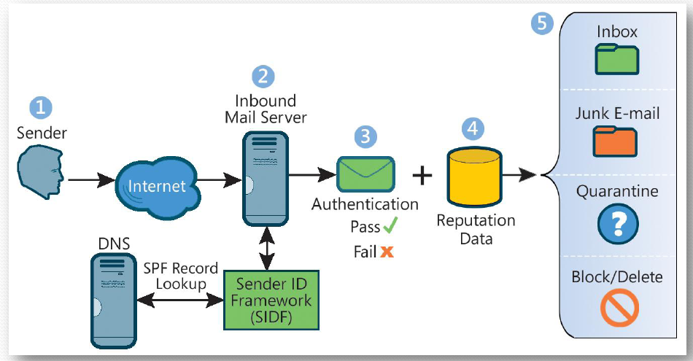
Sender ID and Sender Policy Framework
Store DNS records about severs authorized to send mail for a given domain
Look up domain in From header to find IP address of authorized mail server
Source: Microsoft

Slide 9
DomainKeys Identified Mail (DKIM)
Sender’s mail server signs email to authenticate domain
Public key of server available in DNS record
To be used in conjunction with other spam filtering methods
Public key
Provide
public key
example.net
Name Server
Query for public key
Private key
Verify
signature
Send signed email
Sign mail
yahoo.com MTA
example.net MTA
DomainKey-Signature: a=rsa-sha1; s=mail; d=example.net; c=simple; q=dns;
b=Fg…5J
Authentication-Results: example.net from=bob@example.net; domainkeys=pass;

Slide 10
SenderID vs. DKIM
SenderID
DKIM
Sending MTA authentication
Channel based
Simple implementation
Message integrity not protected
Mail forwarding not supported
Vulnerable to DNS cache poisoning
Vulnerable to IP source spoofing
Sending MTA authentication
Object based
Cryptographic assurance
Protection of message integrity
Supports mail forwarding
Vulnerable to DNS cache poisoning

Slide 11
Cybercrime
Symantec’s definition:
  Cybercrime is any crime that is committed using a computer, network, or hardware device. The computer or device may be the agent of the crime, the facilitator of the crime, or the target of the crime. The crime may take place on the computer alone or in addition to other locations.
Enablers of cybercrime
  Software vulnerabilities
  Online shopping and access to financial accounts
  Countries with lax or corrupt law enforcement

Slide 12
Credit Cards
Credit card information
  Supposed to be kept secret
  Shared with multiple merchants
  Transmitted often insecurely
  Low entropy of the credit card number (first four digits denote financial institution)
Advantage
  Simple scheme for users, banks, and merchants
Disadvantage
  Fraud easy to commit
Tradeoff
  No security measures to facilitate use
  Private customers and merchants held harmless
  Transaction fee covers bank fraud losses

Slide 13
Common Credit Card Frauds
Buy popular goods and resell them
  Needs package delivery address
  Requires resale business
  Often goods reshipped abroad
Buy financial instruments
  Traveler’s checks
  Gift cards
  E-gold
  Additional conversion needed to avoid revocation
Buy cash equivalents
  Western Union money transfers
  Foreign currency

Slide 14
Defending Against Credit Card Fraud
One-time credit card numbers
  Available from several issuers (e.g., AmEx, Citibank)
  Does not work for subscription plans
  Time consuming for users
  Cumbersome to obtain refunds
  Worthwhile for high-value transactions or untrusted merchants
Monitoring transactions
  Email or text message for each transaction
  Continuous annoyance to catch a rare event
Password enabled transactions
  Similar to PIN for ATM cards
  Difficult to share password only with the bank and communicate verification outcome to merchant (three-party protocol)

Slide 15
Bank Accounts
Account information
  Supposed to be kept secret
  Shared with merchants, customers and friends
  Same account number for deposits and withdrawals
Typical bank transactions
  Check
  ATM
  Wire transfer
Banking in the US
  Account title
  Taxpayer ID Number (TIN)
  Checks can be generated by customers or third parties
  Signature not verified in practice for amounts below $30K
  Automated Clearing House (ACH), regulated by Federal Reserve, supports interbank transfers, direct deposits and direct debits
  ACH allows one to initiate from account A an inbound transfer into A from any account B with same TIN as A

Slide 16
Common Bank Frauds
Forged checks
  Create checks with magnetic ink printers
  Cash with fake ID
  Low amounts typically not scrutinized
Wire transfer
  Send fax to bank to order wire transfer
  Most effective if money wired abroad
Account creation
  Create account A impersonating owner of account B
  ACH transfer from B to A
  Cash with ATM or wire transfer

Slide 17
Defending Against Bank Fraud
Multi-factor authentication
  Hardware token generating one-time codes
  Personal images and sentences to defend against phishing
  Code sent by email/sms to registered address to authorize debit transactions
Account ownership verification
  Linking accounts for ACH transfers requires knowledge of to small deposits to the account
Restrictions on accounts
  E.g., only credit transaction accepted
Monitoring bank transactions
  Email/text message after each transactions
No online banking
  Limited bank liability for online frauds

