Slide 1
Digital Rights Management

Slide 2
Introduction
Digital Rights Management (DRM) is a term used for systems that restrict the use of digital media
DRM defends against the illegal altering, sharing, copying, printing, viewing of digital media
Copyright owners claim DRM is needed to prevent revenue lost from illegal distribution of their copyrighted material

Slide 3
DRM Content and Actions
There are many capabilities covered by DRM
Digital Rights Management
Digital content:
Videos
Music
Audio books
Digital books
Software
Video games
Possible Actions and Restrictions:
Play once
Play k times
Play for a set time period
Play an unlimited amount
Copy
Burn to physical media
Lend to a friend
Sell
Transfer to a different device

Slide 4
Early U.S. Copyright History
US Constitution, Article 1, Section 8
  “The Congress shall have the Power … To promote the Progress of Science and useful Arts, by securing for limited Times to Authors and Inventors the exclusive Right to their respective Writings and Discoveries”
Copyright Act of 1790
  "the author and authors of any map, chart, book or books already printed within these United States, being a citizen or citizens thereof....shall have the sole right and liberty of printing, reprinting, publishing and vending such map, chart, book or books...."
  Citizens could patent books, charts, or maps for a period of 14 years – Could renew for another 14 years if you were alive
  Non-citizens and works form other countries not protected
  Other laws followed to change the Act slightly

Slide 5
Copyright Act of 1976
Could copyright literary works, musical works, dramatic works, choreographic works, graphical works, motion pictures, and sound recordings (architectural works added in 1990)
Copyright holders had exclusive right to reproduce, create derivative works of the original, sell, lease, or rent copies to the public, perform publicly, display publicly
Could hold copyright for 28 years with a possible 28 year extension
Rights of copyright holders are limited slightly by sections 107 through section 118 – Often referred to as Fair Use

Slide 6
Fair Use Doctrine
Various purposes for which reproducing a particular work is considered fair use
  Criticism, comment, news reporting, teaching, scholarship and research
Four factors are considered when determining if it is fair use [17 U.S.C. § 106]
  The purpose and character of the use, including whether such use is for commercial nature or is for nonprofit educational purposes;
  The nature of the copyrighted work;
  The amount and substantiality of the portion used in relation to the copyrighted work as a whole; and
  The effect of use upon the potential market for or value of the copyrighted work

Slide 7
Sony vs. Universal Studios
In the 1970s, Sony invented Betamax, a video tape recording format similar to VHS
Could be used to record copyrighted broadcasts
At the same time, some movie studios created Discovision which was a large disk that would disintegrate after a few plays
In 1976 Universal Studios and Disney sued Sony for all the lost profits and tried to ban the use of Video Tape Recorders (VTR)
District Court for the Central District of California rejected the claim on the basis that noncommercial use of VTRs was considered fair use
Court of Appeals for the Ninth Circuit reversed the ruling and held Sony liable for aiding in copyright infringement

Slide 8
Sony vs. Universal Studios (cont.)
In 1984, the Supreme Court had to decide on the issue – Is selling VTRs to the general public aid in copyright infringement of public broadcasts?
The Supreme Court eventually ruled that “the sale of the VTR’s to the general public does not constitute contributory infringement of copyrights”
  Concluded that most copyright holders who license there work for public broadcast would not mind having their broadcasts recorded on to a Betamax tape by viewers
  Betamax was ruled that it fell under the Fair Use clause
Case often referred to by future copyright lawsuits including the Napster case

Slide 9
Digital Millennium Copyright Act (DMCA)
Signed into law by President Clinton on October 28th, 1998
  Illegal to circumvent anti-piracy measures built into software
  Unlawful to create, sell, or distribute devices that illegally copy software
  Legal to crack copyright protection to conduct encryption research, assess product interoperability, and test computer security systems
  Provides exceptions to nonprofit libraries, archives, and educational institutions in some cases
  ISPs are not held accountable for transmitting information resulting from their customers infringements
  Service providers are required to remove material when found
Congress passed the law with almost no opposition
  Congress held the impression that it was merely a technical issue and not one of impact to public policy
  Highly lobbied by the industry

Slide 10
Dmitry Skylarov and Ed Felten
Dmitry Skylarov
  Worked for Elcomsoft in Russia and created product that converts Adobe secure eBook to unprotected PDF (legal in Russia)
  While in the US, Skylarov was arrested and placed in jail for DMCA violations
  Eventually Elcomsoft was sued and Skylarov was released
Professor Edward Felten of Princeton
  In 2000, the Secure Digital Music Initiative (SDMI) invited researchers to try and break their watermark technology
  Felten and his team were able to remove the watermarks and wrote a paper to be presented at a conference
  SDMI and RIAA threatened to take legal action against Felten
  Felten withdrew from conference but talked about the threats
  Felten with help of the Electronic Frontier Foundation sued RIAA and SDMI
  SDMI and RIAA withdrew their threat
  Felten eventually presented the paper at a different conference

Slide 11
Copy Protection Methods
Dongle
  Pluggable hardware device that contains a secret value required to run the software
Product key
  Required to be entered by installation software
  Online check for duplicate use
  Hardware and OS fingerprinting to bind license to machine
Phone activation
  Human-to-human interaction servers as deterrent

Slide 12
The Analog Hole
Every copy protection mechanism is open to the risk of the “analog hole”, that is, recording the content as it is being played
analog
hole

Slide 13
DRM Media File Example
Step 1:
  A media server sends to the player the media file encrypted with the file key and the file key encrypted with the player key
Server
G
encrypted file key
Player
C
encrypted media file
Unprotected Storage
G
C

Slide 14
DRM Media File Example
Step 2:
  The player first decrypts the file key using the player key and then decrypts the media file with the file key.
Player
player key
P
Decrypt
F
file key
media file
Decrypt
M
Unprotected Storage
G
C

Slide 15
Traitors Tracing
A controller distributes protected content to a collection of devices
The devices share a common symmetric key with the controller
Each content item is encrypted with the shared key and broadcast to all the devices
Some devices (traitors) are cloned or used to illegally copy and distribute protected content
Problems:
  Identifying traitors
  Revoking traitors

Slide 16
Logical Key Hierarchy
Balanced binary tree of symmetric encryption keys
Devices associated with leaves, each holding the keys on the path to the root
Content encrypted with the key of a node v can be decrypted by all the devices in the subtree of v
K₅
K₄
K₃
K₂
K₁

Slide 17
Revocation of a Device
If a device needs to be revoked, the keys known to this device must be changed and the new keys must be distributed
The distribution of new keys can be done with a logarithmic number of encrypted broadcast messages

Slide 18
Encrypted Broadcasts
Content hierarchy with various subscription packages
Each content item is encrypted with a single symmetric key before broadcasting
Subscriber authorized to view item must have the key to decrypt the item
Single key per node allows computation of keys of descendant nodes
Key distribution problem
All
Sport
Economy
News
Finance
Business
US
World
Local

Slide 19
CD/DVD Protection
Most CD/DVDs are protected so they cannot be copied
CDs are not indestructible and backups are required
Legal to make backups of CDs you own in most countries – Not legal to sell
Most protection technologies encrypt the files using a key that is added to the disc as a digital signature
Almost every encryption technique has been cracked

Slide 20
CD/DVD Protection
Technically, it is impossible to completely prevent users from copying media they purchase
  Bit-by-bit copy of software
  Recording of music using microphones
  Recording of movies using cameras
  Scanning of text media
Given enough time and resources, any media can be copied
Most companies realize they cannot stop “professionals” from duplicating but they try to stop the casual user from copying

Slide 21
SafeDisc V1 and V2
Copy protection created by MacroVision
Games starting in 1999 were protected
Based on having read errors on the original disc
  CD burners had to be able to copy the errors exactly as is
Version 2Has bad sectors like version 1 but also has “weak” sectors
  Weak sectors often become bad sectors when copying
  Uniform bit-patterns are hard to write for many CD writers – Some people allege hardware manufacturers may have done this on purpose to aid CD copy protection
Easy to break
  1:1 CD-Copy using several CD copy programs
  SafeDisc Patches: Generic SafeDisc Patch, Daemon Tools
  Executable UnWrappers: unSafeDisc, DumPlayerx

Slide 22
DVD copy protection
Traditional recording media (e.g., audio tape, VHS tape) for audio and video are analog and used different standards NTSC, PAL, SECAM ...
Piracy is not too big of a concern because quality degrades with each copy generation.
With digital recording and high-resolution video, DVD copy protection was a big issue to the movie industry.
In fact, it took about 2 years after the invention of DVD to put DVD movies on the shelf. Part of it is due to the development of a reasonable copy protection scheme.

Slide 23
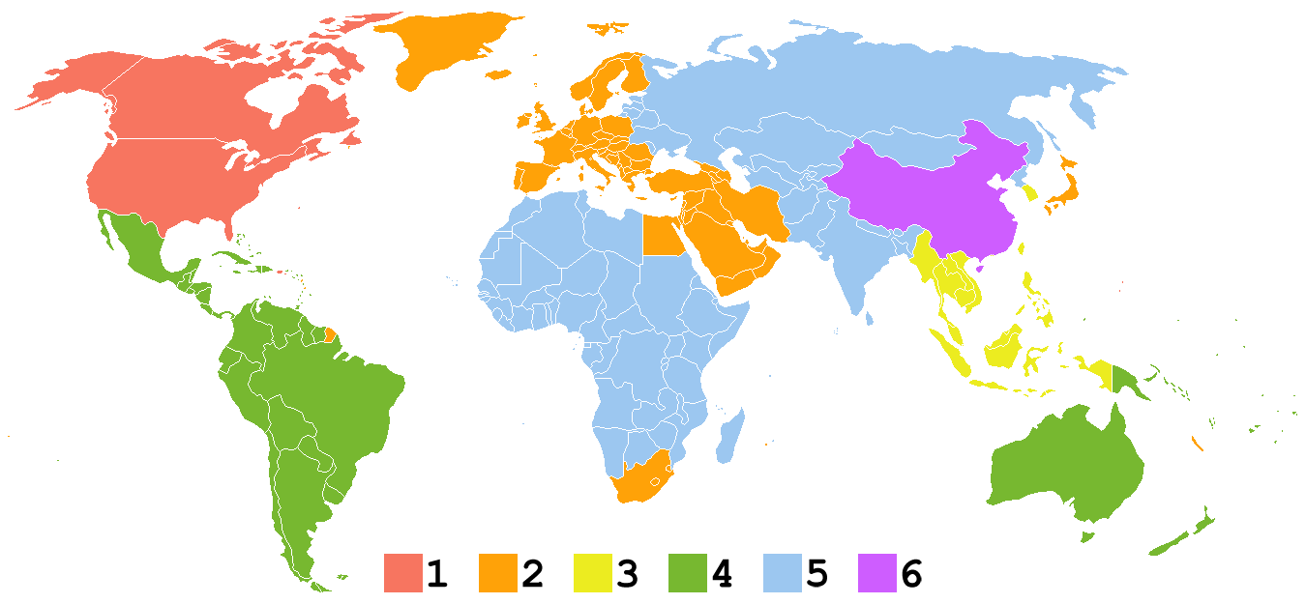

How Studios Split our Planet
DVD Region Code Symbol
A region code byte is recorded on a disc

Slide 24
DRM Architecture
Proposed by the Copy Protection Technical Working Group for DVD (CPTWG), IBM, Intel, Matsushita, Toshiba.
Idea:
  Alice sells Bob a video, in order for Alice to prevent Bob from re-disseminating the video to others, Alice tries to make sure that Bob only accesses the video data on a trusted (or compliant) device

Slide 25
Trusted Devices
A trusted device is manufactured by a trusted manufacturer.
A manufacturer is trusted if it has joined the Copy Control Association (CCA)
A trusted device is given a (secret) player key
The trusted manufacturer has to sign an agreement with CCA, basically barring it from making devices that could undermine the copy protection mechanism.
Since 2000, manufacturers must produce DVD ROM drivers compliant with=RPC 2 (Region Playback Control)

Slide 26
CSS: Content Scrambling System
In most cases, a DVD (video disk) is protected by the CSS scheme. Intuitively, the video content is encrypted using a disc key, k.
In the lead-in area of a CSS-protected DVD, the disk’s key k is encrypted about 400 times, each using a different player key.
A DVD player with the i^{th} player key will read the i^{th} entry of the key block. This entry is then decrypted using the player key k_{i} to obtain the disk key k.
The video content is then decrypted on-the-fly while the movie is played.
Using a normal DVD writer the copy will not have the key block and disk will not be playable
if someone decrypts a video, with special tools (HW or SW), it is possible make pirated copies with the lead-in key block or without CSS (i.e., decrypted).
copy
unencrypted
Lead-in
with
Key block
Lead-in
without
Key block
decrypt
and write

Slide 27
Viewing a DVD
Player Key
Decrypt Disc Key
Disc Key
Encrypted Content
Decrypt Title Key
Title Key
Encrypted Content
Title Key
Decrypt Content
(To Output Device)

Slide 28
CSS Keys
Authentication Key
  Used for mutual authentication
Session/Bus Key
  negotiated during authentication
  encrypt title and disk keys before sending them over the unprotected bus
  Prevent eavesdropping
Player Key
  Licensed by the “DVD Copy Control Association” to the manufacturer of a DVD player
  Stored within the player
  Authenticates the player
  Used to decrypt disk key.
Disk Key
  Used to decrypt the title key
Title Key
  This key is XORed with a per-sector key to encrypt the data within a sector
Sector Key
  Each sector has a 128-byte plain-text header
  Bytes 80 - 84 of each sector’s header contain an additional key used to encode the data within the sector

Slide 29
DeCSS
Created in 1999 by Jon Johansen
Decrypts CSS and allows for copying files to hard drive
At the time, little information known about CSS algorithm
DeCSS came with the source code that showed how easy it was to crack CSS
Technique used for creating open source DVD players that could run on Linux
First in a long line of DVD decrypting programs
Johansen was sued by the DVD-CCA but case was dropped
  Mass pirating occurred far before DeCSS was published
  DVD writers are unable to write to the region that CSS writes
  Most DVD copies done using special equipment that copy bit by bit

Slide 30
Advanced Access Content System
New standard for DRM that allows for limited sharing and copying of next generation DVDs
  Developed by Microsoft, Sony, Disney, IBM, Matsushita, and Warner Brothers
  Used in Blu-Ray
Method
  Based on broadcast encryption
  Revocation of traitors

