Slide 1
Policy, Models, and Trust

Slide 2
Security Policy
A security policy is a well-defined set of rules that include the following:
Subjects: the agents who interact with the system, which could be defined in terms of specific individuals or in terms of roles or ranks that groups of individuals might hold within an organization.
  Individuals could be identified by their names or by their job titles, like President, CEO, or CFO. Groups could be defined using terms such as users, administrators, generals, majors, faculty, deans, managers, and administrative assistants. This category also includes outsiders, such as attackers and guests.
Objects: the informational and computational resources that a security policy is designed to protect and manage.
  Examples include critical documents, files, and databases, and computational resources include servers, workstations, and software.
Actions: the things that subjects may or may not do with respect to the objects.
  Examples include the reading and writing of documents, updating software on a web server, and accessing the contents of a database.
Permissions: mappings between subjects, actions, and objects, which clearly state what kinds of actions are allowed or disallowed.
Protections: the specific security features or rules that are included in the policy to help achieve particular security goals, such as confidentiality, integrity, availability, or anonymity.

Slide 3

Security Models
A security model is an abstraction that provides a conceptual language for administrators to specify security policies.
Typically, security models define hierarchies of access or modification rights that members of an organization can have, so that subjects in an organization can easily be granted specific rights based on the position of these rights in the hierarchy.
Examples include military classifications of access rights for documents based on concepts like “unclassified,” “confidential,” “secret,” and “top secret.”
U.S. government image in the public domain.

Slide 4
Discretionary Access Control
Discretionary access control, or DAC, refers to a scheme where users are given the ability to determine the permissions governing access to their own files.
  DAC typically features the concept of both users and groups, and allows users to set access-control measures in terms of these categories.
  In addition, DAC schemes allow users to grant privileges on resources to other users on the same system.

Slide 5
Mandatory Access Control
Mandatory access control is a more restrictive scheme that does not allow users to define permissions on files, regardless of ownership. Instead, security decisions are made by a central policy administrator.
  Each security rule consists of a subject, which represents the party attempting to gain access, an object, referring to the resource being accessed, and a series of permissions that define the extent to which that resource can be accessed.
Security-Enhanced Linux (SELinux) incorporates mandatory access control.

Slide 6

Trust Management
A trust management system is a formal framework for specifying security policy in a precise language, which is usually a type of logic or programming language, together with a mechanism for ensuring that the specified policy is enforced.
A trust management system consists of two main components:
  a policy language
  a compliance checker
Policy rules are specified in the policy language and are enforced by the compliance checker.

Slide 7
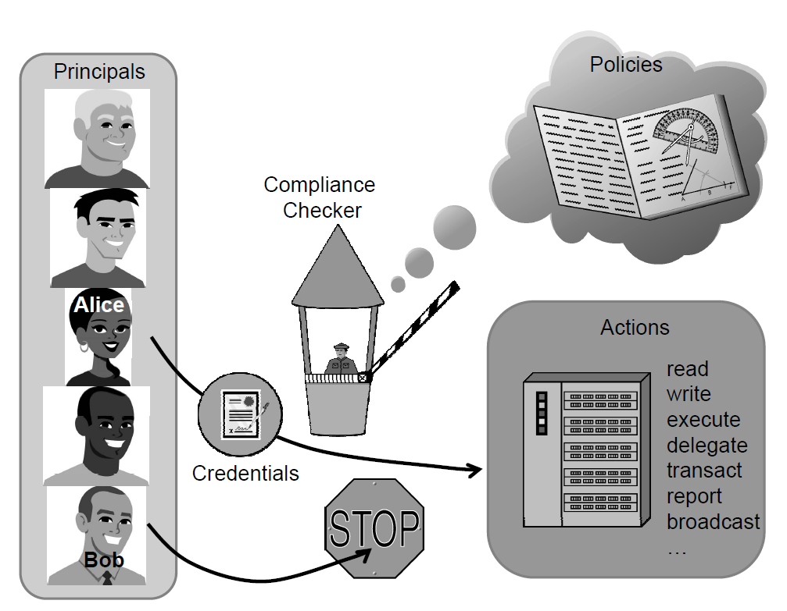
Trust Management Systems
A trust management system typically has rules describing:
Actions: operations with security-related consequences on the system
Principals: users, processes, or other entities that can perform actions on the system
Policies: precisely written rules that govern which principals are authorized to perform which actions
Credentials: digitally signed documents that bind principal identities to allowable actions, including the authority to allow principals to delegate authority to other principals.

Slide 8

Access Control Models
Various models have been developed to formalize mechanisms to protect the confidentiality and integrity of documents stored in a computer system.
  The Bell-La Padula (BLP) model
  The Biba model
  The Low-Watermark model
  The Clark-Wilson model
  The Chinese Wall model (The Brewer and Nash model)

Slide 9
The Bell-La Padula Model
The Bell-La Padula (BLP) model is a classic mandatory access-control model for protecting confidentiality.
The BLP model is derived from the military multilevel security paradigm, which has been traditionally used in military organizations for document classification and personnel clearance.

Slide 10
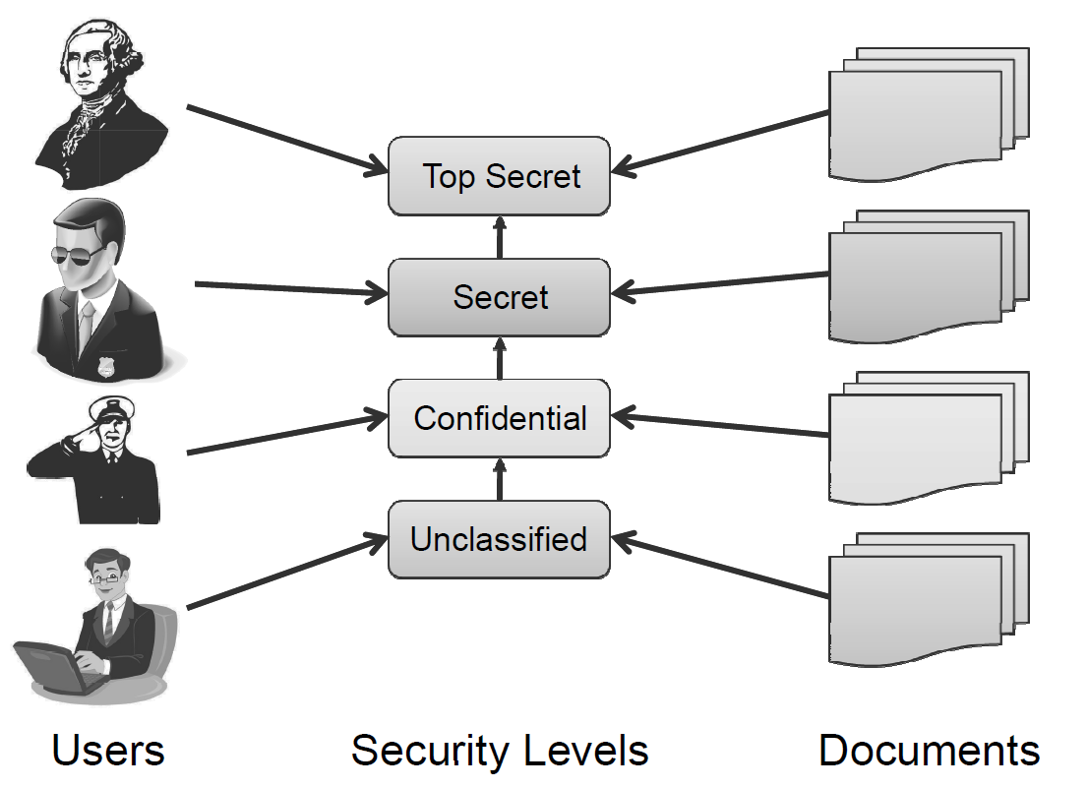
The Bell-La Padula Model
The BLP model has a strict, linear ordering on the security of levels of documents, so that each document has a specific security level in this ordering and each user is assigned a strict level of access that allows them to view all documents with the corresponding level of security or below.

Slide 11
Total Orders and Partial Orders
A linear ordering for documents can be defined in terms of a comparison rule, . We say that such a rule defines a total order on a universe set, U, if it satisfies the following properties:
  Reflexivity: If x is in U, then x < x.
  Antisymmetry: If x < y and y < x, then x = y.
  Transitivity: If x < y and y < z, then x < z.
  Totality: If x and y are in U, then x < y or y < x.
All of the usual definitions of “less than or equal to” for numbers, such as integers and real numbers, are total orders.
If we drop the requirement of totality, we get a partial order.
  The classic example of a partial order is the set of courses taught at a college or university, where we say that, for two courses A and B, A < B, if A is a prerequisite for B.

Slide 12
How the BLP Model Works
The security levels in BLP form a partial order, <.
Each object, x, is assigned to a security level, L(x). Similarly, each user, u, is assigned to a security level, L(u). Access to objects by users is controlled by the following two rules:
  Simple security property. A user u can read an object x only if
  L(x) < L(u).
  *-property. A user u can write (create, edit, or append to) an object x only if
  L(u) < L(x).
The simple security property is also called the “no read up” rule, as it prevents users from viewing objects with security levels higher than their own.
The *-property is also called the “no write down” rule. It is meant to prevent propagation of information to users with a lower security level.

Slide 13
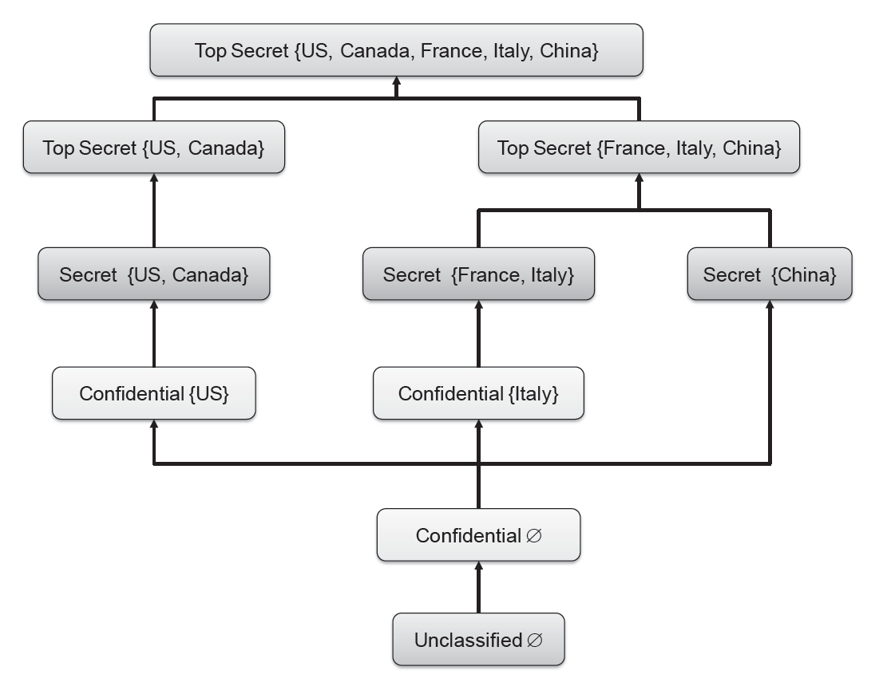
Defining Security Levels Using Categories

Slide 14
The Biba Model
The Biba model has a similar structure to the BLP model, but it addresses integrity rather than confidentiality.
Objects and users are assigned integrity levels that form a partial order, similar to the BLP model.
The integrity levels in the Biba model indicate degrees of trustworthiness, or accuracy, for objects and users, rather than levels for determining confidentiality.
  For example, a file stored on a machine in a closely monitored data center would be assigned a higher integrity level than a file stored on a laptop.
  In general, a data-center computer is less likely to be compromised than a random laptop computer. Likewise, when it comes to users, a senior employee with years of experience would have a higher integrity level than an intern.

Slide 15
The Biba Model Rules
The access-control rules for Biba are the reverse of those for BLP. That is, Biba does not allow reading from lower levels and writing to upper levels.
If we let I(u) denote the integrity level of a user u and I(x) denote the integrity level for an object, x, we have the following rules in the Biba model:
  A user u can read an object x only if
  I(u) < I(x).
  A user u can write (create, edit or append to) an object x only if
  I(x) < I(u).
Thus, the Biba rules express the principle that information can only flow down, going from higher integrity levels to lower integrity levels.

Slide 16
The Low-Watermark Model
The low-watermark model is an extension to the Biba model that relaxes the “no read down” restriction, but is otherwise similar to the Biba model.
In other words, users with higher integrity levels can read objects with lower integrity levels.
After such a reading, the user performing the reading is demoted such that his integrity level matches that of the read object.

Slide 17
The Clark-Wilson Model
Rather than dealing with document confidentiality and/or integrity, the Clark-Wilson (CW) model deals with systems that perform transactions.
It describes mechanisms for assuring that the integrity of such a system is preserved across the execution of a transaction. Key components of the CW model include the following:
  Integrity constraints that express relationships among objects that must be satisfied for the system state to be valid. A classic example of an integrity constraint is the relationship stating that the final balance of a bank account after a withdrawal transaction must be equal to the initial balance minus the amount withdrawn.
  Certification methods that verify that transactions meet given integrity constraints. Once the program for a transaction is certified, the integrity constraints do not need to be verified at each execution of the transaction.
  Separation of duty rules that prevent a user that executes transaction from certifying it. In general, each transaction is assigned disjoint sets of users that can certify and execute it, respectively.

Slide 18
The Chinese Wall Model
The Brewer and Nash model, commonly referred to as the Chinese wall model, is designed for use in the commercial sector to eliminate the possibility of conflicts of interest.
To achieve this, the model groups resources into “conflict of interest classes.”
The model enforces the restriction that each user can only access one resource from each conflict of interest class.
  In the financial world, such a model might be used, for instance, to prevent market analysts from receiving insider information from one company and using that information to provide advice to that company’s competitor.
Such a policy might be implemented on computer systems to regulate users’ access to sensitive or proprietary data.

Slide 19

Role-Based Access Control
The role-based access control (RBAC) model can be viewed as an evolution of the notion of group-based permissions in file systems.
An RBAC system is defined with respect to an organization, such as company, a set of resources, such as documents, print services, and network services, and a set of users, such as employees, suppliers, and customers.
U.S. Navy image in the public domain.

Slide 20
RBAC Components
A user is an entity that wishes to access resources of the organization to perform a task. Usually, users are actual human users, but a user can also be a machine or application.
A role is defined as a collection of users with similar functions and responsibilities in the organization. Examples of roles in a university may include “student,” “alum,” “faculty,” “dean,” “staff,” and “contractor.” In general, a user may have multiple roles.
  Roles and their functions are often specified in the written documents of the organization.
  The assignment of users to roles follows resolutions by the organization, such as employment actions (e.g., hiring and resignation) and academic actions (e.g., admission and graduation).
A permission describes an allowed method of access to a resource.
  More specifically, a permission consists of an operation performed on an object, such as “read a file” or “open a network connection.” Each role has an associated set of permissions.
A session consists of the activation of a subset of the roles of a user for the purpose of performing a certain task.
  For example, a laptop user may create a session with the administrator role to install a new program.
  Sessions support the principle of least privilege.

Slide 21
Hierarchical RBAC
In the role-based access control model, roles can be structured in a hierarchy similar to an organization chart.
More formally, we define a partial order among roles by saying that a role R1 inherits role R2, which is denoted
R1 > R2,
if R1 includes all permissions of R2 and R2 includes all users of R1.
When R1 > R2, we also say that role R1 is senior to role R2 and that role R2 is junior to role R1.
  For example, in a company, the role “manager” inherits the role “employee” and the role “vice president” inherits the role “manager.”
  Also, in a university, the roles “undergraduate student” and “graduate student” inherit the role “student.”

Slide 22
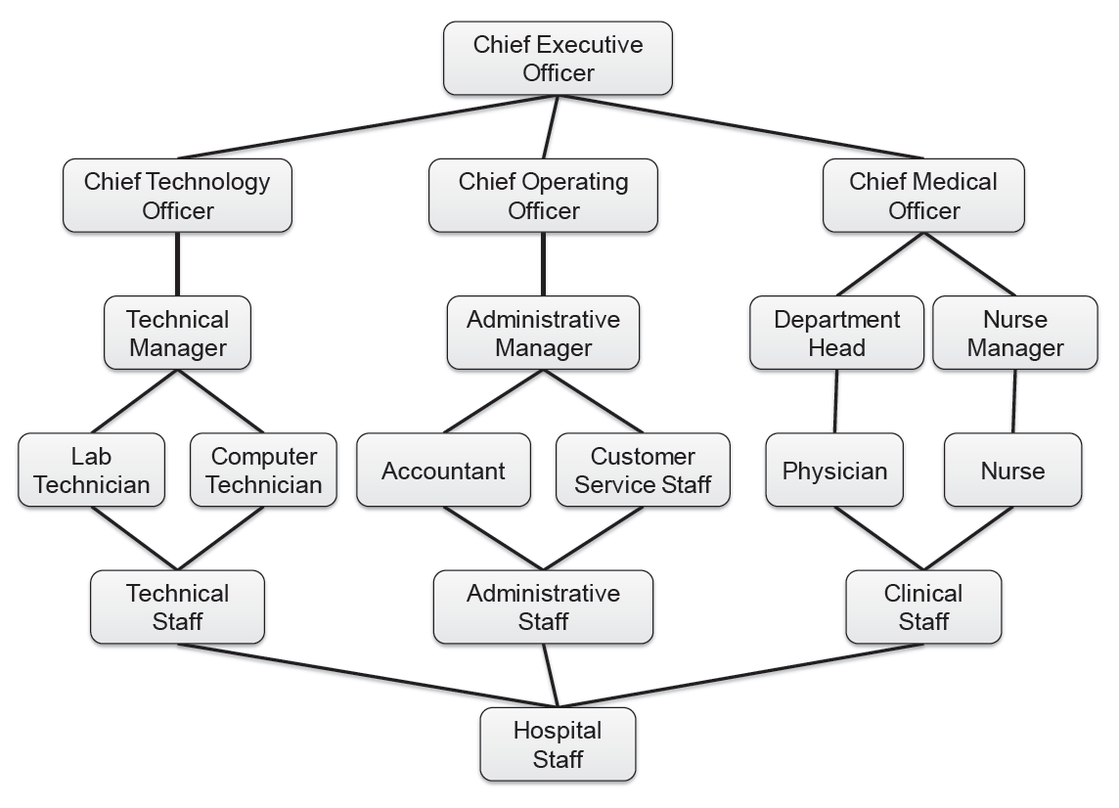
Visualizing Role Hierarchy

