Slide 1
Computer Networks:
Domain Name System
Notes:
1

Slide 2

Domain Name System
The domain name system (DNS) is an application-layer protocol for mapping domain names to IP addresses
DNS
www.example.com
208.77.188.166
http://www.example.com
My Example Blog Spot
http://208.77.188.166
My Example Blog Spot
Vacation
Savings
Vacation
Savings
Notes:
2
2

Slide 3
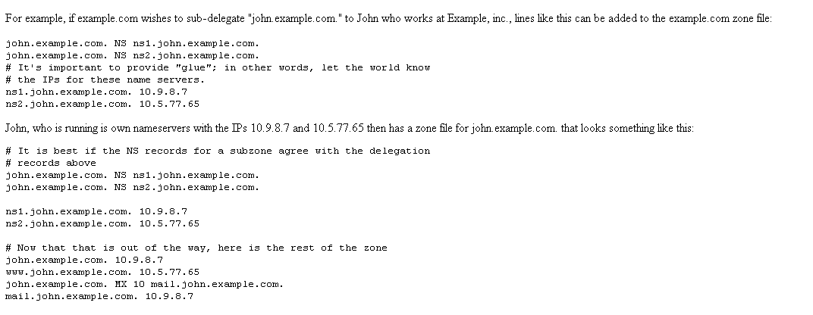
Domain Name System
DNS provides a distributed database over the internet that stores various resource records, including:
  Address (A) record: IP address associated with a host name
  Mail exchange(MX) record: mail server of a domain
  Name server (NS) record: authoritative server for a domain
Example DNS entries from http://www.maradns.org/tutorial/recordtypes.html
Notes:
3
3

Slide 4
Name Servers
Domain names:
  Two or more labels, separated by dots (e.g., cs166.net)
  Rightmost label is the top-level domain (TLD)
Hierarchy of authoritative name servers
  Information about root domain
  Information about its subdomains (A records) or references to other name servers (NS records)
The authoritative name server hierarchy matches the domain hierarchy: root servers point to DNS servers for TLDs, etc.
Root servers, and servers for TLDs change infrequently
DNS servers refer to other DNS servers by name, not by IP: sometimes must bootstrap by providing an IP along with a name, called a glue record

Slide 5
DNS Tree
A xxx.com ###########
A xxx.com ###########
A xxx.com ###########
A xxx.com ###########
A xxx.com ###########
A xxx.com ###########
A xxx.com ###########
A xxx.com ###########
A xxx.com ###########
A xxx.com ###########
A xxx.com ###########
A xxx.com ###########
A xxx.com ###########
A xxx.com ###########
A xxx.com ###########
A xxx.com ###########
A xxx.com ###########
A xxx.edu ###########
A xxx.edu ###########
A xxx.edu ###########
A xxx.edu ###########
A xxx.edu ###########
A xxx.edu ###########
A xxx.edu ###########
A xxx.edu ###########
A xxx.edu ###########
A xxx.edu ###########
A xxx.edu ###########
A xxx.edu ###########
A xxx.edu ###########
A xxx.edu ###########
com
edu
...
...
...
google.com
microsoft.com
stanford.edu
brown.edu
A google.com 66.249.91.104
A xxx.google.com ###########
A xxx.google.com ###########
A xxx.google.com ###########
A xxx.google.com ###########
A xxx.google.com ###########
A xxx.google.com ###########
A xxx.google.com ###########
A xxx.google.com ###########
A xxx.google.com ###########
A xxx.google.com ###########
A xxx.google.com ###########
A xxx.google.com ###########
A xxx.google.com ###########
Amicrosoft.com 207.46.232.182
A xxx.microsoft.com ###########
A xxx.microsoft.com ###########
A xxx.microsoft.com ###########
A xxx.microsoft.com ###########
A xxx.microsoft.com ###########
A xxx.microsoft.com ###########
A xxx.microsoft.com ###########
A xxx.microsoft.com ###########
A xxx.microsoft.com ###########
A xxx.microsoft.com ###########
A xxx.microsoft.com ###########
A xxx.microsoft.com ###########
A xxx.microsoft.com ###########
A xxx.microsoft.com ###########
A xxx.microsoft.com ###########
A stanford.edu 171.67.216.18
A xxx.stanford.edu 171.67.###.###
A xxx.stanford.edu 171.67.###.###
A xxx.stanford.edu 171.67.###.###
A xxx.stanford.edu 171.67.###.###
A xxx.stanford.edu 171.67.###.###
A xxx.stanford.edu 171.67.###.###
A xxx.stanford.edu 171.67.###.###
A xxx.stanford.edu 171.67.###.###
A xxx.stanford.edu 171.67.###.###
A xxx.stanford.edu 171.67.###.###
A xxx.stanford.edu 171.67.###.###
A xxx.stanford.edu 171.67.###.###
A xxx.stanford.edu 171.67.###.###
A brown.edu 128.148.128.180
A xxx.brown.edu 128.148.###.###
A xxx.brown.edu 128.148.###.###
A xxx.brown.edu 128.148.###.###
A xxx.brown.edu 128.148.###.###
A xxx.brown.edu 128.148.###.###
A xxx.brown.edu 128.148.###.###
A xxx.brown.edu 128.148.###.###
A xxx.brown.edu 128.148.###.###
A xxx.brown.edu 128.148.###.###
A xxx.brown.edu 128.148.###.###
A xxx.brown.edu 128.148.###.###
A xxx.brown.edu 128.148.###.###
A xxx.brown.edu 128.148.###.###
A xxx.brown.edu 128.148.###.###
cs.brown.edu
A cs.brown.edu 128.148.32.110
A xxx.brown.edu 128.148.32.###
A xxx.brown.edu 128.148.32.###
A xxx.brown.edu 128.148.32.###
A xxx.brown.edu 128.148.32.###
A xxx.brown.edu 128.148.32.###
A xxx.brown.edu 128.148.32.###
A xxx.brown.edu 128.148.32.###
A xxx.brown.edu 128.148.32.###
A xxx.brown.edu 128.148.32.###
resource records

Slide 6
Namespace Management
ICANN: Internet Corporation for Assigned Names and Numbers
ICANN has the overall responsibility for managing DNS. It controls the root domain, delegating control over each top-level domain to a domain name registry
Along with a small set of general TLDs, every country has its own TLD -- (cTLDS) – controlled by the government.
ICANN is the governing body for all general TLDs
Until 1999 all .com, .net and .org registries were handled by Network Solutions Incorporated.
After November, 1999, ICANN and NSI had to allow for a shared registration system and there are currently over 500 registrars in the market
Also since 1999, ICANN has created additional gTLDs including some which are sponsored by consortiums or groups of companies.
Notes:
6
6

Slide 7
Top Level Domains
Started in 1984
Originally supposed to be named by function
  .com for commercial websites, .mil for military
Eventually agreed upon unrestricted TLDs for .com, .net, .org, .info
In 1994 started allowing country TLDs such as .it, .us
Tried to move back to hierarchy of purpose in 2000 with creation of .aero, .museum, etc.

Slide 8
Name Resolution
Zone: collection of connected nodes with the same authoritative DNS server
Resolution method when answer not in cache:
root
name server
Where is www.example.com?
ISP DNS
Server
Try com nameserver
Client
Where is www.example.com?
Where is www.example.com?
com
name server
Try example.com nameserver
208.77.188.166
Where is www.example.com?
208.77.188.166
example.com
name server

Slide 9
Recursive Name Resolution
Server B
Resolver
cache
Server A
referral
Local Machine
query
Resolver
query
Application
Resolver
answer
answer
cache
cache

Slide 10
Iterative Name Resolution
. (root)
Resolver
cache
1
answer
query
.com
Local Name Server
Resolver
2
query
Application
Resolver
answer
google.com
cache
cache
query
Resolver
answer
3
cache

Slide 11
Authoritative Name Servers
Control distributed among authoritative name servers (ANSs)
  Responsible for specific domains
  Can designate other ANS for subdomains
ANS can be master or slave
  Master contains original zone table
  Slaves are replicas, automatically updating
Makes DNS fault tolerant, automatically distributes load
ANS must be installed as a NS in parents' zone

Slide 12
Dynamic Resolution
Many large providers have more than one authoritative name server for a domain
Problem: need to locate the instance of domain geographically closest to user
Proposed solution: include first 3 octets of requester's IP in recursive requests to allow better service
Content distribution networks already do adaptive DNS routing

Slide 13
DNS Caching
There would be too much network traffic if a path in the DNS tree would be traversed for each query
  Root zone would be rapidly overloaded
DNS servers cache results for a specified amount of time
  Specified by ANS reply's time-to-live field
Operating systems and browsers also maintain resolvers and DNS caches
  View in Windows with command ipconfig /displaydns
  Associated privacy issues
DNS queries are typically issued over UDP on port 53
  16-bit request identifier in payload

Slide 14
DNS Caching
Step 1: query yourdomain.org
Local Machine
Local NS
Authoritative
Name Server
Resolver
Application
Resolver
query
query
cache
cache
Step 2: receive reply and cache at local NS and host
Local Machine
Local NS
Authoritative
Name Server
answer
Resolver
answer
Application
Resolver
cache
cache

Slide 15
DNS Caching (con'd)
Step 3: use cached results rather than querying the ANS
Local NS
Local Machine 1
Application
Resolver
Resolver
cache
cache
query
Local Machine 2
Application
Resolver
answer
cache
Step 4: Evict cache entries upon ttl expiration

Slide 16
Pharming: DNS Hijacking
Changing IP associated with a server maliciously:
208.77.188.166
74.208.31.63
Normal
DNS
Pharming
attack
www.example.com
www.example.com
http://www.example.com
My Premium Blog Spot
http://www.example.com
My Premium Blog Spot
userID:
password:
userID:
password:
Phishing: the different web sites look the same.

Slide 17
DNS Cache Poisoning
Basic idea: give DNS servers false records and get it cached
DNS uses a 16-bit request identifier to pair queries with answers
Cache may be poisoned when a name server:
  Disregards identifiers
  Has predictable ids
  Accepts unsolicited DNS records
Notes:
17
17
There are 3 main different ways to do DNS cache poisoning. The first relies on redirecting the nameserver of the attacker's domain to the nameserver of the target domain, and then assigning this target nameserver a fake IP address. The second variant relies on redirecting the nameserver of another, unrelated domain to a fake nameserver. The third variant just involves “racing” the real nameserver to give an answer.

Slide 18
DNS Cache Poisoning Prevention
Use random identifiers for queries
Always check identifiers
Port randomization for DNS requests
Deploy DNSSEC
  Challenging because it is still being deployed and requires reciprocity
Notes:
18
18
There are 3 main different ways to do DNS cache poisoning. The first relies on redirecting the nameserver of the attacker's domain to the nameserver of the target domain, and then assigning this target nameserver a fake IP address. The second variant relies on redirecting the nameserver of another, unrelated domain to a fake nameserver. The third variant just involves “racing” the real nameserver to give an answer.

Slide 19
DNSSEC
Guarantees:
  Authenticity of DNS answer origin
  Integrity of reply
  Authenticity of denial of existence
Accomplishes this by signing DNS replies at each step of the way
Uses public-key cryptography to sign responses
Typically use trust anchors, entries in the OS to bootstrap the process
Notes:
19

Slide 20
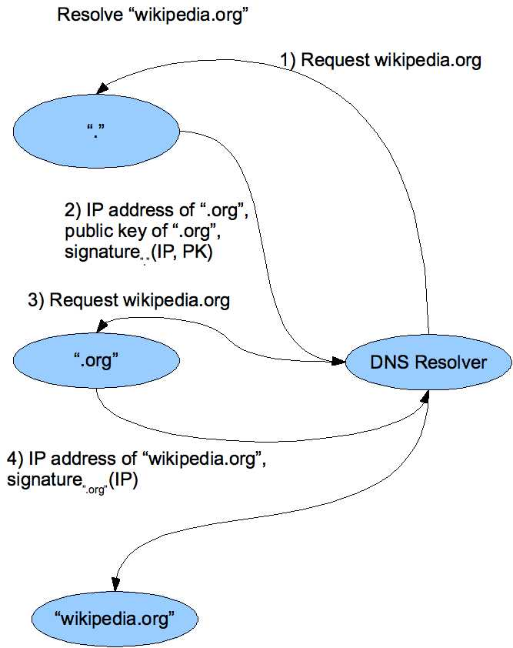
DNS Signing
Notes:
20

Slide 21
DNSSEC Deployment
As the internet becomes regarded as critical infrastructure there is a push to secure DNS
NIST is in the process of deploying it on root servers now
May add considerable load to dns servers with packet sizes considerably larger than 512 byte size of UDP packets
There are political concerns with the US controlling the root level of DNS

