Slide 1
Firewalls, Tunnels, and
Network Intrusion Detection

Slide 2
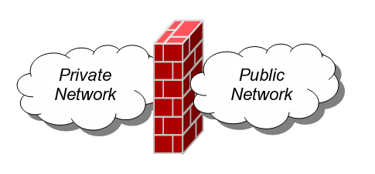
Firewalls
A firewall is an integrated collection of security measures designed to prevent unauthorized electronic access to a networked computer system.
A network firewall is similar to firewalls in building construction, because in both cases they are intended to isolate one "network" or "compartment" from another.

Slide 3
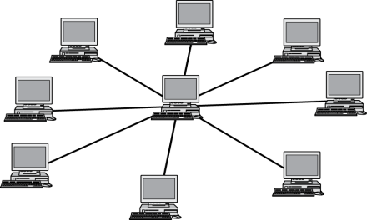




Firewall Policies
To protect private networks and individual machines from the dangers of the greater Internet, a firewall can be employed to filter incoming or outgoing traffic based on a predefined set of rules called firewall policies.
Trusted internal network
Firewall policies
Untrusted
Internet
Firewall

Slide 4
Policy Actions
Packets flowing through a firewall can have one of three outcomes:
  Accepted: permitted through the firewall
  Dropped: not allowed through with no indication of failure
  Rejected: not allowed through, accompanied by an attempt to inform the source that the packet was rejected
Policies used by the firewall to handle packets are based on several properties of the packets being inspected, including the protocol used, such as:
  TCP or UDP
  the source and destination IP addresses
  the source and destination ports
  the application-level payload of the packet (e.g., whether it contains a virus).

Slide 5
Blacklists and White Lists
There are two fundamental approaches to creating firewall policies (or rulesets) to effectively minimize vulnerability to the outside world while maintaining the desired functionality for the machines in the trusted internal network (or individual computer).
Blacklist approach
  All packets are allowed through except those that fit the rules defined specifically in a blacklist.
  This type of configuration is more flexible in ensuring that service to the internal network is not disrupted by the firewall, but is naïve from a security perspective in that it assumes the network administrator can enumerate all of the properties of malicious traffic.
Whitelist approach
  A safer approach to defining a firewall ruleset is the default-deny policy, in which packets are dropped or rejected unless they are specifically allowed by the firewall.

Slide 6
Firewall Types
packet filters (stateless)
  If a packet matches the packet filter's set of rules, the packet filter will drop or accept it
"stateful" filters
  it maintains records of all connections passing through it and can determine if a packet is either the start of a new connection, a part of an existing connection, or is an invalid packet.
application layer
  It works like a proxy it can “understand” certain applications and protocols.
  It may inspect the contents of the traffic, blocking what it views as inappropriate content (i.e. websites, viruses, vulnerabilities, ...)

Slide 7

Stateless Firewalls
A stateless firewall doesn’t maintain any remembered context (or “state”) with respect to the packets it is processing. Instead, it treats each packet attempting to travel through it in isolation without considering packets that it has processed previously.
SYN
Seq = x
Port=80
Client
SYN-ACK
Seq = y
Ack = x + 1
ACK
Seq = x + 1
Ack = y + 1
Trusted internal
network
Server
Firewall
Allow outbound SYN packets, destination port=80
Allow inbound SYN-ACK packets, source port=80

Slide 8

Stateless Restrictions
Stateless firewalls may have to be fairly restrictive in order to prevent most attacks.
Client
(blocked)
SYN
Seq = y
Port=80
Attacker
Trusted internal
network
Firewall
Allow outbound SYN packets, destination port=80
Drop inbound SYN packets,
Allow inbound SYN-ACK packets, source port=80

Slide 9
Statefull Firewalls
Stateful firewalls can tell when packets are part of legitimate sessions originating within a trusted network.
Stateful firewalls maintain tables containing information on each active connection, including the IP addresses, ports, and sequence numbers of packets.
Using these tables, stateful firewalls can allow only inbound TCP packets that are in response to a connection initiated from within the internal network.

Slide 10
Statefull Firewall Example
Allow only requested TCP connections:
76.120.54.101
SYN
Seq = x
Port=80
Server
128.34.78.55
Client
SYN-ACK
Seq = y
Ack = x + 1
ACK
Seq = x + 1
Ack = y + 1
Trusted internal
network
(blocked)
SYN-ACK
Seq = y
Port=80
Attacker
Allow outbound TCP sessions,
destination port=80
Firewall
Established TCP session:
(128.34.78.55, 76.120.54.101)
Firewall state table

Slide 11
Tunnels
The contents of TCP packets are not normally encrypted, so if someone is eavesdropping on a TCP connection, he can often see the complete contents of the payloads in this session.
One way to prevent such eavesdropping without changing the software performing the communication is to use a tunneling protocol.
In such a protocol, the communication between a client and server is automatically encrypted, so that useful eavesdropping is infeasible.

Slide 12
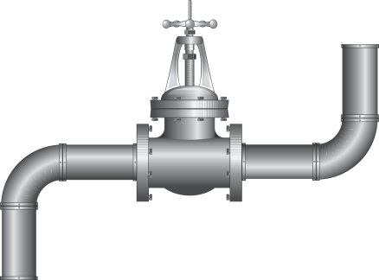
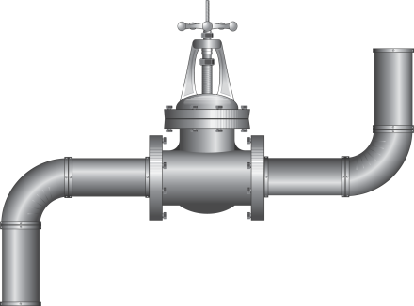
Tunneling Prevents Eavesdropping
Packets sent over the Internet are automatically encrypted.
Client
Server
Tunneling protocol
(does end-to-end encryption and decryption)
Untrusted Internet
TCP/IP
TCP/IP
Payloads are encrypted here

Slide 13
Secure Shell (SSH)
A secure interactive command session:
The client connects to the server via a TCP session.
The client and server exchange information on administrative details, such as supported encryption methods and their protocol version, each choosing a set of protocols that the other supports.
The client and server initiate a secret-key exchange to establish a shared secret session key, which is used to encrypt their communication (but not for authentication). This session key is used in conjunction with a chosen block cipher (typically AES, 3DES) to encrypt all further communications.
The server sends the client a list of acceptable forms of authentication, which the client will try in sequence. The most common mechanism is to use a password or the following public-key authentication method:
  If public-key authentication is the selected mechanism, the client sends the server its public key.
  The server then checks if this key is stored in its list of authorized keys. If so, the server encrypts a challenge using the client’s public key and sends it to the client.
  The client decrypts the challenge with its private key and responds to the server, proving its identity.
Once authentication has been successfully completed, the server lets the client access appropriate resources, such as a command prompt.

Slide 14
IPSec
IPSec defines a set of protocols to provide confidentiality and authenticity for IP packets
Each protocol can operate in one of two modes, transport mode or tunnel mode.
  In transport mode, additional IPsec header information is inserted before the data of the original packet, and only the payload of the packet is encrypted or authenticated.
  In tunnel mode, a new packet is constructed with IPsec header information, and the entire original packet, including its header, is encapsulated as the payload of the new packet.

Slide 15
Virtual Private Networking (VPN)
Virtual private networking (VPN) is a technology that allows private networks to be safely extended over long physical distances by making use of a public network, such as the Internet, as a means of transport.
VPN provides guarantees of data confidentiality, integrity, and authentication, despite the use of an untrusted network for transmission.
There are two primary types of VPNs, remote access VPN and site-to-site VPN.

Slide 16
Types of VPNs
Remote access VPNs allow authorized clients to access a private network that is referred to as an intranet.
  For example, an organization may wish to allow employees access to the company network remotely but make it appear as though they are local to their system and even the Internet itself.
  To accomplish this, the organization sets up a VPN endpoint, known as a network access server, or NAS. Clients typically install VPN client software on their machines, which handle negotiating a connection to the NAS and facilitating communication.
Site-to-site VPN solutions are designed to provide a secure bridge between two or more physically distant networks.
  Before VPN, organizations wishing to safely bridge their private networks purchased expensive leased lines to directly connect their intranets with cabling.

Slide 17
Intrusion Detection Systems
Intrusion
  Actions aimed at compromising the security of the target (confidentiality, integrity, availability of computing/networking resources)
Intrusion detection
  The identification through intrusion signatures and report of intrusion activities
Intrusion prevention
  The process of both detecting intrusion activities and managing automatic responsive actions throughout the network

Slide 18





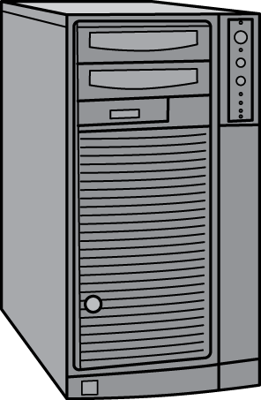
IDS Components
The IDS manager compiles data from the IDS sensors to determine if an intrusion has occurred.
This determination is based on a set of site policies, which are rules and conditions that define probable intrusions.
If an IDS manager detects an intrusion, then it sounds an alarm.
Untrusted Internet
IDS Manager
router
IDS Sensor
IDS Sensor
Firewall
router
router

Slide 19
Intrusions
An IDS is designed to detect a number of threats, including the following:
  masquerader: an attacker who is falsely using the identity and/or credentials of a legitimate user to gain access to a computer system or network
  Misfeasor: a legitimate user who performs actions he is not authorized to do
  Clandestine user: a user who tries to block or cover up his actions by deleting audit files and/or system logs
In addition, an IDS is designed to detect automated attacks and threats, including the following:
  port scans: information gathering intended to determine which ports on a host are open for TCP connections
  Denial-of-service attacks: network attacks meant to overwhelm a host and shut out legitimate accesses
  Malware attacks: replicating malicious software attacks, such as Trojan horses, computer worms, viruses, etc.
  ARP spoofing: an attempt to redirect IP traffic in a local-area network
  DNS cache poisoning: a pharming attack directed at changing a host’s DNS cache to create a falsified domain-name/IP-address association

Slide 20




Possible Alarm Outcomes
Alarms can be sounded (positive) or not (negative)
Intrusion Attack
No Intrusion Attack
Alarm
Sounded
True Positive
False Positive
No
Alarm
Sounded
False Negative
True Negative

Slide 21
The Base-Rate Fallacy
It is difficult to create an intrusion detection system with the desirable properties of having both a high true-positive rate and a low false-negative rate.
If the number of actual intrusions is relatively small compared to the amount of data being analyzed, then the effectiveness of an intrusion detection system can be reduced.
In particular, the effectiveness of some IDSs can be misinterpreted due to a statistical error known as the base-rate fallacy.
This type of error occurs when the probability of some conditional event is assessed without considering the “base rate” of that event.

Slide 22
Base-Rate Fallacy Example
Suppose an IDS is 99% accurate, having a 1% chance of false positives or false negatives. Suppose further…
An intrusion detection system generates 1,000,100 log entries.
Only 100 of the 1,000,100 entries correspond to actual malicious events.
Because of the success rate of the IDS, of the 100 malicious events, 99 will be detected as malicious, which means we have 1 false negative.
Nevertheless, of the 1,000,000 benign events, 10,000 will be mistakenly identified as malicious. That is, we have 10,000 false positives!
Thus, there will be 10,099 alarms sounded, 10,000 of which are false alarms. That is, roughly 99% of our alarms are false alarms.

Slide 23
IDS Data
In an influential 1987 paper, Dorothy Denning identified several fields that should be included in IDS event records:
  Subject: the initiator of an action on the target
  Object: the resource being targeted, such as a file, command, device, or network protocol
  Action: the operation being performed by the subject towards the object
  Exception-condition: any error message or exception condition that was raised by this action
  Resource-usage: quantitative items that were expended by the system performing or responding to this action
  Time-stamp: a unique identifier for the moment in time when this action was initiated

Slide 24
Types of Intrusion Detection Systems
Rule-Based Intrusion Detection
  Rules identify the types of actions that match certain known profiles for an intrusion attack, in which case the rule would encode a signature for such an attack. Thus, if the IDS manager sees an event that matches the signature for such a rule, it would immediately sound an alarm, possibly even indicating the particular type of attack that is suspected.
Statistical Intrusion Detection
  A profile is built, which is a statistical representation of the typical ways that a user acts or a host is used; hence, it can be used to determine when a user or host is acting in highly unusual, anomalous ways.
  Once a user profile is in place, the IDS manager can determine thresholds for anomalous behaviors and then sound an alarm any time a user or host deviates significantly from the stored profile for that person or machine.

