Slide 1
Computer Networks

Slide 2
Circuit and Packet Switching
Circuit switching
  Legacy phone network
  Single route through sequence of hardware devices established when two nodes start communication
  Data sent along route
  Route maintained until communication ends
Packet switching
  Internet
  Data split into packets
  Packets transported independently through network
  Each packet handled on a best efforts basis
  Packets may follow different routes

Slide 3
Packet Switching
B
F
A
3
2
1
D
C
D

Slide 4
Packet Switching
B
F
1
A
3
2
D
C
D

Slide 5
Packet Switching
B
F
1
2
A
3
D
C
D

Slide 6
Packet Switching
B
F
1
2
3
A
D
C
D

Slide 7
Protocols
A protocol defines the rules for communication between computers
Protocols are broadly classified as connectionless and connection oriented
Connectionless protocol
  Sends data out as soon as there is enough data to be transmitted
  E.g., user datagram protocol (UDP)
Connection-oriented protocol
  Provides a reliable connection stream between two nodes
  Consists of set up, transmission, and tear down phases
  Creates virtual circuit-switched network
  E.g., transmission control protocol (TCP)

Slide 8
Encapsulation
A packet typically consists of
  Control information for addressing the packet: header and footer
  Data: payload
A network protocol N1 can use the services of another network protocol N2
  A packet p1 of N1 is encapsulated into a packet p2 of N2
  The payload of p2 is p1
  The control information of p2 is derived from that of p1
Header
Header
Payload
Footer
Footer
Payload

Slide 9
Network Layers
Network models typically use a stack of layers
  Higher layers use the services of lower layers via encapsulation
  A layer can be implemented in hardware or software
  The bottommost layer must be in hardware
A network device may implement several layers
A communication channel between two nodes is established for each layer
  Actual channel at the bottom layer
  Virtual channel at higher layers

Slide 10
Internet Layers
Application
Application
Transport
Transport
Network
Network
Network
Network
Link
Link
Link
Link
Ethernet
Fiber Optics
Wi-Fi
Physical Layer

Slide 11
Intermediate Layers
Link layer
  Local area network: Ethernet, WiFi, optical fiber
  48-bit media access control (MAC) addresses
  Packets called frames
Network layer
  Internet-wide communication
  Best efforts
  32-bit internet protocol (IP) addresses in IPv4
  128-bit IP addresses in IPv6
Transport layer
  16-bit addresses (ports) for classes of applications
  Connection-oriented transmission layer protocol (TCP)
  Connectionless user datagram protocol (UDP)

Slide 12
Internet Packet Encapsulation
Application Packet
Application Layer
TCP
Header
TCP Data
Transport Layer
IP
Header
IP Data
Network Layer
Frame
Header
Frame Data
Frame
Footer
Link Layer

Slide 13
Internet Packet Encapsulation
Data link frame
IP packet
TCP or UDP packet
Application packet
Data link header
IP header
TCP or UDP header
Application packet
Data link footer

Slide 14
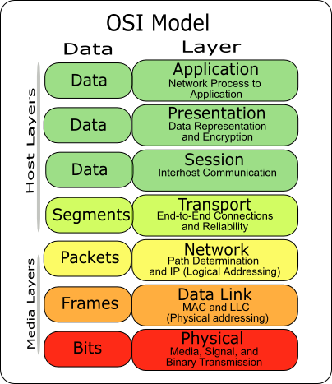
The OSI Model
The OSI (Open System Interconnect) Reference Model is a network model consisting of seven layers
Created in 1983, OSI is promoted by the International Standard Organization (ISO)

Slide 15
Network Interfaces
Network interface: device connecting a computer to a network
  Ethernet card
  WiFi adapter
A computer may have multiple network interfaces
Packets transmitted between network interfaces
Most local area networks, (including Ethernet and WiFi) broadcast frames
In regular mode, each network interface gets the frames intended for it
Traffic sniffing can be accomplished by configuring the network interface to read all frames (promiscuous mode)

Slide 16
MAC Addresses
Most network interfaces come with a predefined MAC address
A MAC address is a 48-bit number usually represented in hex
  E.g., 00-1A-92-D4-BF-86
The first three octets of any MAC address are IEEE-assigned Organizationally Unique Identifiers
  E.g., Cisco 00-1A-A1, D-Link 00-1B-11, ASUSTek 00-1A-92
The next three can be assigned by organizations as they please, with uniqueness being the only constraint
Organizations can utilize MAC addresses to identify computers on their network
MAC address can be reconfigured by network interface driver software
Notes:
MAC addresses can be permanently burned in (BIA), or be a locally administered address (LAA) set by an administrator. A MAC address starting out with 00-08-74 for instance is assigned by Dell, while one starting out with 00-0a-95 is assigned by Apple. Despite the IEEE limitations on LAAs, most OSs allow you to specify an arbitrary MAC for an interface.

Slide 17
Switch
A switch is a common network device
  Operates at the link layer
  Has multiple ports, each connected to a computer
Operation of a switch
  Learn the MAC address of each computer connected to it
  Forward frames only to the destination computer

Slide 18
Combining Switches
Switches can be arranged into a tree
Each port learns the MAC addresses of the machines in the segment (subtree) connected to it
Fragments to unknown MAC addresses are broadcast
Frames to MAC addresses in the same segment as the sender are ignored

Slide 19
MAC Address Filtering
A switch can be configured to provide service only to machines with specific MAC addresses
Allowed MAC addresses need to be registered with a network administrator
A MAC spoofing attack impersonates another machine
  Find out MAC address of target machine
  Reconfigure MAC address of rogue machine
  Turn off or unplug target machine
Countermeasures
  Block port of switch when machine is turned off or unplugged
  Disable duplicate MAC addresses

Slide 20
Viewing and Changing MAC Addresses
Viewing the MAC addresses of the interfaces of a machine
  Linux: ifconfig
  Windows: ipconfig /all
Changing a MAC address in Linux
  Stop the networking service: /etc/init.d/network stop
  Change the MAC address: ifconfig eth0 hw ether <MAC-address>
  Start the networking service: /etc/init.d/network start
Changing a MAC address in Windows
  Open the Network Connections applet
  Access the properties for the network interface
  Click “Configure …”
  In the advanced tab, change the network address to the desired value
Changing a MAC address requires administrator privileges
Notes:
In other derivatives like FreeBSD, MacOSX and others stopping the network service is not required, and the hw flag is dropped, leading to a single command ifconfig eth0 ether <MAC-address>

Slide 21
ARP
The address resolution protocol (ARP) connects the network layer to the data layer by converting IP addresses to MAC addresses
ARP works by broadcasting requests and caching responses for future use
The protocol begins with a computer broadcasting a message of the form
who has <IP address1> tell <IP address2>
When the machine with <IP address1> or an ARP server receives this message, its broadcasts the response
<IP address1> is <MAC address>
The requestor’s IP address <IP address2> is contained in the link header
The Linux and Windows command arp - a displays the ARP table
  Internet Address Physical Address Type
  128.148.31.1 00-00-0c-07-ac-00 dynamic
  128.148.31.15 00-0c-76-b2-d7-1d dynamic
  128.148.31.71 00-0c-76-b2-d0-d2 dynamic
  128.148.31.75 00-0c-76-b2-d7-1d dynamic
  128.148.31.102 00-22-0c-a3-e4-00 dynamic
  128.148.31.137 00-1d-92-b6-f1-a9 dynamic
Notes:
IPv6 does not use ARP, and ARP is instead replaced by Neighbor Discovery Protocol.

Slide 22
ARP Spoofing
The ARP table is updated whenever an ARP response is received
Requests are not tracked
ARP announcements are not authenticated
Machines trust each other
A rogue machine can spoof other machines

Slide 23
ARP Poisoning (ARP Spoofing)
According to the standard, almost all ARP implementations are stateless
An arp cache updates every time that it receives an arp reply… even if it did not send any arp request!
It is possible to “poison” an arp cache by sending gratuitous arp replies
Using static entries solves the problem but it is almost impossible to manage!

Slide 24
Telnet Protocol (RFC 854)
Telnet is a protocol that provides a general, bi-directional, not encrypted communication
telnet is a generic TCP client
  Allows a computer to connect to another one
  Provides remote login capabilities to computers on the Internet
  Sends whatever you type
  Prints whatever comes back
  Useful for testing TCP servers (ASCII based protocols)
Notes:
One computer can connect to another to use its services

Slide 25

Wireshark
Wireshark is a packet sniffer and protocol analyzer
  Captures and analyzes frames
  Supports plugins
Usually required to run with administrator privileges
Setting the network interface in promiscuous mode captures traffic across the entire LAN segment and not just frames addressed to the machine
Freely available on www.wireshark.org

Slide 26
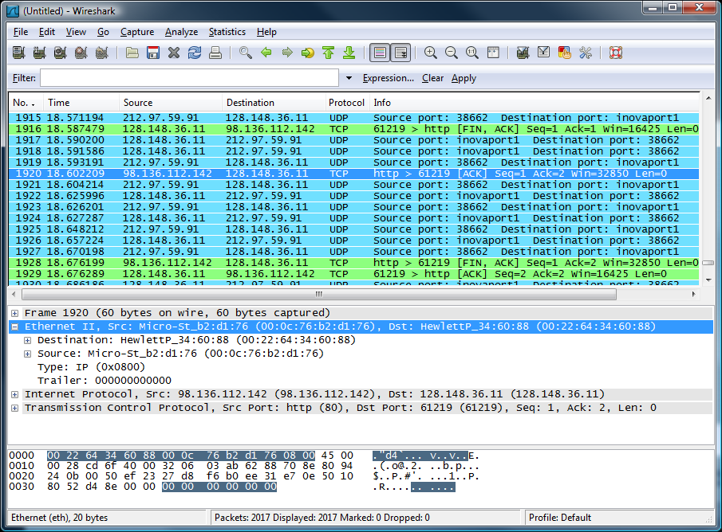
⬅ menu
⬅ main toolbar
⬅ filter toolbar
⬅ packet list pane
⬅ packet details pane
⬅ packet bytes pane
⬅ status bar

Slide 27
DEMO 1: Configuration using Telnet
CLIENT
LAN: 192.168.1.x
SERVER
<< link >>
<< link >>
switch
Alice
Bob
Add a user on server:
adduser user
and then follow
program instructions
.10
.100
In a switched network,
packets are sent only
to the destination
computer
One would think that
another computer plugged
to the switch cannot
sniff traffic
<< link >>
Cracker
Ethernet UTP
.1
RJ 45

Slide 28
DEMO 1: ARP Spoofing
CLIENT
LAN: 192.168.1.x
SERVER
Regular traffic
switch
Alice
Using arp poisoning
Bob
.10
.100
MAC: 00:0A:E4:2E:9B:11
MAC: 00:0A:E4:3B:47:7E
gratuitous arp reply
Bob’s IP→ Cracker’s MAC
arpspoof 192.168.1.10 192.168.1.100
gratuitous arp reply
Alice’s IP→ Cracker’s MAC
arpspoof 192.168.1.100 192.168.1.10
victim ip
gateway ip
victim ip
gateway ip
Cracker
MAC: 00:22:64:34:60:88
.1

Slide 29
DEMO 1: catch telnet password
CLIENT
LAN: 192.168.1.x
SERVER
Regular traffic
switch
Alice
Using arp poisoning
Bob
.10
.100
With dsniff, we catch the passwords used to log in to a telnet service:
dsniff -n
Acts as a router
Cracker
.1

Slide 30
ARP Caches
IP: 192.168.1.1
MAC: 00:11:22:33:44:01
IP: 192.168.1.105
MAC: 00:11:22:33:44:02
Data
192.168.1.1 is at 00:11:22:33:44:01
192.168.1.105 is at 00:11:22:33:44:02
ARP Cache
192.168.1.105 | 00:11:22:33:44:02
ARP Cache
192.168.1.1 | 00:11:22:33:44:01

Slide 31
Poisoned ARP Caches
192.168.1.106
00:11:22:33:44:03
Data
Data
192.168.1.105 is at 00:11:22:33:44:03
192.168.1.1 is at 00:11:22:33:44:03
192.168.1.1
00:11:22:33:44:01
192.168.1.105
00:11:22:33:44:02
Poisoned ARP Cache
192.168.1.105 | 00:11:22:33:44:03
Poisoned ARP Cache
192.168.1.1 | 00:11:22:33:44:03

Slide 32
DEMO 2: network DOS using ARP
Ping 192.168.1.101
switch
192.168.1.101
192.168.1.102
Cable Loop
ping
arp request
Broadcast storm
How can it be avoided?

