Slide 1
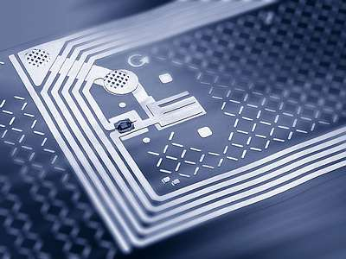
RFID Security
Materials from the FIRB SAT lecture slides by Massimo Rimondini
included with permission.

Slide 2
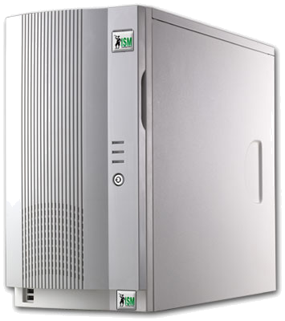
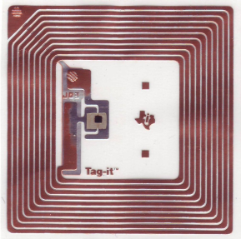
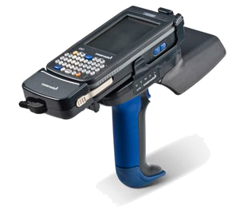
Architecture
communication interface & protocol
data format
middleware
0100101110100...
tag
Object Naming Service
reader

Slide 3
Who
Supply chain management
  Benetton
  Wal-Mart
  Procter & Gamble
  Gillette
U.S. Department of Defense
Tires
  Michelin (truck tires)
  Goodyear (racing tires)
Volkswagen

Slide 4
Why
Unique identification and tracking of goods
  Manufacturing
  Supply chain
  Inventory
  Retail
Unique identification and tracking of people and animals
  Access control & Authorization
  Medical applications (drugs, blood banks, mother‑baby pairing, etc.)
  Tracking of livestock, endangered species, and pets
Anti-theft systems
Toll systems
Passports
Sports event timing
Sam Polniak. The RFID Case Study Book: RFID Application Stories from Around the Globe. Abhisam Software.

Slide 5
Operating Frequency
The operating frequency of an RFID tag affects several parameters
Range
  LF (9-135KHz): a few cms
  HF (13.56MHz): up to 1m
  UHF (0.3-1.2GHz): >1m
  MW (2.45-5.8GHz)
Data exchange speed
Signal attenuation through materials
(Cross-country) Interoperability
  FCC
    ETSI

Slide 6
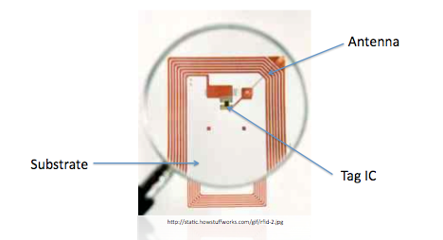
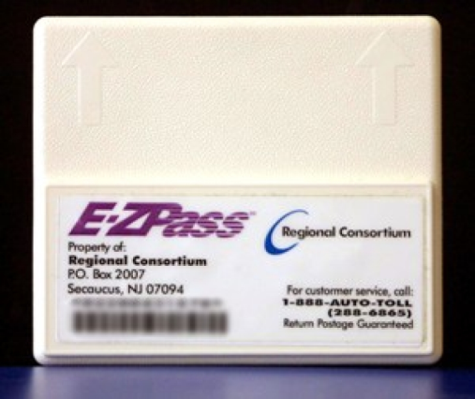
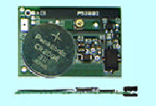
Types of Tags
Passive
  Operational power scavenged
  from reader radiated power
Semi-passive
  Operational power provided by battery
Active
  Operational power provided by battery - transmitter built into tag

Slide 7
Reading Multiple Tags
SDMA (Space-Division Multiple Access)
  Multiple antennas with non-overlapping fields
FDMA (Frequency-division multiple access)
  Multiple frequencies
TDMA (Time-division multiple access)
  “Speak” at different times

Slide 8
What to Protect
ISO 18000 (supply chain)
  UID: 64 bit
  Memory: max 256 blocks of 32 bits each
  Total: 1KB
  Writable tags
Notes:
Translate to English
EPCglobal è stata fondata dalla fusione di EAN International e Uniform Code Council (EAN-UCC, ora sostituite da GS1) nel 2003

Slide 9
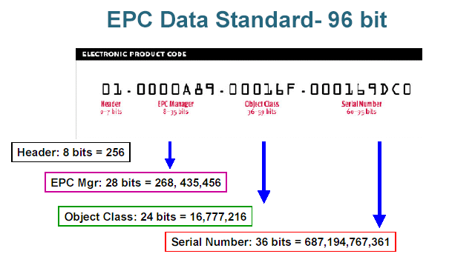
What to Protect
EPC global was founded by the union of EAN International and Uniform Code Council in 2003
  Class 0
    read-only, factory-programmed
    identifier
  Class 1 Gen 1
    write-once identifier
    lock, kill (with 8 bit password)
With 96 bit code, 268 million companies can each categorize 16 million different products where each product category contains up to 687 billion individual units

Slide 10
What to Protect (cont.)
Class 1 Gen 2
  =ISO/IEC 18000-6 Type C
  writable tags
  4 memory blocks
    Reserved: access, kill passwords
    (32 bits each)
    reversible/one-way read/write lock
    EPC ID (up to 304 bits)
    TID: incremental serial number written by the vendor (64 bits)
    User (up to 512 bits)

Slide 11
Threats & Countermeasures
Eavesdropping
  Passive monitoring of the air interface
  Encryption, shielding, range reduction
Relaying
  Man-in-the-middle (allows legitimate authentication)
  Shielding, range reduction, distance bounding protocols
Unauthorized tag reading
  Fake reader with extended range
  Reader authentication, on-demand tag enabling, sensitive data in the backend, tag killing
Pawel Rotter. A Framework for Assessing RFID System Security and Privacy
Risks. IEEE Pervasive Computing, 7(2):70–77, June 2008.

Slide 12
Threats & Countermeasures
Cloning
  Duplication of tag contents and functionality
  Authentication, manufacturing-stage countermeasures against reverse engineering
Tracking
  Rogue readers in doors or near legitimate ones
  Authentication, range reduction, shielding tags, tag disabling, pseudonyms
Replaying
  Repeated authentication sequences
  Authentication [see eavesdropping]
Pawel Rotter. A Framework for Assessing RFID System Security and Privacy
Risks. IEEE Pervasive Computing, 7(2):70–77, June 2008.

Slide 13
Threats & Countermeasures
Tag content changes
  Insertion or modification of data in the tag's memory
  Lock, permalock, smarter malware-proof readers
Tag destruction
  Burn in a microwave oven, slam with a hammer, etc.
  ...?
Blocking
  Reader awaits response from several non-existent tags
  Detection is possible
Jamming
  Radio noise
  Detection is possible
Pawel Rotter. A Framework for Assessing RFID System Security and Privacy
Risks. IEEE Pervasive Computing, 7(2):70–77, June 2008.

Slide 14
Threats (reprise)
Breakdown of business processes
Handling of crucial and strategical information
Privacy violations
External risks
  e.g., exposure to RF radiation, middleware hacking
Tom Karygiannis, Bernard Eydt, Greg Barber, Lynn Bunn, and Ted Phillips. Guidelines for securing radio frequency identiﬁcation (RFID) systems. Recommendations of the National Institute of Standards and Technology, NIST 800-98, 2007.

Slide 15
Security coordinates
Service availability
Cloning
Security of read operations
Security of write operations
Security of information

Slide 16
Risks vs. Security
 | Risks (NIST)
 | Business processes | Strategical information | Privacy violation | Others
Service availability | ✓
Cloning | ✓ |  | ✓ | ✓
Read | ✓ | ✓ | ✓ | ✓
Write | ✓ |  |  | ✓
Information | ✓ | ✓ | ✓ | ✓

Slide 17
Focus
0100101110100...

Slide 18
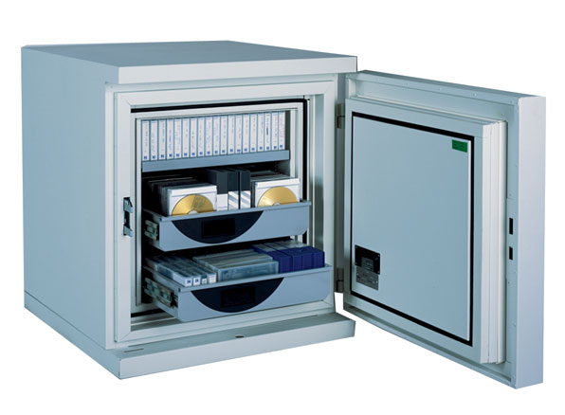
Denial of Service

Slide 19
Denial of Service
Impair communication with valid tag
  Jamming
    oscillator+audio amplifier
  Faraday cage
    aluminium leaf
Fool the reader with counterfeit tags
Confuse the singulation tree walking
  Blocker tag
Interposing metals
Detaching tag antennas
Physical destruction (of anti-shoplifting tags)
    camera’s flash circuit

Slide 20
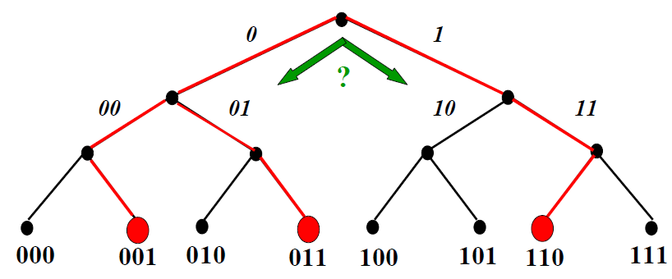
Singulation Tree Walking
Reader tries to read several tags
Electromagnetic noise (jamming) is possible
Avoids jamming in the presence of multiple tags
Performance: up to 1000 tags/s
Blocker tag (fully/selectively) “spoofs” the walk
Reader broadcasts
current prefix
Each tag with this prefix
responds with its next bit
If responses don’t collide,
reader adds 1 bit to current
prefix, otherwise tries both
possibilities
A. Juels, R. L. Rivest, and M. Szydlo. The Blocker Tag: Selective Blocking of RFID Tags for Consumer Privacy. In V. Atluri, ed. 8th ACM Conference on Computer and Communications Security, pp. 103-111. ACM Press. 2003.
Notes:
Explain in more detail

Slide 21
Tag Singulation Process
Read individual tag from group of all tags in range of reader:
  All tags within range of reader backscatter their MSB (most significant bit) to the reader
  Reader responds with either a 1 or a 0
  If tag bit == reader bit, tag sends the next bit in it is ID code; else, tag goes mute for remainder of singulation
  Process continues until reader has completely read a single tag
  Reader conducts consecutive singulations until all tags in its range are read
  Reader can interrupt the singulation process to send commands to a single tag, a subset of all tags in range, or globally to all tags in range
Notes:
Read sa solo un prefisso

Slide 22

Cloning

Slide 23
Cloning
Violates information integrity
  Breaks stock availability (rather than money gain)
  Allows spoofing & theft
Made possible by writable memories
Possible even just with a PDA+PC card
Countermeasures:
  Killing
  Read-only memories
  (Mutual) Authentication protocols
  PUFs
Annalee Newitz. The rﬁd hacking underground. WIRED, 14(05):72, 77, May 2006.

Slide 24
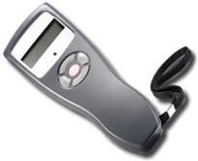

Challenge-Response Protocol
Challenge : nonce X
Response : Y = f (K,X)
Y’ = f (K,X)
RFID TAG
RFID reader
Function f is public
Secret key K is known only to the tag and reader
The reader sends challenge X and the tag responds with Y, computed from K and X
The reader computes Y’ = f(K,X) and verifies that Y=Y’

Slide 25
Physically Unclonable Function
PUF
  Easy to calculate and difficult to characterize
  Lightweight
  Safer alternative to storing keys on tag
Challenge response protocol
  Binary vector X sent to tag
  Tag computes vector Y=f(K, X)
  “Hardwired” vector K different for each tag, due to random manufacturing variations
  Repeating the same challenge results in responses with small Hamming distance
Notes:
Major revision: check for accuracy
How many bits do the challenge and response have?
64 or 128
Is K a constant for a given tag or are small variations possible for the same tag and different challenges?
Explain difference between a PUF and a MAC (message authentication code)?

Slide 26
PUF: Architecture
Switch
Arbiter
0
1
c
0
c
1
c
2
c
61
c
62
c
63
Arbiter
0
Arbiter
1
c
i
=0
c
i
=1
The operation of arbiter includes:
Switch Operations
a race between the signals in which
the arbiter keeps the outcome
A PUF uses variations in the production of the circuit to generate a bit different response for each challenge presented
The same challenge response generally produces different tags on different PUF
Notes:
Merge with previous slide
Explain better input/output behavior
Hardware details and block diagram can be omitted
This is achieved by starting a race between a rising edge that is fed into a series of switches. The signal is routed depending on the challenge bit at each switch and depending on whether the signal on the top rail or the bottom rail arriving first the arbiter outputs a 1 or a 0. Same challenge on most occations will not produce the same response from chip to chip due to propagations and delay variations in the circuit components.
Thus a PUF circuit can be used to characterise each label IC and the fabrications variation tend to from the secret key. Thus it is possible to authenticate each IC by observing the response of the PUF circuit to a set of challenges.
It has been evaluated that around 800 challenges reponse pairs are enough to uniquely identify around a billions chips.

Slide 27
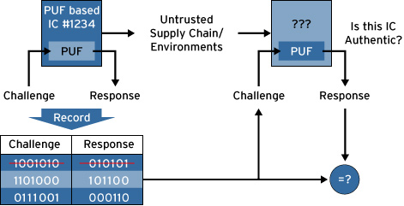
PUF
Function on the unpredictable behavior that allows for creating challenge-response pairs
The set of challenge-response pairs of DNA is a kind of electronic RFID tags
Notes:
Per un PUF dal comportamento ideale è possibile pubblicare un hash del response per evitare la clonazione tramite tag virtuale
Il tag Vera X512H, dell’americana Verayo, se sfidato più volte con lo stesso challenge risponde con response che sono tra loro a distanza di Hamming minore di 17 bit

Slide 28
PUF vs. MAC
Bob sends Alice an object
Bob sends Alice some data
Builds challenge response pairs (CRPs) table of the PUF Tag
Send the object with the Tag
Send securely to Alice the PUF CRP table
Alice can verify using CRPs that the object has not been tampered
Hashes of the data
Encrypts hash with a crypto key
data and the encrypted hash are sent to Alice
Alice knows the crypto key and hash function so she can verify data integrity and source

Slide 29
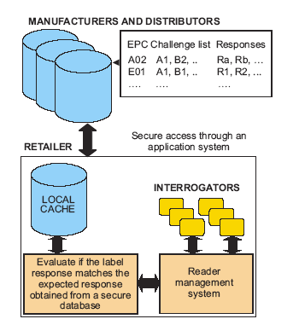
PUF: Security Infrastructure
To ensure security in PUF is necessary :
  A database backend to keep challenge response pair (CRP)
  A method for secure distribution of CRPs
  Build a CRP table for each tag before distribution
  (after verification of the TAG may be extended)
Notes:
Encryption controlled by the label owner.
Hence it is independent of the other parties in the supply chain. Individual establishments can define a security policy that suits them. Such as when encryption is performed how to handle the tag contents at point of sale. Level of security to commensurate the data/ item being protected.

Slide 30
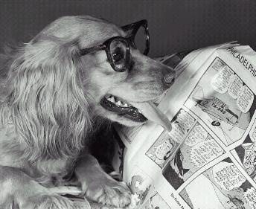
Information Security
Security of Read Operations

Slide 31
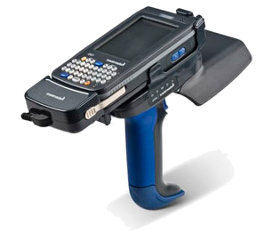
Ranges
traffic analysis
(without interpreting transmission)
Depend on the frequency
rogue command
nominal
back channel
eavesdropping
forward channel eavesdropping
rogue skimming/scanning

Slide 32
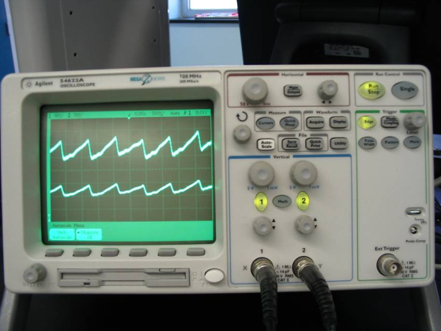
Power Analysis
ICs introduce electrical noise
Tag power consumption
depends on internal
operations
Submitting bits of kill passwords reveals whether they are correct
Limited application to EPC Gen 2 Tags
Countermeasures
  Random noise
  Tag redesign
Yossi Oren. Remote power analysis of rﬁd tags. Master’s thesis, Computer Network and Security Lab, Tel-Aviv University, 2006.

Slide 33
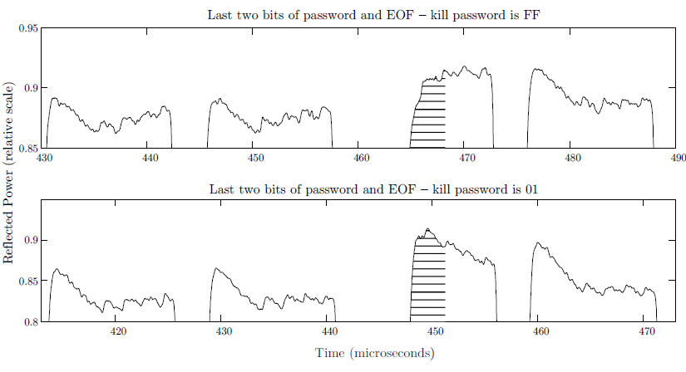
Power Analysis

Slide 34
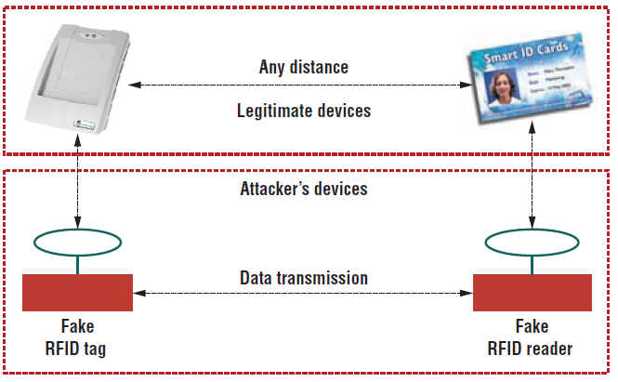
Relaying
out of range
ghost
leech
dedicated network
Pawel Rotter. A Framework for Assessing RFID System Security and Privacy
Risks. IEEE Pervasive Computing, 7(2):70–77, June 2008.

Slide 35
Relaying
Mafia fraud
  Man-in-the-middle
  Additional fraudulent reader & tag
  No data alteration
    Cannot be prevented by application level cryptographic protocols!
Terrorist fraud
  No malicious reader
  Tag is not honest and cooperates with malicious tag
  Malicious tag is not aware of tag’s secrets
Chong Hee Kim, Gildas Avoine, François Koeune, Fran¸ois-Xavier Standaert, and Olivier Pereira. The swiss-knife RFID distance bounding protocol. In Proc. ICISC 2008, 2008.

Slide 36
Counter{feit,measures}
On labels: holographies, watermarks
In RFID: authentication protocols
  Privacy
  Computational constraints
    Power
    Space
    Cost
  Traceability
    Forward: predict future information
    Backward: successful identification based on past information
  Standards compliance
Notes:
Il problema Learning Parity without Noise:
sono date diverse sequenze di bit e, per ciascuna, un valore di parità (XOR) calcolato con una funzione f. Determinare f

Slide 37
Cryptography on tags
Three approaches
  Standard cryptographic primitives
  (Ultra)light cryptographic primitives
  Hardware implementations (FPGA)
Block ciphers
Simplified AES
Public key
Security by obscurity
  Karsten Nohl, David Evans, Starbug, and Henryk Plotz. Reverse-Engineering a Cryptographic RFID Tag. In 17th USENIX Security Symposium, July 2008.
Standard compliance
  Daniel Bailey and Ari Juels. Shoehorning Security into the EPC Standard. International Conference on Security in Communication Networks – SCN 2006, September 2006.

Slide 38
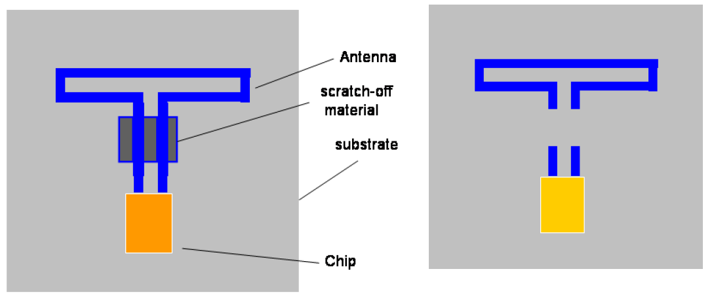
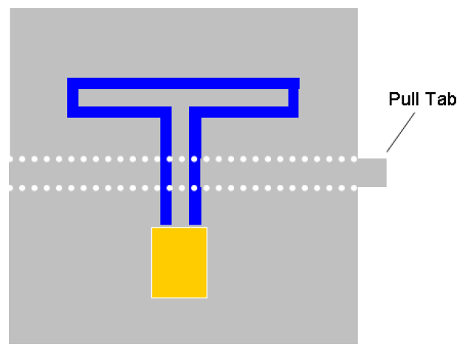
Physical destruction
More relevant for privacy issues
Kill command
Clipped tags
Guenter Karjoth and Paul Moskowitz. Disabling RFID tags with visible
conﬁrmation: Clipped tags are silenced. Technical Report RC23710, IBM, 2005.

Slide 39
Exchanging keys securely
Narrowband radio frequencies are subject to
  eavesdropping
  jamming
  side-channel attacks
Solutions:
  Advanced modulation scheme
    Ultra-wideband
    Spreading code is kept secret
  Key sharing across time and/or space
  Noisy tags
    Eavesdroppers cannot differentiate their signals from those of the queried tag
P. Yu, P. Schaumont, D. Ha. Securing RFID with Ultra-Wideband Modulation. RFIDSec 06, July 2006.
A. Juels, R. Pappu, B. Parno. Unidirectional Key Distribution Across Time and Space with Applications to RFID Security. In 17th USENIX Security Symposium, July 2008.
C. Castelluccia, G. Avoine. Noisy Tags: A Pretty Good Key Exchange Protocol for RFID Tags. CARDIS, April 2006.

Slide 40
Hash lock
Tags can operate in two states:
  unlocked
  locked
    always reply with the metaID
To lock, store the metaID
To unlock, retrieve k from the backend and send it to the tag
Tags are unlocked for a short while
Stephen Weis, Sanjay Sarma, Ronald Rivest, and Daniel Engels. Security and
Privacy Aspects of Low-Cost Radio Frequency Identiﬁcation Systems. International Conference on Security in Pervasive Computing – SPC 2003, March
2003. Springer-Verlag.

Slide 41
Unauthorized changes
Private memory on the tags
  Readers can access it
  Only the tag can write to it
Records changes to tag information
Akira Yamamoto, Shigeya Suzuki, Hisakazu Hada, Jin Mitsugi, Fumio Teraoka, and Osamu Nakamura. A Tamper Detection Method for RFID Tag Data. IEEE International Conference on RFID, pages 51–57, April 2008.

Slide 42
Prevent eavesdropping
In EPC tags can “mask” (XOR) responses with a random 16-bit value
  Weak security
Combine RFID with optical memory
  Optical communication is more secure
  Optical memory may store access keys
Mikko Lehtonen, Thorsten Staake, Florian Michahelles, and Elgar Fleisch. Strengthening the Security of Machine Readable Documents by Combining RFID and Optical Memory Devices. In Ambient Intelligence Developments Conference – AmI.d, September 2006.

Slide 43
Prevent server impersonation
RFID memory is not tamper-proof
  Too costly
Compromised tags can cause desynchronization with database
Countermeasures:
  Digital signature
    Not viable
  Additional tag storing most recently used secret
    Not viable
  Tags authenticate the server

Slide 44

Information Security
Security of Write Operations

Slide 45

Security of write operations
Recycle solutions for read operations

Slide 46
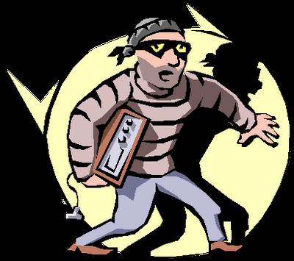
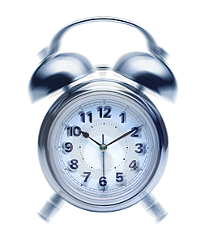
Timings
Writes may take longer than reads
  Some skimming-like scenarios vanish

Slide 47

Faulty writes
Tags may confirm faulty writes
  Wrong data has been written
  Data has not been written at all
Caused by
  Temporary antenna
  failure
  Radio interference
  Laser radiation
Michael Hutter, Jörn-Marc Schmidt, and Thomas Plos. RFID and Its Vulnerability to Faults. Proceedings of the 10th International Workshop Cryptographic Hardware and Embedded Systems, CHES 2008, August 2008. Springer.

Slide 48
Focus
0100101110100...

Slide 49
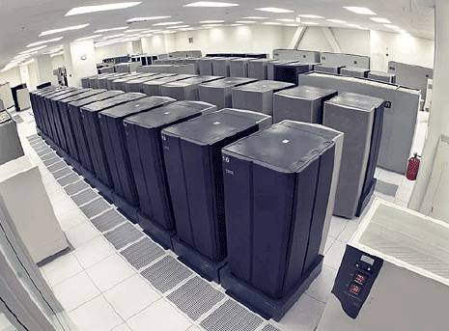
Information Security
Security of Data (and Infrastructure)

Slide 50
Backend vulnerabilities
Each component of an RFID systems may be vulnerable
Compromising a component reflects on others
Compromising tags may affect the backend!

Slide 51

Backend vulnerabilities
0100101110100...

Slide 52
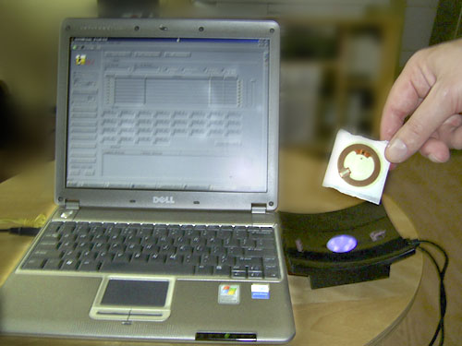
Malware
The world's First RFID chip infected with a virus
Melanie Rieback, Bruno Crispo, and Andrew Tanenbaum. Is your cat infected
with a computer virus? In Proc. IEEE PerCom 2006, 2006.

Slide 53
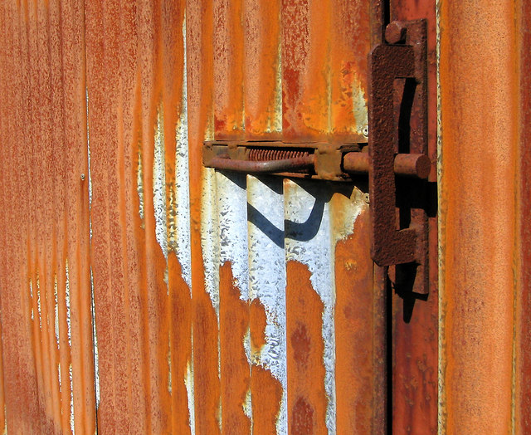
Security of existing applications

Slide 54
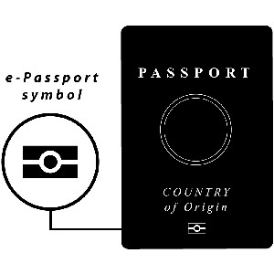
Security of existing applications
e-Passports
  ICAO (International Civil Aviation Organization) requires:
    compulsory authentication of passport data, signed by the issuer
    (optionally) access control based on cryptographic keys
    (optionally) public key authentication of the passport
  Vulnerabilities still exist
    Transferability (verifier becomes prover)
    Reset attacks (same coin toss by resetting internal state of one party)
Carlo Blundo, Giuseppe Persiano, Ahmad-Reza Sadeghi, and Ivan Visconti. Resettable and Non-Transferable Chip Authentication for ePassports. In Conference on RFID Security, Budaperst, Hongria, July 2008.
Notes:
Reset attacks: reset the internal state of a protocol

Slide 55
Security of existing applications
Car ignition: Keeloq
  Manufacturer has master secret
  Cars have unique ID
  MASTER ⊕ ID = car’s secret key
  Finding 1 key leads to the master secret!!
  ~2 days on a cluster of 50 Dual-Cores
  “Soon, cryptographers will all drive expensive cars” :-)
Sebastian Indesteege, Nathan Keller, Orr Dunkelman, Eli Biham, and Bart
Preneel. A practical attack on keeloq. In Proc. Eurocrypt 2008, 2008.

Slide 56
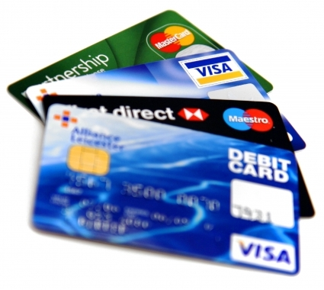
Security of existing applications
Credit cards
  First-generation
  Holder, number, expire date are transmitted in clear text
Thomas S. Heydt-Benjamin, Dan V. Bailey, Kevin Fu, Ari Juels, and Tom O’Hare. Vulnerabilities in First-Generation RFID-Enabled Credit Cards. Manuscript, October 2006.

Slide 57
Security of existing applications
Medical implants
  Some defibrillators are vulnerable
  175KHz ⇒ low range!
Daniel Halperin, Thomas S. Heydt-Benjamin, Benjamin Ransford, Shane S. Clark, Benessa Defend, Will Morgan, Kevin Fu, Tadayoshi Kohno, and William H. Maisel. Pacemakers and Implantable Cardiac Deﬁbrillators: Software Radio Attacks and Zero-Power Defenses. In Proceedings of the 29th Annual IEEE Symposium on Security and Privacy, May 2008.

Slide 58
Security of existing applications
MIFARE
  Widespread for contactless smart cards
  ISO 14443 type A (HF, 13.56MHz)
  ~10cm operating distance
  About 16KB memory, fragmented in sectors
  Buggy pseudorandom generator
    The 1st sector can be overwritten!
    Each sector for which one block is known can be overwritten!
    Based on active attack, requires eavesdropping response from legitimate tag
  Secret keys still inaccessible

Slide 59
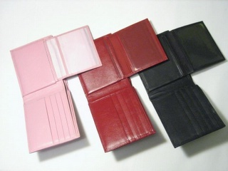
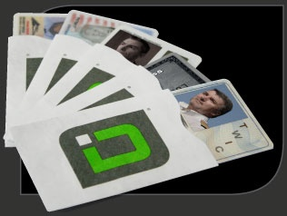
Skimmer
“Would you be comfortable wearing your name, your credit card number and your card expiration date on your T-shirt?”
Skim ~ quick eavesdrop
As cheap as $150 to build
  Readily available computer
  & radio components
Solution: shield
  http://www.difrwear.com/
  http://www.idstronghold.com/
Thomas S. Heydt-Benjamin, Dan V. Bailey, Kevin Fu, Ari Juels, and Tom O’Hare. Vulnerabilities in First-Generation RFID-Enabled Credit Cards. Manuscript, October 2006.
Ilan Kirschenbaum and Avishai Wool. How to Build a Low-Cost, Extended-Range RFID Skimmer. Cryptology ePrint Archive, Report 2006/054, 2006.

Slide 60
References
http://www.avoine.net/rfid/
B. Palazzi, M. Rimondini. Survey su RFID e Sicurezza. TR. Feb 2009. (in Italian)
http://mifare.net/
http://www.rfidjournal.com/
http://www.verayo.com/

