Slide 1
Machine recognition of human activities : a survey
Pavan Turaga, Student Member, IEEE, Rama Chellappa, Fellow, IEEE, V. S. Subrahmanian, and Octavian Udrea
Presented by Hakan Boyraz

Slide 2
Outline
Actions vs. Activities
Applications of Activity Recognition
Activity Recognition System
  Low Level Feature Extraction
  Action Recognition Models
  Activity Recognition Models
Future Work

Slide 3
Actions vs. Activities
Recognizing human activities from videos
Actions: simple motion patterns usually executed by a single person: walking, swimming, etc.
Activities: Complex sequence of actions performed by multiple people

Slide 4
Applications
Behavioral biometrics
Content based video analysis
Security and surveillance
Interactive Applications and Environments
Animation and Synthesis

Slide 5
Activity Recognition Systems
Lower Level : Extraction of low level features: background foreground segmentation, tracking, object detection
Middle Level: Action descriptions from low level features
Higher Level: reasoning engines

Slide 6
Low Level Feature Extraction

Slide 7
Feature Extraction
Optical Flow
Point Trajectories
Background Subtraction
Filter Responses

Slide 8
Action Recognition

Slide 9
Modeling & Recognizing Actions
Actions
Non-Parametric
Volumetric
Parametric
2D Template Matching
3D Objects
Manifold Learning
Space Time Filtering
Part Based Methods
Sub-volume Matching
HMMs
Linear Dynamic Systems (LDS)
Switching LDS
Notes:
Nonparametric approaches typically extract a set of features from each frame of the video.
The features are then matched to a stored template.
Volumetric approaches on the other hand do not extract features on a
frame-by-frame basis. Instead, they consider a video as a 3-D
volume of pixel intensities and extend standard image features
such as scale-space extrema, spatial filter responses, etc., to
the 3-D case.
Parametric time-series approaches specifically
impose a model on the temporal dynamics of the motion. The
particular parameters for a class of actions is then estimated
from training data.

Slide 10
Modeling & Recognizing Actions
Actions
Non-Parametric
Volumetric
Parametric
2D Template Matching
3D Objects
Manifold Learning
Space Time Filtering
Part Based Methods
Sub-volume Matching
HMMs
Linear Dynamic Systems (LDS)
Switching LDS
Notes:
Nonparametric approaches
typically extract a set of features from each frame of the video.
The features are then matched to a stored template. Volumetric
approaches on the other hand do not extract features on a
frame-by-frame basis. Instead, they consider a video as a 3-D
volume of pixel intensities and extend standard image features
such as scale-space extrema, spatial filter responses, etc., to
the 3-D case. Parametric time-series approaches specifically
impose a model on the temporal dynamics of the motion. The
particular parameters for a class of actions is then estimated
from training data.

Slide 11
2-D Temporal Templates
Background subtraction
Aggregate background subtracted blobs into a static images
  Equally weight all images in the sequence (MEI = Motion Energy Image)
  Higher weights for new frames (MHI = Motion History Image)
  Hu moments are extracted from templates
Complex actions – overwrite of the motion history

Slide 12
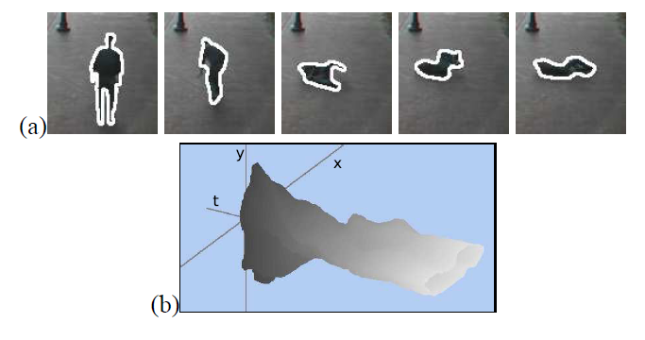
3-D Object Models - Counters
Boundaries of objects are detected in each frame as 2D (x,y) counter
Sequence of counters with respect to time generates spatiotemporal volume (STV) in (x,y,t)
The STV can be treated as a 3D object
Extract the descriptors of the object’s surface corresponding to geometric features such as peaks, valleys, and ridges
Point correspondence needs to be computed between each frame
Notes:
Once STV is generated from a sequence of contours, we analyze
it to compute important action descriptors which correspond
to changes in direction, speed and shape of parts
of contour. Changes in these quantities are reflected on the
surface of STV, and can be computed using the differential
geometry. A set of these action descriptors for an action is
called the action sketch.
the fundamental surface types are defined
by two metric quantities, the Gaussian curvature, K, and
mean curvature, H, computed from the first and second fundamental
forms of the underlying differential geometry.

Slide 13
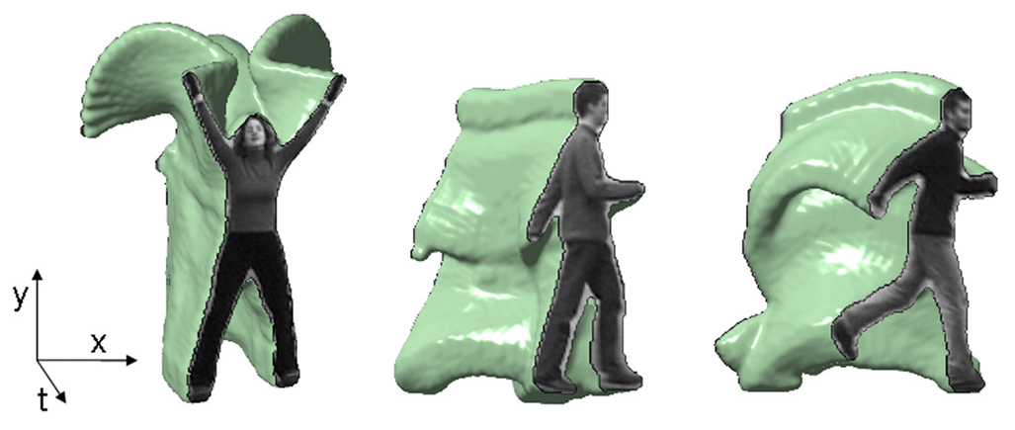
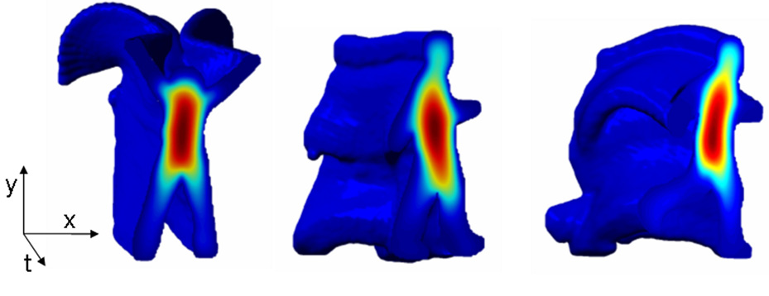
3-D Object Models - Blobs
Uses background subtracted blobs instead of counters
Blobs are stacked together to create an (x,y,t) binary space-time volume
Establishing correspondence between points on counters is not required
Solution to Poisson equation is used to extract space-time features such as local space-time saliency, action dynamics, shape structure, and orientation.

Slide 14
Manifold Learning Methods
Determine inherent dimensionality of the data as opposed to raw dimensionality
Reduce the high dimensionality of video feature data
Apply action recognition algorithms (such as template matching) on the new data

Slide 15
Manifold Learning Methods (Con’t)
Principal Component Analysis (PCA)
  Subtract the mean
  Compute the Covariance Matrix
  Calculate the eigenvalues and eigenvectors of the Covariance Matrix
  Sort the eigenvalues from high to low
  Select the eigenvectors as new basis corresponding to high eigenvalues
  Linear Subspace Assumption : the observed data is a linear combinations of certain basis
Nonlinear methods
  Locally Linear Embedding (LLE)
  Laplacian Eigenmap
  Isomap

Slide 16
Modeling & Recognizing Actions
Actions
Non-Parametric
Volumetric
Parametric
2D Template Matching
3D Objects
Manifold Learning
Space Time Filtering
Part Based Methods
Sub-volume Matching
HMMs
Linear Dynamic Systems (LDS)
Switching LDS
Notes:
Volumetric approaches on the other hand do not extract features on a
frame-by-frame basis. Instead, they consider a video as a 3-D
volume of pixel intensities and extend standard image features
such as scale-space extrema, spatial filter responses, etc., to
the 3-D case.

Slide 17
Spatio-Temporal Filtering
Model a segment of video as spatio-temporal volume
Compute the filter responses using oriented Gaussian kernels and/or Gabor Filter banks
Derive the action specific features from the filter responses
Filtering approaches are fast and easy to implement
Filter bandwidth is not know a priori; large filter banks at several spatial and temporal scales are required

Slide 18
Spatio-Temporal Filtering
“Probabilistic recognition of activity using local appearance”
Filter responses are computed using Gabor filters at different orientations and scales at space domain and a single scale is used in temporal domain
A multi-dimensional histogram is computed from the outputs of the filter bank
Histograms are used as a form of signature for activities
Bayesian rule is used to estimate activities

Slide 19
Part Based Approaches
3-D Generalization of Harris interest point detector
Dollar’s method
Bag of words

Slide 20
3D Generalization of Harris Detector
Detect spatio-temporal interest points using generalized version of Harris interest point detector
Compute the normalized spatio-temporal Gaussian derivatives at the interest point as feature descriptor
Use Mahalanobis distance between feature descriptors to measure the similarity between events

Slide 21
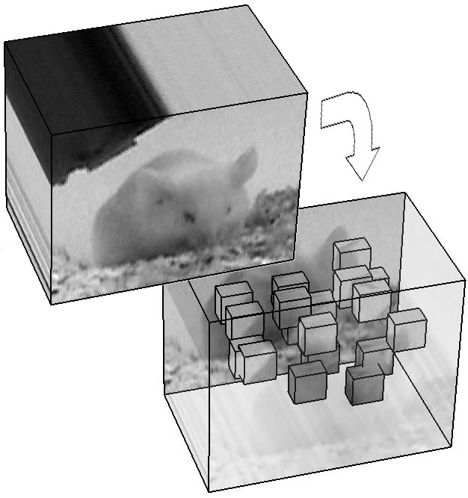
Dollar’s Method
Explicitly designed a spatio-temporal feature detector to detect large number of features rather than too few
At each interest point extract the cuboids which contains the pixel values

Slide 22
Dollar’s Method (Con’t)
Apply the following transformations to each cuboids:
  Normalized pixel values
  Brightness gradient
  Windowed Optical flow
Create a feature vector given a transformed cuboid : flatten the cuboid into a vector
Cluster the cuboids extracted from the training data (using K-means) to create a library of cuboid prototypes
Use the histogram of cuboid types as behavior descriptor

Slide 23
Bag of Words
Represent each video sequence as a collection of spatio temporal words
  Extract the local space-time regions using interest point detectors
  Cluster local regions into a set of video codewords, called codebook
Calculate the brightness gradient for each word and concatenate it into form a vector
Reduce the dimensionality of the feature descriptors using PCA
Unsupervised learning of actions using the probabilistic Latent Semantic Analysis (pLSA)

Slide 24
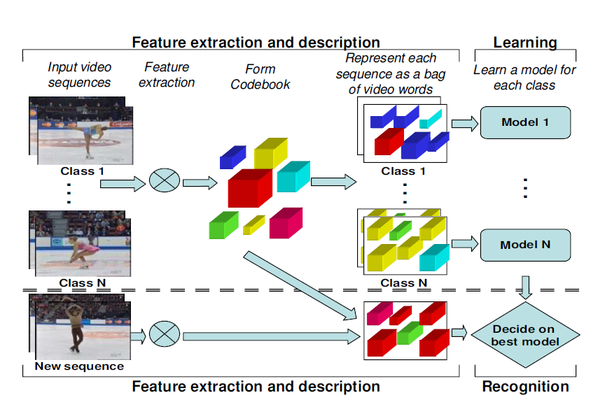
Bag of Words
“Unsupervised learning of human action categories using spatial-temporal words”

Slide 25
Sub Volume Matching
Matching the videos by matching sub-volumes between a video and template
No action descriptors are extracted
Segment the input video into space-time volumes
  Segment the three dimensional spatio-temporal volume instead of individually segmenting video frames and linking the regions temporarily
Correlate action templates with the volumes using shape and flow features (volumetric region matching)

Slide 26
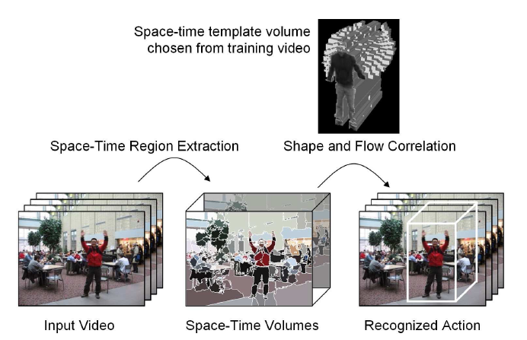
Sub Volume Matching (Con’t)
“Spatio-temporal Shape and Flow Correlation for Action Recognition”

Slide 27
Modeling & Recognizing Actions
Actions
Non-Parametric
Volumetric
Parametric
2D Template Matching
3D Objects
Manifold Learning
Space Time Filtering
Part Based Methods
Sub-volume Matching
HMMs
Linear Dynamic Systems (LDS)
Switching LDS
Notes:
Parametric time-series approaches specifically
impose a model on the temporal dynamics of the motion. The
particular parameters for a class of actions is then estimated
from training data.

Slide 28
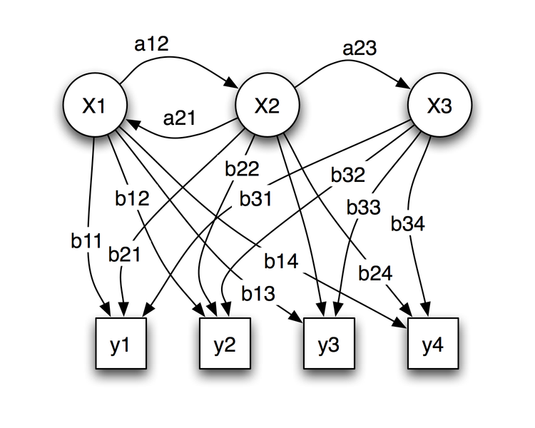
Hidden Markov Model (HMM)
Train the model parameters α= (A, B, π) in order to maximize P(Y/ α)
Given observation sequence Y = y1y2..yN and the model α, how do we choose the corresponding state sequence X=x1x2….x3

Slide 29
HMM (Con’t)
Assumption is single person is performing the action
Not effective in applications where multiple agents are performing an action or interacting with each other
Different algorithms based on HMM are proposed for recognizing actions with multiple agents such as coupled HMM

Slide 30
Linear Dynamical Systems
Continuous state–space generalization of HMMs with a Gaussian observation model
  x(t) = A x(t-1) + w(t), w ~ N(0, Q)
  y(t) = C x(t) + v(t), v ~ N(0,R)
Learning the model parameters is more efficient than in the case of HMM
It is not applicable to non-stationary actions

Slide 31
Non Linear Dynamical Systems
Time varying version of LDS:
  x(t) = A(t) x(t-1) + w(t), w ~ N(0, Q)
  y(t) = C(t) x(t) + v(t), v ~ N(0,R)
More complex activities can be modeled using switching linear dynamical systems (SLDS)
An SLDS consists of set of LDSs with a switching function that causes model parameters to change

Slide 32
Activity Recognition

Slide 33
Recognizing Activities
Activities
Graphical Models
Syntactic
Knowledge Based
Dynamic Belief Nets
Petri nets
Context Free Grammar
Stochastic CFG
Attribute Grammars
Constraint Satisfaction
Logic Rule
Ontologies

Slide 34
Recognizing Activities
Activities
Graphical Models
Syntactic
Knowledge Based
Dynamic Belief Nets
Petri nets
Context Free Grammar
Stochastic CFG
Attribute Grammars
Constraint Satisfaction
Logic Rule
Ontologies

Slide 35
Belief Networks
Belief Network (BN)is a directed acyclic graphical model for probabilistic relationship between set of random variables
Each node in the network corresponds to a random variable
Arc between nodes represents casual connection between random variables
Each node contains a table which provides conditional probabilities of node’s possible states given each possible states of its parents

Slide 36
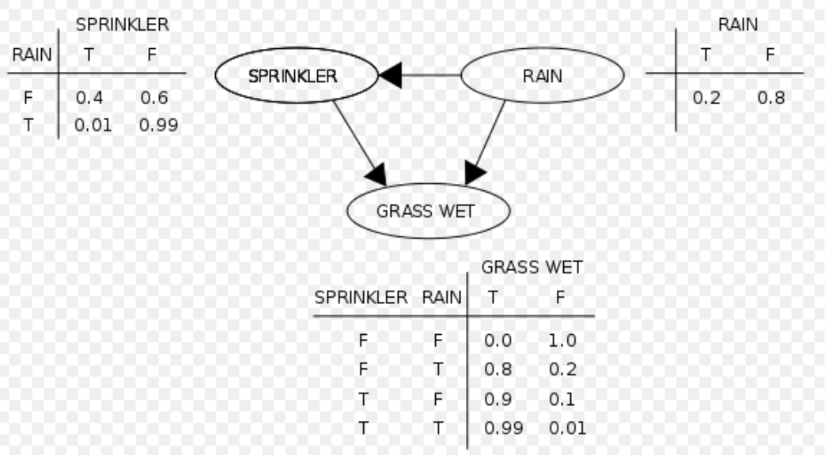
Belief Networks (Con’t)
The figure is from Wikipedia

Slide 37
Dynamic Belief Networks
Dynamic Belief Networks (DBN) are generalization of BN
Observations are taken at regular time slices
A given network structure is replicated for each slice
Nodes can be connected to other nodes in the same slice and/or to the nodes in previous or next slices
When new slices are added to the network, older slices are removed
Example: vision based traffic monitoring

Slide 38
Dynamic Belief Networks (Con’t)
Only sequential activities can be handled by DBNs
Learning local conditional probability densities require for a large networks requires very large amount of training data
Requires area experts to tune the network structure

Slide 39
Petri Nets
Petri Nets contain two types of nodes: places and transitions
  Places: State of Entity
  Transitions: changes in state of entities
Transitions has certain number of input and output places
When an action occurs a token is inserted in the place where action occurs
When all input conditions are met (all the input places have tokens) then the transition is enabled
Transition is fired only when the condition associated with the transition is met
When the condition is met, the transition is fired and input tokens are moved from input place to output place
p₁
t₁
p₂

Slide 40
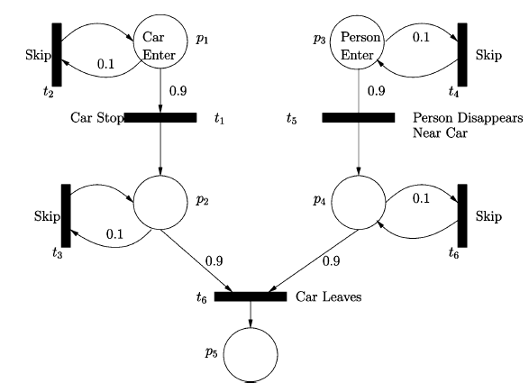
Probabilistic Petri Nets
Petri Nets are deterministic
Real-life human activities don’t conform to hard-coded models
Probabilistic Petri Nets:
  Transitions are associated with a weight

Slide 41
Petri Nets (Con’t)
Manually describe the model structure
Learning the structure from training data is not addressed

Slide 42
Recognizing Activities
Activities
Graphical Models
Syntactic
Knowledge Based
Dynamic Belief Nets
Petri nets
Context Free Grammar
Stochastic CFG
Attribute Grammars
Constraint Satisfaction
Logic Rule
Ontologies

Slide 43
Context Free Grammars (CFG)
Define complex activities based on simple actions
  Words ->Activity primitives
  Sentences -> Activities
  Production rules -> how to construct Activities from Activity Primitives
HMM and BNs are used for primitive action detection
Not suited to deal with errors in low level tasks
It is difficult to formulate the grammars manually

Slide 44
Stochastic CFG
Probabilistic extension of CFGs
Probabilities are added to each production rule
Probability of a parse tree is the product of rule probabilities
More robust to insertion errors and errors in low-level modules

Slide 45
Attribute Grammars
“Recognition of Multi-Object Events Using Attribute Grammars”
Associate additional finite set of attributes with primitive events
Passenger Boarding Example:
Track objects using background subtraction
Objects were manually classified into person, vehicle and passive object
Recognize primitive events (appear, disappear, move-close, and move-away)
Associate attributes with primitives:
  idr: id of the entity to/from which person moves close/away
  Contextual objects are Plane and Gate
  Class: object classification label
  Loc: location in the image where the primitive event occurs

Slide 46
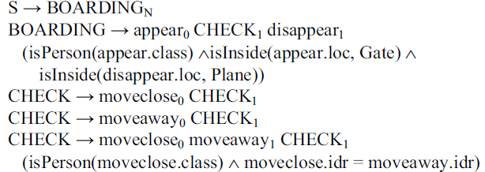
Attribute Grammars (Con’t)

Slide 47
Recognizing Activities
Activities
Graphical Models
Syntactic
Knowledge Based
Dynamic Belief Nets
Petri nets
Context Free Grammar
Stochastic CFG
Attribute Grammars
Logical Rules
Ontologies

Slide 48
Logical Rules
“Event Detection and Analysis from Video Streams”
Logical Rules are used to describe activities
Object trajectories are computed by the object detection and tracking module
Given object trajectories and associated contextual information, behavior interpretation system tries to recognize activities
Scenario recognition system uses two kinds of context information:
  Spatial Context (defined as a priori information)
  Mission Context (defines specific methods to recognize the type of actions)

Slide 49
Logical Rules (Con’t)
Scenario (Activity) Modeling:
Single state constraint on object properties
  “Car goes toward the checkpoint”
  Distance between the car and checkpoint
  Direction of the car
  Speed of the car
Multi state constraint representing temporal sequence of sub-scenarios
  “the car avoids the checkpoint”

Slide 50
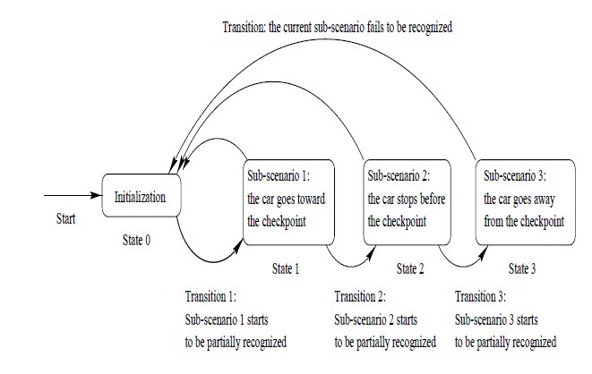
Logical Rules (Con’t)
Activity representation of the car avoids the checkpoint

Slide 51
Ontologies
Ontologies are used
  standardize activity definitions
  Allow for easy portability to specific deployments
  Enable interoperability
Different ontologies have been defined for six domains of video surveillance
  Internal security
  Railroad crossing surveillance
  Visual bank monitoring
  Visual metro monitoring
  Store security
  Airport-tarmac security

Slide 52
Challenges in Activity Recognition

Slide 53
Real-World Conditions
Errors at low level feature extraction due to noise, occlusions, shadows, etc can propagate to higher levels
Algorithms should be able to deal with low-resolution video

Slide 54
Invariances in Action Analysis
Activity algorithms should be invariant to the following:
  Viewpoints
  Execution Rate
  Anthropometry (size, shape, gender, etc. )

Slide 55
Future Directions
Establishing of a standardized test beds
Integration with other modalities such as audio, temperature, inertial sensors
Intention reasoning: predicting the activities beforehand

Slide 56
Questions?

Slide 57
Context Free Grammar
Context free grammar consists of following components:
  A finite set N of non-terminal symbols
  A finite set ∑ of terminal symbols
  A finite set P of production rules
  A start symbol S Є N

Slide 58
Context Free Grammar - Example
Given a Grammar G with following components:
    N = {S,B}, ∑ = {a,b,c},
    S aBSc
    S abc
    Ba aB
    Bb bb
Example Strings:
    S => abc
    S =>aBSc=>aBabcc=>aaBbcc=>aabbcc

Slide 59
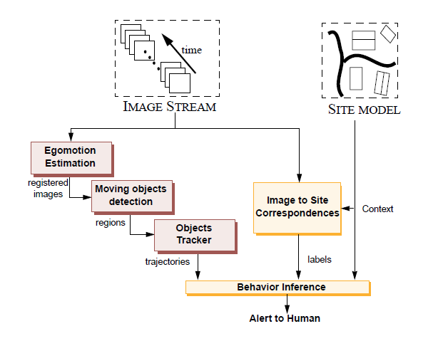
Event Detection and Analysis from Video Streams

