Slide 1
IM2GPS: Estimating Geographic Information from a Single Image
James Hays and Alexei A. Efros
CMU – CVPR 2008
Presented by: Janaka

Slide 2
The Idea
Find the geo location where the image is taken
Visually compare the image to a DB of images with known locations

Slide 3
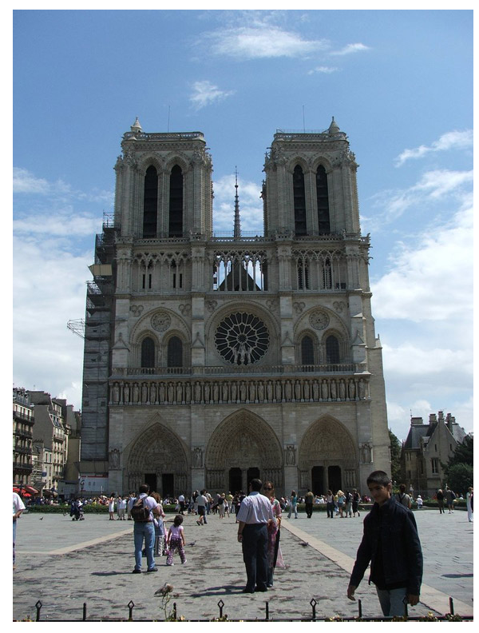

Slide 4
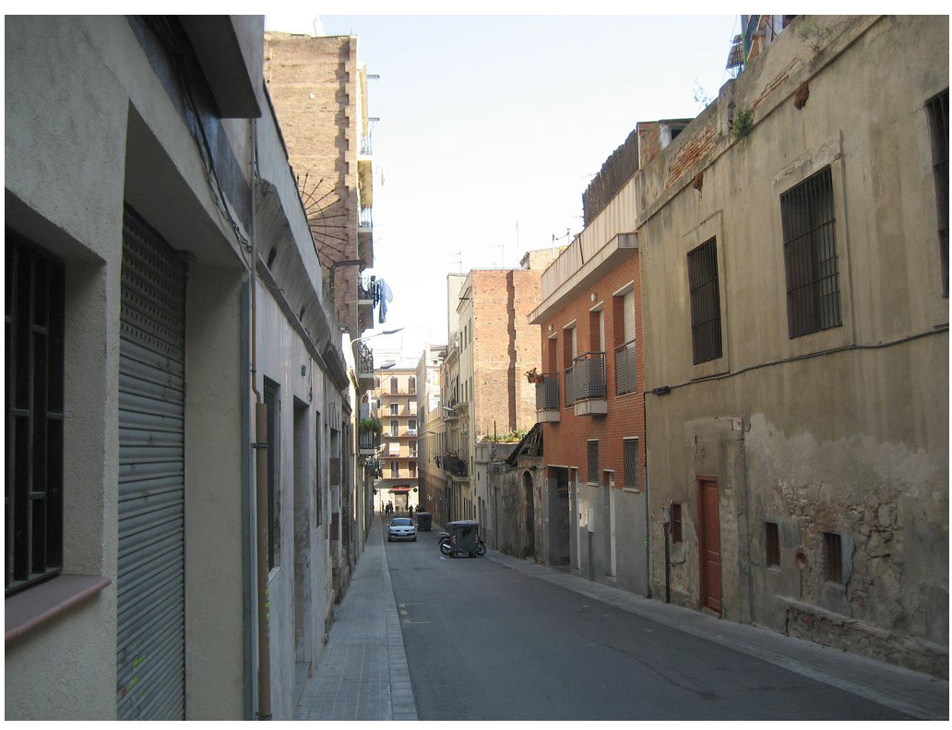

Slide 5
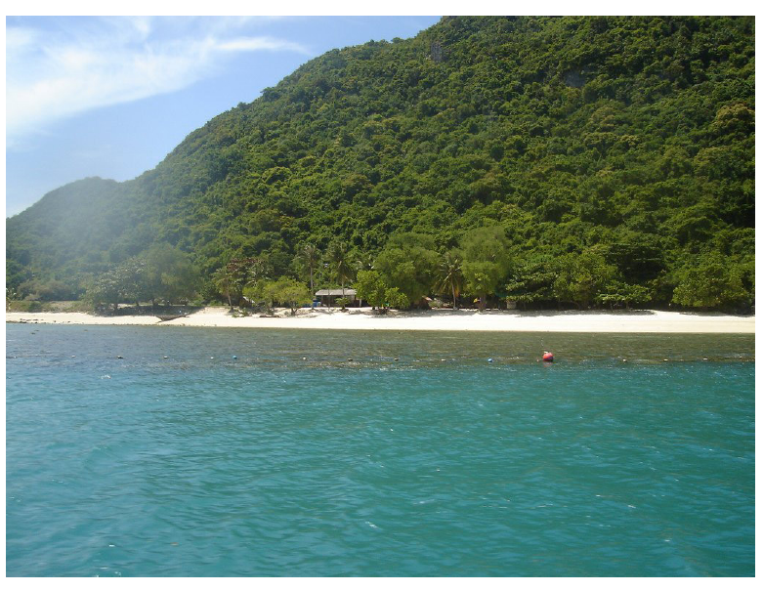
Notes:
Have you seen this exact scene? Of course not. Are you reasoning about its location based on what you know about vegetation distribution, etc?
We’re going to try and locate images like this through data association, not the semantic reasoning that a human like yourself could employ

Slide 6
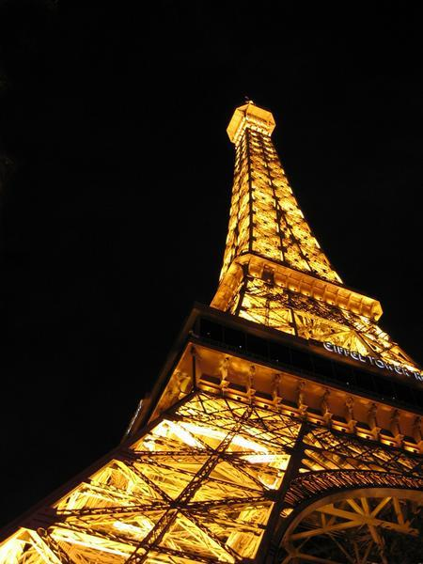
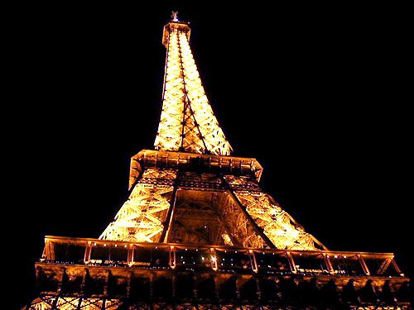
Difficulties
  Many images are uninformative
  World is dynamic
  World is (sometimes intentionally) self similar
Paris
Las Vegas
Notes:
The world is so self similar that “noise” from the dynamic processes of the earth will obfuscate the true nearest neighbor
People are often intentionally against you- think multiple eifel towers, theme parks simulating other regions
This algorithm might, in fact, be fighting against the very phenomena that makes scene matching promising for computer vision.

Slide 7
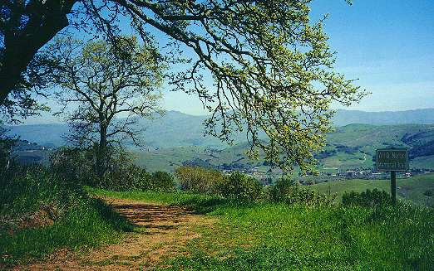
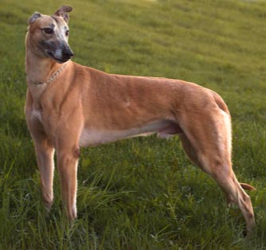
Building image database
Extract Flickr Images
Geographic keywords – Ambiguous
  Washington city/state
  Georgia state/country
Geo-location – sometimes not useful
Label: Trail
Tag: (-36.431, 121.733)
Label: Dog
Tag: (-56.739, 182.736)
Take intersection of 1) & 2)

Slide 8
Building image database
Geotags accurate to 1km, 90% of the time
Geographic keywords
  Every country and continent
  Top 200 most populated cities
  Every US state and popular tourist site
Images with both geotags and geographic keywords – 20 million
Remove images with – birthday, concert, abstract etc. – 6 million

Slide 9
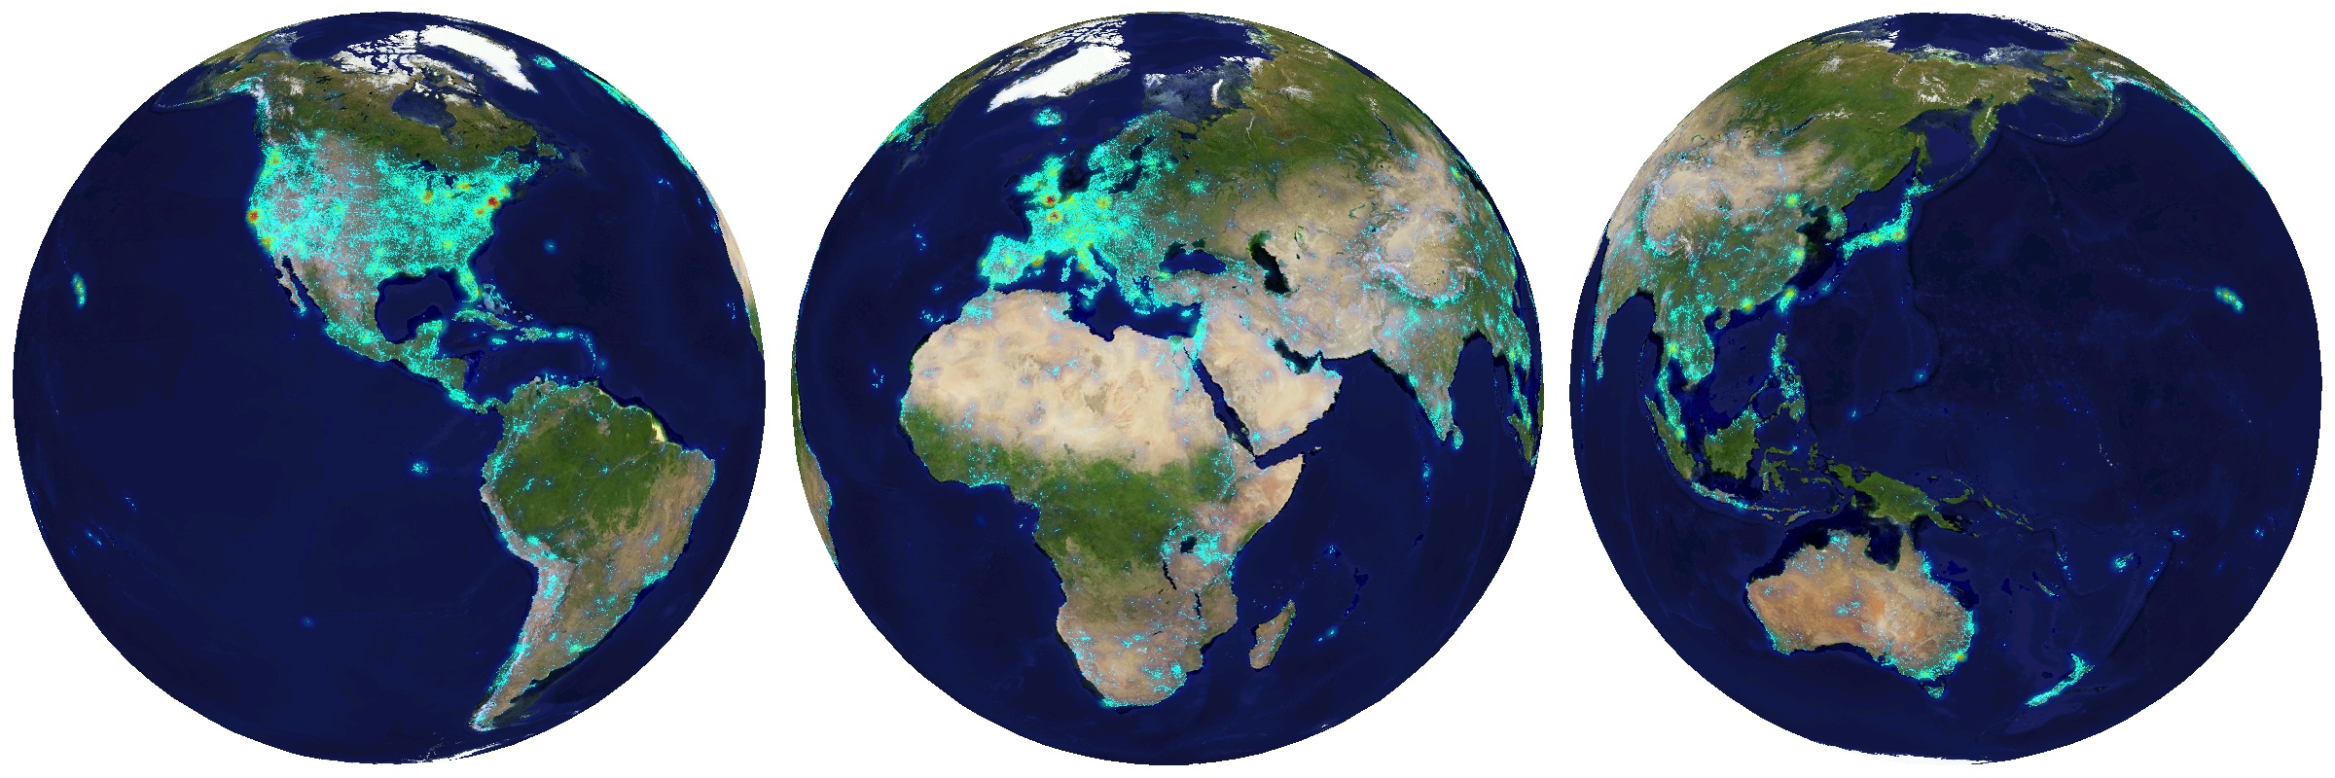
Distribution of Data

Slide 10
Distribution of Data

Slide 11
Features for Visual Similarity
Tiny Images – 16x16 RGB images
Color Histograms - L*A*B* 4x14x14 histograms
Texton Histograms – 512 entry, filter bank based
Line Features – Histograms of straight line stats
Geometric Context – Ground, Vertical, Sky prob.
Gist Descriptor + Color

Slide 12
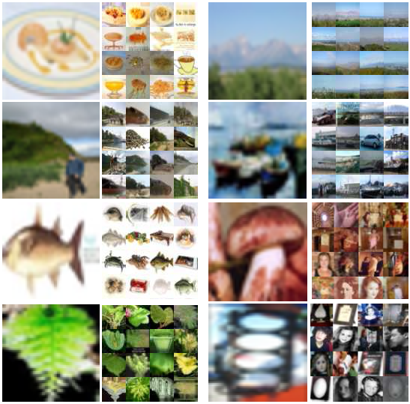
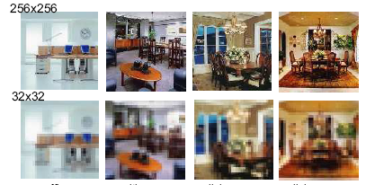
Tiny Images (Torralba MIT)
Reduce image dimensions to 16x16
Computationally feasible
Less sensitive to exact alignment

Slide 13
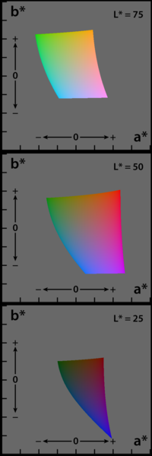

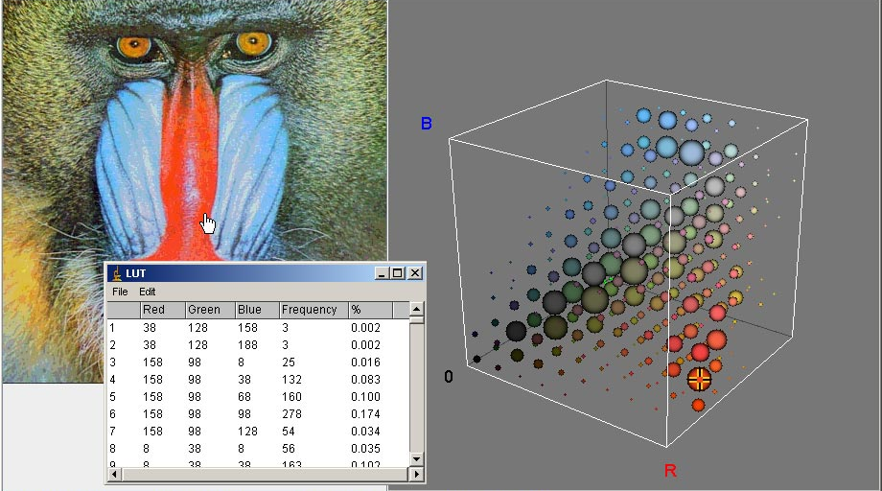
Color Histograms
L*a*b* color space
  L :lightness, a & b: color components
4, 14 and 14 bins along L, a and b – 784 total bins
χ² distance between histograms

Slide 14
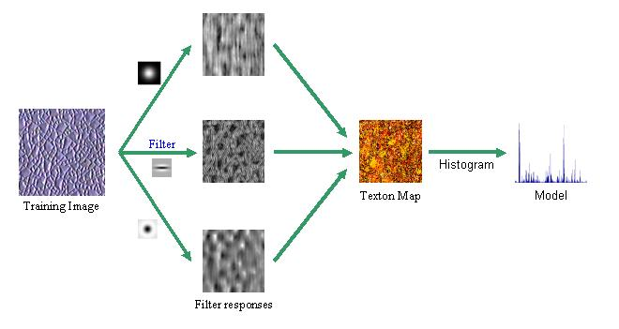
Texton Histograms
Texture features
  Identifies – building material, vegetation, terrain types etc
Build 512 entry Texton dictionary – 32 filters
Texton histograms with 512 bins

Slide 15
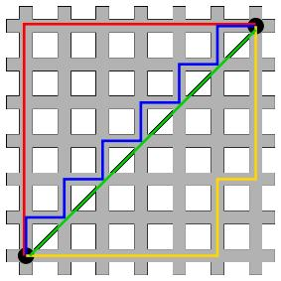
Line Features
Use Canny to find edges and then find straight lines
Two Histograms
  Line angles
  Line lengths
L1 distance (Manhattan, city-block, taxicab)

Slide 16
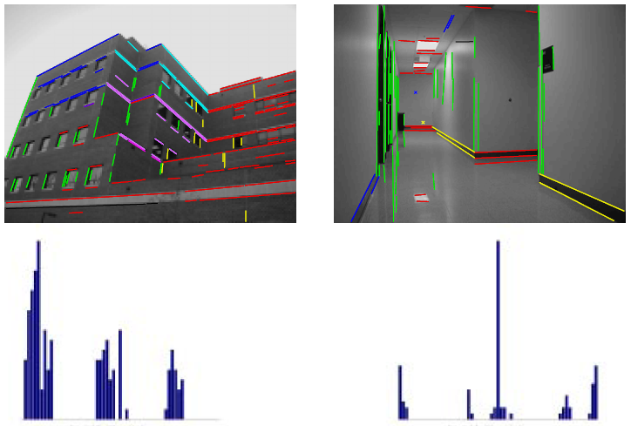
Line Angle Histogram

Slide 17
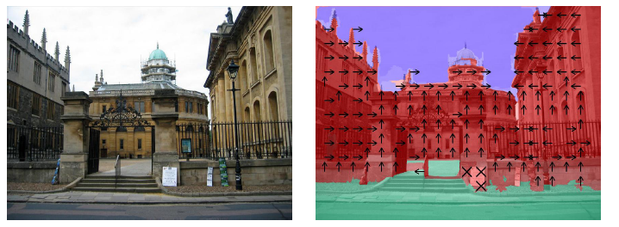
Geometric Context
Three classes
  Ground - green
  Sky - blue
  Vertical – red
Compute class probabilities for each regions
Use L2 distance (Euclidean)
Notes:
Reduce map to 8x8 for each class

Slide 18
Processing
6 million image – 15 secs per image
Intel Research – Pittsburgh (CMU)
400 processors 3 days – 3.08 CPU years

Slide 19
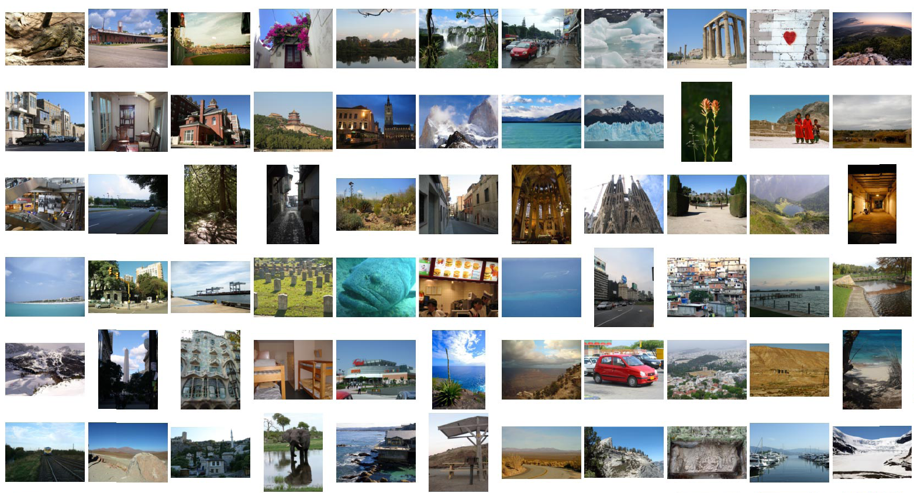
Test Set
237 Images

Slide 20
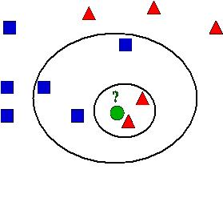
Finding Geo-location
Compare each test image to all 6 million
Scale each feature – equal Standard Deviation
Aggregate feature distances (6D)
Evaluation
  1-NN
  k-NN with k=120
    Probability map

Slide 21
Nearest Neighbors
Mean shift clustering on k neighbors' geolocations
Mean Shift bandwidth – 500km
Center of the cluster with highest cardinality

Slide 22
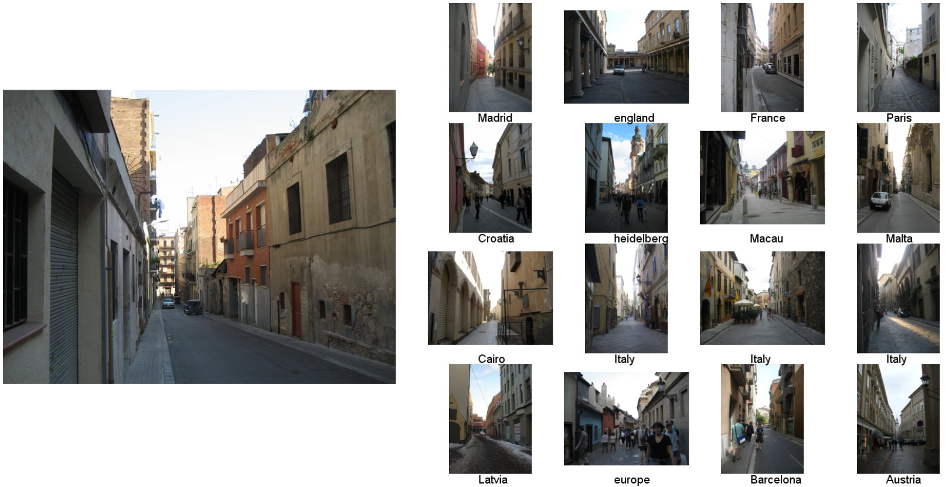
Example Scene Matches
Barcelona

Slide 23
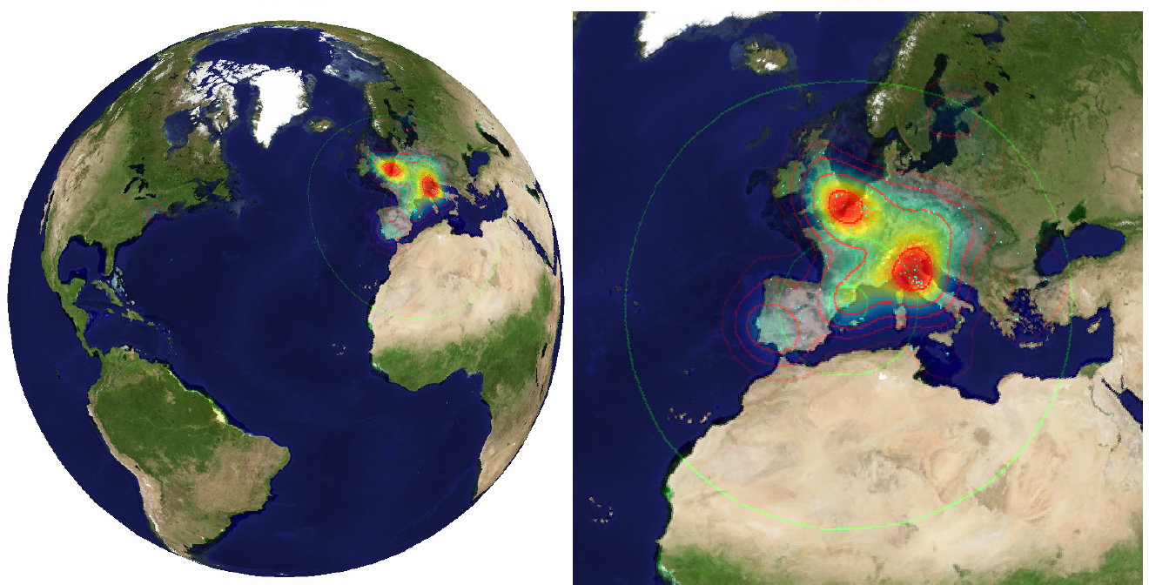
Distribution of Matches
Notes:
Probability map for that same image
Explain the green circles and how they relate to evaluation

Slide 24
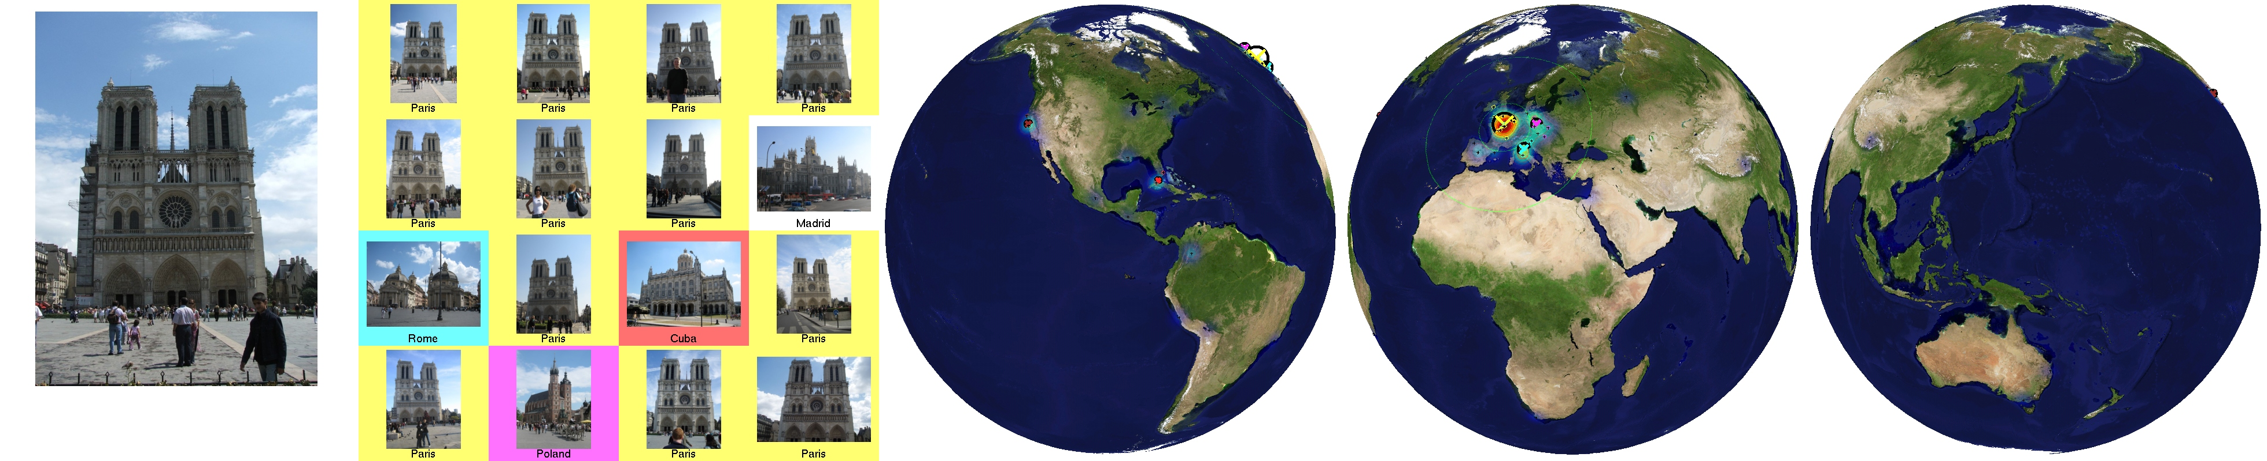
Paris

Slide 25


Slide 26
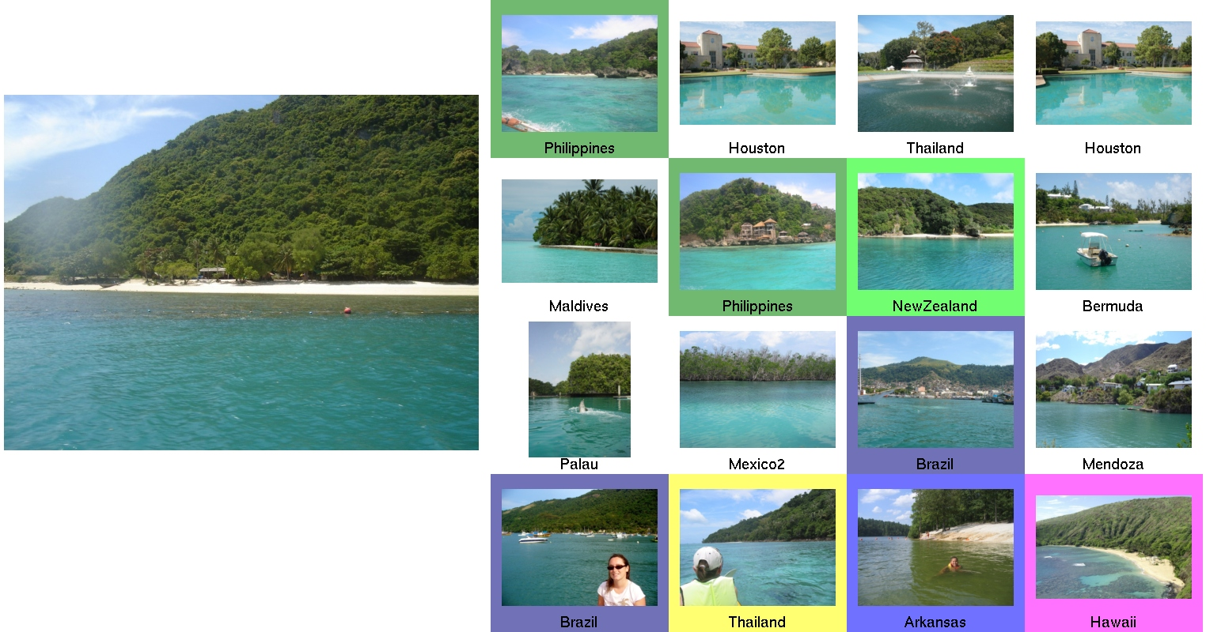
Thailand

Slide 27



Slide 28
How is Data Helping?
18 times better than chance

Slide 29
What features help?
Good – Gist and color (when outliers are removed)
Bad – Geometry and tiny images

Slide 30
How accurate?
25% - within the country
50% - within the continent

Slide 31
What if guesses are allowed?
Median error 500km if 6 guesses are allowed

Slide 32
Secondary Geographic Tasks
Probability Map of similar images (k-NN)
Global distribution of a certain geographic property (X)
  Light pollution (urban/rural)
  Land cover
  Population density
  Elevation Gradient
Intersection of 1 & 2 is proportional to the amount X in original image

Slide 33
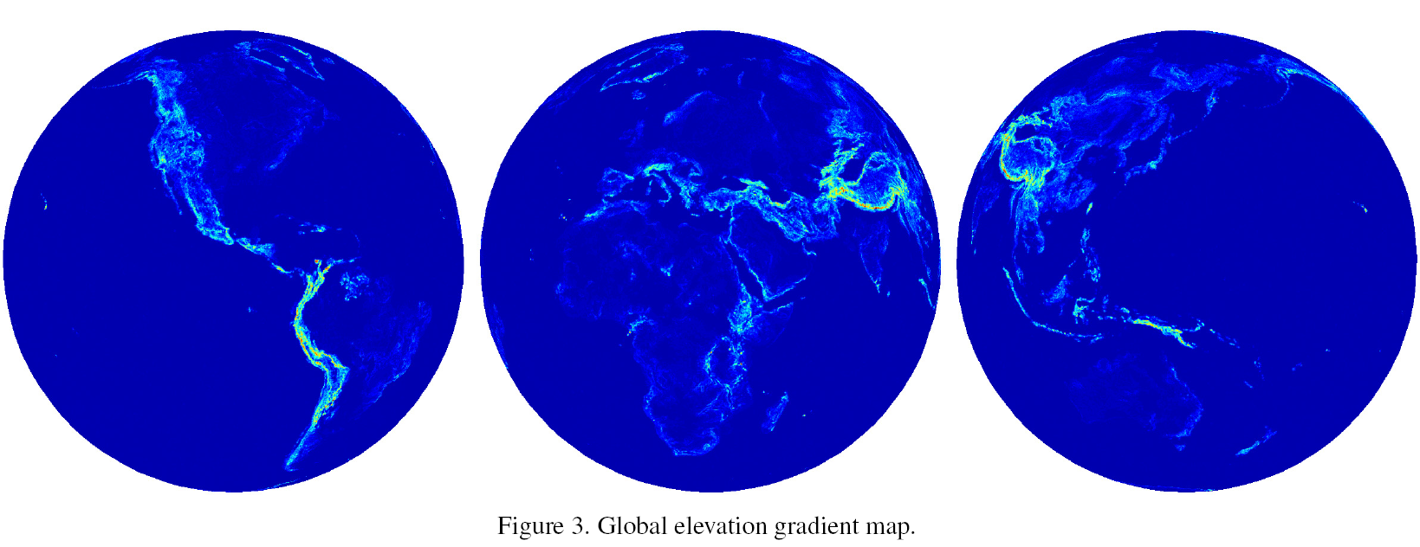
Elevation Gradient

Slide 34
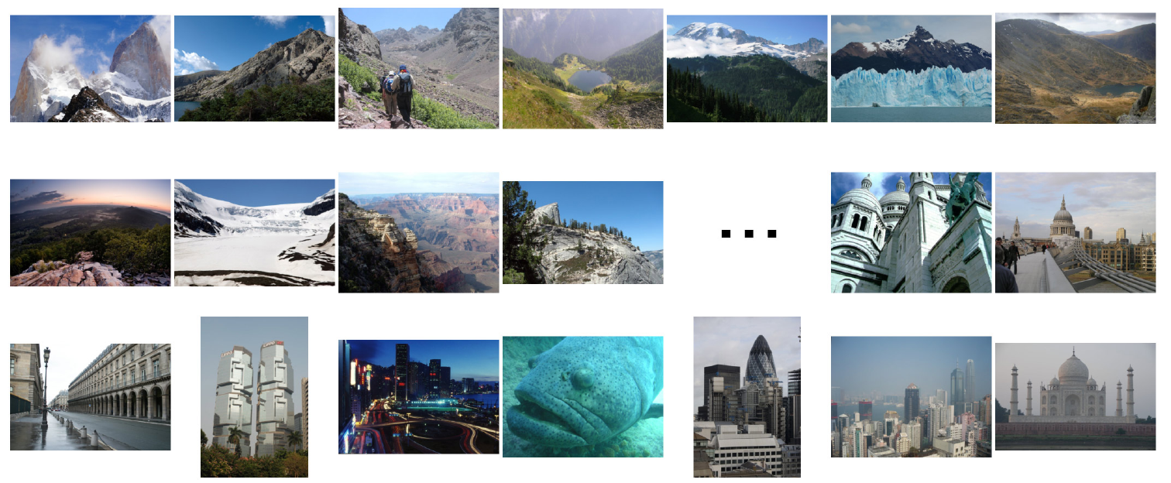
Elevation gradient magnitude ranking

Slide 35
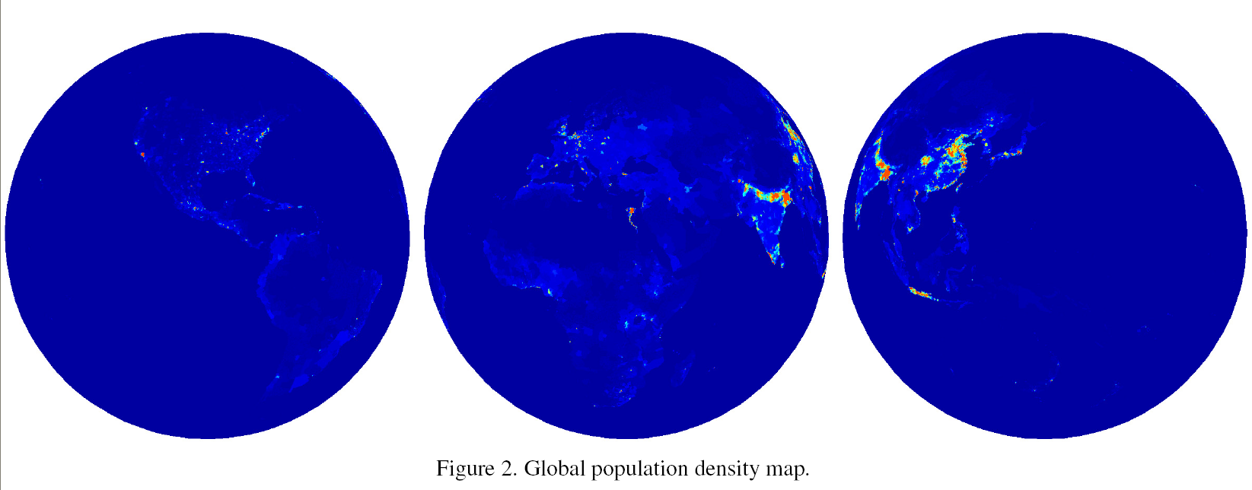
Population Density Map

Slide 36
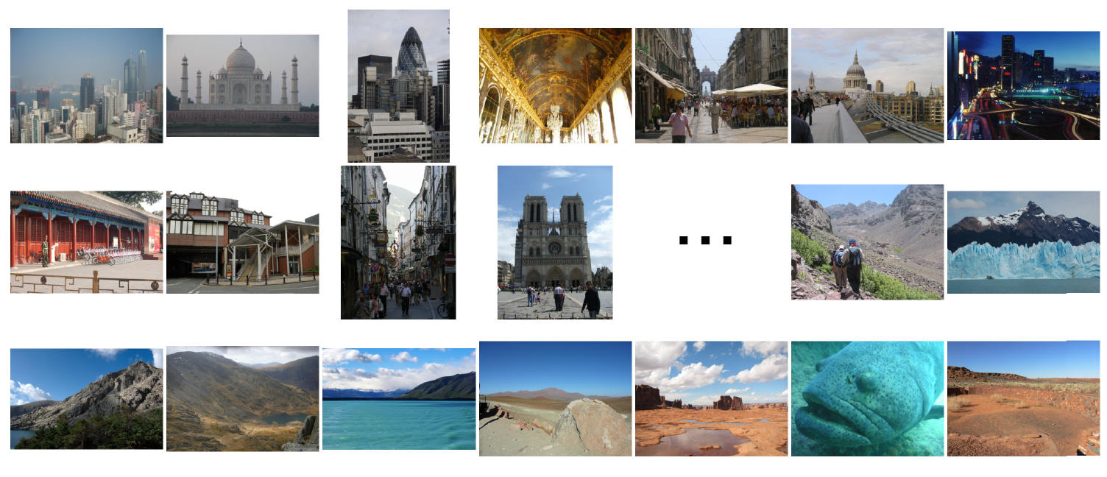
Population density ranking

Slide 37
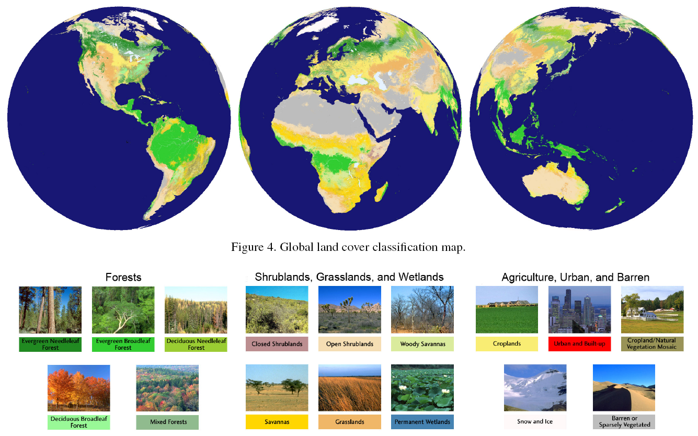
Land cover classification

Slide 38
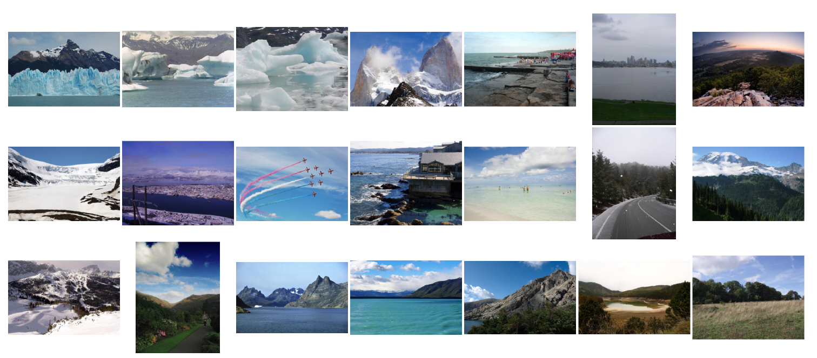
Snow and Ice

Slide 39
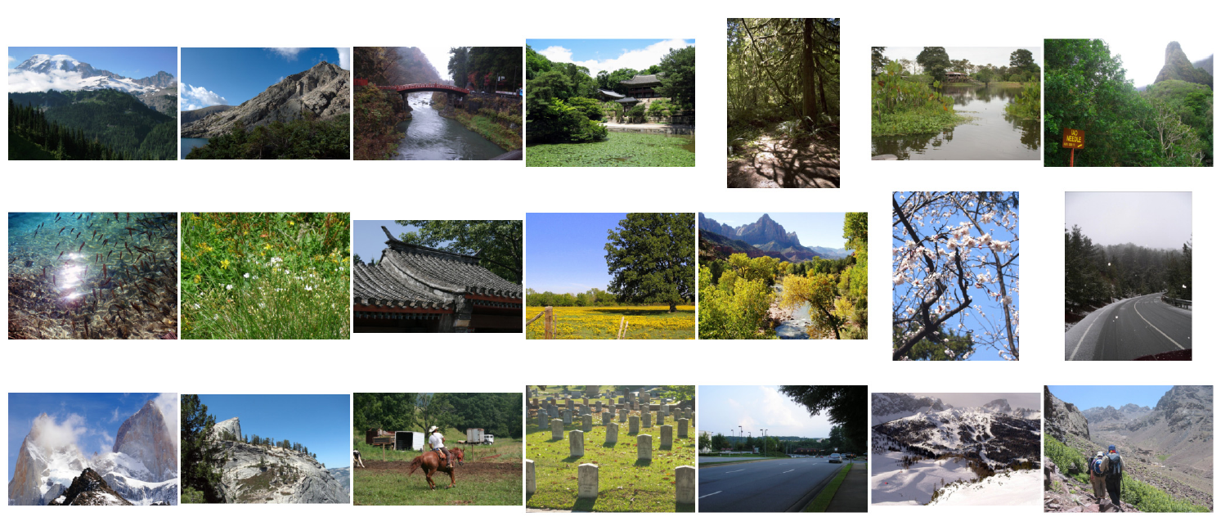
Forest (non rain forest)

Slide 40
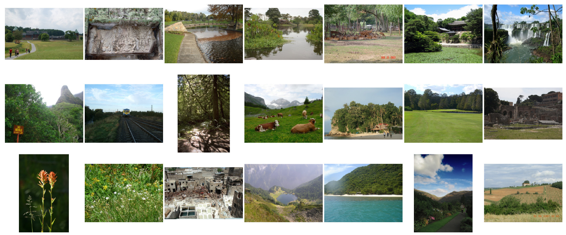
Rain forest

Slide 41
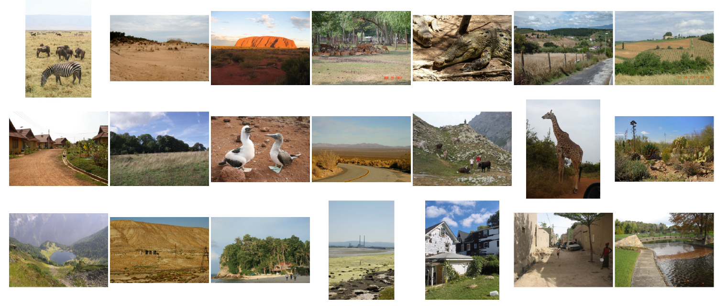
Savannah

Slide 42
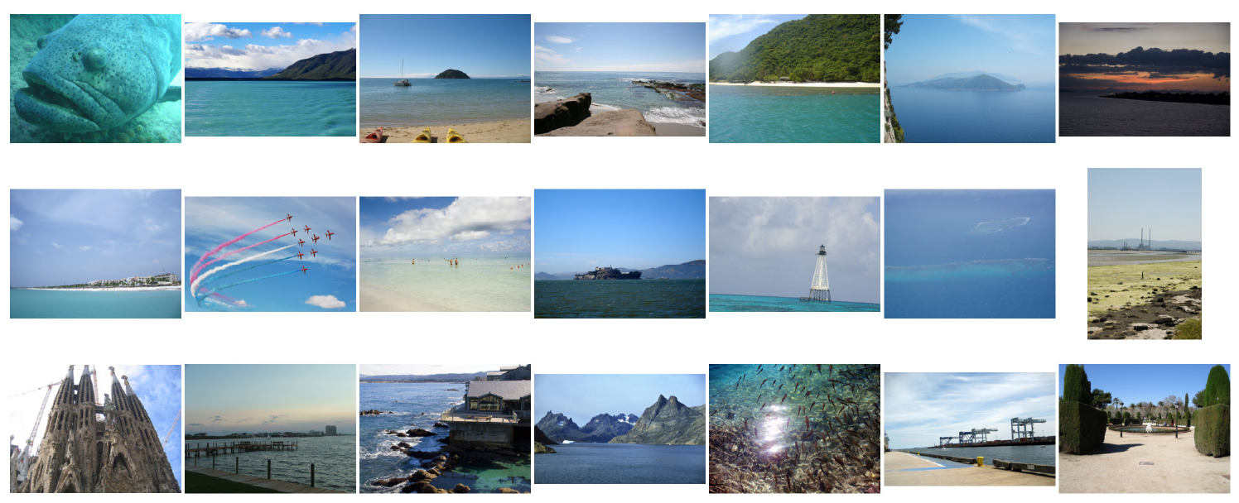
Water

Slide 43
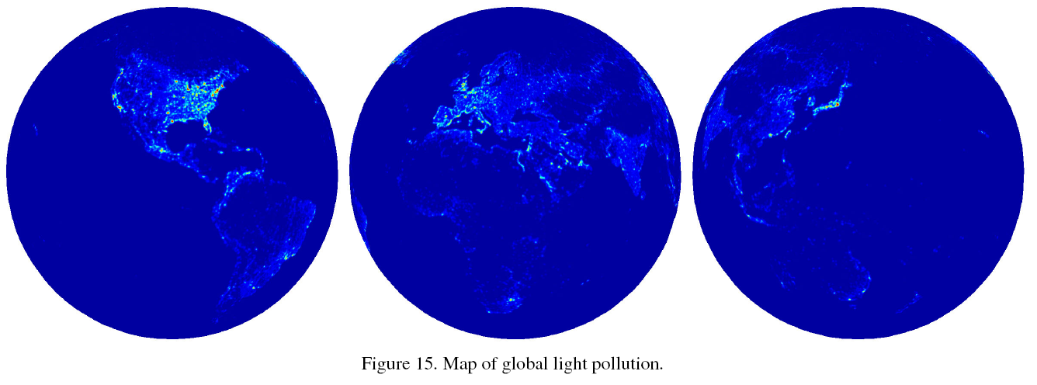
Rural / Urban classification

Slide 44
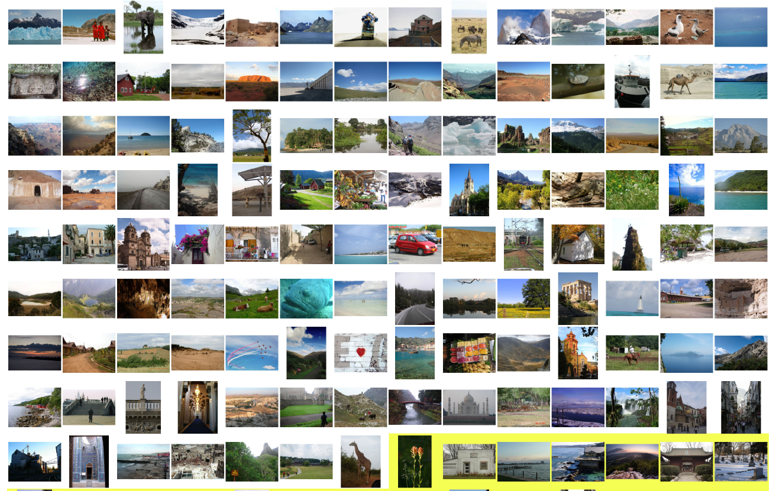
Rural Images

Slide 45
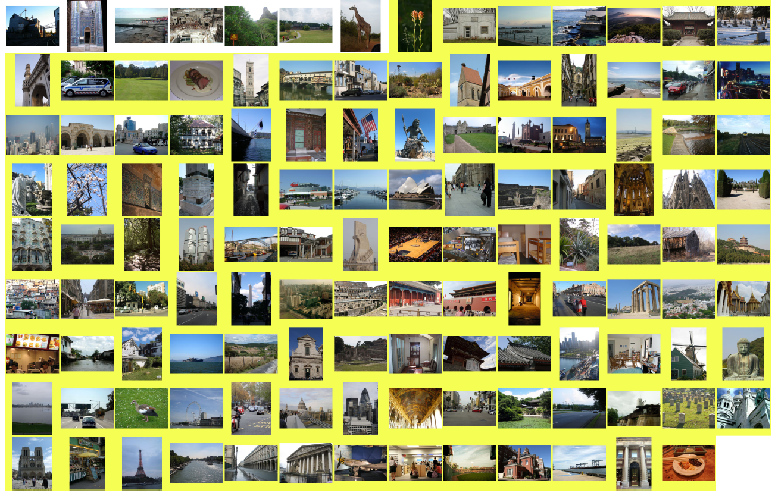
Urban Images

Slide 46
Urban vs Rural ROC
82% under ROC curve

Slide 47
Conclusion
What is it? – no idea
What is it like? – small town in Mediterranean

