Slide 1
Recursive Unsupervised Learning of
Finite Mixture Models
Zoran Zivkovic and Ferdinand van der Heijden
Netherlands – PAMI 2004
Presented by: Janaka

Slide 2
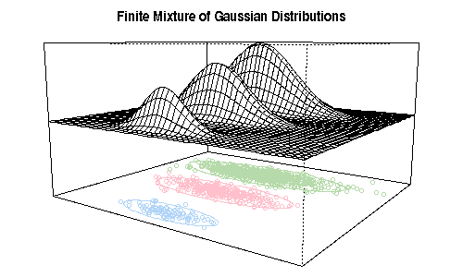
Introduction
Sample data -> Mixture Model parameters
EM - maximum likelihood estimation of parameters
Variations
  Fixed vs. Variable number of components
  Batch vs. Online (recursive)

Slide 3


ML and MAP
Estimate population parameter θ from samples (x)
Maximum Likelihood (ML)
Prior distribution g over θ exists
Maximum a posteriori (MAP)

Slide 4
Introduction
Using a prior with EM [3] [6]
Recursive parameter estimation [5,13,15] – approximates batch processing
Connecting above two – coming up with a heuristic
Randomly initialize M components
Search for MAP using iterative proc(e.g. EM)
Let prior drive irrelevant components to extinction

Slide 5
EM algorithm
Definition
Iteratively reach the best set of parameters that model the observed data, under the occurrence of some unobserved (missing) parameters/data.
Apply to Mixture models
  Unobserved data – the component each data point belongs to
  Parameters – parameters of the each component

Slide 6
EM Algorithm
How to classify points and estimate parameters of the models in a mixture at the same time?
(Chicken and egg problem)
Expectation step: Use current parameters (and observations) to reconstruct hidden structure
Maximization step: Use that hidden structure (and observations) to reestimate parameters
Repeat until convergence!

Slide 7
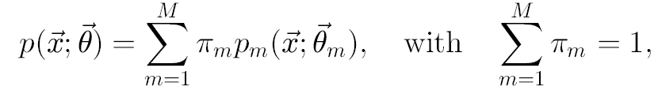



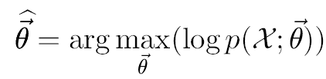
Mixture Models
is a random variable of d-dimensions,
Given data,
ML estimate given by
EM searches for the local maximum of log likelihood function (i.e. ML estimate)

Slide 8



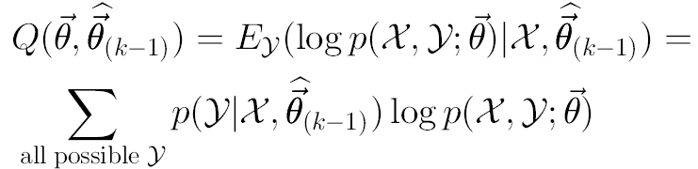

EM for Mixture Models
For each , missing data
  Multinomial distribution
Set of unobserved data
Estimate in k^{th} iteration
  E-step
  M-step

Slide 9
Differences with EM
For EM must know the M-num components
All data at the same time
Apply MAP (ML with prior) to the EM – the prior biased towards compact models
Data – one at a time

Slide 10



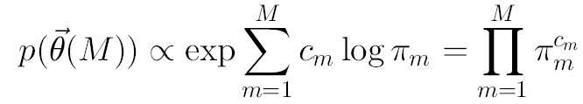
Prior
Criteria: increase
Log-likelihood and prior
Find ML for different M’s (by EM) and find highest J.
Simple prior
Prior is about the distribution of parameters

Slide 11


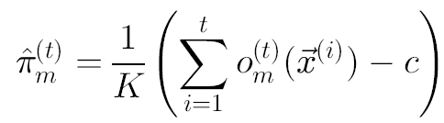
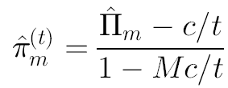
Prior in EM
Select
Start with
Ownership
ML estimate
MAP using prior
Combining

Slide 12





EM + Prior iterations
Keep bias fixed
  Decreases with t
  Negative update for small t
Approx by
Update equation for weights
Prior only influences weights - Remove when negative
Other parameters same as EM

Slide 13
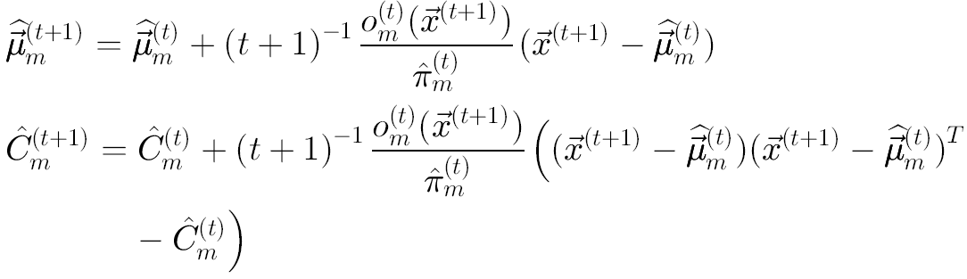
EM for GMM
Other parameters same as in EM
Mean and covariance matrix

Slide 14




Practical Algorithm (RuEM)
Fix the Influence from new samples to
  Instability for small t
  Rapidly forget the past
Apply to GMM
  Start with a large M
  For d-dimensional data N =

Slide 15
RuEM

Slide 16








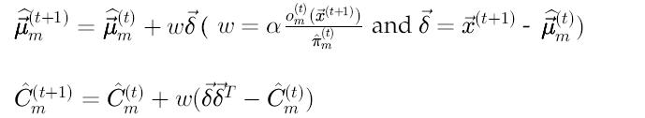


Slide 17
Experiments
Apply to standard problems (Gaussian)
  Three 2D - 900
  Iris - Three 4D – 150
  3D shrinking spiral - 900
  Enzyme - 1D -245
Comparison with batch algorithms
  Carefully initialized EM
  Split and Merge EM
  Greedy EM – start with one component
  Polished RuEM – learn rate + EM

Slide 18
Three Gaussians
Mixture of 3 Gaussians – 2D
900 samples
EM needs 200 iterations (x 900)
RUEM needs 9000 iterations (repeatedly apply 900 samples)
20 times faster

Slide 19
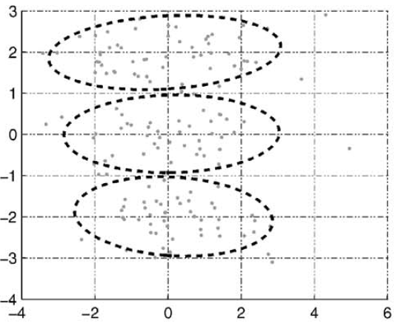
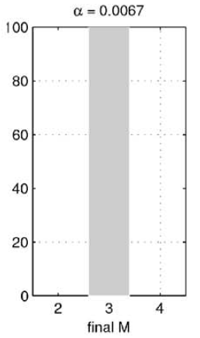
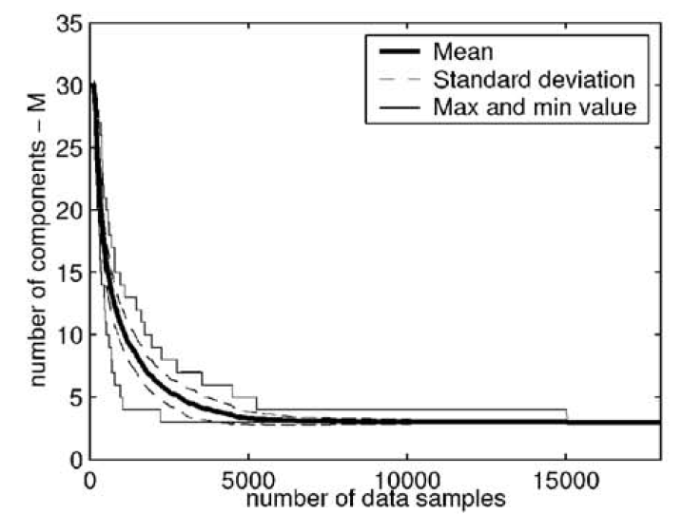

Slide 20
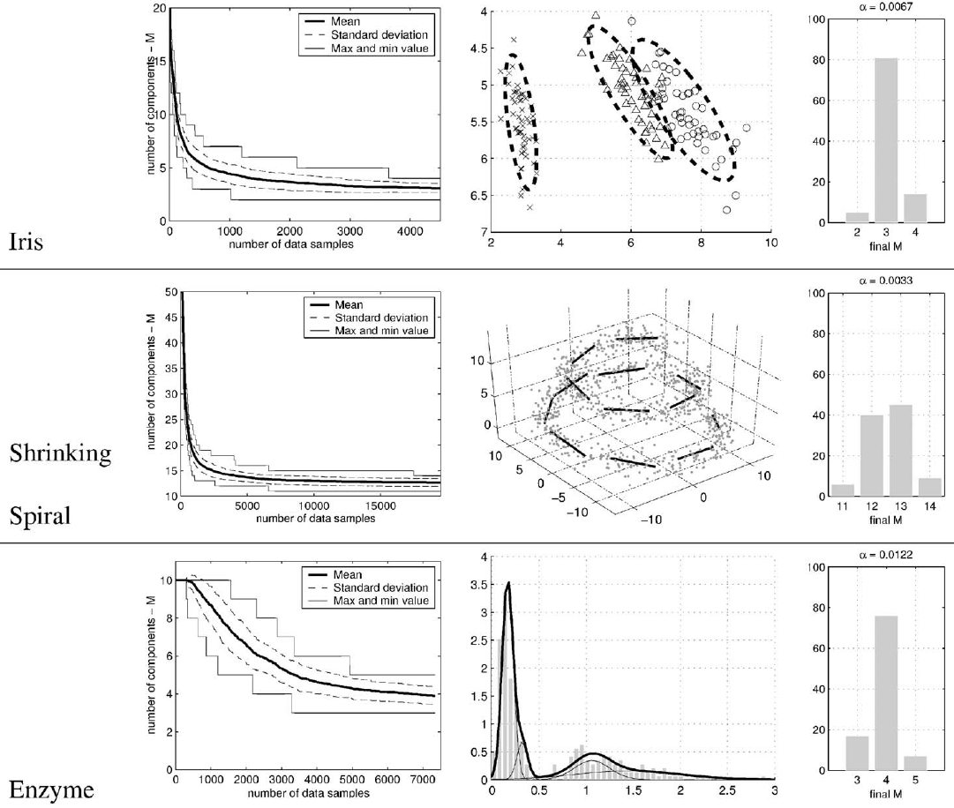
Iris, Shrinking Spiral, Enzyme

Slide 21
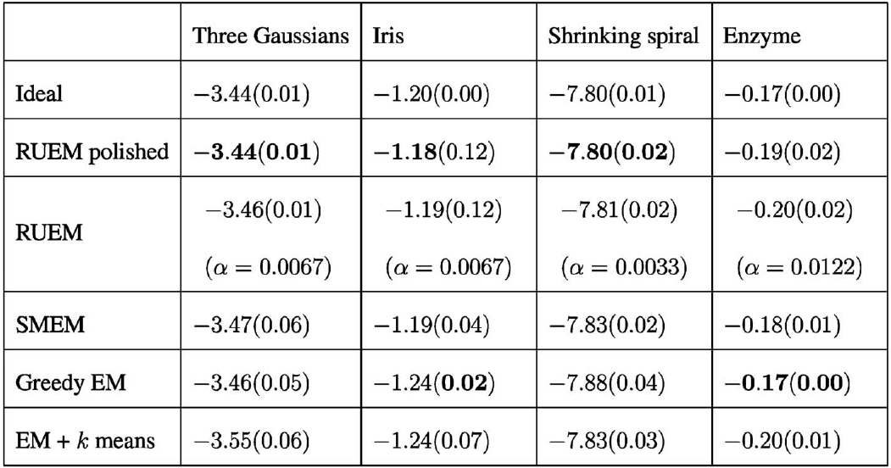
ML (mean and variance)

Slide 22
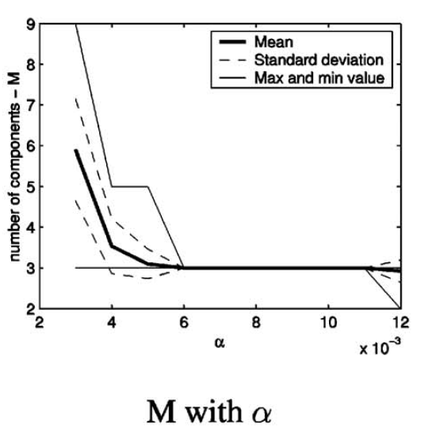
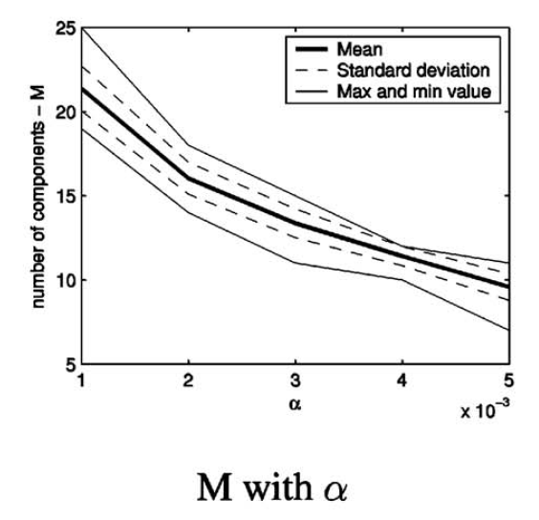
Learning rate on M
Three Gaussians Shrinking Spiral

Slide 23
Discussion

