Slide 1
Unified Crowd Segmentation
P. Tu, T. Sebastian, G. Doreto, N. Krahnstoever, J. Rittscher, T. Yu
ECCV 2008
Presenter: Ramin Mehran

Slide 2
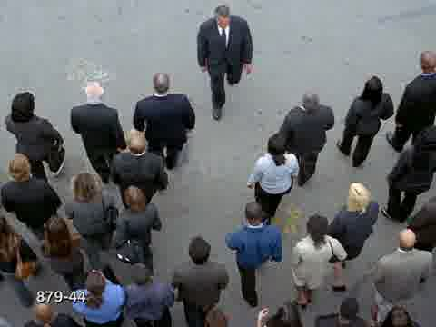
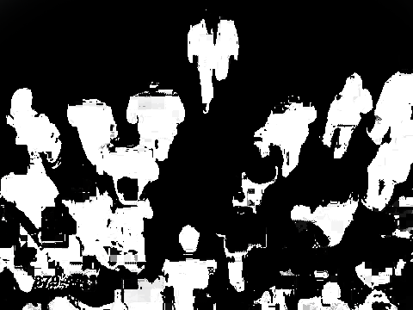
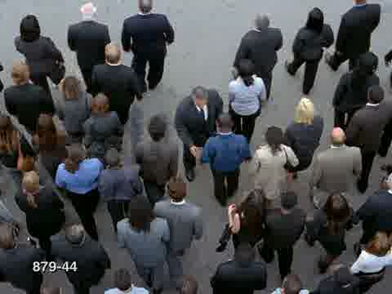
Goal: Segmentation
Crowd Analysis
  Conventional Approach
    Segmentation
    Object Detection
    Tracking
    Analysis

Slide 3
Ideas: a Robust Algorithm
Partial Occlusion
Dynamic Background
Foreground Clutter

Slide 4
Approaches
Bottom up
  Low level feature grouping
  Whole body classifiers
Top down
  Background segmentation
BOTH!

Slide 5
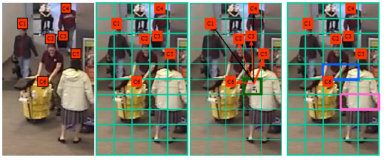
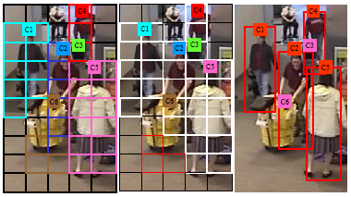
Algorithm Overview
Head-Shoulder Detection
Assigning Patches to Heads
Grouping Patches
E-Step (assignment update)
M-Step (consistency check)

Slide 6
Affinity of Patches to Hypotheses
Head-Shoulder Detection
C_{k} Hypothesis
Head/Shoulder
Background
C_{k}
g_{k}(z_{i})
Assigning Patches to Heads
z_{i}
z_{j}
Grouping Patches
g_{k}(z_{i}, z_{j})
Top Down → Head/Shoulder Detection
Bottom up → Patch Affinities

Slide 7
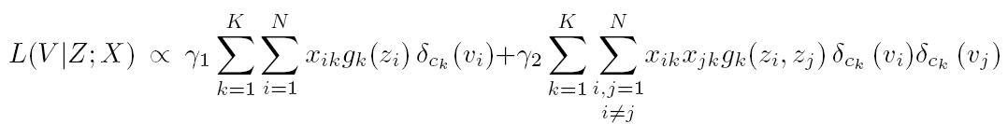
Maximum Likelihood
How likely is the assignment a patch to a head
E-M Steps
Is it likely near the head?
Is it like neighboring patches?
Consistency
Affinity
Assignment
indicator

Slide 8
E-Step
k
i
Increase the expectations

Slide 9
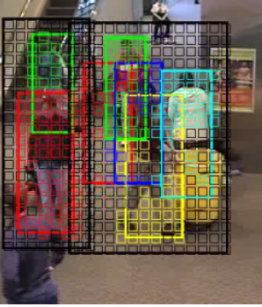
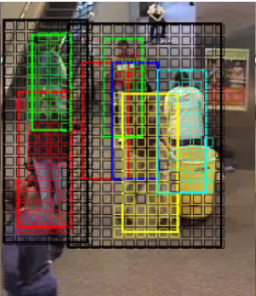
E-Step affect

Slide 10
M-Step
Enforce Consistency
  Where is the head?
  Contiguous patches
    Path from Patches to the Head
    Dynamic Programming
    Shortest low cost path
C_{k}
C_{m}
  Inconsistent patches
  No Contribution to V (assignment)

Slide 11
Head/Shoulder Body Detection
Strong Classifier out of Weak Classifiers
Strong Classifier (SC(s,z))
Orientation
Orientation
Orientation
Orientation
Aggregation of weak Classifiers

Slide 12
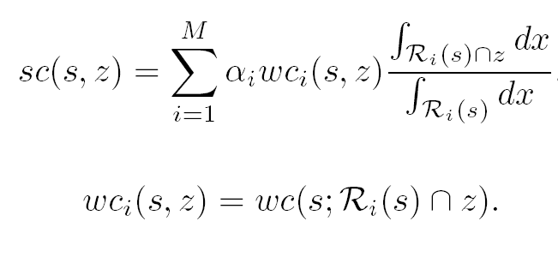
Weak Classifier
Weak Classifier
  Ratio of the intersection of patch and the region
  Sobel Orientation
R
C_{k}
Needs
Camera Calibration
z_{i}

Slide 13
What’s the Affinity?
Patch to Head/Shoulder Affinity
Patch to Patch Affinity
  Histogram matching of colors
  Motion matching of flow
patch
Head and
body bounding box

Slide 14
Patch Size
Camera Calibration
Width of the average pedestrian
Large Patches
  Occlusion Handling
Small Patches
  Discrimination of correct and incorrect assigments

Slide 15
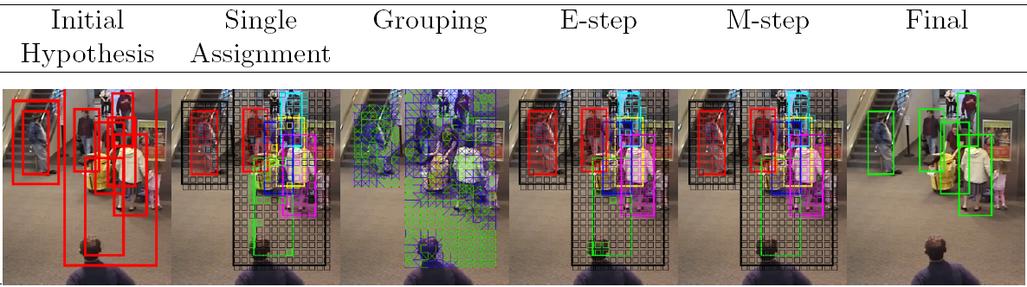
Sample Results

Slide 16
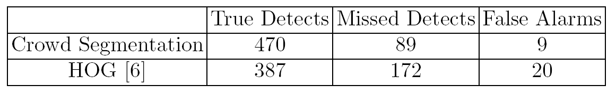
Results
Compared to Histogram of Oriented Gradient method
Superior mostly because of handling occlusions

Slide 17
Thank you!

