Slide 1
Robust Object matching for persistent tracking with heterogeneous features
Presented by Enrique G. Ortiz

Slide 2
Metadata
Time
Object velocity
Platform aspect angle
Depression agle
Slant range
Resolution
Sensor azimuth
Sensor Modality
Object bounding box
Etc.

Slide 3
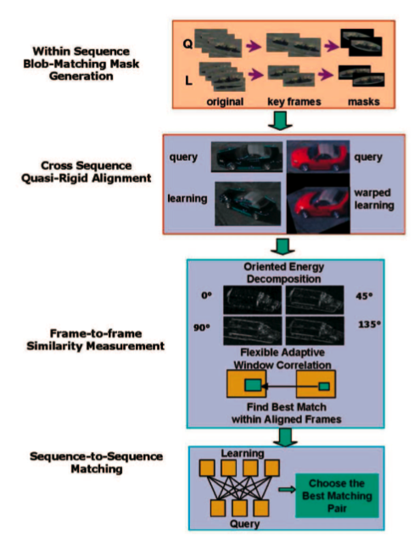
System Overview

Slide 4
Prewarping Stage
Approximately match resolutions
Define vehicles three directions
Chamfer matching for initial translation

Slide 5
Within Sequence Object Mask Generation
Robust Blob Feature Extraction
Blob Tracking via Earth Mover’s Distance
Object Mask Generation

Slide 6
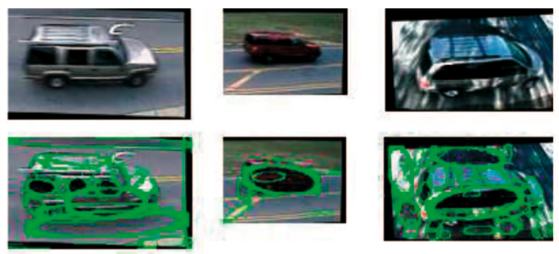
Blob Detection

Slide 7
Earth Mover’s Distance
Intuition
Transportation Problem

Slide 8
Region Matching through EMD
Distribution 1
Distribution 2
w_{i,j}
d_{i,j}
[R, G, B, X, Y, A]
d_{i,j}
d_{i,j}
w_{i,j}
f_{i,j}=min(w_{i,j},w’_{I,j})

Slide 9
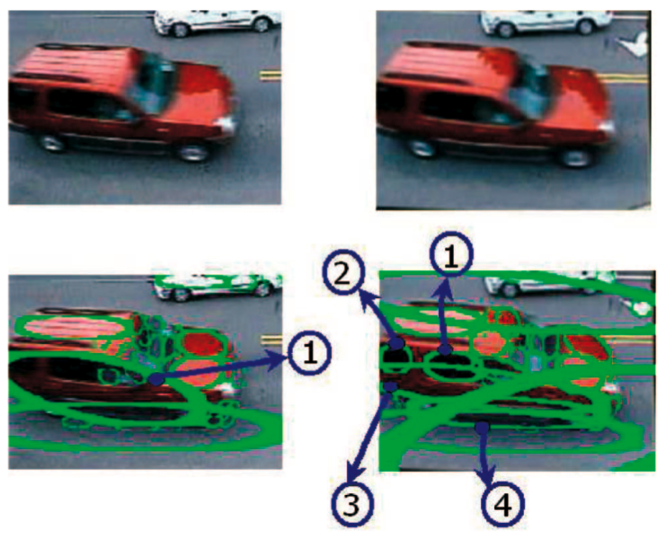
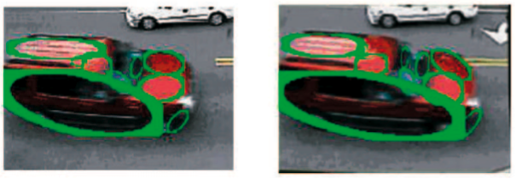
Object Mask Generation

Slide 10
Segmentation Result

Slide 11
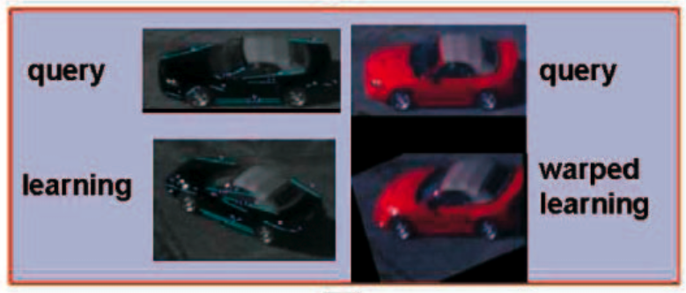
Cross Sequence Quasi-Rigid Alignment

Slide 12
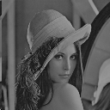
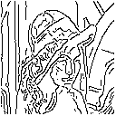
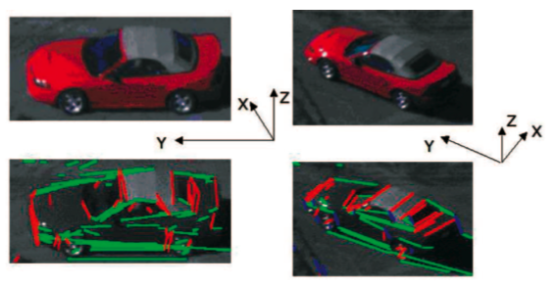
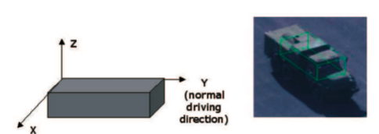
Detect and Classify Edges
Canny Edge Detection
Classify Edges

Slide 13
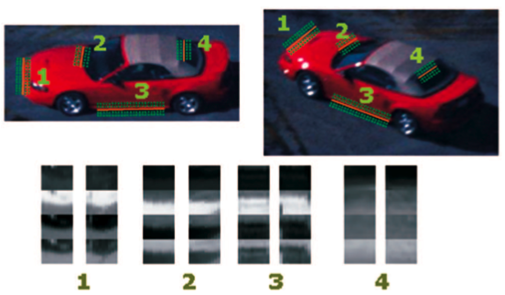
Descriptor and Matching
Band Image [Y R G B]
Normalized Correlation

Slide 14
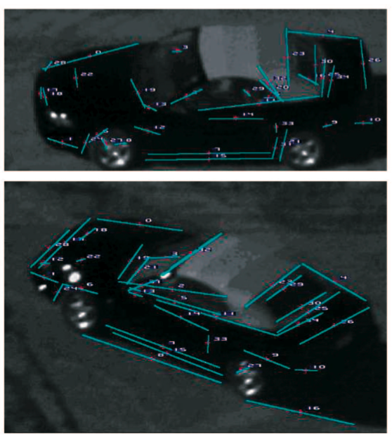
Matching Result

Slide 15
Reject Outliers
Outliers
Edges with similar appearance
False matches
Edges with cluttered background
Solution:
Impose two rigidity constraints

Slide 16
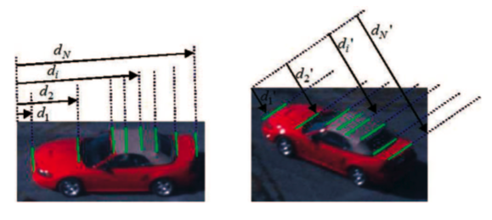
Reject Outliers - Affine Rigidity
Target depth variation smaller than range
Distances should satisfy 1D affine model

Slide 17
Reject Outliers – 3D Line Reconstruction
Metadata
Camera Rotation
2D Line Correspondences
Camera Translation
3D Line Location
Reject line with large 3D location error

Slide 18
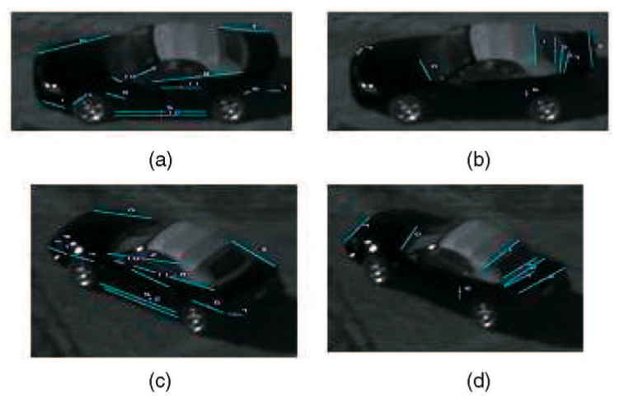
Outlier Rejection Result

Slide 19
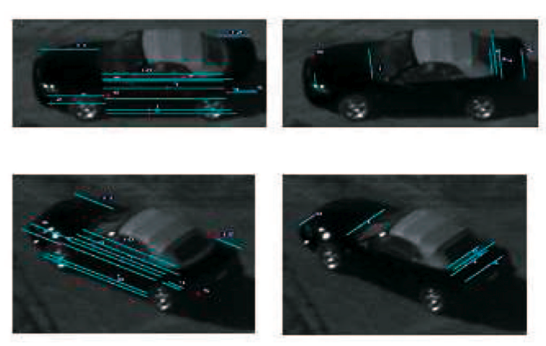
Extend Line Segments
Extend until intersection
Modify for equal orientation

Slide 20
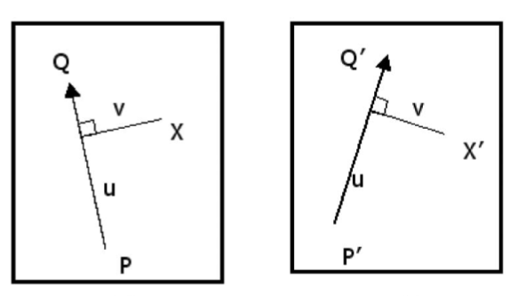
Interpolating Flow Fields
Similarity Transformation
Weight flow less as move away from line

Slide 21
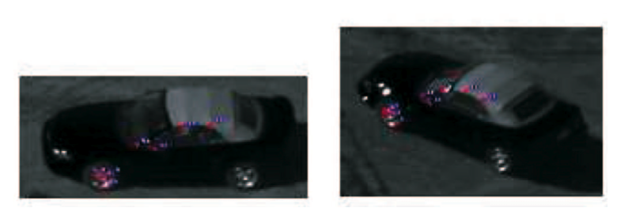
Incorporation of Points
Harris corner detector
Match by correlation
Alone insufficient for global motion model

Slide 22
“Quasi-Rigid” Alignment Results

Slide 23
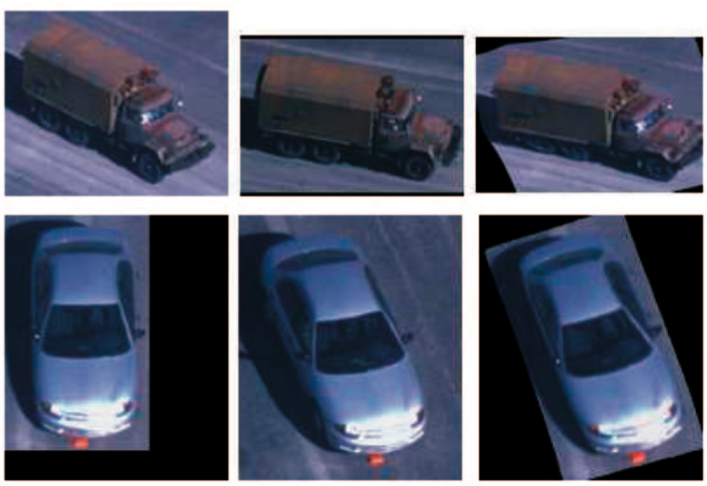
“Quasi-Rigid” Alignment Results
Query
Model
Warped Query

Slide 24
Match path to a local distribution of patches within constraints provided by aligned images
Represent patches as oriented energy filter outputs
Captures significant features
Ignores some illumination effects
Each patch captures spatial arrange of edge energy and orientations within patch
Perform nearest-neighbor matching with patches in target image to account for alignment error
Score of the patch is computed as that of the best matching patch within a small range of translations around the patch
Scores from all local patches aggregated to form overall score between two images

Slide 25
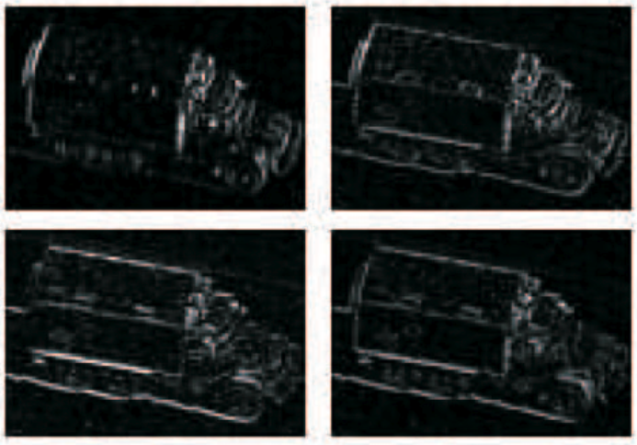
Matching
Oriented Energy Filter (0, 45, 90, 135)

Slide 26
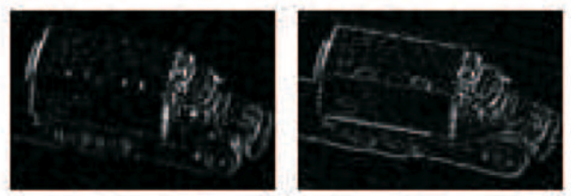
Patch Matching
Weighted sum of correlation score from all the pixels
- Spatial Edge Energy
- Orientation

Slide 27
Local Correlation Scores
Global Affine Alignment
“Quasi-Rigid” Alignment

Slide 28
Color and Texture
Local Template Matching
Similar to Normalized Correlation
Average Color Similarity
Measure the angle between RGB vectors

Slide 29
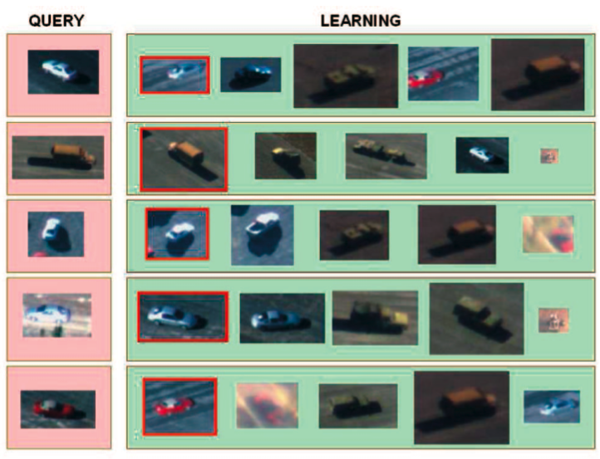
Results

Slide 30
Results
Performance well for sequences up to 30 seconds apart (98.8%)
Does well up to approximately 30° pose change

Slide 31
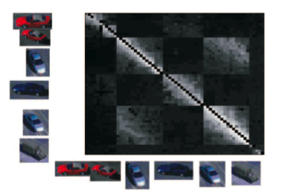
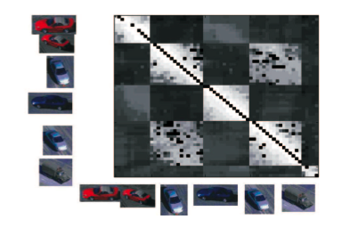
2D Affine Alignment + global correlation
80% for pose < 33°
Their Method
91% for pose < 33°

Slide 32
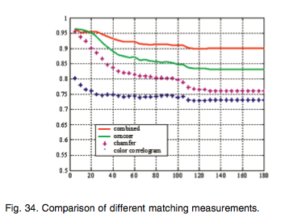
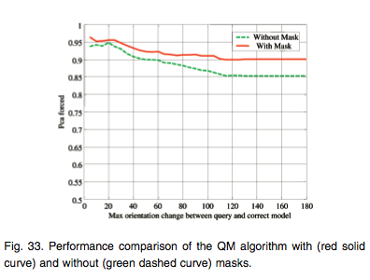

Slide 33
End

