Slide 1
Data-Driven Enhancement of Facial Attractiveness
Tommer Leyvand, Daniel Cohen-Or,
Gideon Dror and Dani Lischinski
ACM SIGGRAPH 2008 (
Presenter: Ramin Mehran

Slide 2
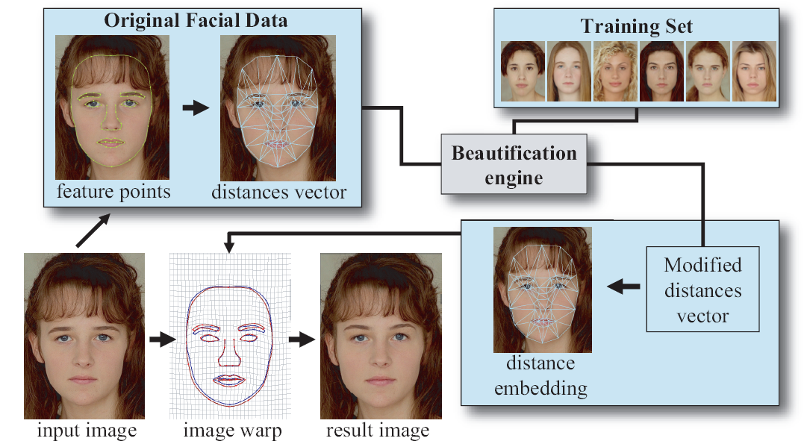
Overview

Slide 3
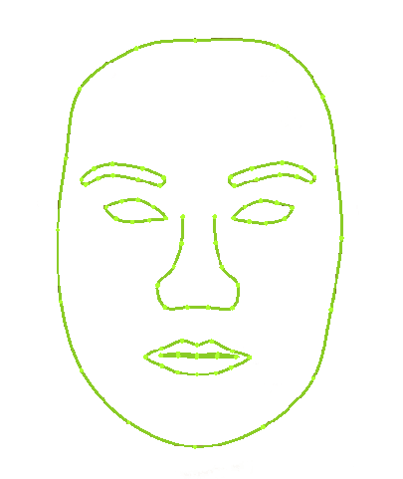
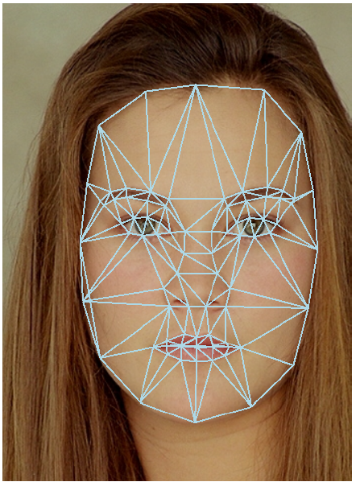
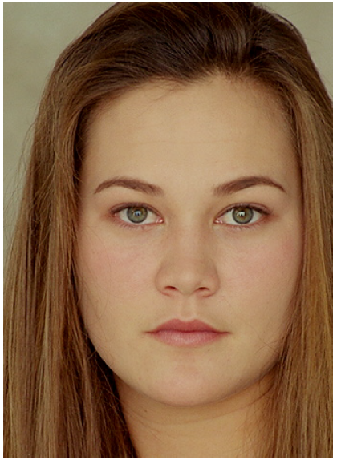
Finding Features
Detect initial scale and orientation of the face using OpenCV Haar calssifier cascade
Fit the points using Active Shape Model (ASM)
Triangulation: distant vector v

Slide 4
Distance Vector
v₁
v₂
v₃
.
.
.
v₂₃₄
v =
Normalized to the square root of the face
Notes:
234 features from triangulation of 84 features

Slide 5
Beauty Function
Beauty is not in the eye of beholder
Data-Driven beauty estimation
Support Vector Regression

Slide 6
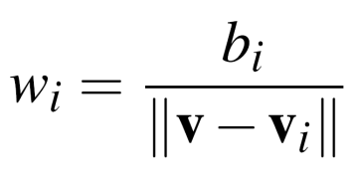
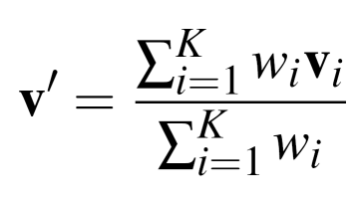
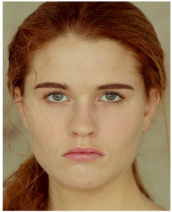
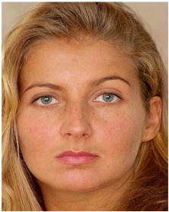
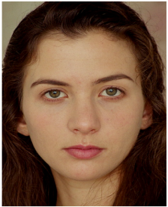

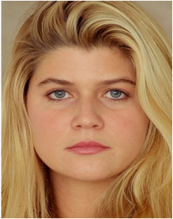
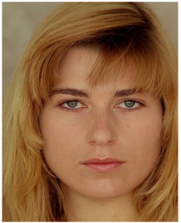
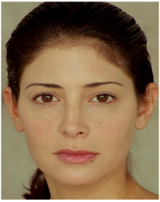
KNN Beautification
5.1
4.3
3.1
v'
v
4.5
4.6
5.3

Slide 7
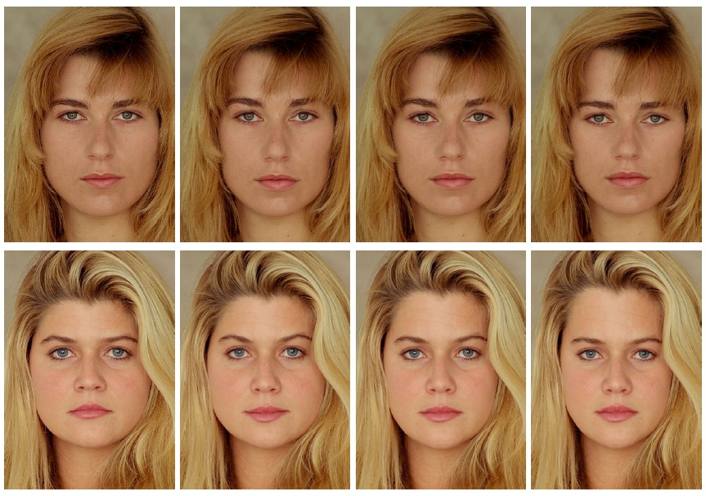
K parameter in KNN method
Original
K=3
K=5
SVR

