Slide 1
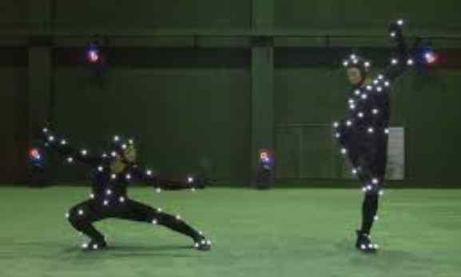
Motion Processing
One way to process motion between two image frames in a
video is to identify points in one frame and then in the next
frame; then, for each point in frame One, find its best match
in frame Two, smartly handling collisions and ambiguities.

Slide 2
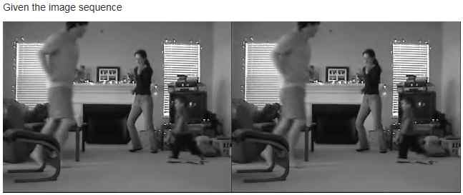
Motion Processing
A second way is to have a definition of motion based on
physics and mathematics. Until the past ten years or so,
this approach was theoretically nice, but did not work in
practice. Since this is an elegant theory, and now is growing
in popularity, and because it works (more or less) nowadays,
we present it to you. Here are two frames.

Slide 3
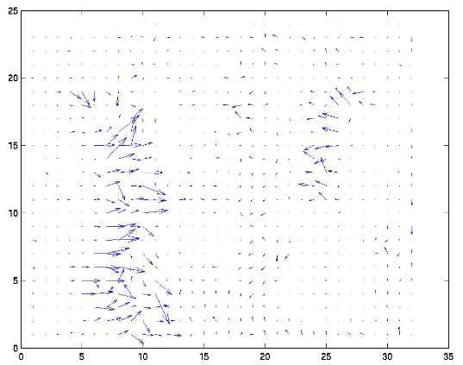
Motion Processing
This figure shows the output expected from the theoretical
approach (still not perfect, but much better than a decade
ago).

Slide 4
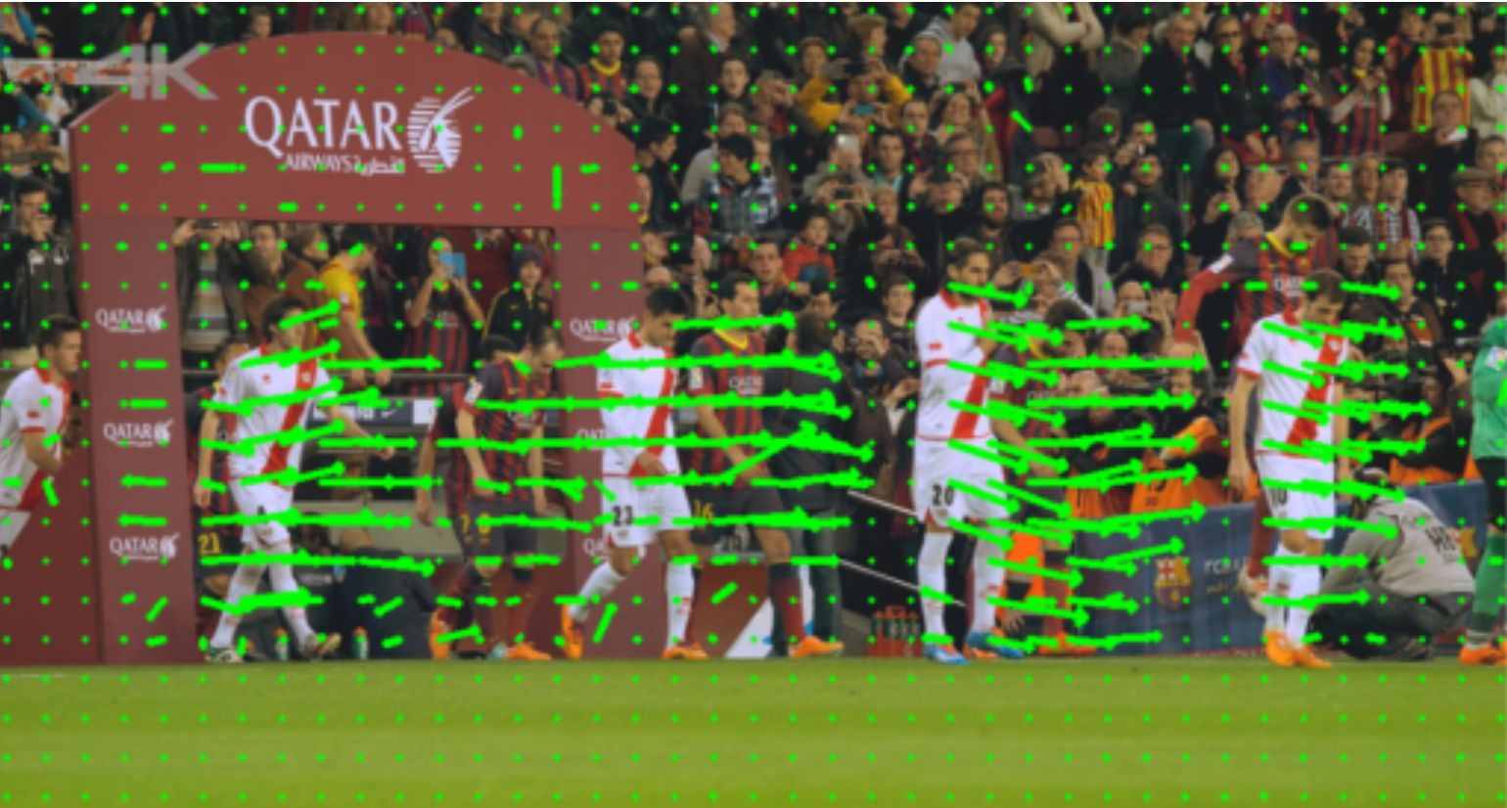
Motion Processing
Another example of real output from Optical Flow algorithm.
Let us next understand how 2d motion is modeled.

Slide 5
Understanding the Model of 2d Motion
We will examine the physics of a concrete situation. This will let us get some math equations.
Imagine there is a floor being viewed by a camera from above.

Slide 6
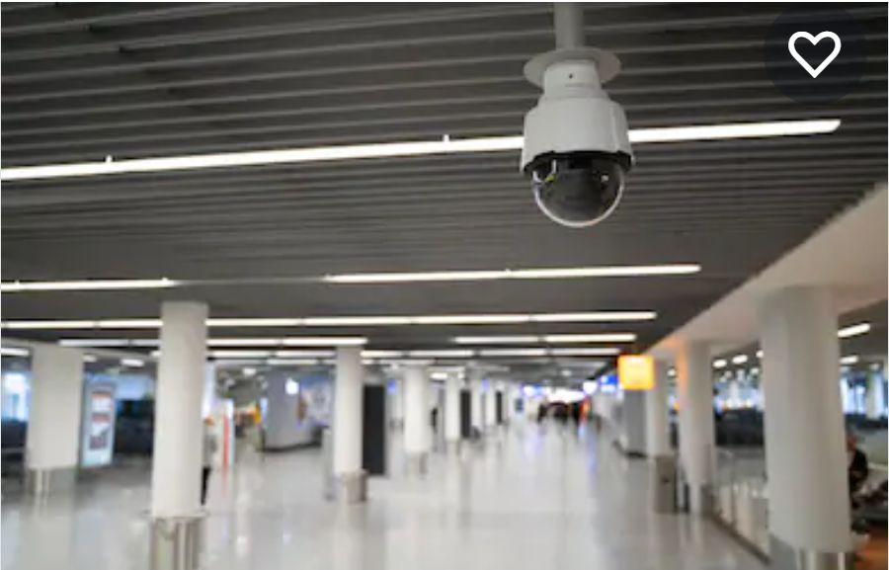
Understanding the Model of 2d Motion
Imagine there is a floor being viewed from above
Photo credit: Shutterstock

Slide 7

Understanding the Model of 2d Motion
Suppose there is this (ramp) pattern of Intensity (image brightness) on the floor (could be a rug).

Slide 8
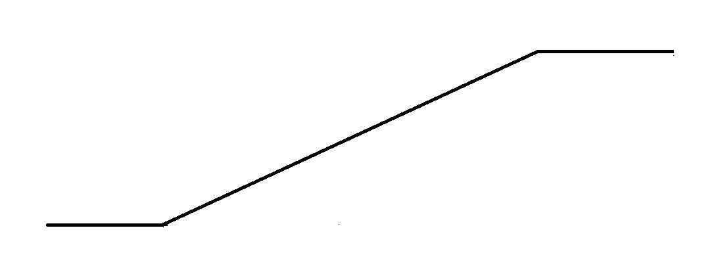
Understanding the Model of 2d Motion
The ramp’s pattern of brightness (Intensity Profile) can be viewed as a plotted graph.
We take one row of values and plot them.

Slide 9
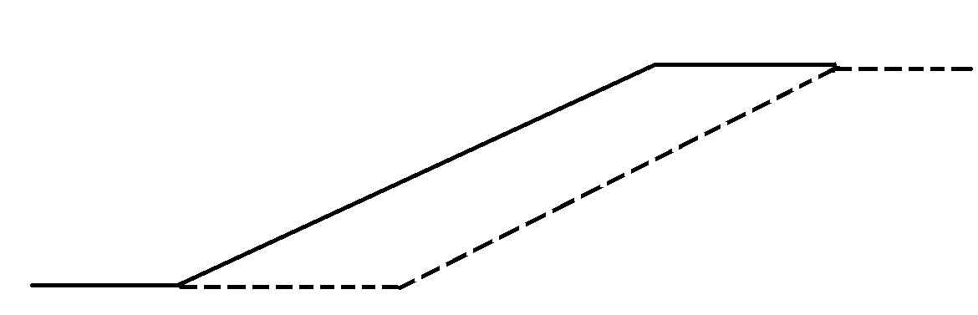
Understanding the Model of 2d Motion
Now, suppose pattern (rug) moves to the right.
Dotted line shows where pattern has moved to, within unit time.

Slide 10
Understanding the Model of 2d Motion
So, to be clear, this WAS the pattern on the floor (rug), and we are saying, imagine someone pulls the pattern (rug) to the right.

Slide 11
Understanding the Model of 2d Motion
Now, suppose pattern (rug) moves to the right.
Dotted line shows where pattern has moved to, within unit time.

Slide 12
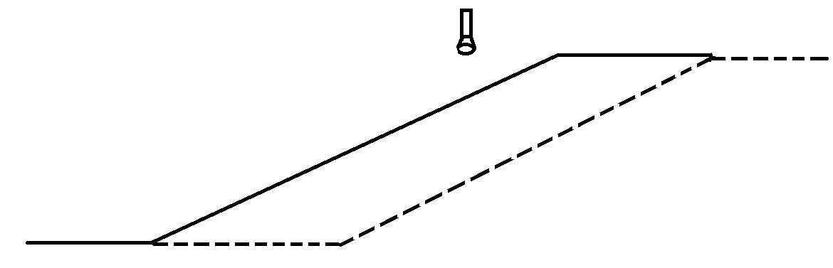
Understanding the Model of 2d Motion
Now, Suppose a Single Pixel Camera saw this

Slide 13
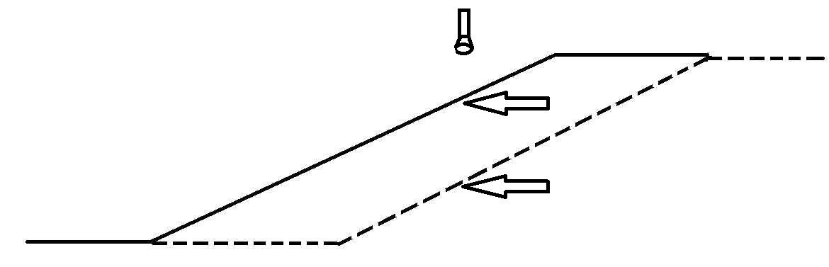
Understanding the Model of 2d Motion
The camera (Sensor) sees the brightness change
The 2 arrows show what two brightnesses the detector sees

Slide 14
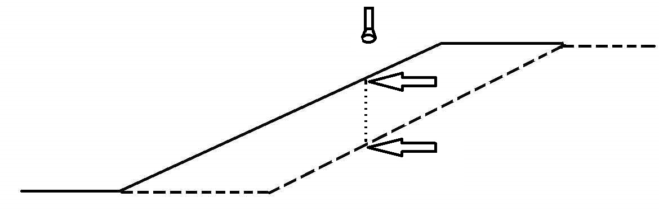
Understanding the Model of 2d Motion
The Sensor would see the brightness change
The Dotted segment shows the amount of brightness drop.

Slide 15

Understanding the Model of 2d Motion
The Sensor would see the brightness change
The brightness drop is given by the distance between A and B.

Slide 16
Understanding the Model of 2d Motion
What physical properties of this situation will
determine how much brightness drop happens?

Slide 17
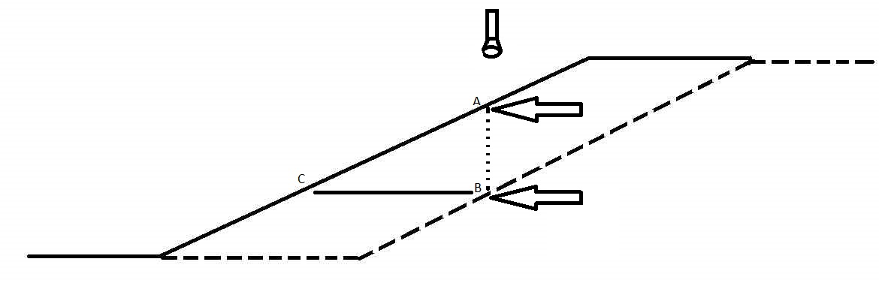
Understanding the Model of 2d Motion
One factor contributing to the quantity of the brightness drop, is the speed.
Speed is given by the lowermost dashed segment, because
that is how much movement there was. This amount of
motion is the same as the length of the segment CB.

Slide 18
Understanding the Model of 2d Motion
One contributing factor is the speed.
Make sure you understand that the faster speed will give a bigger drop, while slower speed will give smaller drop.

Slide 19
Understanding the Model of 2d Motion
Second contributing factor is the ramp’s slope.
Make sure you understand that the steeper slope will give a bigger drop, while shallower slope will give a smaller drop.

Slide 20
Understanding the Model of 2d Motion
So, drop proportional to ramp’s slope & speed
Let us give symbols to these quantities, so we can work them.
The ramp itself is labeled I(x), for image or intensity function,
varying along x. Speed is labeled u. Drop is labeled Iᵼ. Slope is
labeled Iₓ.

Slide 21
Understanding the Model of 2d Motion
Speed is labeled u. Drop is labeled Iᵼ. Slope is labeled Iₓ.
So, we have: Iᵼ α u and Iᵼ α Iₓ
To convert (from proportionalities to equations), each needs a
Proportionality Constant. Turns out: each is the constant of
the other one. i.e., The result is: Iᵼ = u ∙ Iₓ

Slide 22
Understanding the Model of 2d Motion
Iᵼ = u ∙ Iₓ
We have just argued that this equation is correct; To Prove it is much harder. Alternately, if that is the figure that goes along with this reasoning, then we can use the idea that
Slope = Rise/Run, to obtain the equation: From the fig, we see that Rise is the distance between A and B, hence is Iᵼ.

Slide 23
Understanding the Model of 2d Motion
Claim: Iᵼ = u ∙ Iₓ
We are going to use Slope = Rise/Run, to obtain the equation:
From the fig, we see that Rise is the distance between A and
B, hence is Iᵼ. Then we see that in the triangle in the figure,
Run is the distance between C and B, and this distance is the
same as the dashed line at the figure base; this is u. Slope is just Iₓ.

Slide 24
Understanding the Model of 2d Motion
So, We have argued (two ways) that Iᵼ = u ∙ Iₓ.
The only fix needed is a sign change: u is shown as motion
to the right, I(x) is a rising function, so its slope is positive.
So, on the Right-Hand-Side, we have 2 positive quantities. But
on the Left-Hand-Side, Iᵼ is a “drop”, i.e., a negative quantity. To
compensate, we need to put a negative sign on the Iᵼ . So, -Iᵼ=u∙Iₓ.

Slide 25
Understanding the Model of 2d Motion
So, - Iᵼ = u ∙ Iₓ
This allows us to do: u = -(Iᵼ/Iₓ ), which would allow us to compute the speed from two easily obtainable quantities, which are Iₓ (this is the x-component of Image Gradient), and Iᵼ (which is the drop we observe). Hence, our efforts have proved fruitful, and we can get u.

Slide 26
Understanding the Model of 2d Motion
I just want to check that you are following the basic diagram and model shown here. So, can you tell me, if we assume that velocity is constant, then at time 3, where will the dashed profile curve appear?

Slide 27
Understanding the Model of 2d Motion
Now, we need to derive a similar equation for the vertical direction.
So, similar reasoning: Suppose the region has variation only in the y-direction (not shown here, the original pattern is shown, you must imagine the new pattern); suppose that the motion is in the vertical direction (called v, now), suppose there is a single pixel sensor (camera) placed over the center of the pattern.
Then, by similar reasoning as before, we get that: - Iᵼᵧ = v ∙ Iᵧ
We had written Iᵼ earlier, when we only had one dimension to play in. Now, to keep things separate, we say Iᵼᵧ , by which we mean the drop seen by the sensor, but only that portion of the drop that is due to vertical aspects of this problem (in the original equation, to describe the horizontal behavior, we will now be using Iᵼₓ.) In the new equation here, the meaning of Iᵧ should be obvious, it is the vertical component of the image gradient.

Slide 28
Understanding the Model of 2d Motion
We just got: - Iᵼᵧ = v ∙ Iᵧ and, had, for horizontal, - Iᵼₓ = u ∙ Iₓ
So, now we add the two equations up …
We get,
- Iᵼₓ - Iᵼᵧ = u ∙ Iₓ + v ∙ Iᵧ
The terms on the Left are to be combined into one term Iᵼ.
So, we (finally!) get
- Iᵼ = u ∙ Iₓ + v ∙ Iᵧ
This is a famous equation in the field of Computer Vision, and it has several names:
2d motion Equation
Image motion Equation
Optical Flow Equation (this term is from perceptual psychology)

Slide 29
What does the 2d Motion Equation mean?
We have
- Iᵼ = u ∙ Iₓ + v ∙ Iᵧ
As you can see, this is a single equation. What are the knowns in it? They are the things that we can know by other measurements.

Slide 30
What does the 2d Motion Equation mean?
We have
- Iᵼ = u ∙ Iₓ + v ∙ Iᵧ
So, this is a single equation. What are the knowns in it? They are the things that we can know by other measurements. These are: Iᵼ, Iₓ, and Iᵧ. They can all be measured by other means (gradient of image, and the temporal derivative, Iᵼ, which is measured by subtracting the measurement of brightness at a fixed pixel, at two very close points in time, and subtracting one from the other.
The unknowns are u and v, which are the two components of 2d
motion (the horizontal component, and the vertical component.)

Slide 31
How to solve the 2d Motion Equation?
We have
- Iᵼ = u ∙ Iₓ + v ∙ Iᵧ
So, we have one equation in two unknowns, u and v.
Math tells us that the only way to get answers for this is to have a second equation with the same unknowns.
That means we need to have another single pixel camera, that can produce a second equation (for a position somewhere nearby to the first position), and we must be able to make the assumption that the two observed positions are watching two different points that are moving with the identical motion (i.e., the first point is moving with components u and v, and the second point is also moving with the same pair of motion components).

Slide 32
How to solve the 2d Motion Equation?
So, if we have
- Iᵼᴾ¹ = u ∙ Iₓᴾ¹ + v ∙ Iᵧᴾ¹ where the
superscript P1 is being used
to denote that the
measurements are coming
from a position labeled P1,
and a 2ᴺᴰ equation
- Iᵼᴾ² = u ∙ Iₓᴾ² + v ∙ Iᵧᴾ² , from P2,
then, when can
we solve this?

Slide 33
How to solve the 2d Motion Equation?
So, if we have
- Iᵼᴾ¹ = u ∙ Iₓᴾ¹ + v ∙ Iᵧᴾ¹
- Iᵼᴾ² = u ∙ Iₓᴾ² + v ∙ Iᵧᴾ²
then, when can we solve this?
We can solve for u and v, exactly when ( Iₓᴾ¹ , Iᵧᴾ¹ ) is different from
(Iₓᴾ² , Iᵧᴾ² ). Each pair is the image gradient at the respective point. So,
if the gradient vectors are different, we can solve. Not being different,
means that we have only one edge direction even though we have two
points. So, it is pretty clear: we can only solve if we have two
independent edge directions, from which the two observed points
come. So, getting both points on the same straight edge is a bad idea.

