Slide 1

Introduction of Incidence Response Software - Splunk
CIS 6395, Incident Response Technologies
Fall 2021, Dr. Cliff Zou
czou@cs.ucf.edu

Slide 2
Acknowledgement
SlidesShare.net
  SplunkLive! Zurich 2017 - Getting Started with Splunk Enterprise https://www.slideshare.net/Splunk/splunklive-zurich-2017-getting-started-with-splunk-enterprise
WEB APPLICATION MONITORING AND ANALYTICS WITH SPLUNK http://depts.washington.edu/learnit/techconnect/wordpress/wp-content/uploads/2015/02/Splunk-Presentation.pdf (does not exist anymore)
Splunk – Meetup.

Slide 3
Security information and event management Software
https://en.wikipedia.org/wiki/Security_information_and_event_management
UCF IT uses ArcSight SIEM

Slide 4
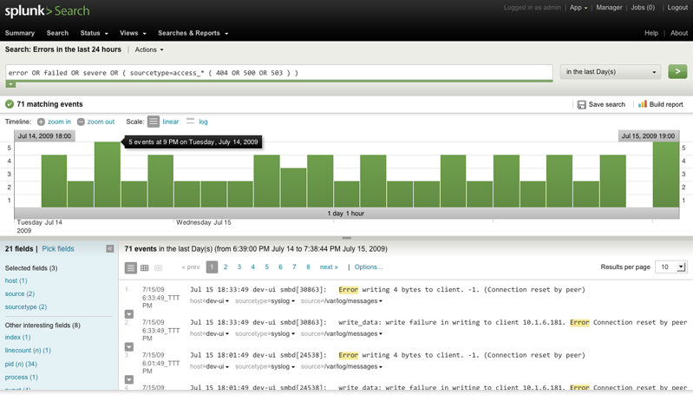
What is Splunk?
Search and analysis engine
Google like search of all/most of your log data
Splunk as a data analytics tool

Slide 5
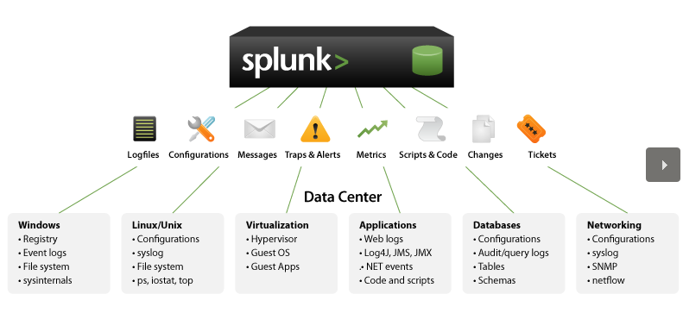
Data Sources
Splunk is built to understand a vast data log format

Slide 6
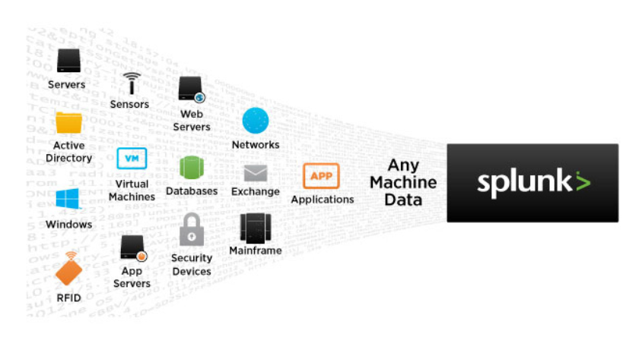
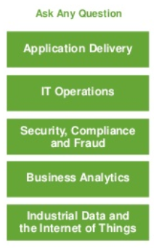
Splunk provides comprehensive data analytics
Can automatically collects data in real-time from multiple systems
Can give Alerts/Event notfications

Slide 7
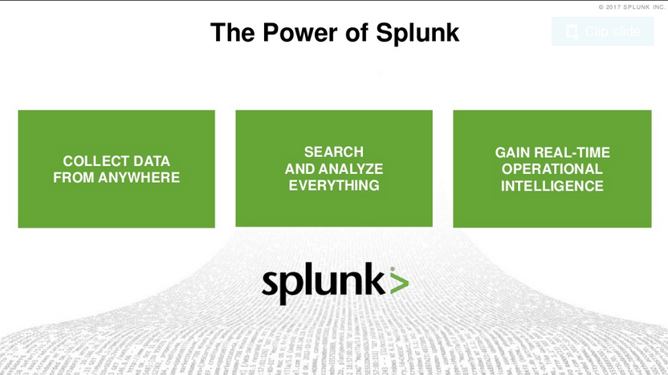

Slide 8


Why Splunk?
Traditional
Splunk
Schema at Write
Schema at Read
SQL
Search
ETL
Universal Indexing
Structured
RDBMS
Unstructured
Volume
Velocity
Variety

Slide 9
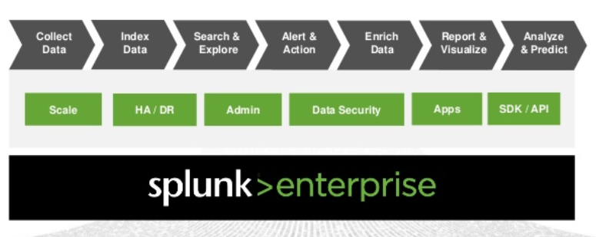
Splunk Overall Process

Slide 10
Splunk Has Two Parts
Splunkd
  Does all the heavy lifting
  Indexes all files
  Controls Access to data
  Core component
SplunkWeb
  User interface to the data
  CherryPY web server
  User can use browser to utilize Splunk

Slide 11
Versions
Free version (the one we introduce here)
  500MB/day
  Reporting
  Ad-hoc search
Enterprise (all above and)
  500MB/day and more!
  Access controls
  Distributed Search, Load Balancing
  Monitoring & Alerting

Slide 12
Download and Install Free Splunk
https://www.splunk.com/en_us/download.html
  Download Splunk Enterprise for 60-day free trial
You need to create a free account to continue to download
  Download the ‘Splunk Enterprise’ version
Try to download to install on your Host OS for faster speed
After installation, you can follow the instructions below to convert it to free version: https://docs.splunk.com/Documentation/Splunk/latest/Admin/MoreaboutSplunkFree

Slide 13
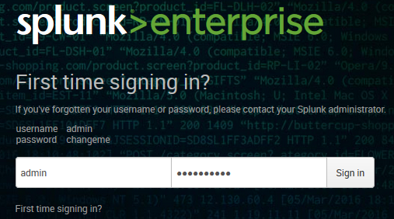
Installation
Splunk uses Browser to provide graphic user interface.
  It runs as a local webserver on port 8000
  In this part, it is very similar to Nessus (vulnerability scanner)
First time runs with the account/password you created during installation

Slide 14
Web Browser-based GUI and Remote Access
Many recent software use Browser-based GUI for implementation
Pros:
  A user can remote access and use the software from anywhere
  Remote user does not need any client-side software installation
Cons:
  Rely on the graphic and interaction functions provided by Browsers, may not be beautiful
  Could suffer the same Web-based attacks

Slide 15
Demonstration
The following slides are mainly from SplunkLive! Zurich 2017 - Getting Started with Splunk Enterprise https://www.slideshare.net/Splunk/splunklive-zurich-2017-getting-started-with-splunk-enterprise
Before we start, you need to:
  Download the tutorial data (a small zip file)
    http://splk.it/2ey34P8

Slide 16
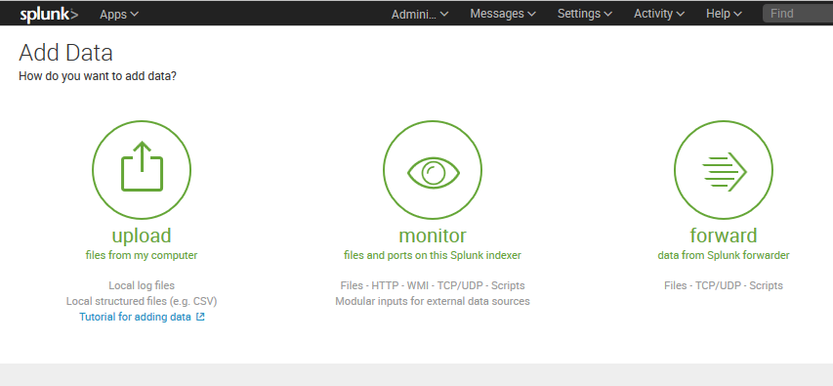
Add Local Data
After logged in the web interface, you can click the “Add Data” to add the tutorialdata.zip for demo
Click “upload” to upload local files

Slide 17
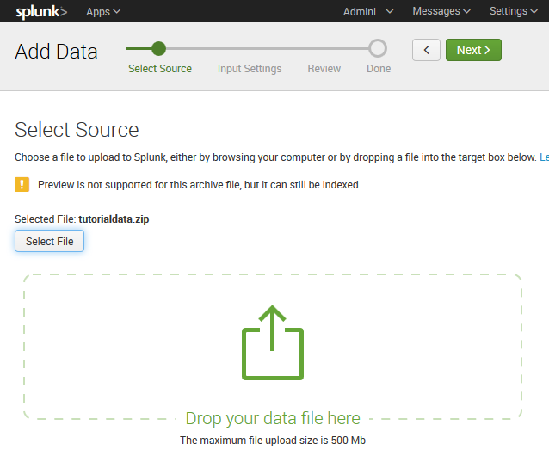
Add Local Data
Drag and drop the tutorialdata.zip, then click next on top

Slide 18
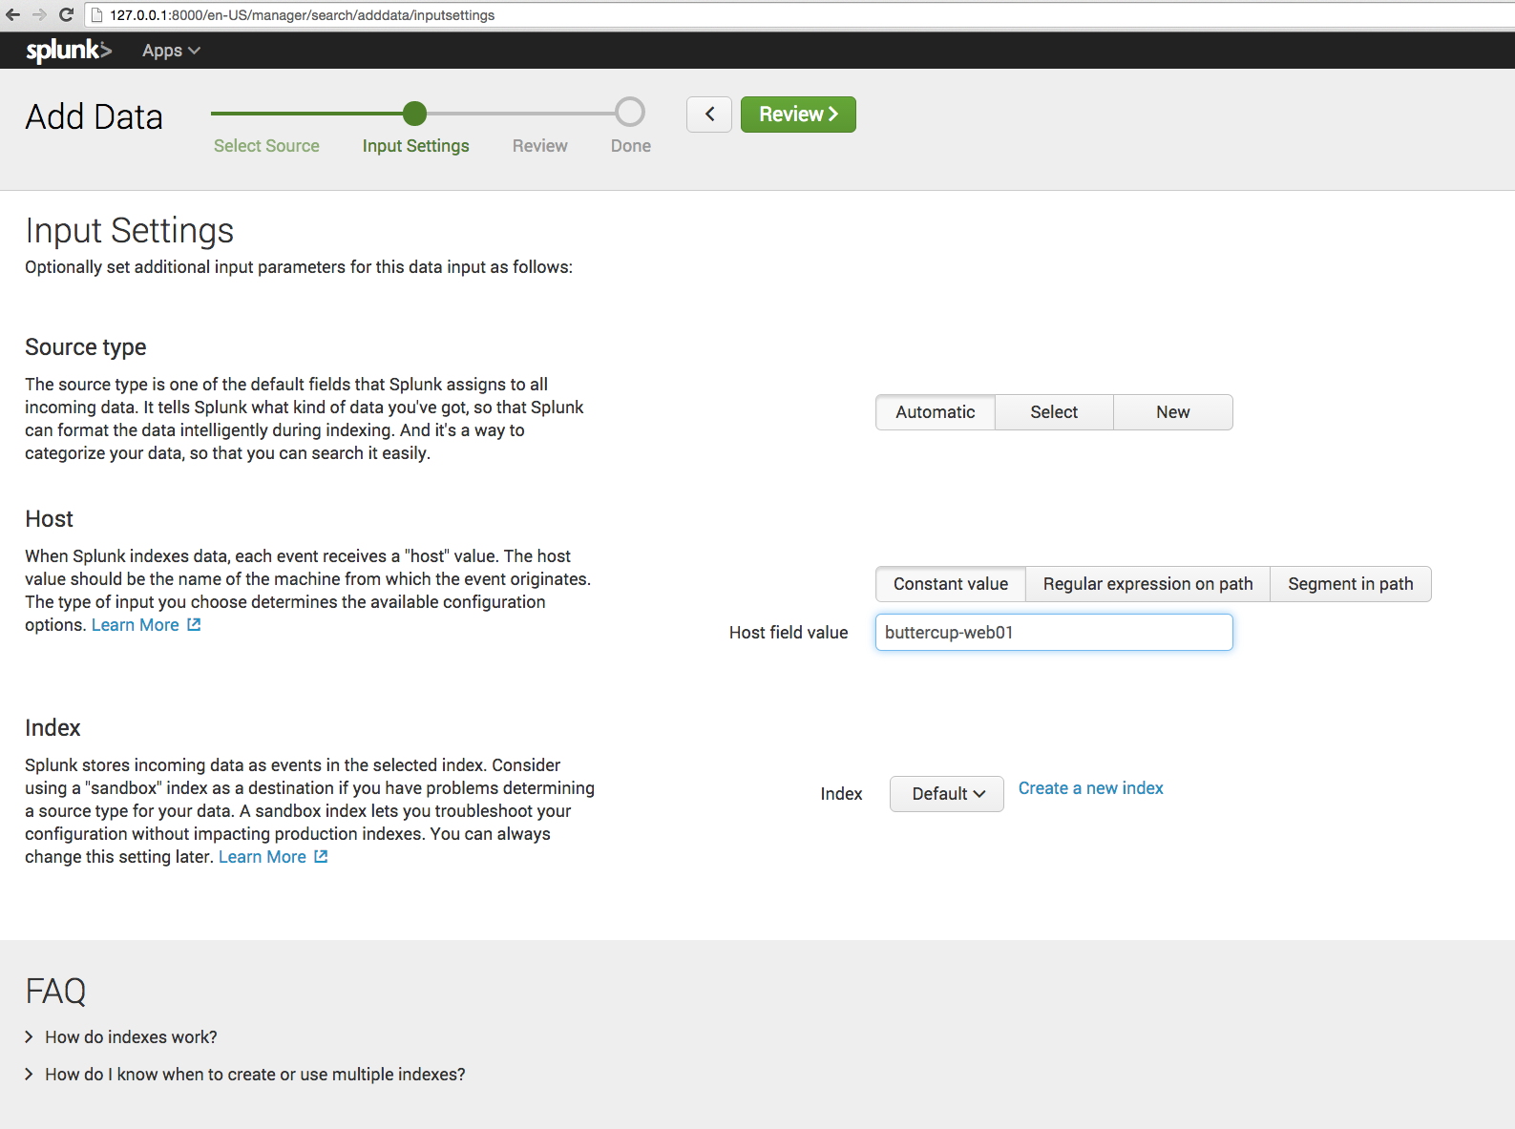
Splunk can auto detect the source type. Lets change host field
to buttercup-web01, and then click Review.

Slide 19
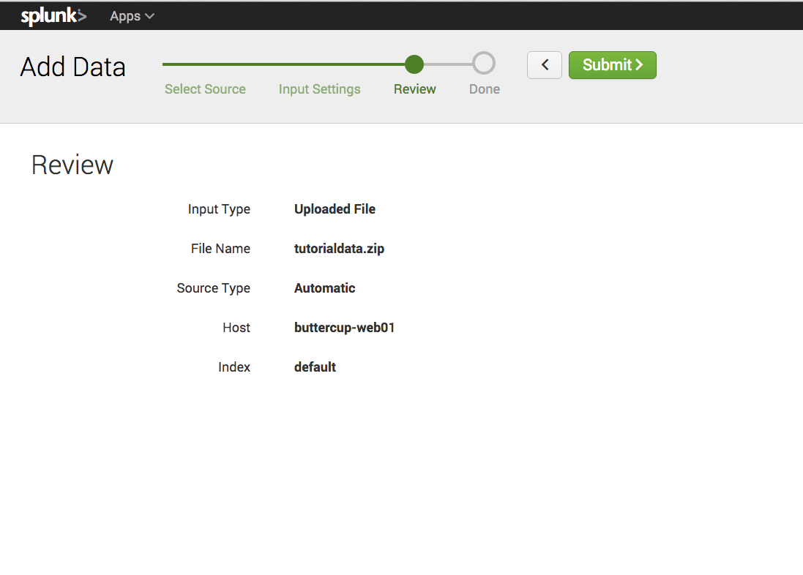
Looks good, click Submit.

Slide 20
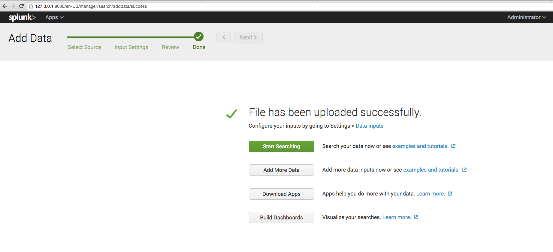
Let’s Start Searching our data.

Slide 21
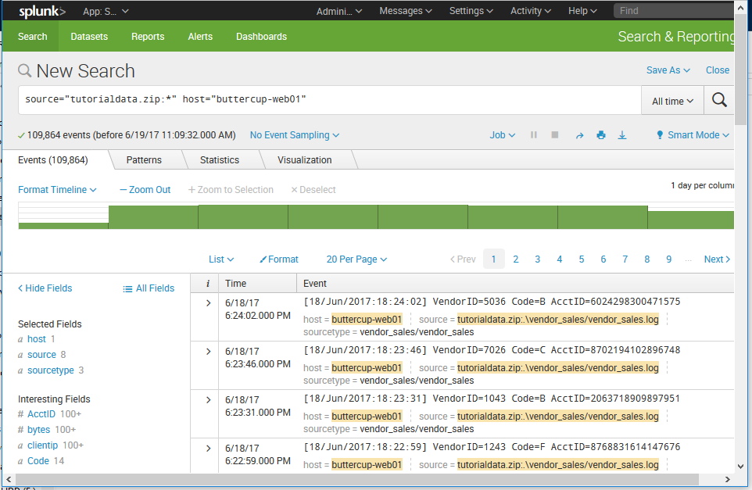

Slide 22
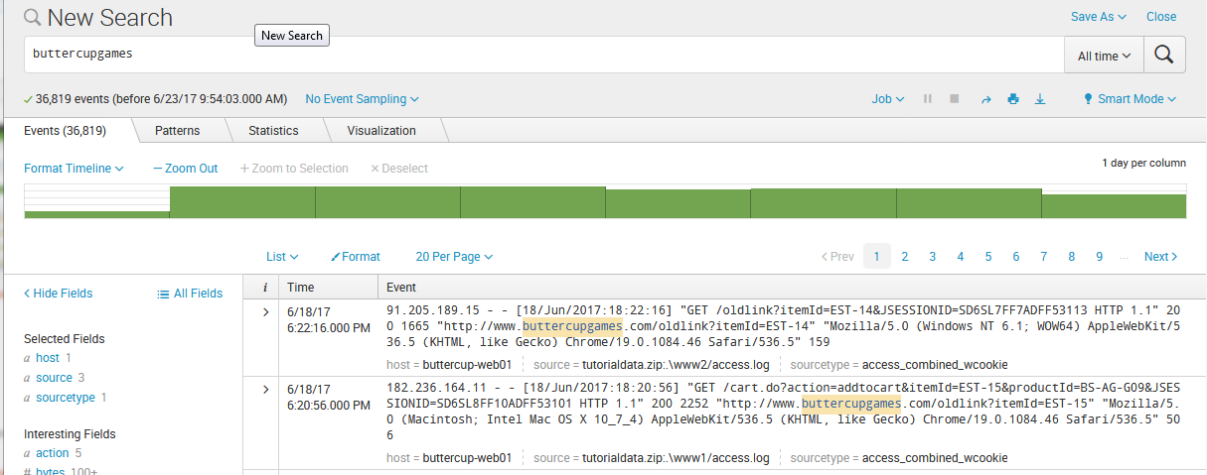
Let’s type “buttercupgames” in the search bar, and double click into a bar on the histogram.

Slide 23
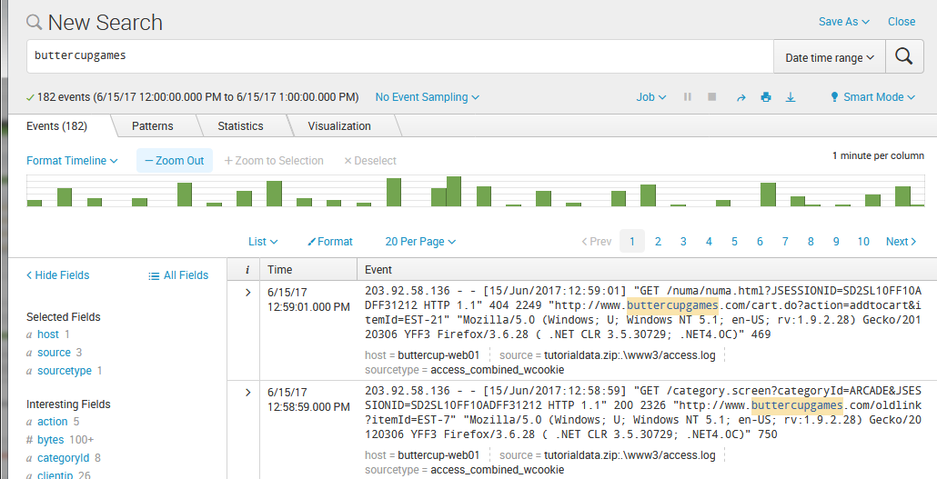
Notice the time picker changed with our drill into the histogram bar
(1 day → 1 hour → 1 minute….)

Slide 24
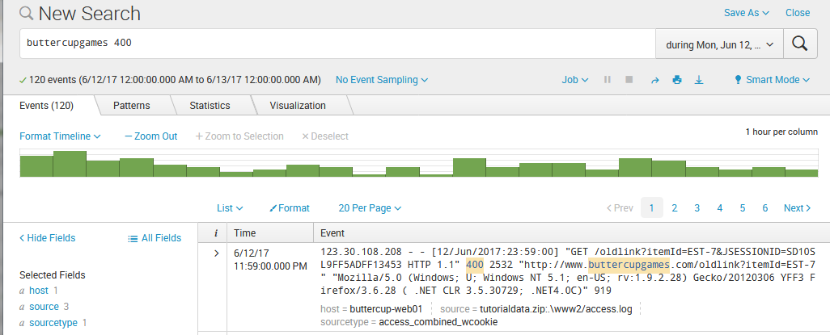
Given that this data is web access, lets do a string search for 400, which is an HTTP “Bad Request” code.
Notice that the number of events will vary for different histogram time scale.

Slide 25
Rethink: Splunk vs. Wireshark
It seems the traffic and search is very similar to Wireshark?
  Wireshark can only process wireshark, or tcpdump (or similar networking) trace; Splunk can deal with many many different software’s logs
  Wireshark does traffic capturing; Splunk does log processing
  For networking traffic, wireshark has more enriched search/analysis options

Slide 26
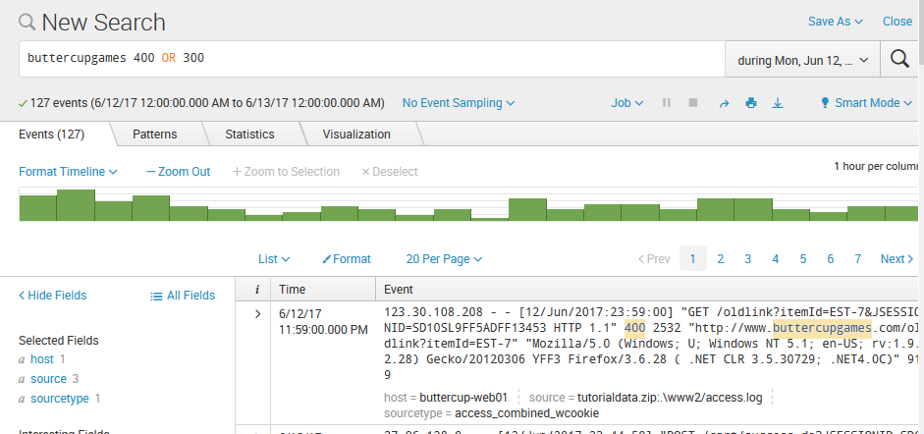
Lets also add 300 into the mix, and notice that my event count is higher now.
Note: the logical word “OR” must be capital letters.

Slide 27
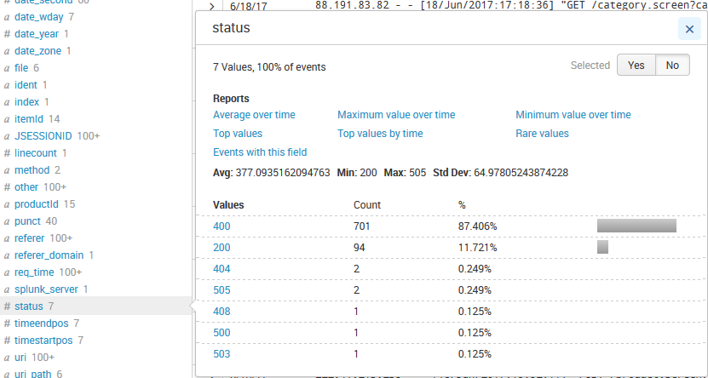
Splunk shows all its understandable fields at left column.
We can see the 400 status codes, but not 300’s. That’s because the string search of 300 doesn’t explicitly search for status code of 300 – it’ll string match any event that contains “300”.

Slide 28
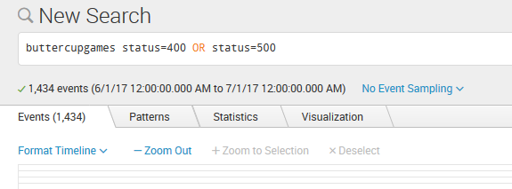
Lets explicitly search for status codes equaling values we want to see returned.

Slide 29
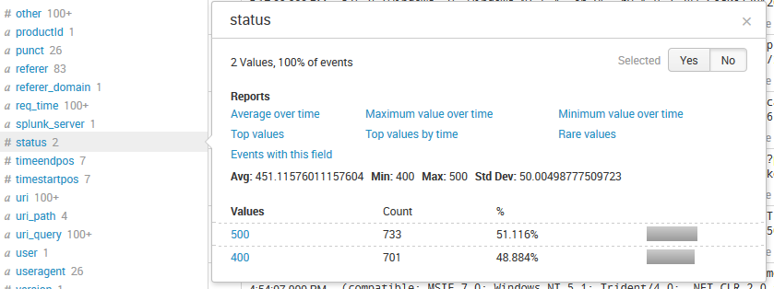
Great, we’re now returned all the events containing the two status codes we searched for.
Click on “Top values by time”, which will build out a timechart for us.

Slide 30
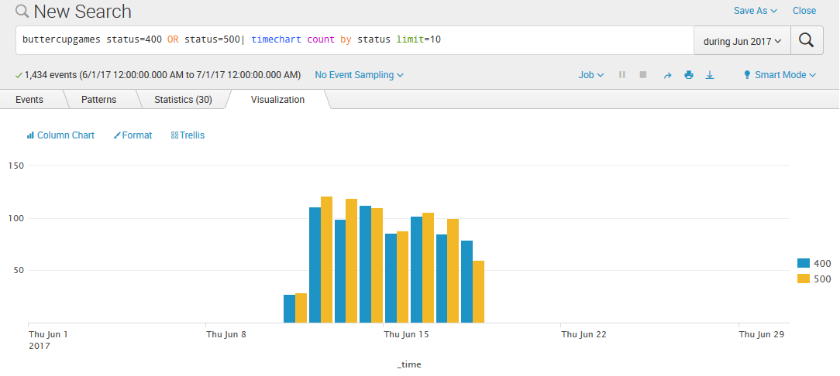
Notice how our search query changed, there’s a | (pipeline symbol in Linux), and a timechart command added.
The pipe followed by a command allows further operation on your filtered data set.

Slide 31
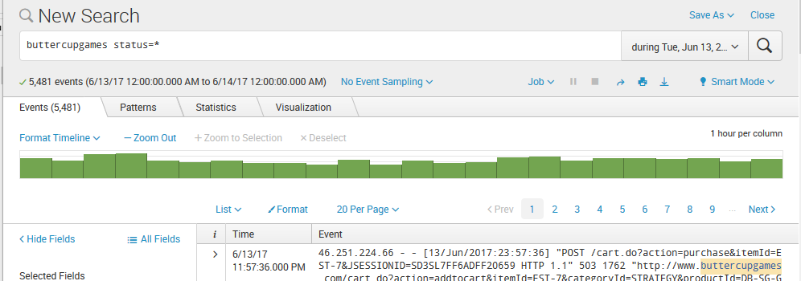
Let’s change our search to: buttercupgames status=*
And – drill into one bar on the histogram.

Slide 32
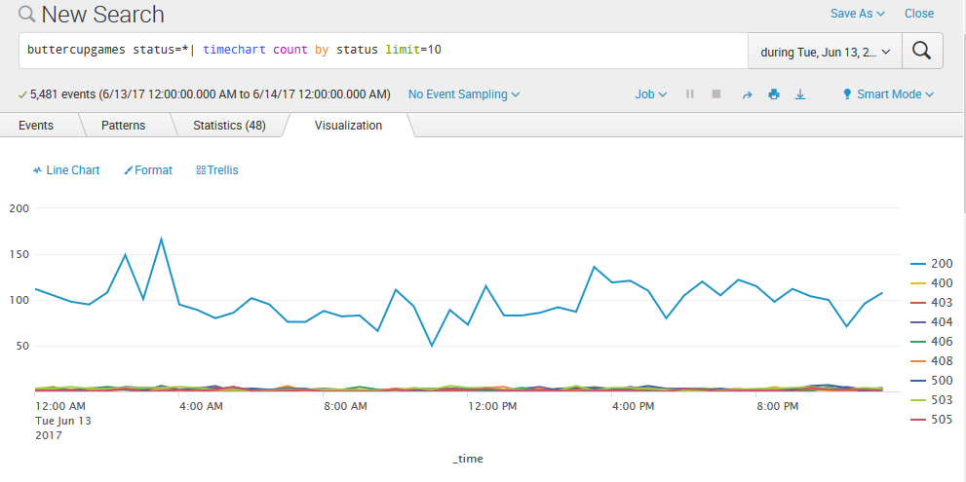
Click on “top values by time” under the status field on the left, which will produce the timechart above.

Slide 33
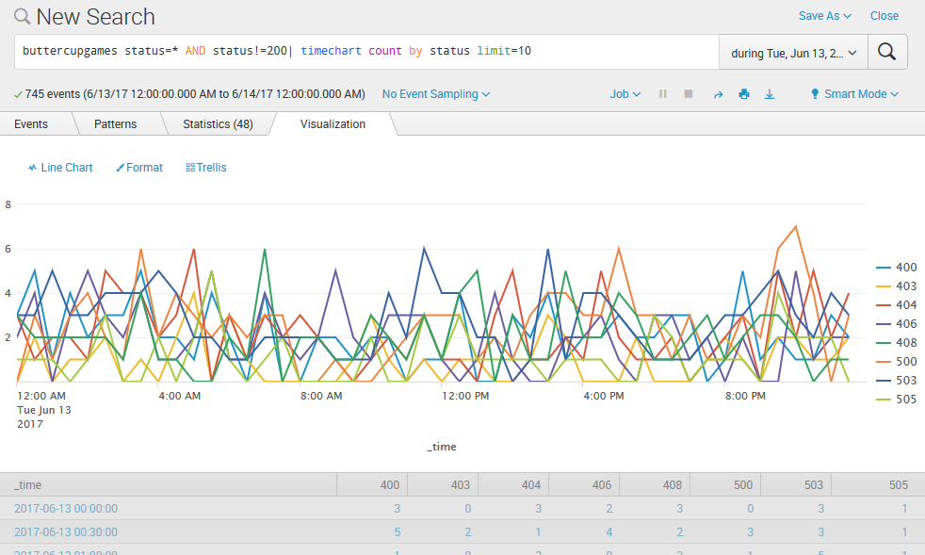
Let’s exclude 200 status codes by adding AND status!=200, and change Line to Column.

Slide 34
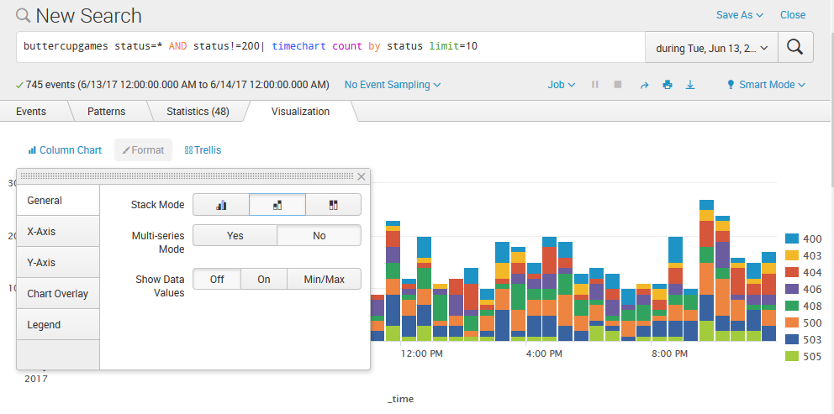
After changing from Line to Column, lets Stack the results (middle stack under Stack Mode). Much better!

Slide 35
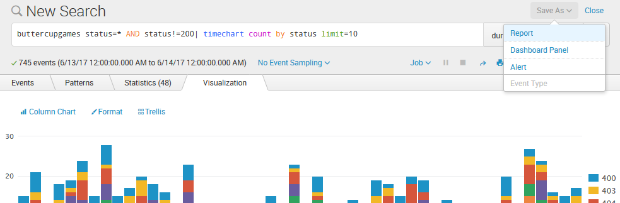
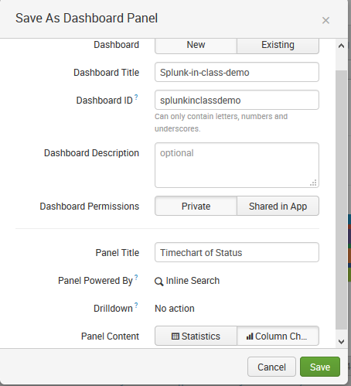
Lets now save this to a dashboard, a place we can go to view this search without having to remember what we had just searched for. Click Save AS -> Dashboard Panel. Fill in, and click Save. Then View dashboard.

Slide 36
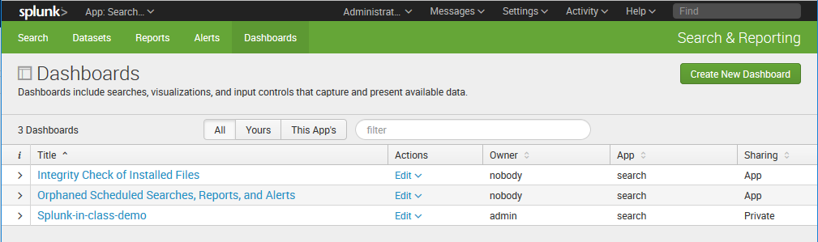
Now the dashboards shows the one we have just created.

Slide 37
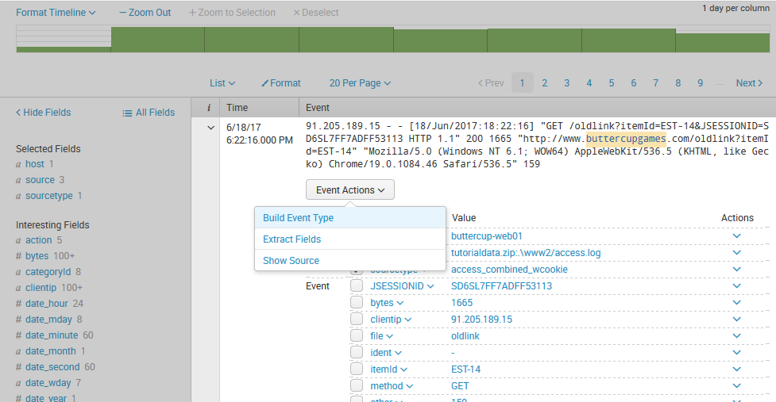
Click on Search to get us back to our search bar, and lets key in: buttercupgames.
Development wants to know what web browsers are being used to access the site, but no fields currently exist on the left-side panel.
No problem – lets extract the browser field.
Find an event that contains a value that you’re looking for, and click the “>” arrow just to the left of “Time”. The event will expand with a down arrow, and Extract Fields will be under Event Actions. Click Extract Fields.

Slide 38
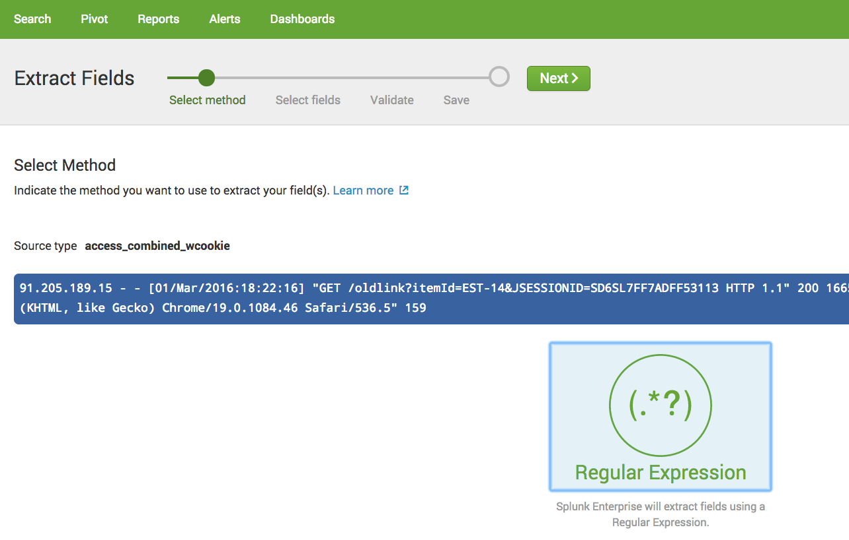
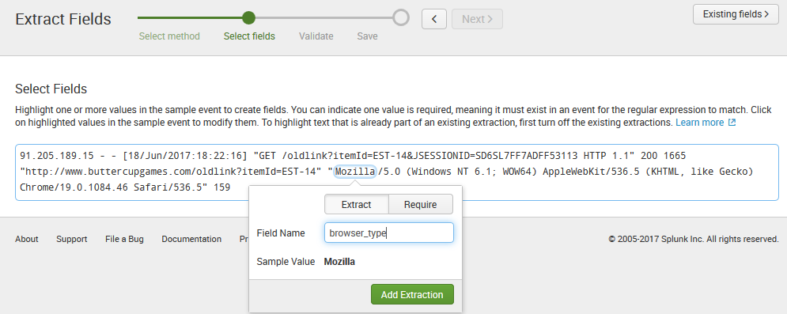
Click Regular Expression (Splunk will build a regular expression to extract our fields), and click next.
Highlight the value of the field you’d like to create, and lets name the field: browser_type
Click Add Extraction.

Slide 39
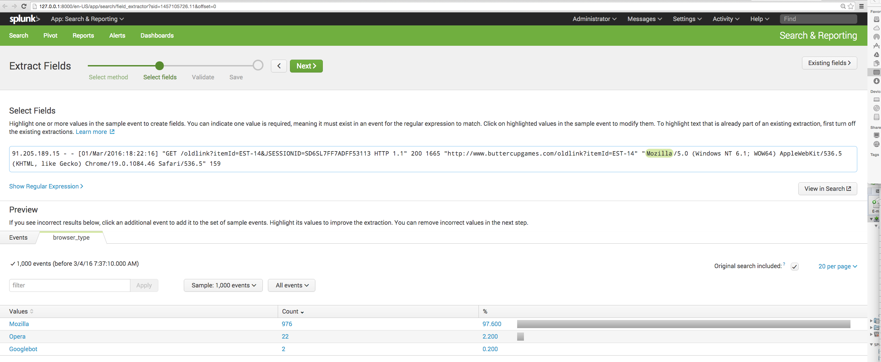
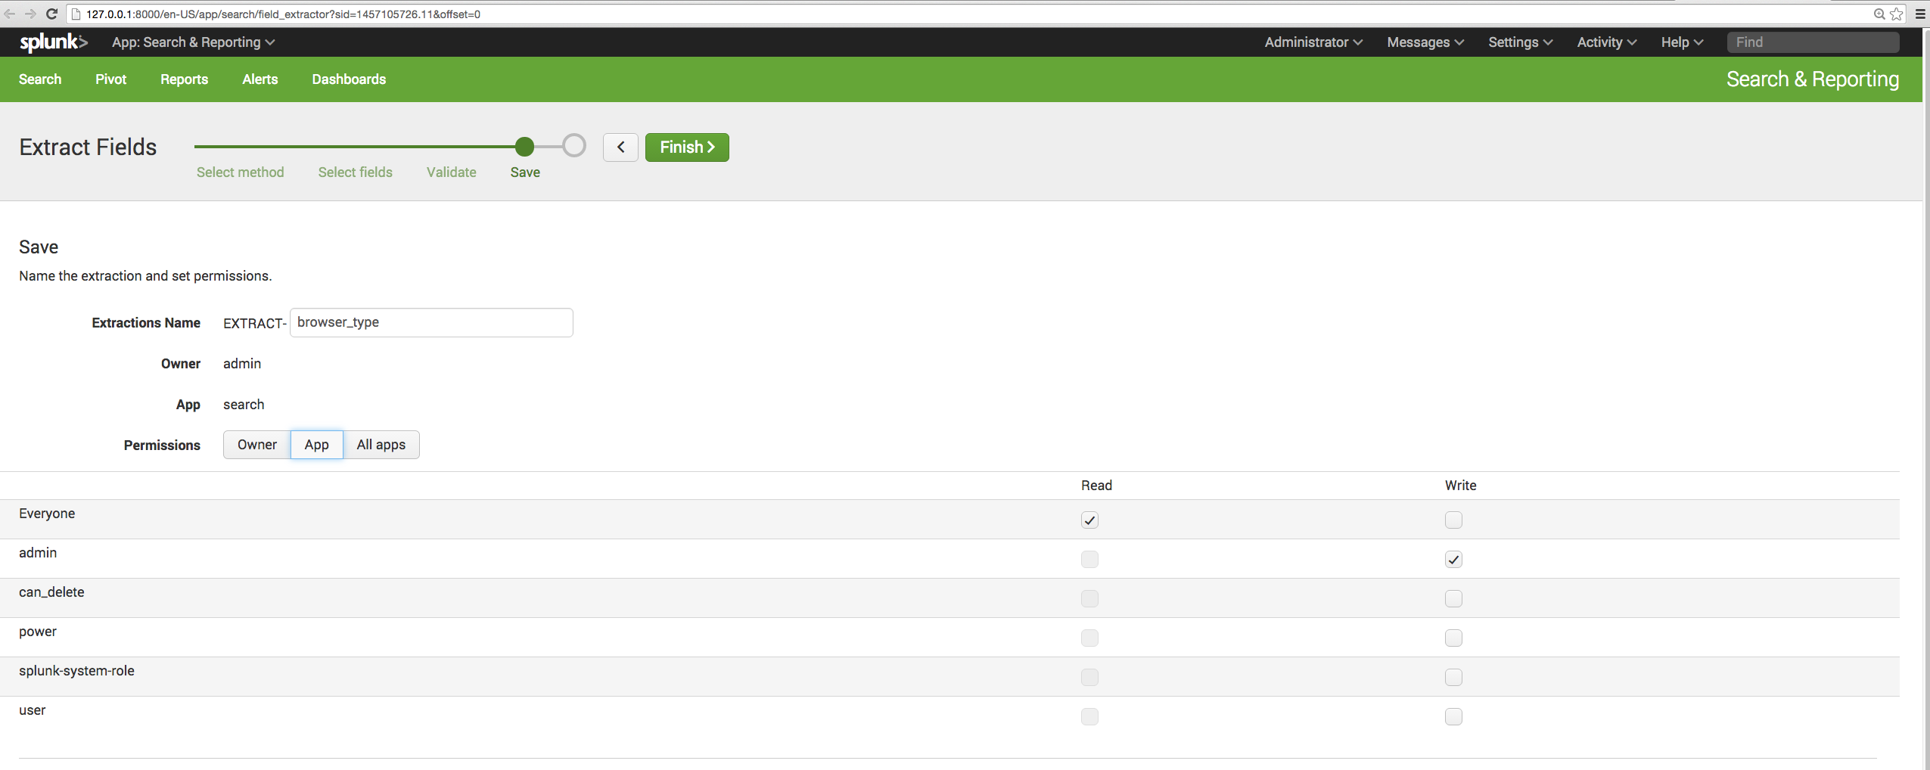
Let’s verify that the extracted field contains values that are indeed types of browsers.
Good, click next to proceed.
Now, open the permissions to “App” which will allow users of the App the ability to leverage this extraction.
Click Next.

Slide 40
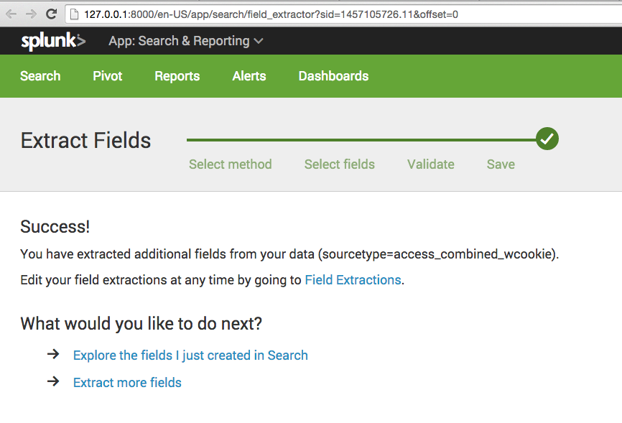
Success, Let’s explore the fields just created in search, by clicking the link.

Slide 41
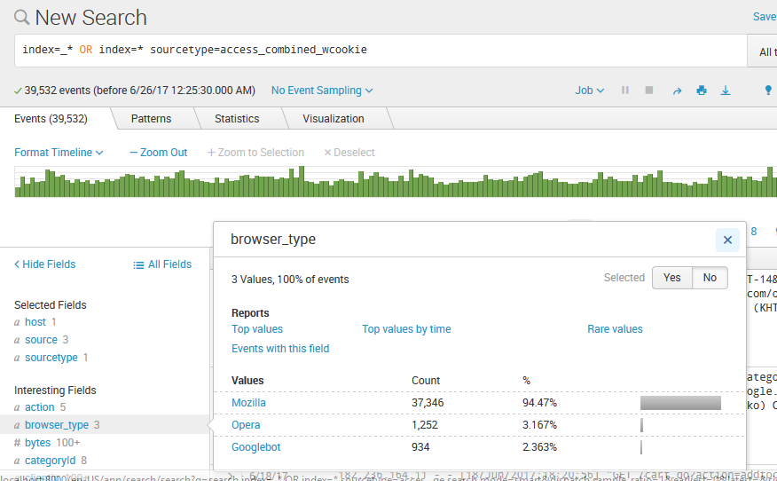
You’ll now be taken to search, with the filter set to the sourcetype that the field extraction has been applied to. Note – field extractions are coupled to a sourcetype.
Click on “Top values”.

Slide 42
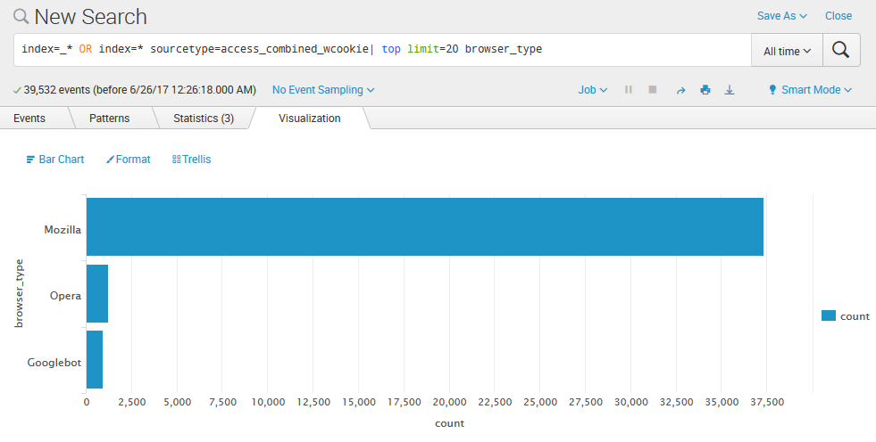
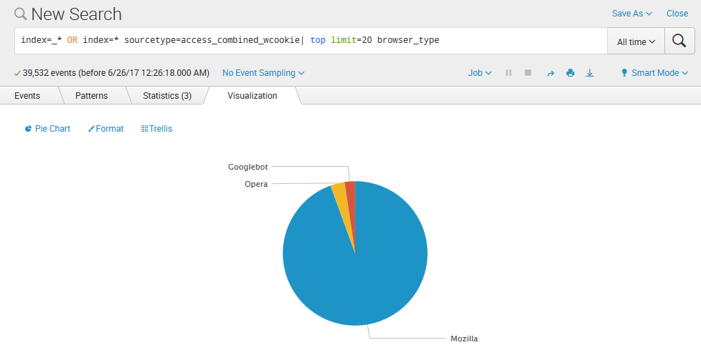
Notice how the search changed. And, instead of a bar graph, we want a pie chart, so drop down the “bar” option and change it to Pie.

Slide 43
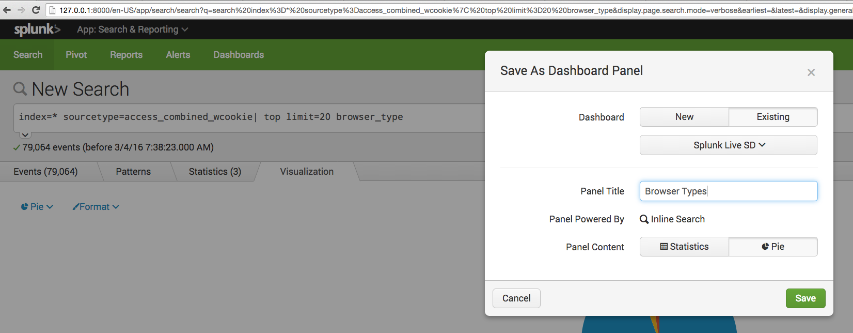
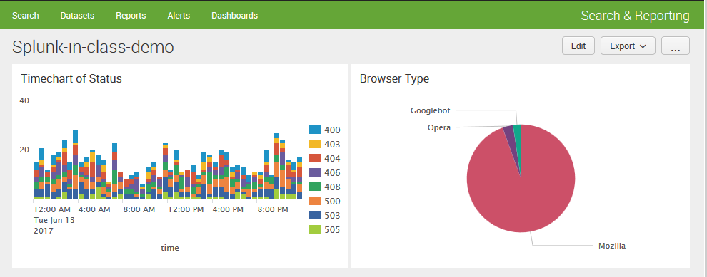
Lets add this search to our dashboard (use Existing dashboard option), and then view the dashboard.
Click Edit -> Edit Panels to drag the different panels to different positions.

Slide 44
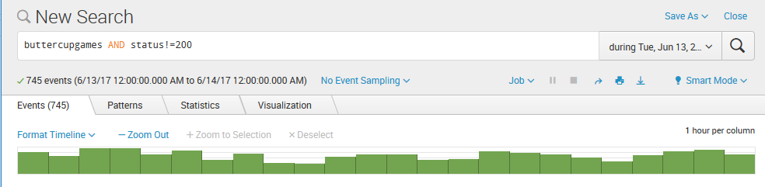
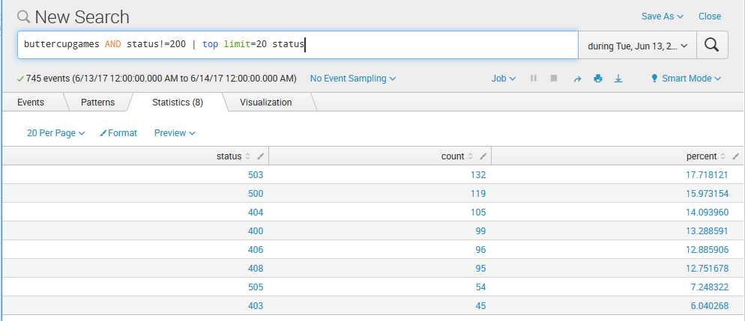
Let’s go back to search, and search for buttercupgames AND status!=200 again (we want to see events that aren’t successful). Click the “status” field on left panel and select “Top count” to show top-counted unsuccessful status codes.

Slide 45
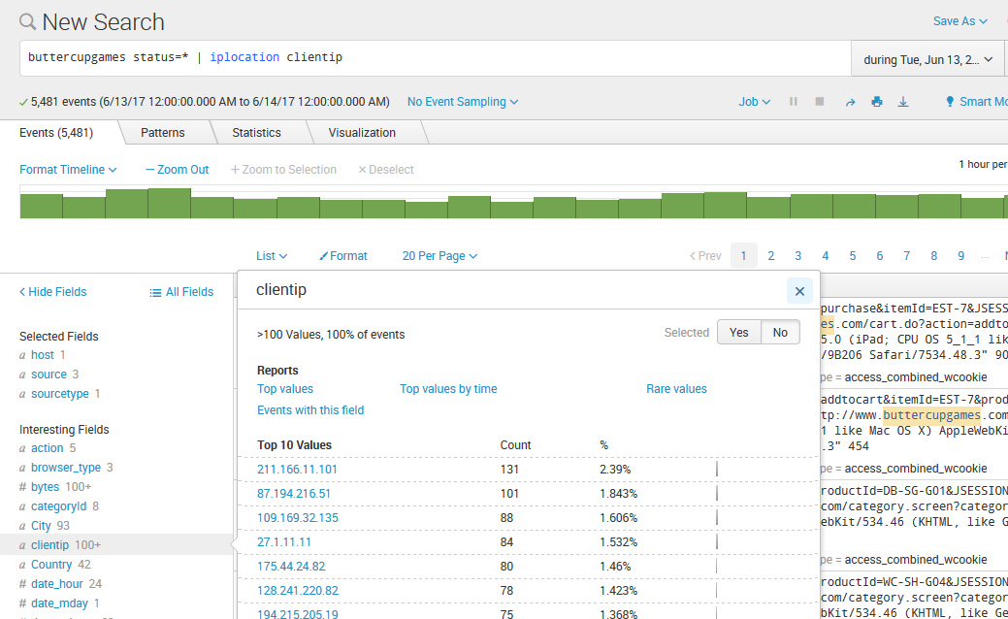
Let’s go back to search and: buttercupgames status=* | iplocation clientip
We want to lookup the clientip values against the MaxMind database to pull in City, Country, State, Lat, Lon of the IPs.

Slide 46
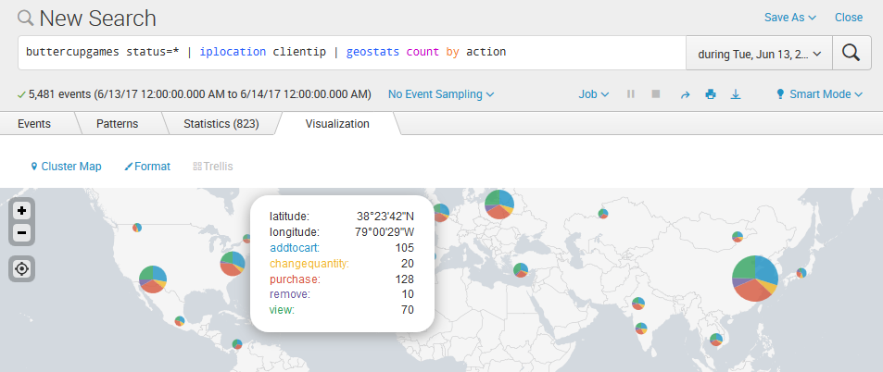
Now, business is interested in seeing plots on a map of web users and what they’re doing with the website.
Lets append a “geostats” command that counts the events by the values of the action field. Select “Cluster map” for the graph option. Pretty cool! This is definitely dashboard worthy! Lets add to dashboard.

Slide 47
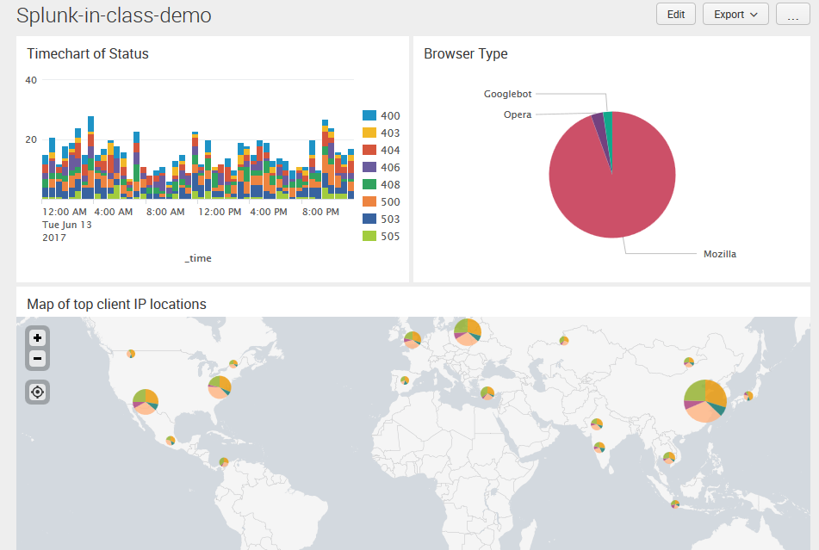
Awesome! Now we have a single pane of glass that Operations, Development, and Business all care about – from one data source! Talk about value!

Slide 48
SPL (Search Processing Language) Overview
Over 140+ search commands
Syntax was originally based upon the Unix pipeline and SQL and is optimized for time series data
The scope of SPL includes data searching, filtering, modification, manipulation, enrichment, insertion and deletion
Includes anomaly detection and machine learning
Acknowledgement: this and the next slide are modified based on “SplunkLive! Zurich 2017 - The Power of SPL”
  https://www.slideshare.net/Splunk/splunklive-zurich-2017-the-power-of-spl

Slide 49
SPL Basic Structure
search and filter | munge | report | cleanup
sourcetype=access*
| eval KB=bytes/1024
| stats sum(PrxyLgKB) dc(ASA_NAT_clientip)
| rename sum(PrxyLgKB) AS "Total KB" dc(ASA_NAT_clientip) AS "Unique Customers"

Slide 50
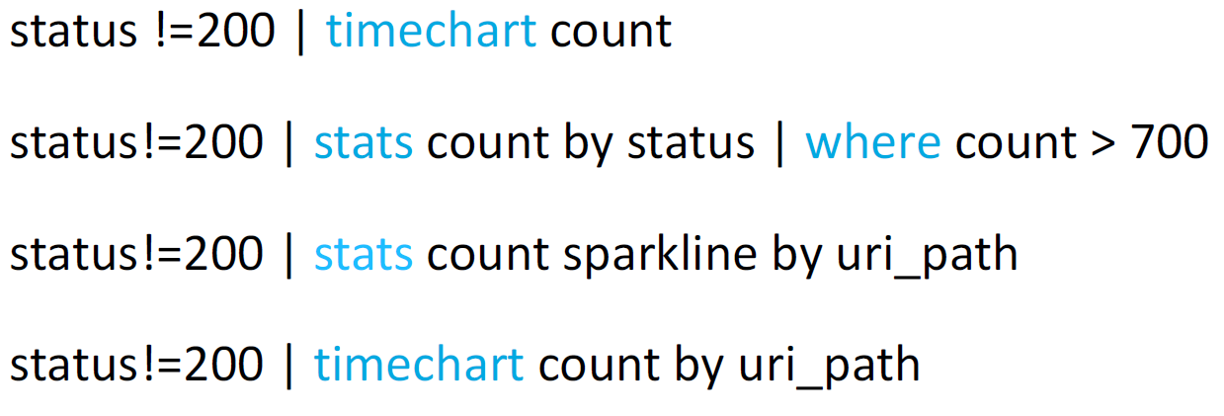
Some Example Searches
Acknowledgement: this and the next slide are modified based on “Getting Started with Splunk Hands-on”
  https://www.slideshare.net/Splunk/getting-started-with-splunk-handson-69769395

Slide 51
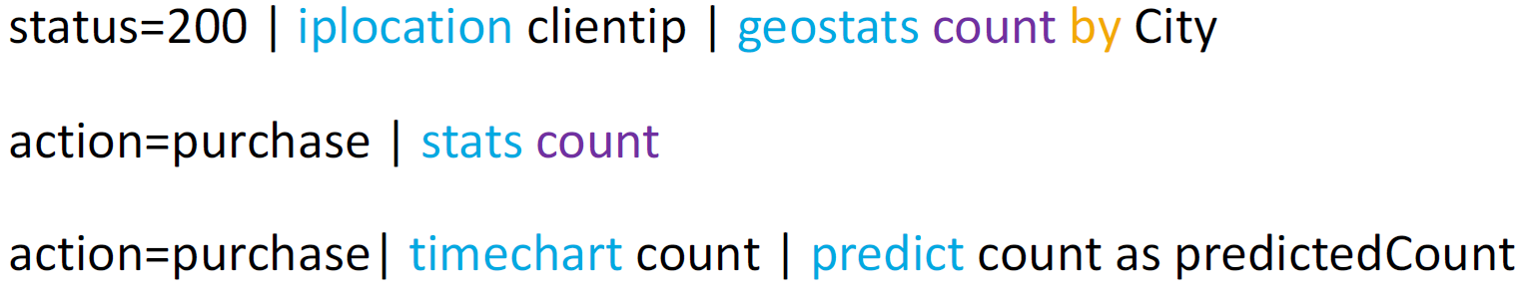
Searches Used Cont’d

