Slide 1

System Hardening: Secure the Vulnerable Metasploitable 2 Linux Virtual Machine
CIS 6395, Incident Response Technologies
Fall 2021, Dr. Cliff Zou
czou@cs.ucf.edu

Slide 2
Acknowledgement
Online tutorials:
  https://akvilekiskis.com/work/metasploitable/index.html
Some useful webpages on Linux System Hardening:
    https://www.tecmint.com/linux-server-hardening-security-tips/
    https://www.cyberciti.biz/tips/linux-security.html
Online PenTesting Tutorials:
    http://www.computersecuritystudent.com/HOME/index.html
    https://akvilekiskis.com/work/pentesting/bpt1.html

Slide 3
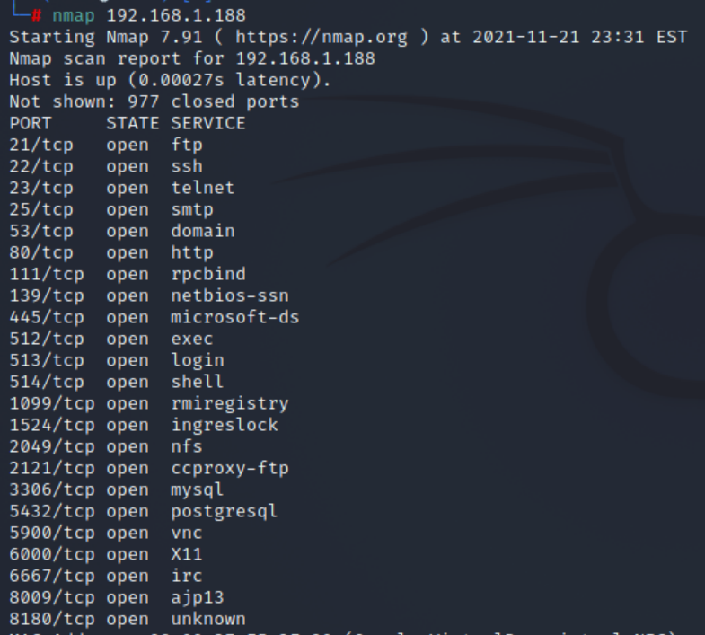
Nmap Scanning to find All Open Ports of Metasploitable Linux VM

Slide 4
Remote Login: Disable Telnet Service
Remote login should always use SSH (encrypted traffic), not Telnet (plaintext traffic)
Modify /etc/inetd.conf to change startup services
  Commenting out the Telnet line, then restart machine
  When you use nmap again on Kali Linux to scan Metasploitable 2 Linux VM, you can see that the telnet service is gone
  Another way is remove the telnet package
    Apt-get remove telnet
  A third way is to set iptables firewall to block tcp/23 incoming connections

Slide 5
Vulnerable vFTP Service
Checking /etc/inetd.conf in Metasploitable VM, we can see that ftp service is disabled, but tftp service runs from startup (where vsftpd 2.3.4 has backdoor vulnerability)
  TFTP is the protocol, where the server software is vsftpd
Solution#1: Disable tftp service, just like Telnet
  Edit /etc/inetd.conf to comment out the tftp line

Slide 6
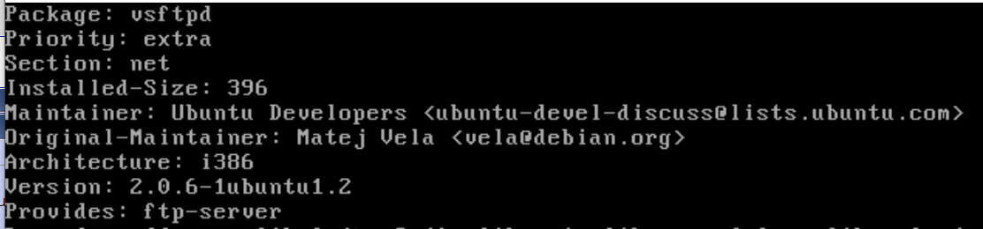
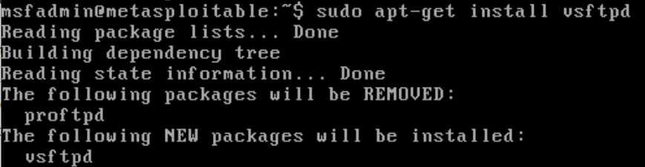
Update Vsftpd
Solution#2: update vsftpd software
  Check current vsftpd version $apt-cache show vsftpd
    Apt-cache is to search apt software package
      https://www.tecmint.com/useful-basic-commands-of-apt-get-and-apt-cache-for-package-management/
  Update vsftpd

Slide 7
Patch Vsftpd
However, apt-get may not be able to connect to the repository website
  You need to download its source and install
  Tutorial on ftp install: https://phoenixnap.com/kb/install-ftp-server-on-ubuntu-vsftpd
Solution # 3: Patch the vsftpd to make it secure
  Disable anonymous upload for the ftp service by commenting out the line ‘anon_upload_enable=YES’ in /etc/vsftpd.conf
  Drop incoming port 6200 connection (used by vsftpd backdoor attack, with the username ‘user:)’ , password ‘pass’ ) by using iptables command
    ‘-A’ means append the rule to existing rule set
  Iptables is Linux firewall software
    https://www.hostinger.com/tutorials/iptables-tutorial
    Use command ‘/sbin/iptables-save’ to make your changes persistent after reboot

Slide 8
Ports 139/145 - Samba
What is Samba?
  Running on a Unix system, it allows Windows to share files and printers on the Unix host, and it also allows Unix users to access resources shared by Windows systems.
Metasploit exploit using exploit/multi/samba/usermap_script
Solution#1: update samba
Solution#2: disable user map script
  Edit /etc/samba/smb.conf, comment out the map script line

Slide 9


Port 1524 – Ingreslock Backdoor
Netcat service without password
Solution: disable ingreslock service
  Edit /etc/inetd.conf, comment out ingreslock
  After reboot, the exploit will not work anymore

Slide 10
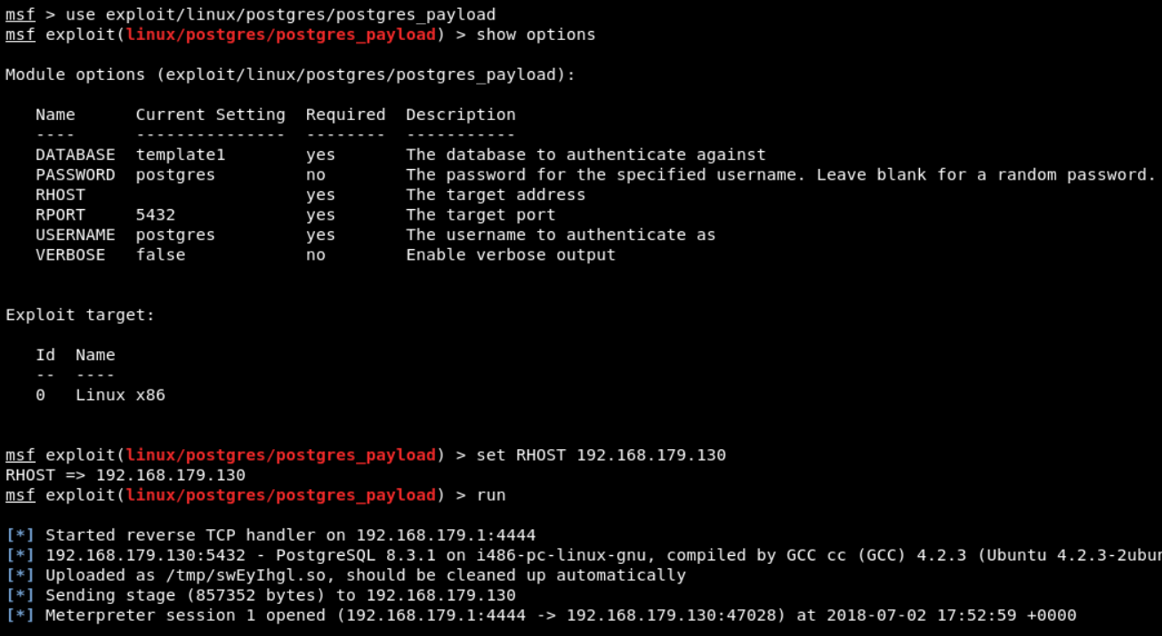
Port 5432 - PostGreSQL
Metasploit exploit using linux/postgres/postgres_payload

Slide 11
Port 5432 - PostGresSQL
Solution#1: Use iptables to block incoming postgresql traffic
  Use command ‘/sbin/iptables-save’ to make your iptable changes persistent after reboot
Solution#2: change the default dir used by the exploit
  Edit /etc/postgresql/8.3/main/postgresql.conf
    The default directory is /var/lib/postgresql/8.3/main so you can change it to whatever you like
  Then the exploit will not work

Slide 12
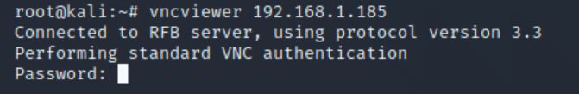
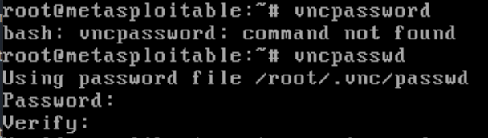
Port 5900 - VNC
Metasploit attack to find password
  https://www.youtube.com/watch?v=ZyFFIeeNrr0
Metasploitable2 has the password of ‘password’
Solution: change vnc to a stronger password

Slide 13
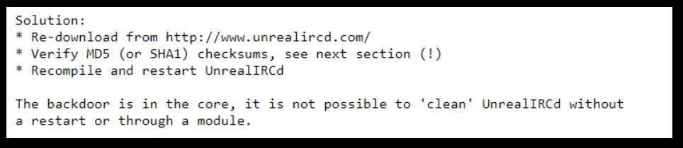
Port 6667 - UnrealIRCd
Cannot be patched
Solution: Disable UnrealIRCd, or use Iptables to block incoming IRC traffic
  iptables -A INPUT -p tcp --dport 6667 -j DROP

Slide 14
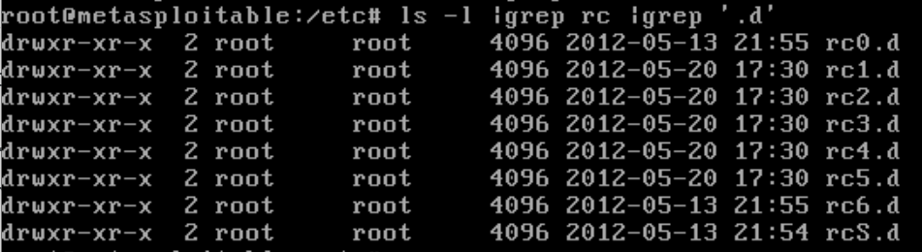
Manage Startup Service using update-rc.d
https://www.debuntu.org/how-to-managing-services-with-update-rc-d/
Startup services are listed in rc?.d dir
Remove startup ‘apache2’ service
  # update-rc.d -f apache2 remove
Add a startup service
  # update-rc.d apache2 defaults

Slide 15
Port 8180 - Apache Tomcat
Weak password vulnerability, exploit tutorial:
  https://pentestlab.blog/2012/03/22/apache-tomcat-exploitation/
  Its admin has username ‘tomcat’ password ‘tomcat’

Slide 16
Port 2121 - vsftpd
Metasploit attack port 2121 tutorial:
  https://medium.com/hacker-toolbelt/metasploitable-2-ix-port-2121-8ccff086b309
  Due to weak password
Solution: disable ftp service, or use Iptables to block incoming port 2121 traffic

Slide 17
Unresolved: Port 80 - Apache
Metasploitable2 Apache server has PHP vulnerability, but its complicated to secure
  The Metasploit attack tutorial:
    https://www.rapid7.com/db/modules/exploit/multi/http/php_cgi_arg_injection/

Slide 18
Linux System Hardening
Can be done at system and application levels
Generalized steps to Linux System Hardening
  Preliminary Planning
  Physical System Security
  Operating System Installation
  Securing Local File Systems
  Configuring and Disabling Services
  Securing the root account
  User Authentication and User Account Attributes
  Securing Remote Authentication
  Setup Ongoing System Monitoring
  Backups

Slide 19
OS-Level Security Tools and Techniques
OS Installation: Software Selection and Initial Setup
Patch Management
Network-Level Access Controls
Using iptables for “Local Firewall” Rules
Antivirus Software
User Management
Password ageing
Root Delegation
Logging

Slide 20
Patch Management
Installed server applications must be:
  Configured securely
  Kept up to date with security patches
Patching can never win “patch rat-race”
Have tools to automatically download and Install security updates
  Example: up2date, YaST, apt-get
    #apt-get update
  Should not run automatic updates on change-controlled systems without testing
Notes:
Carefully selecting what gets installed on linux system is an important but also they must also kept up to date with security patches and configure securely
Patch rat-race : there will always be software vulnerabilities that attackers are able to exploit for some period of time before vendor issue patches for them.
Good news is modern linux distributions includes tools for automatically download and install security updates
Should not run automatic updates on change-controlled systems without testing because it may introduce instability

Slide 21
Network Access Controls
Network a key attack vector to secure
Libwrappers & TCP wrappers a key tool to check access
  Before allowing connection to service, tcpd first evaluate access control
    Defined in /etc/hosts.allow
    Defined in /etc/hosts.deny
Notes:
One of the most important attack vectors in linux threats is the network
Network-level access control (that is, controls that restrict access to local resources based on ip addresses of the networked system attempting to access them) are there for import tool in linux security

Slide 22
Using iptables for “Local Firewall” Rules
Also have the very powerful netfilter Linux kernel native firewall mechanism and iptables user-space front end
Useful on firewalls, servers, desktop
Typically for “personal” firewall use will:
  Allow incoming requests to specified services
  Block all other inbound service requests
  Allow all outbound (locally-originating) requests
Do have automated rule generators
If need greater security, manually configuration required
Notes:
Linux kernel’s native firewall mechanism, netfilter is powerful tool because netfilter is commonly referred to by the name of its user-space frontend, iptables.
Useful on firewalls, servers, desktop
Typically for “personal” firewall use will:
Allow incoming requests to specified services
Block all other inbound service requests
Allow all outbound (locally-originating) requests
Do have automated rule generators
If need greater security, manually configuration required

Slide 23
Antivirus Software
Historically Linux not as vulnerable to viruses
Windows targeted more due to popularity
Prompt patching of security holes more effective for worms
Viruses abuse users privileges
Non-privileged user account
  Less scope of being exploited
Growing Linux popularity means growing exploits
Hence antivirus software will be more important
  Various commercial and free Linux A/V

Slide 24
User Management
Guiding principles in user-account security:
  Be careful setting file / directory permissions
  Use groups to differentiate between roles
  Use extreme care in granting / using root privileges
Notes:
These guidelines user need to follow for security
Be careful setting file / directory permissions
Use groups to differentiate between roles
Use extreme care in granting / using root privileges

Slide 25
Password Aging
Maximum and minimum lifetime for user passwords
  Globally changed in /etc/login.defs
Some settings:
  PASS_MAX_DAYS 150
  PASS_MIN_DAYS 0
  PASS_CHANGE_TRIES
Notes:
Password againg is ste globally in the files /etc/login.defs and /etc/default/useradd but these settings are only applied when new user accounts are created
To modify password lifetime for existing account use the ‘change’ command

