Slide 2
Defining Security
The “security” of a system, application, or protocol is always a relative feature that is defined by
  A set of desired properties
  An adversary with specific capabilities
For example, standard file access permissions in Linux and Windows are not effective against an adversary who can boot from a CD

Slide 3

Security Goals
Integrity
C.I.A.
Confidentiality
Availability

Slide 4
Confidentiality
Confidentiality is the avoidance of the unauthorized disclosure of information.
  “Keep information secret”
  confidentiality involves the protection of data, providing access for those who are allowed to see it while disallowing others from learning anything about its content.

Slide 5
Tools for Confidentiality
Encryption: the transformation of information using a secret, called an encryption key, so that the transformed information can only be read using another secret, called the decryption key (which may, in some cases, be the same as the encryption key).
Sender
Communication
channel
Recipient
encrypt
decrypt
ciphertext
plaintext
plaintext
shared
secret
key
shared
secret
key
Attacker
(eavesdropping)

Slide 6
Tools for Confidentiality
Access control: rules and policies that limit access to confidential information to those people and/or systems with a “need to know.”
  “need to know” may be determined by
    identity, such as a person’s name or a computer’s serial number,
    a role that a person has, such as being a manager or a computer security specialist.

Slide 7
Tools for Confidentiality
Authentication: the determination of the identity or role that someone has.
  something the person has (like a smart card or a radio key fob storing secret keys),
  something the person knows (like a password),
  something the person is (like a human with a fingerprint).
password=ucIb()w1V
mother=Jones
pet=Caesar
human with fingers
and eyes
Something you are
Something you know
radio token with
secret keys
Something you have

Slide 8
Integrity
Integrity: the property that information has not be altered in an unauthorized way.
Tools:
  Backups: the periodic archiving of data.
  Checksums: the computation of a function that maps the contents of a file to a numerical value. A checksum function depends on the entire contents of a file and is designed in a way that even a small change to the input file (such as flipping a single bit) is highly likely to result in a different output value.
  Data correcting codes: methods for storing data in such a way that small changes can be easily detected and automatically corrected.

Slide 9
Availability
Availability: the property that information is accessible and modifiable in a timely fashion by those authorized to do so.
Tools:
  Physical protections: infrastructure meant to keep information available even in the event of physical challenges.
  Computational redundancies: computers and storage devices that serve as fallbacks in the case of failures.
Attack:
  Information attack: Denial-of-Service (DoS)
  Hardware attack: physical attack, power, link cut…

Slide 10
Other Security Concepts
A.A.A.
Authenticity
Anonymity
Assurance

Slide 11
Assurance
Assurance refers to how trust is provided and managed in computer systems.
  The degree to which we have confidence that systems are behaving in the way we expect.

Slide 12
Authenticity
Authenticity is the ability to determine that statements, policies, and permissions issued by persons or systems are genuine.
Primary tool:
  digital signatures. These are cryptographic computations that allow a person or system to commit to the authenticity of their documents in a unique way that achieves nonrepudiation, which is the property that authentic statements issued by some person or system cannot be denied.

Slide 13
Anonymity
Anonymity: the property that certain records or transactions not to be attributable to any individual.
Tools:
  Aggregation: the combining of data from many individuals so that disclosed sums or averages cannot be tied to any individual.
  Mixing: the intertwining of transactions, information, or communications in a way that cannot be traced to any individual.
  Proxies: trusted agents that are willing to engage in actions for an individual in a way that cannot be traced back to that person.
  Pseudonyms: fictional identities that can fill in for real identities in communications and transactions, but are otherwise known only to a trusted entity.

Slide 14
Threats and Attacks
Eavesdropping: the interception of information intended for someone else during its transmission over a communication channel.
Alice
Bob
Eve

Slide 15

Threats and Attacks
Alteration: unauthorized modification of information.
  Example: the man-in-the-middle attack, where a network stream is intercepted, modified, and retransmitted.
Sender
Communication
channel
Recipient
encrypt
decrypt
plaintext M
plaintext M′
shared
secret
key
shared
secret
key
ciphertext C
ciphertext C′
Attacker
(intercepting)

Slide 16
Threats and Attacks
Denial-of-service: the interruption or degradation of a data service or information access.
  Example: email spam, to the degree that it is meant to simply fill up a mail queue and slow down an email server.
Alice

Slide 17
Threats and Attacks
Masquerading: the fabrication of information that is purported to be from someone who is not actually the author.
  Or called impersonation
“From: Alice”
(really is from Eve)

Slide 18
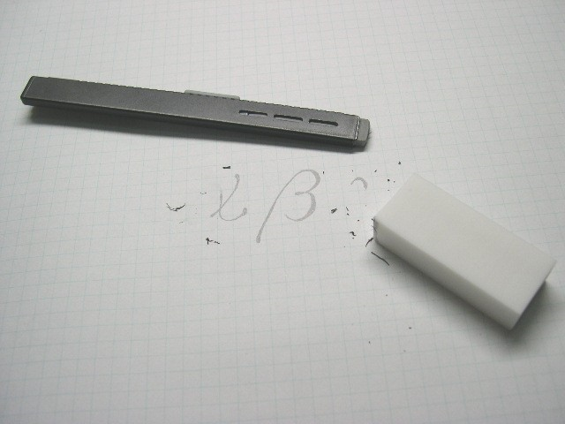
Threats and Attacks
Repudiation: the denial of a commitment or data receipt.
  This involves an attempt to back out of a contract or a protocol that requires the different parties to provide receipts acknowledging that data has been received.
Public domain image from http://commons.wikimedia.org/wiki/File:Plastic_eraser.jpeg

Slide 19
Threats and Attacks
Correlation and traceback: the integration of multiple data sources and information flows to determine the source of a particular data stream or piece of information.
Bob

Slide 20
Topic: Access Control
Users and groups
Authentication
Passwords
File protection
Access control lists
Which users can read/write which files?
Are my files really safe?
What does it mean to be root?
What do we really want to control?

Slide 21
Access Control Matrices
A table that defines permissions.
  Each row of this table is associated with a subject, which is a user, group, or system that can perform actions.
  Each column of the table is associated with an object, which is a file, directory, document, device, resource, or any other entity for which we want to define access rights.
  Each cell of the table is then filled with the access rights for the associated combination of subject and object.
  Access rights can include actions such as reading, writing, copying, executing, deleting, and annotating.
  An empty cell means that no access rights are granted.

Slide 22
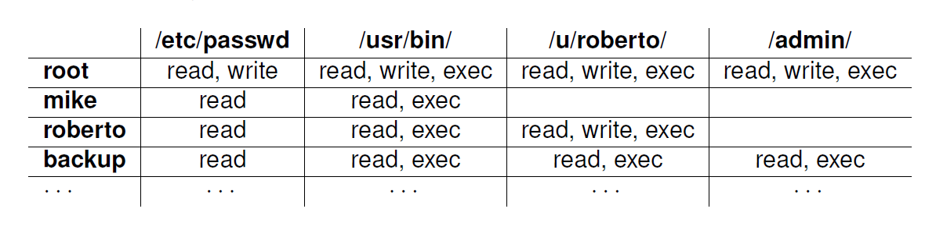
Example Access Control Matrix

Slide 23
Access Control Lists (ACL)
It defines, for each object, o, a list, L, called o’s access control list, which enumerates all the subjects that have access rights for o and, for each such subject, s, gives the access rights that s has for object o.
/etc/passwd
/usr/bin/
/u/roberto/
/admin/
root: r,w
mike: r
roberto: r
backup: r
root: r,w,x
mike: r,x
roberto: r,x
backup: r,x
root: r,w,x
roberto: r,w,x
backup: r,x
root: r,w,x
backup: r,x

Slide 24
Capabilities
/etc/passwd: r,w,x; /usr/bin: r,w,x;
/u/roberto: r,w,x; /admin/: r,w,x
root
Takes a subject-centered approach to access control. It defines, for each subject s, the list of the objects for which s has nonempty access control rights, together with the specific rights for each such object.
mike
/usr/passwd: r; /usr/bin: r,x
/usr/passwd: r; /usr/bin: r;
/u/roberto: r,w,x
roberto
/etc/passwd: r,x; /usr/bin: r,x;
/u/roberto: r,x; /admin/: r,x
backup

Slide 25
Role-based Access Control
Define roles and then specify access control rights for these roles, rather than for subjects directly.
Department Chair
Administrative Manager
Lab Manager
System Administrator
Undergraduate TA
Graduate TA
Accountant
Secretary
Lab Technician
Backup Agent
Undergraduate Student
Graduate Student
Administrative Personnel
Technical Personnel
Faculty
Student
Department Member

Slide 26
Passwords
A short sequence of characters used as a means to authenticate someone via a secret that they know.
Userid: _________________
Password: ______________

Slide 27
How a password is stored?
User
Password file
Dog124
Butch:ASDSA
21QW3R50E
ERWWER323
…
…
hash function

Slide 28
Strong Passwords
What is a strong password
  UPPER/lower case characters
  Special characters
  Numbers
When is a password strong?
  Seattle1
  M1ke03
  P@$$w0rd
  TD2k5secV
28
Notes:
28
28
Spostare in altra sezione

Slide 29
Password Complexity
A fixed 6 symbols password:
  Numbers
  10⁶ = 1,000,000
  UPPER or lower case characters
  26⁶ = 308,915,776
  UPPER and lower case characters
  52⁶ = 19,770,609,664
  32 special characters (&, %, $, £, “, |, ^, §, etc.)
  32⁶ = 1,073,741,824
94 practical symbols available
  94⁶ = 689,869,781,056
ASCII standard 7 bit 2⁷ =128 symbols
  128⁶ = 4,398,046,511,104
29

Slide 30
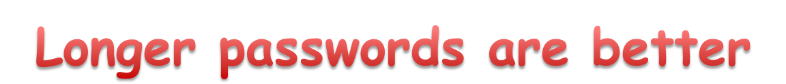
Password Length
26 UPPER/lower case characters = 52 characters
10 numbers
32 special characters
=> 94 characters available
5 characters: 94⁵ = 7,339,040,224
6 characters: 94⁶ = 689,869,781,056
7 characters: 94⁷ = 64,847,759,419,264
8 characters: 94⁸ = 6,095,689,385,410,816
9 characters: 94⁹ = 572,994,802,228,616,704
30
Notes:
30
30

Slide 31
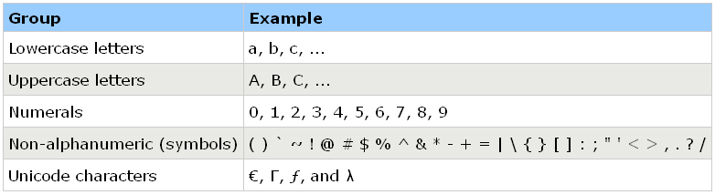
Secure Passwords
A strong password includes characters from at least three of the following groups:
Use pass phrases eg. "I re@lly want to buy 11 Dogs!"
31

