Slide 1
(1,1)
(1,2)
(1,3)
(1,4)
(1,5)
(1,6)
(1,7)
(1,8)
(2,1)
(2,8)
(3,1)
(3,8)
(4,1)
(4,8)
(5,1)
(5,8)
(6,1)
(6,8)

Slide 2
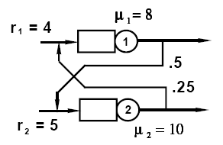
μ₁ = 8
r₁ = 4
1
Even
customer
.25
r₂ = 5
2
μ₂ = 10

