Slide 1
Click-Tracking Blocker: Privacy Preservation by Disabling Search Engine’s Click-Tracking
Roberto Alberdeston, Erich Dondyk, Cliff C. Zou
Computer Science Division
Department of Electrical Engineering and Computer Science
University of Central Florida, Orlando, FL

Slide 2
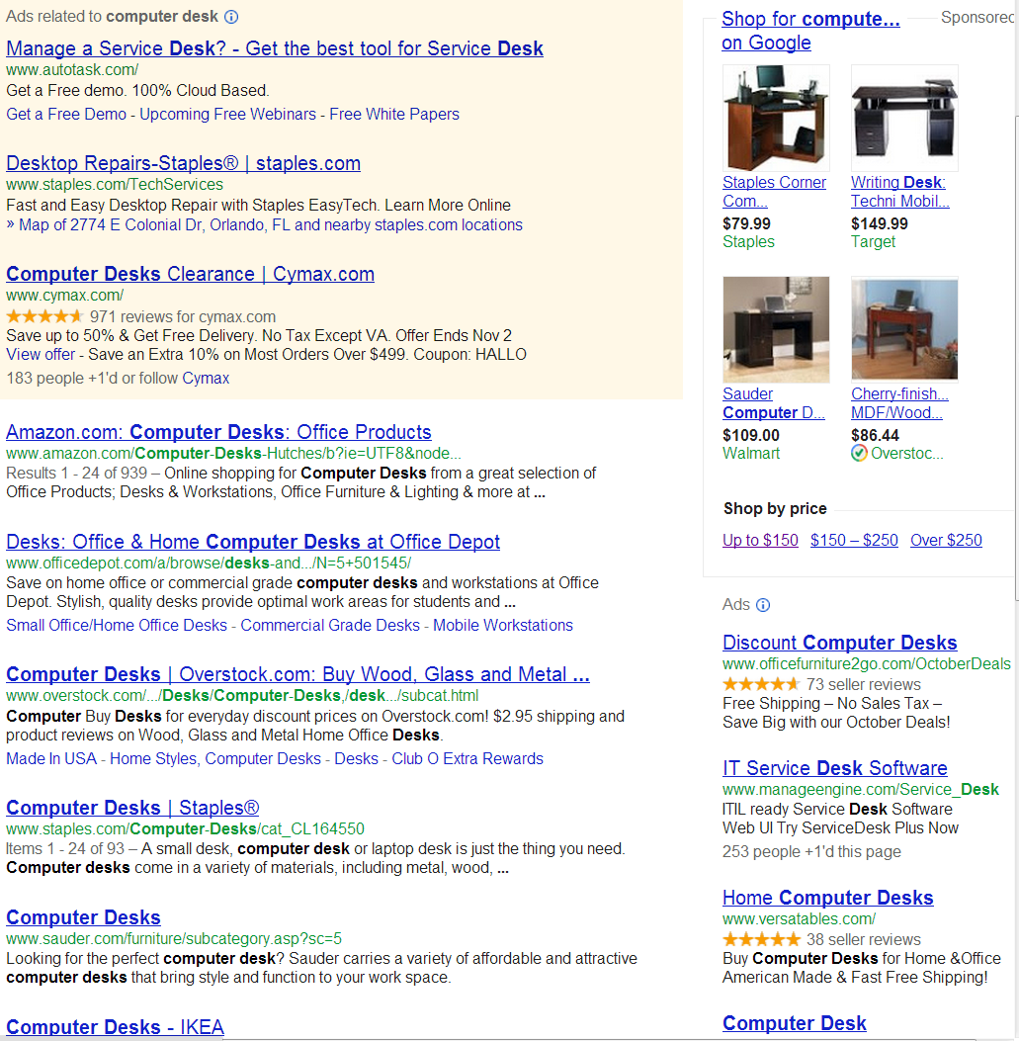
Search Engine Result Page (SERP)
Two types of URLs:
Organic links
Sponsored links
Your click on any link on SERP will be tracked by search engine!
Google, Yahoo, Bing
Ads business model
Better user profiling
It is OK for search engine to know my search phrase, but my selection is none of their business!

Slide 3
Design Goal and Requirement
Protect user’s privacy by disabling any click-tracking on search engine result pages
Must be transparent to end users
Do not introduce additional traffic, or search delays
Best to be a browser plug-in for easy installation and use

Slide 4
Feasibility of Proposed Design
FACT: Search engines always ENCODE URLs on their search engine result pages (SERP), NO encryption is used
Thus we can decode SERP’s URLs to recover the targeted website URLs
Retrieved SERPs are under the control of end user’s browser
A browser plug-in program can conduct post-processing on retrieved SERP html file before showing it to an end user

Slide 5
How the Click-Tracking Works?
Suppose the selected website URL (organic link) is:
http://buy.com/?id=2&ref=30
When you click this website link on SERP:
On Google’s SERP, your browser will connect to:
http://www.google.com/url?^^^^^&url=http%3A%2F%2Fbuy.com%2F%3Fid%3D2%26ref%3D30&^^^^^
On Yahoo’s SERP:
http://search.yahoo.com/r/^^^^^RU=http%3a//buy.com/%3fid=2%26ref=30
Bing does not track clicks on organic links

Slide 6
How the Click-Tracking Works?
Suppose the selected website URL (sponsored link) is:
http://buy.com/?id=2&ref=30
When you click this website link on SERP:
On Google’s SERP, your browser will connect to:
http://www.google.com/aclk?^^^^^&adurl=http://buy.com/%3Fid%3D2%26ref%3D30&^^^^^^
On Bing’s SERP:
http://$$$$.r.msn.com/?ld=^^^^^&u=http%3a%2f%2fbuy.com%2f%3fid%3d2%26ref%3d30
On Yahoo’s SERP:
http://search.yahoo.com/r/_ylt=^^^^^RU=http%3a//$$$$.r.msn.com/%3fld=%26u%3dhttp%253a%252f%252fbuy.com%252f%253fid%253d2%2526ref%253d30

Slide 7
Encoding: Percent-Encoding
In original sponsored URL, each char in
{# & % [ ] + { } | ? =} is encoded into a three-char of its ASCII hexademical value.
‘=’ has ASCII value of 0x3D ➔ ‘%3D’
‘?’ has ASCII value of 0x3F ➔ ‘%3F’
‘&’ has ASCII value of 0x26 ➔ ‘%26’
In organic link, the encoding char set is
{# & % [ ] + { } | ? =} plus {/ :}
‘/’ has ASCII value of 0x2F ➔ ‘%2F’

Slide 8
Yahoo Encoding of Sponsored Links
Microsoft has taken over search adtertising operation of Yahoo, formed “Yahoo! And Microsoft Search Alliance”
Yahoo’s sponsored link encapsulates Bing’s sponsored link
But encode char ‘%’ again by its ASCII value in ‘%25’
Keyword “&u=“ become “%26u%3d”
For the original URL: http://buy.com/?id=2&ref=30
Encoded result URL is:
http://search.yahoo.com/r/_ylt=^^^^^RU=http%3a//$$$$.r.msn.com/%3fld=%26u%3dhttp%253a%252f%252fbuy.com%252f%253fid%253d2%2526ref%253d30

Slide 9
Prototype of Click-Tracking Blocker
Firefox plug-in prototype can be downloaded from:
http://www.cs.ucf.edu/~czou/clickTrackBlocker/
Utilize the platform of browser extension ‘Greasemonkey’
It allows other developers to customize the way webpages look and function

Slide 10
Evaluation
A standalone program is used to download thousands of SERPs and compare webpage contents before and after Click-Tracking Blocker
> 80% of webpages are either completely identical or have less than 1% char differences
Need to improve aspect: About 10% of webpages were inconclusive because these sponsored links on SERPs were unreachable because they
were offline during our testing
were third-party advertisement websites
did not support our implemented HTTP protocol

Slide 11
Conclusion
As long as search engines do not conduct URL encryption, end users can utilize Click-Tracking Blocker to protect their privacy
Open question: why search engines do not do encryption?
Click-Tracking Blocker is easy to use, transparent to end users, do not introduce additional traffic or delay

Slide 12
Backup
Related Work
Google Anonymizer: Click-tracking blocker for Google’s organic links
Also implemented on Greasemokey platform
Cannot deal with sponsored links, or other search engines
Straight Google: circumvent click tracking in most Google websites
Cannot deal with sponsored links, or other search engines
TrackMeNot: from NYU
Anonymize search phrase from Search Engine’s tracking
Idea: Generate large amount of random NOISE search phrases (cause additional noise traffic)

