Slide 1
VEX: Vetting Browser Extensions for Security Vulnerabilities Sruthi Bandhakavi, Samuel T. King, P. Madhusudan, and Marianne Winslett, USENIX Security Symposium (Usenix), 2010
Presentation By
Saurabh Mankar
EECS Department

Slide 2
Agenda
Introduction (What is VEX ?)
Background
Key Terminologies
Vulnerability Issues
Addressed & Unaddressed Issues
Assumptions of VEX tool
More Details on VEX

Slide 3
Introduction
VEX – What is it ?
A tool or framework for highlighting potential security vulnerabilities in browser extensions.

Slide 4
Background
Is it Plugins or Extensions that this tools works on ?
Plugins are complicated, loadable modules. Flash and Java are two examples
Extensions are written mostly in JavaScript. They act as part of the browser and they have wider access privileges than JS-in-a-webpage
VEX works on Extensions.
150 million extensions are in use

Slide 5
What is an Extension ?
A browser extension is a computer program that extends the functionality of a web browser in some way.
Ex: Adblock Plus, Media Sniffer

Slide 6
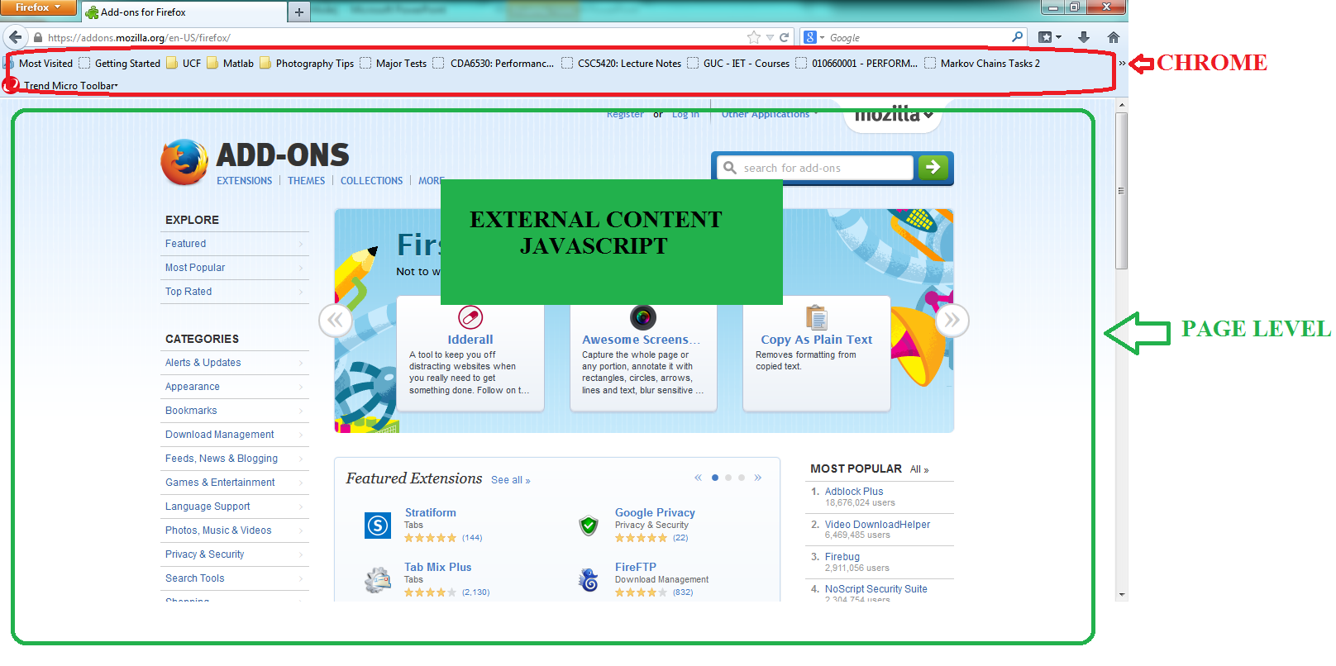
Firefox Architecture for Extensions

Slide 7
Firefox Architecture for Extensions
Page - for web pages displayed in the browser’s content window restrictive - a page loaded from site x cannot access content from sites other than x
Chrome - for elements belonging to Firefox and its extensions. Gives access to:
all browser states and events
OS resources
all web pages
Extensions have full chrome privileges by using an API called the XPCOM Components to extension JavaScript, thereby allowing the extensions to have access to all the resources Firefox can access.

Slide 8
How are Extensions Uploaded on Firefox ?
SANDBOX
no
fail
Author Nominates
non-public add-on
Update to Public Add-On
yes
Add-On Submitted
no
yes
Editor Review
Trusted Add-On ?
New Add-On ?
no
yes
Pass
PUBLIC

Slide 9
Extensions are not secure
Developers:
Many developers write extensions because of hobbies
Likely to write vulnerable extensions
Don’t have time or interests to update their extensions
Reviewers:
Not possible to understand all the extensions
Don’t need to have great knowledge about extensions or security
Follow guidelines for what is not acceptable:
The guidelines focus on finding malicious extensions
Vulnerable extensions can quiet easily slip through.

Slide 10
Extensions are not secure
Extensions can:
Access objects that run with page privileges and interact with page content.
Access objects that run with full chrome privileges.
Include user interface components via a chrome document, which also runs with full chrome privileges: window.content.document.
Thus, it can Lead to execution of remote code in privileged context, e.g. RSS reader extension takes the content of the RSS feed (HTML code) and insert it into the extension window.

Slide 11
VEX
GOAL:
finding security vulnerabilities in browser extensions
ASSUMPTIONS:
1. Developers are not malicious
2. Extensions are not obfuscated
3. There are no bugs in the browser itself.

Slide 12
VEX : Process Flow

Slide 13
Points of Attack
eval function
InnerHTML
EvalInSandBox
wrappedJSObject

Slide 14
Eval Function
Example :

Slide 15
innerHTML Function
Example :

Slide 16
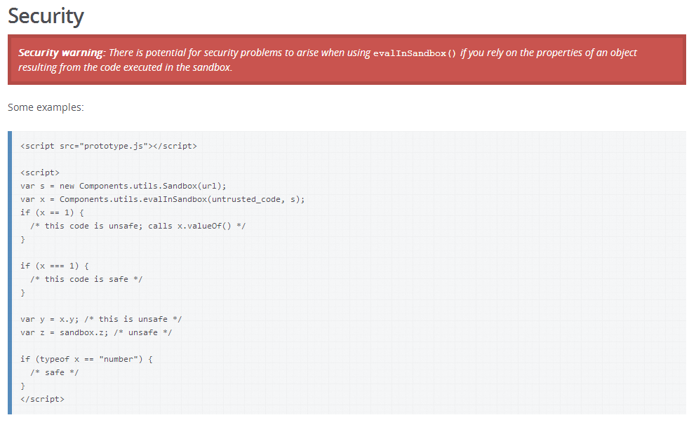
EvalInSandBox Function
Example :

Slide 17
EvalInSandBox Function
evalInSandBox :
To avoid this potential security risk, you should either carefully avoid using objects resulting from evalInSandbox() in any way that might result in a function in that object being called, or you should make sure that untrusted JSON strings don't contain any functions or expressions before using evalInSandbox() to evaluate them.

Slide 18
wrappedJSObject Function
The wrappedJSObject method, which lets the extension access the modiﬁed version, even when automatic wrapping is turned on; calling wrappedJSObject on a content document is potentially dangerous.

Slide 19
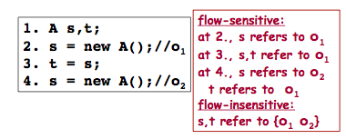
How VEX works ?
Uses static information flow analysis to find flows in the extension code.
Other flow analysis method : Dynamic.
Static Vs Dynamic :
Static: efficient and Complete
Dynamic: accurate
Context Sensitive and Flow Sensitive
Abstract Heap is Required for flow & context sensitive information!

Slide 20
What is Information Flow?
A variable A is said to depend on another variable B in a procedure if there is a path such that the value of B can cause the value of A to change
we also say that there is a flow from variable B to variable A
Types of dependencies:
strongly dependent: A = B + 1
weakly dependent: if (condition) A = B + 1
conditionally dependent: if (B > 0) A = 0
Information Flow Analysis (also called variable dependency analysis) is a study of the interdependencies of the program variables

Slide 21
What is Information Flow?
This is a difficult task:
large number of objects and functions.
there are program defined objects as well as objects of DOM and of the extension (using XPCOM components)
the objects are dynamic. new object properties can be created dynamically at run-time.
functions are objects in JavaScript, they can be created, redefined dynamically, and passed as parameters.

Slide 22
What flows are considered by VEX?
Resource Description Framework (RDF) data to InnerHTML
Content document data to eval
Content document data to innerHTML
evalInSandbox return objects used improperly by code running with chrome privileges
wrappedJSObject return object used improperly by code running with vulnerabilities
The five flows don’t always result in a vulnerability and they are not an exhaustive list of all possible extension security bugs.

Slide 23
Abstract Heap
The analysis uses an abstract heap (AH)
the analysis keeps track of one abstract heap at each program point.
VEX creates a node for every:
object
function
Property (non-associative arrays)
Ignores the exact primitive values in the heap.
The AH records explicit-ﬂow dependencies to heap nodes.

Slide 24
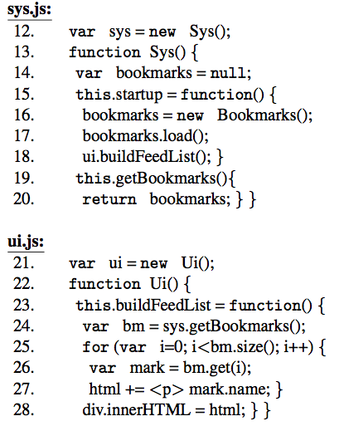
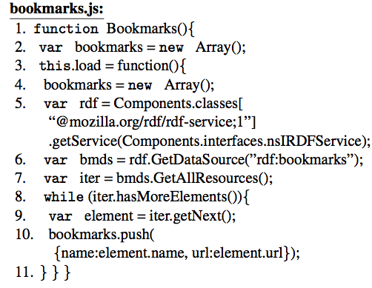
How VEX works ?
Source
Sink
Find Suspicious Flow
Pattern

Slide 25
Attack Models Considered
Attacks that originate from web sites. The attacker can send arbitrary HTML and JavaScript to the user’s browser, that might lead to code injection or privilege escalation through buggy extensions.
In the second model some web sites are considered trusted.

Slide 26
Static Analysis Details
Code is segregated as per below concepts for its analysis:
Variable Access
Binary Operators
Object
Function
Variable Declaration
Assignment
Condition
While
EVAL

Slide 27
Static Analysis Details
Big step operational semantics on abstract heaps:
A relation
prog - an program expression or statement
- the initial abstract heap
- the abstract heap obtained from the complete evaluation of prog starting from the heap
This resulting heap, in every iteration, will be merged with the current heap, conservatively taking the union of dependencies.

Slide 28
Static Analysis Details
What happens to the AH when evaluating a constant?
The only change is that the current node isn’t a heap location, and there isn’t any program variable that flow into it.
Thus: Rule (CONSTANT) evaluates to a node with empty dependencies:

Slide 29
Static Analysis Details
Other rules not visited in the presentation to avoid technical Jargons.

Slide 30
Static Analysis Details
The analysis is :
Flow-sensitive: takes into account the order of statements in a program.
Path-sensitive: computes different pieces of analysis information dependent on the predicates at conditional branch instructions.
Context-sensitive: interprocedural analysis that considers the calling context when analyzing the target of a function call.

Slide 31
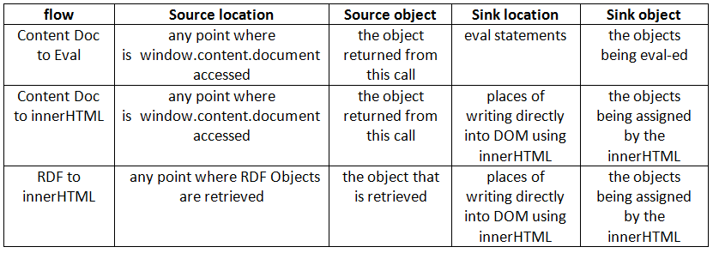
Current Flows Addressed in Vex

Slide 32
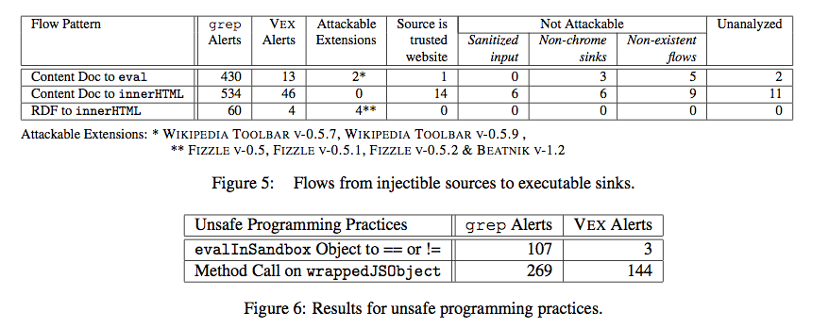
Results
Download a total of 2452 extensions, on an average, VEX took only 15.5 seconds per extension

Slide 33
Results
VEX reported 3 new and other existing vulnerabilities.
Successful attacks being on Fizzle, Wikipedia ToolBar, BEATNIK.

Slide 34
Conclusions
Advantages of VEX:
VEX vets the ﬂows automatically
greatly reduces the number of extensions that need to be manually reviewed
15.5 seconds per extension instead of hours
more accurate than manual review
VEX performs the analysis only once and from the results, allow us to search for any source-to-sink ﬂow
Flow-sensitive, path-sensitive, context-sensitive analysis

Slide 35
Conclusions
Disadvantages of VEX:
Unsoundness and incompleteness
false positives and false negatives
The design choices aren’t necessarily optimal
No modeling of actual values
conditional and while statements aren’t evaluated
The evaluation is executed until reaching a specific condition
No evaluation of prototypes
No evaluation of statically unknown strings subject to eval
There is no information about the existence of known vulnerabilities that VEX hasn’t detected

Slide 36
QUESTIONS?

Slide 37
Thank You!

