Slide 1
Routing Around Decoys
Max Schuchard, John Geddes,
Christopher Thompson, Nicholas Hopper
Proposed in FOCI'11, USINIX Security'11 and CCS'11
Presented by: Aman Goel

Slide 2
Decoy Routing and its adversary
- Decoy routing, a new approach against web censorship
- Aims to hamper nation-state level Internet with routers
- We analyze its security against a routing adversary

Slide 3
What we are going to talk about?
- Background on modern decoys
- Routing adversary introduction
- Methods of detecting decoys
- Timing attacks
- Countermeasures
- Conclusion
- Related Work

Slide 4
Modern censorship resistance tools
Traditional means: end-to-end proxy, TOR, JAP, Ultra-surf...
- Quickly blocked after government probing
- Decoy routing: puts proxy in middle of paths
- user initiate a TLS connection to an uncensored host (hidden on net)
- this host is called "overt destination", or decoy
- decoy acts as a proxy sending data to actual "covert destination"
- Decoy routing is better because...
- Avoid censor's enumeration
- Hide client's usage

Slide 5

Ultra-surf

Slide 6
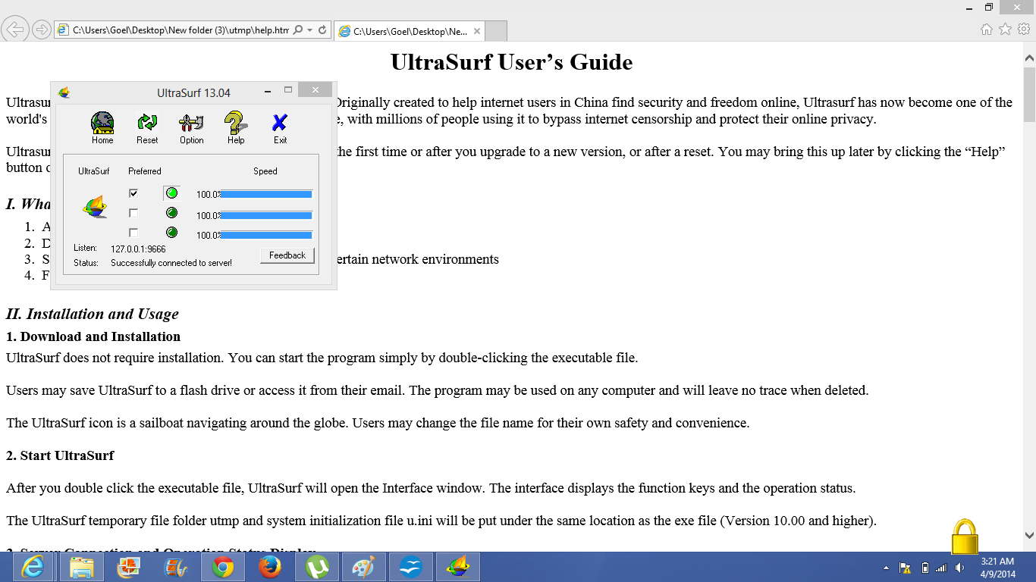
Ultra-surf

Slide 7

Ultra-surf

Slide 8
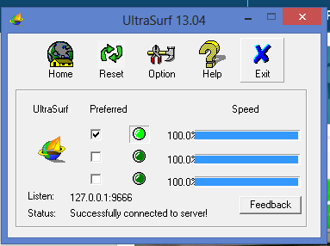
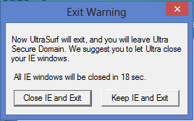
Ultra-surf

Slide 9
Routing adversary overview
- A "warden", a new adversary against censorship
circumvention schemes
- A censoring authority capable of monitoring / controlling
packets' routes in subnetwork (premise)
- Basically, a tool built to defeat decoy routings
- Hide user's packets from decoy
- Predict properties of paths, thus reveal decoys
- Launch confirmation attack, test user's decoy usage

Slide 10
Detecting decoy routers:
Availability attack
Premise theory: Internet routing topology
Autonomous Systems (ASes) as nodes / hubs
3 roles: customer, provider, peer, based on who's carrying traffic
Providers advertise all routes to all nodes to any customers.
This pattern is predictable thus we can infer paths between 2 nodes without access to either.

Slide 11
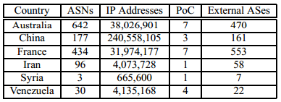
Internet Topology
The number of autonomous and IP addresses in each country, as well as the number of points of control(the smallest number of ASes that control 90% of IP addresses), and the number of external ASes directly connected to each country.

Slide 12
Detecting decoy routers:
Availability attack
Passive
- Probing scan conducted by warden's client
- Scans public directory of decoy routers (ASes)
Challenge: during probing, warden adversary must effectively mark all "tainted" nodes (maximize shadow)
- Harder than it seems: instead of 1 path with decoy, all paths to destination need decoys deployed
- Clean Path method: each warden has at least 1 path that didn't have decoy

Slide 13
Detecting decoy routers:
Detection attack
More active / aggressive
- Goal: break decoy routing system's unobservability
TCP Replay Attack: replay TCP packet sent by host, not along tainted path, but along "clean path"
Forced Asymmetry: alter the path that sent traffic, force user pick a different one
Crazy Ivan Attack: intensely filp the paths

Slide 14
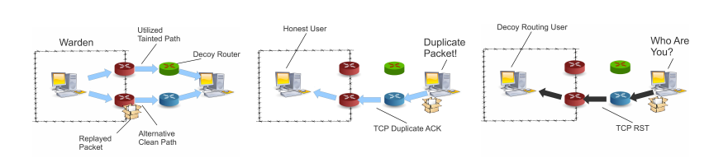
Illustration of a single confirmation attack
The warden has both a tainted path and clean path to a destination(figure 1), and allows users to utilize the tainted path. The warden then replays an observed TCP packet using the clean path.
A duplicate acknowledgment is seen.
A TCP reset is instead seen.

Slide 15
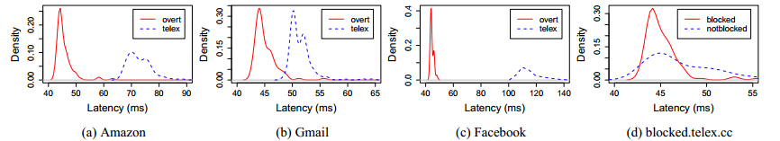
Routing adversary's timing attack
Detect who's using decoy by monitoring network latency
Detecting Telex vs overt
Significant difference between the latencies measurements.

Slide 16
Routing adversary's timing attack
Fingerprinting Covert Destinations (Confirmation attack)
Warden selects a set of covert destinations as targets
Enumerate all decoy routers
When client tries to connect, warden compares by latency
- Can identify which decoy is used by the graphs
Construct a database during attacks
- False positive rate under 10%

Slide 17
Countermeasure
A strong enough decoy routing network
- must cover all paths to a large set of destinations
- infeasible for wardens to launch attacks / block
Or, surround warden with a "ring" of decoys
- Depth two ring but it is large in size.
Or, "ring" popular websites / destinations...
Or, "ring" specific geographic location...
Perhaps through political and cultural means to counter censorship is the better way to go

Slide 18
Conclusion
In this paper, we have introduced a novel adversary model for decoy routing, the routing capable adversary, exploring the actual routing capabilities that a warden has and the implications that such an adversary has with respect to decoy routing. Speciﬁcally, we showed how wardens can easily enumerate all deployed decoy routers and use this information to successfully route around all such routers.
We explored the intricacies of deployment strategies and analyzed the effects they have with respect to the enumeration attacks.
Can use fingerprinting techniques
Results show that small deployments can be trivially defeated, requiring larger deployments for decoy routing to be successful.
However, several of our conﬁrmation attacks still work, even against very large deployments.

Slide 19
Related Work
Several previous works have explored the impact of ISP-type adversaries on anonymity schemes.
Feamster analyzed the diversity of AS-level paths in anonymity netwotks, such as TOR and showed how path asymmetry could lead to poor location independence.
Murdoch examined how even with high AS-level diversity in anonymity networks, many of the packets will travel through a single physical internet exchange allowing a single entity to perform traffic analysis, negating the need for a global view.
As for timing attacks there has been much research done on how traffic analysis is used on anonymity and similar systems.
Several papers suggest that using more sophisticated fingerprinting method makes adversaries to perform website fingerprinting in the TOR network to identify the end user. These attacks are based on the size of downloaded files and could potentially be combined with our timing attacks to yield even more accurate identification of covert destinations.

Slide 20
Questions

