Slide 1
Persistent OSPF Attacks
Gabi Nakibly, Alex Kirshon and Dima Gonikman, Dan Boneh
19th Annual Network & Distributed System Security Conference (NDSS 2012)

Slide 2
Outline
Introduction (OSPF v2)
OSPF Security Strengths
Attack
Impact and Analysis
Mitigation Measures

Slide 3
Introduction (OSPF v2)
Most used protocol in Autonomous System
Link State Routing Protocol
LSA is flooded throughout the AS
Designated Router
Database Description (DBD) Messages
Notes:
Most popular interior gateway protocol,. It aim is to allow routers to constructs routing tables within the autonomous system.
Link state routing protocol which means that each router advertises its link to neighboring routers and networks as well as costs. These advertisements are called LSA
LSA is flooded throughout AS, where each router receiving lsa resend to its neighboring routers, with the help of which router know about whole topology
In every AS , one of the router is elected as Designated router . Election are held for DR and BDR.
DBD messages contain summary of LSA’s and flags(I,M and MS)

Slide 4
Routing table

Slide 5
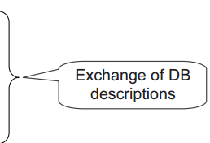
Adjacency set up

Slide 6
Security Strengths
Per Link Authentication
Flooding
Fight Back
LSA Content
Notes:
Every router flooded throughout the AS, there is no chance any malicious router can prevent the LSA reaching other router
Once router receives newer instance of its own LSA which is newer than the last one, it immediately advertise the newer instance of LSA and cancels out false one.
LSA contains only small part of the topology which means the information of neighboring routers . Therefore in order for an attacker to attack , it has to falsify many LSA

Slide 7
Remote False Adjacency Attack
To fool a remote router
Persistent control over routing table
Denial of Service
-Link overload
-Routing loops
-Delivery Failure
Eavesdropping
Notes:
Fools a remote router by advertising a non-existing link in its LSA

Slide 8
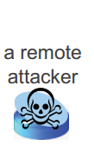
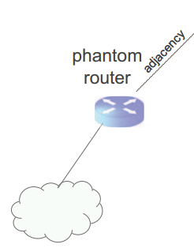
Mechanism
Notes:
Master router can successfully complete the adjacency set up with the neighbor without seeing the message. Then a remote attacker can fool a remote victim router and confuse the victim router into setting up a adjacency with non- existing phantom router. Attack is successful even though attacker cannot see victims messages. As phantom router is adjacent to victims router victim router sends LSA to on behalf of local network to phantom router . So a non existing link is taken in to consideration.

Slide 9
Notes:
Attacker choose the router id greater than victim’s router id . This in turns make phantom router as a designated router. Then there is exchange of DBD messages and attacker send arbitrary large of messages. When attacker send it last DBD message victim will not request any LSA from phantom router since it consider its database is empty.

Slide 10
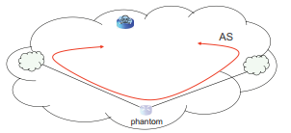
Consequences
Attack can be exploited to black hole traffic
Black-holing most AS traffic with single phantom router
Notes:
Attack can be exploited to black hole traffic destined to a specific network. Attacker can create phantom router anywhere it wishes on the AS.
Another potential use of this attack is to place phantom router in a strategic location on the AS where there is large volume of the traffic. Same phantom router can cbe linked to distant networks on the AS

Slide 11
Real World Impact List of AS topologies used
AS number | ISP name | Number of Routers
1221 | Telstra | 115
3967 | Exodus | 80
6461 | Abovenet | 145

Slide 12
Percentage of black-holed routers pairs when multiple phantom routers are used
Notes:
The effect of the attacks are measured by the percentage of pairs of routers on the AS which the shortest path between them is diverted through the phantom router. Phantom router is connected to each possible pair of routers and each case measured the number of pair of routers which were black holed

Slide 13
Mitigation Measures
Protocol Weakness
Same secret key
Master cannot see message content
Anti source-IP spoofing
Master must prove to slave that it has seen at least one message from slave
Notes:
There are some protocol weakness . Same secret key is shared on all links thought-out the AS. The attack is ineffective if independent key is used on every link.
Master can complete the adjacency protocol without seeing any of the slave’s message.
Routers can employ anti source-Ip spoofing measures on OSPF packets. This will prevent the spoofed Hello and DBD messages from reaching the victim.
Master must prove to slave that it has seen at least one message from slave , in this solution slave adds some random nonce to its DBD message that needed to be echoed by master in its DBD message

Slide 14
THANK YOU AND ANY Questions?

