Slide 1
USER DRIVEN ACCESS CONTROL: RETHINKING PERMISSION GRANTING IN MODERN OPERATING SYSTEM
Presentation by: Manik Challana
Presented at : IEEE Symposium on Security and Privicy,2012.(Best Practical Paper)

Slide 2
.
“Every Program and every privilege user of the system should operate using least amount of privileges necessary to compute the job”
-- Jerome Saltzer

Slide 3
Abstract
Problem : Allowing user to grant access in a non-disruptive manner.
Principal of Least Privilege: Allowing only the privileges that are needed.
Approach : To built permission granting in context of application.
Goal
Notes:
Goal: To enable user-driven access control. This allows user’s natural UI interactions in context of app to govern the access control of user owned resources.

Slide 4
Flaws in Permission Granting
Globalizing Resources: Traditional desktops exposes user resources by globalizing them.
Manifests: Install time manifests are security hazard.
Prompts: Teaches user to ignore them in time. So, unhelpful.
No Access: Certain system and application do no support access to certain user owned resources.

Slide 5
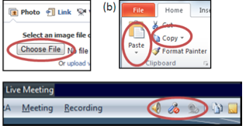
Introduction
What is an ACG?
Permission Granting User interface elements to capture user’s intent.

Slide 6
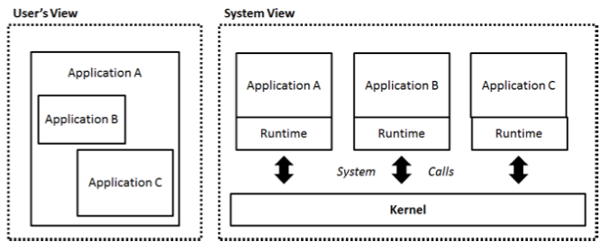
System Model
Same Origin policy
Applications are isolated based on some principal
definition.

Slide 7
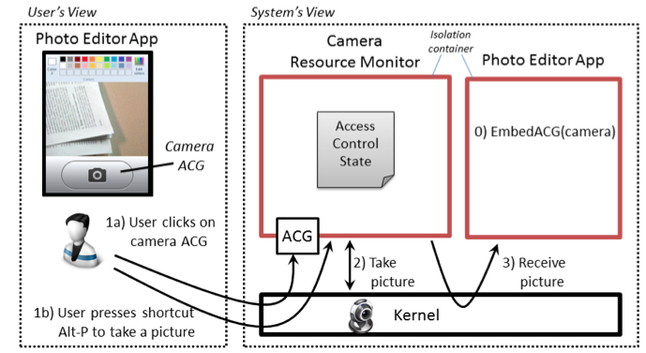
System Model
Application Embedding
Some application may Embed one or more applications.
Role of Kernel

Slide 8
Resource Manager
It is a privileged application that mediates access to all user owned physical devices of particular resource type and maintain respective access control state.
It exposes to app: -
1. ACGs
2. Device access APIs.

Slide 9
ACG Display Integrity
Display Isolation
Application embedding an ACG shouldn’t be able to set ACG’s pixels.
Complete Visibility
An malicious application might overlay the labels to reverse the meaning of an ACG’s copy/paste. Z ordering is used to determine which window is at top of display.
Sufficient display duration
Time based clicking attacks can be implemented if this is not taken into measures.

Slide 10
Authentic User Input
Its is Important to ensure that:
The input event on ACG come from user.
That Kernel grants permission to correct application.
Problem with Embedded applications
A malicious ad in publisher.com might embed ACG for geo location access. Such app might mimics UI of publisher.com and trick user into thinking that ACG will grant access to publisher.com .

Slide 11
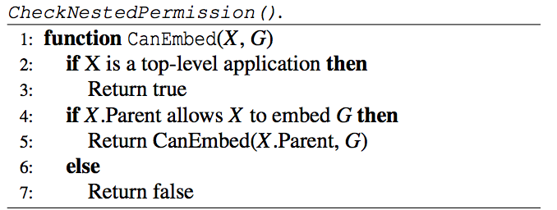
Authentic User Input
Only top lever application can embed ACG by default and embedded application can only embed ACG using PermissionToEmbed.

Slide 12
Access Semantics
Types of access durations
1.One-time : Such as taking a picture
2. Session : Such as recording a video.
3. Schedule : Such as sending a monthly SMS reminder for paying rent.
4. Permanent : Such as permanent to various resources for Apple’s digital assistant Siri.

Slide 13
ACG Composition
Allows single user action to initiate multiple user owned resources
A user might want to take a picture and tag it at same time then Composition ACG (C-ACG) is used.
Composition RM serves as UI proxy for RM’s of composed resources.
The C-ACG is designed such that its least privileged with no access to composition resources.

Slide 14
Permission via Input Sequence
Instead of interacting with ACGs some users prefer input method.
Sequence ownership
It by default resides with top-level application. It can grant application to receive permission granting sequence with PermissionToReceiveSequence permission.
Sequence Conflicts
Two RM’s may attempt to define same global sequence
Application may assign global sequence to their own application specific functionality.

Slide 15
Design Evaluation
User Driven access control eliminates most of the vulnerabilities, 82% for chrome and 96% for Firefox.
A survey of android top apps show that user driven access control offers least privilege access to user owned resources for 95% of apps.
Vulnerabilities removes by user driven access control which were dominant category

Slide 16
Analysis of Android Apps

Slide 17
Conclusion
Merits
The System presented is very effective in providing user more grip over the device.
Since it has better insights in user activities helps eliminates many vulnerabilities.
The prototype presented is easy to implement and requires less tedious effort.

Slide 18
Conclusion
Demerits
Its easier to launch social engineering attack on such system.
An Application can take advantage of permanent access.

Slide 19
.
Questions
?

