Slide 1
HEY,YOU,GET OFF MY CLOUD: EXPLORING INFORMATION LEAKAGE IN THIRD-PARTY COMPUTE CLOUDS
Thomas Ristenpart,Eran Tromer, Horav Shahcham and Stefan Savage

Slide 2
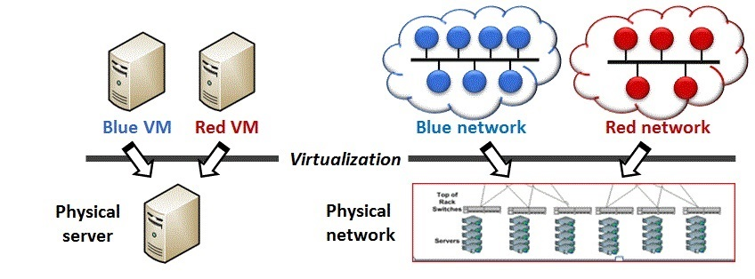
Third-party cloud computing
Microsoft’s Azure and Amazon’s EC2
Usage of Virtualization

Slide 3
Threats and cross-VM attacks
Issues on cloud with
Transparent sharing of physical resources
Multi-tenancy
Source of cross-VM attacks
Steps for attacks-Placement and Extraction
Attacks in multi-process environments

Slide 4
EC2 Service
Services for guest Operating Systems – Linux,FreeBSD,OpenSolaris and Windows
Xen Hypervisor and Domain0
An Instance
Choose region,availability zone and instance-type related to hardware requirements
Hardware – 5 types
32 bit – ‘m1.small’ and ‘c1.medium’
64 bit – ‘m1.large’ ,’m1.xlarge’ and ‘c1.xlarge’
Connectivity to each instance

Slide 5
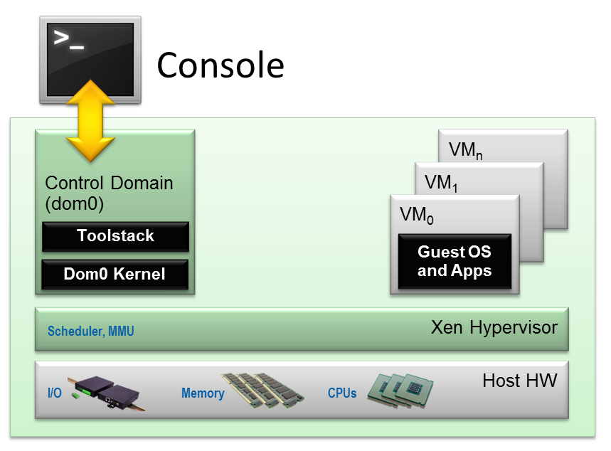
EC2 architecture

Slide 6
Network probing
Study done for understanding VM placement
Utilization of nmap,hping,wget
Nmap – useful for TCP connect
Hping – useful for TCP SYN traceroutes
Wget – useful for retrieving web pages
Targeted Ports – 80 and 443
Two types of probes – External and Internal

Slide 7
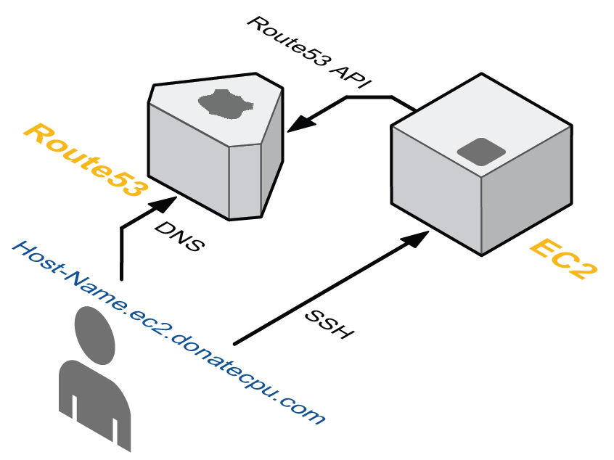
Cloud cartography
Mapping the EC2 service
DNS of EC2
Two data sets
1. Enumerating public EC2-based web servers
2. Launching a number of EC2 instances

Slide 8
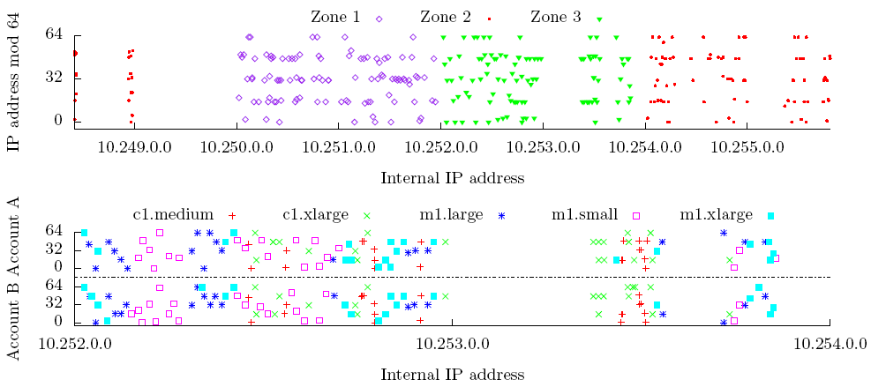
Surveying public servers on ec2
IP address prefixes – a /16, /17, /18, /19
Instance placement parameters

Slide 9
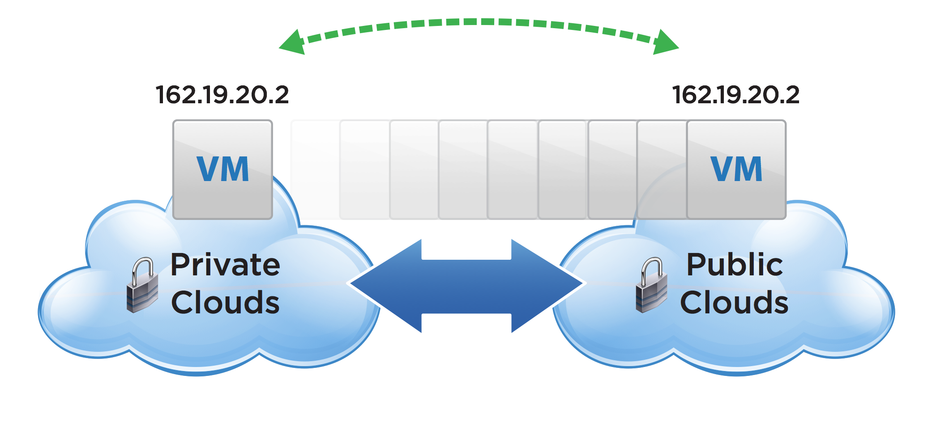
Preventing cloud cartography
Providers Reasons
Hide the infrastructure
Local IP addresses static
Difficult Administration
Translating victim’s IP address

Slide 10
Determining co-residence
Achieving placement
Co-resident checks
Network based co-resident checks
Instances likely co-resident if
(1) matching Dom0 IP address,
(2) small packet round-trip time, or
(3) numerically close internal IP address
Veracity of the co-residence checks and Obfuscating co-residence

Slide 11
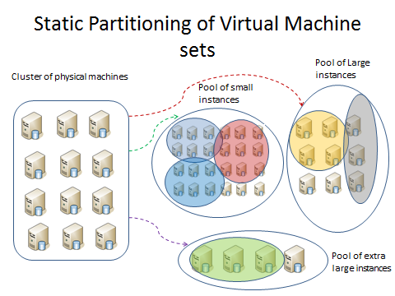
Exploiting placement in ec2
Towards understanding placement
Placement Locality

Slide 12
Brute-forcing placement
Strategy - Run numerous instances and see how many targets one can achieve co-residence with
Working of the strategy
Analysis
Number of probe instances – 1785
Number of unique Dom0 IPs – 78
Number of co-residents – 141
Attack achieved 8.4% coverage of target set

Slide 13
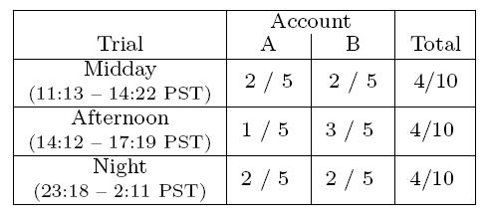
Abusing placement locality
Attacker launches instances relatively soon after launch of target victim
Engagement in instance flooding
Dynamic nature of cloud computing
Experimental Reports

Slide 14
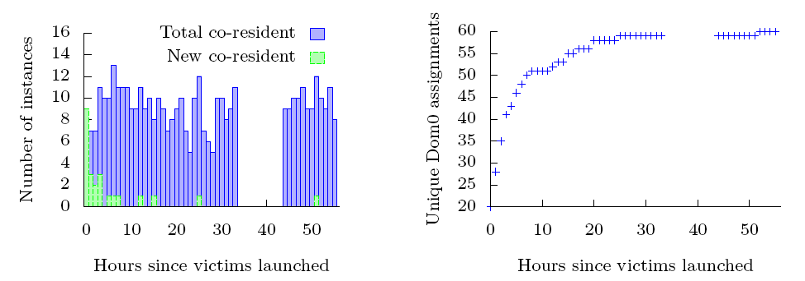
Effect of increased time lag
Window of opportunity an attacker has for launching instances is quite large
Result for the experiment measuring the effects of increasing time lag between victim launch and probe launch

Slide 15
Cross-vm information leakage
Ability of malicious instances
Usage of time-shared caches
Stealing cryptographic keys
Other channels and denial of service

Slide 16
Measuring cache usage
Measuring the utilization of CPU caches
Estimation of current load of machine
Load Measurement
Prime+Trigger+Probe technique

Slide 17
Process of load measurement
Contiguous buffer B of b bytes
s – Cache line size in bytes
To generate each load sample
Prime – Read B at s-byte offset
Trigger – Busy-loop until the CPU’s cycle counter jumps by a larger value
Probe – Measure time it takes to again read B

Slide 18
Cache based covert channel
Significant when communication is forbidden
Simplest cache-covert channel attack
Creation of the effective cross-VM covert channel
Partitioning of the cache set
Use of differential coding
Protocol has three parameters – a, b and d
‘a’ > attacked cache level, ‘b’ < attacked cache level and ‘d’ is cache line size times a power of 2

Slide 19
Defining the difference
1. Allocate a contiguous buffer B of b bytes
2. Sleep briefly
3. Prime – Read all of B
4. Trigger – Busy-loop until CPU’s cycle counter jumps by a larger value
5. Probe – Decide ‘0’ if difference is positive
Receiver takes average of multiple samples for making his decision

Slide 20
Load-based co-residence detection
Testing co-residence without using network-based techniques
Case when the condition holds true - Publicly-accessible service on target and Adversary has a priori information
Example – Running a webserver

Slide 21
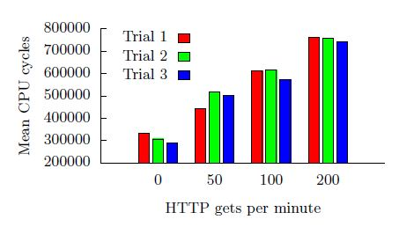
Estimating traffic rates
Load measurement for estimating number of visitors to a co-resident web server
Report on initial experimentation with estimation
Four separate runs of 1000 cache load measurements in which we sent
(1) sent no HTTP requests (2) sent at a rate of 50/minute (3) 100/min (4) 200/min

Slide 22
Keystroke timing attack
Measure time between keystrokes
Network taps with co-residence and local measurements
Spike in load on an otherwise idle machine
Experimental setup – Opteron CPUs, Xen Hypervisor and Linux kernels(similar to EC2)
Prime+Trigger+Probe load measurement technique to detect spikes
Cache sets accessed to filter out false positives
Implemented on the machine with variants exploiting L1 or L2 cache
Condition for EC2- VMs should time-share a core

Slide 23
Inhibiting side-channel attacks
Preventing side-channel vulnerabilities
Use of blinding attacks
Drawbacks of countermeasures
1. Impractical
2. Confident that all possible-side channels have been disabled
Security against cross-VM attacks - Resort to avoiding co-residence

Slide 24
conclusion
Mitigating the risks
Obfuscate the internal structure of their services and placement policy
Employing blinding techniques
Customers need to demand for strong privacy requirements

Slide 25
Questions ?

