Slide 1
Protecting Browsers from Extension Vulnerabilities
Paper by:
Adam Barth, Adrienne Porter Felt, Prateek Saxena at University of California, Berkeley and Aaron Boodman at Google, 2010.
Presentation by:
Prachi Shivhare
12 March 2014

Slide 2
Introduction
Roughly one third of Firefox users have at least one browser extension
Modifies the core browser user experience by changing the browser’s user interface and interacting with web sites
Most extension developers are not security experts.
Firefox extensions run with the browser’s full privileges.
Does browser extensions require such a high level of privilege?

Slide 3
Introduction
Study of Firefox 25 most popular extensions chosen from 13 categories was conducted.
Results:
88% of these extensions need less than the full set of available privileges
76% of these extensions use unnecessarily powerful APIs
Only 3 of the 25 extensions required full system access
Rest are over-privileged, needlessly increasing the severity of extension vulnerabilities

Slide 4
Attacks against browser extensions
The paper describe four classes of attacks against Firefox browser extensions
Cross-Site Scripting
Using inputs without sanitizing can cause a script to be able to be injected into the extension
Replacing Native APIs
A malicious web page can confuse (and ultimately exploit) a browser extension by replacing native DOM APIs with methods of its own definition
JavaScript Capability Leaks
If extension leaks an object to a malicious web page, the attacker can gain access to other objects
Mixed Content
An active network attacker can control content loaded via HTTP

Slide 5
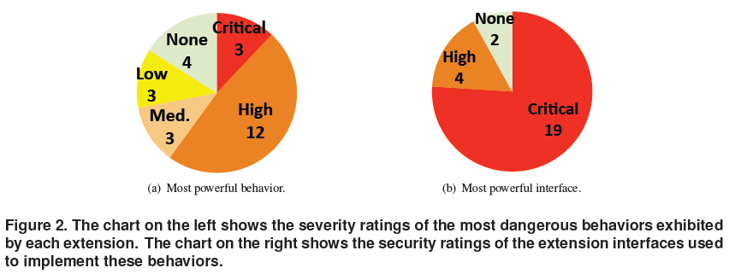
Firefox security severity rating
Critical: Can run arbitrary code on the user’s system (e.g., arbitrary file access)
High: Can access site-specific confidential information (e.g., cookies and password) or the Document Object Model (DOM) of all web pages
Medium: Can access private user data (e.g., recent history) or the DOM of specific web pages
Low: Can annoy the user
None: No security privileges (e.g., a string) or privileges limited to the extension itself

Slide 6
Behavioral Vs Interface Privilege

Slide 7
Security Lattice
In Firefox, extensions and internal browser components use same interfaces known as XPCOM interfaces
613 interfaces out of 1582
Deductive system:
computes which additional interfaces a principal (the browser or an extension) can obtain from one interface .
For example, type foo has a method that accepts type bar as a parameter. Type bar has a method getFile that returns a file type. We do not know whether an implementation of foo actually ever calls bar.getFile, but we know it is possible.

Slide 8
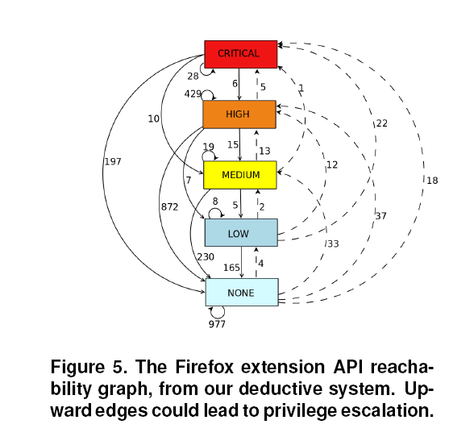
Security Lattice
Reachability:
Of the 2920 edges in the lattice, 147 edges go “up” the lattice
upward edges represent potential escalation points
Recommend to remove such edges either by adding runtime access control checks or by taming the interfaces at design time

Slide 9
Suggested arch. for extensions
Least Privilege – set of privileges chosen at install time.
If an extension later becomes compromised, the extension will be unable to increase this set of privileges
Privilege Separation – break up extension into three main parts: content script, extension core, and native binary
Strong isolation – the different components of an extension are isolated from each other by strong protection boundaries
Each component runs in a separate operating system process.

Slide 10
Least Privileges
Explicitly requested in extension manifest
Developers define privileges in manifest
Execute arbitrary code: The only way to do this is to list a native binary in the manifest.
Web site access: In order to access a website, it must be listed in the manifest under the permissions category.
If the extension were later compromised, the attacker would not have the privilege to access
API Access: extensions can also request access to extension APIs and must be listed in the manifest under the permissions category

Slide 11
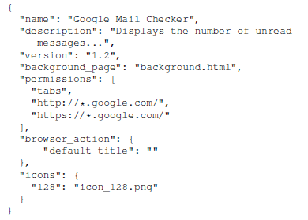
Least Privileges
For example, Gmail Checker needs access to subdomains of google.com and the tabs API

Slide 12
Least Privileges
Alter the user experience for installing an extension from the Google-controlled extension gallery based on the maximum privilege level the extension requests
extensions with the privilege to execute arbitrary code are not permitted in the gallery unless the developer signs a contract with Google
Incentivizes developers to request fewer privileges to reduce review latency

Slide 13
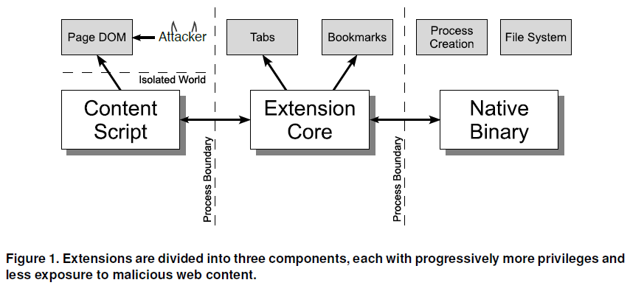
Privilege Separation
Content Script: lets extensions interact directly with untrusted web content. Manifest limits the extension’s access to origins
Extension Core: contains the majority of the extension’s privileges, but it is insulated from direct interaction with untrusted web content
Native Binary: Only native binaries can run arbitrary code or access arbitrary files

Slide 14
Isolation Mechanism
Extension Identity: A public key in extension’s URL
For Example: chrome-extension://ilpnegfhimflflifcnmgpeihglhedbnn/
Process Isolation: Each component runs in a different process
Extension Core and Native Binaries are in different processes
Content Scripts run in the same process associated with the web page
Isolated Worlds: Content script accesses the DOM with its “own” JavaScript objects. Content scripts and web pages therefore never exchange JavaScript pointers.

Slide 15
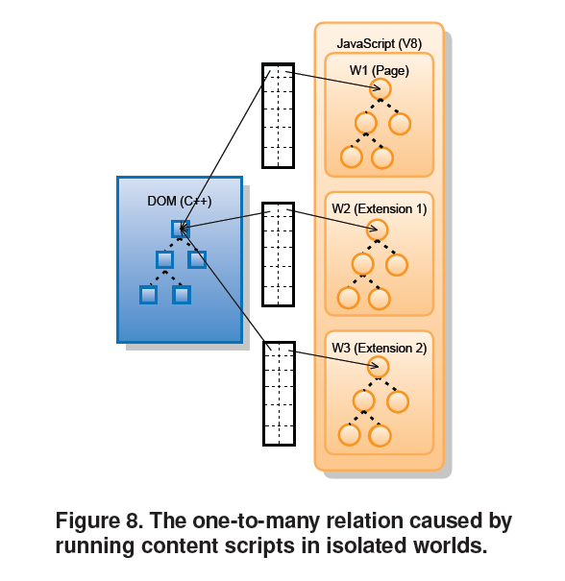
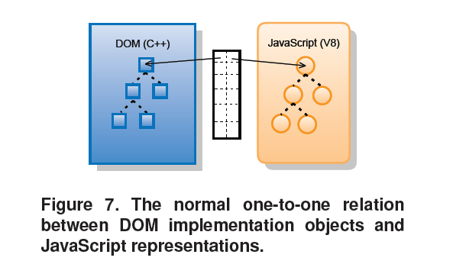
Isolation Mechanism

Slide 16
Performance
Inter-component communication
Round-trip latency between content script & extension core: 0.8 ms
Isolated Worlds Mechanism
Added 33.3% overhead

Slide 17
Conclusion
Firefox extension system
Extensions are over-privileged
API needs to be tamed for least privilege
New extension system for Google Chrome
Developer encouraged to request few privileges
Extensions have a reduced attack surface

Slide 18
Weakness
The developer of the extension can still include more privileges than necessary.
There are around ten thousand Firefox extension, selecting 25 most popular extensions is only 0.25%.
Most popular extension might not be best developed.
Users still have to accept privileges at the time of installation.

Slide 19
Improvements
A comparison study between the previous Google chrome extension and new proposed Google chrome extension.

Slide 20
Thank You !!

